Slide 1


Here's your outline to get started
Key facts about your topic
Computer programming is the process of designing and building an executable computer program for accomplishing a specific computing task. Programming involves tasks such as analysis, generating algorithms, profiling algorithms' accuracy and resource consumption, and the implementation of algorithms in a chosen programming language. The source code of a program is written in one or more programming languages. The purpose of programming is to find a sequence of instructions that will automate the performance of a task for solving a given problem. The process of programming thus often r...
Subdiscipline of: Computer Science
Academic conference: European Conference on Artificial Intelligence (ECAI) 2016
See more: Open the Notes below for more information.
Notes:
QuickStarter has created an outline to help you get started on your presentation. Some slides include information here in the notes to provide additional topics for you to research.
Summary:
Computer programming is the process of designing and building an executable computer program for accomplishing a specific computing task. Programming involves tasks such as analysis, generating algorithms, profiling algorithms' accuracy and resource consumption, and the implementation of algorithms in a chosen programming language. The source code of a program is written in one or more programming languages. The purpose of programming is to find a sequence of instructions that will automate the performance of a task for solving a given problem. The process of programming thus often requires expertise in several different subjects, including knowledge of the application domain, specialized algorithms, and formal logic.

Slide 2

Related topics to research
Computer
Programmer
Software Engineering
C++
Software development
Software
Java
C
Python
JavaScript
Use Smart Lookup to learn more
1
Highlight one of the related topics
Right-click on the topic
Choose "Smart Lookup"
2
3

Slide 3


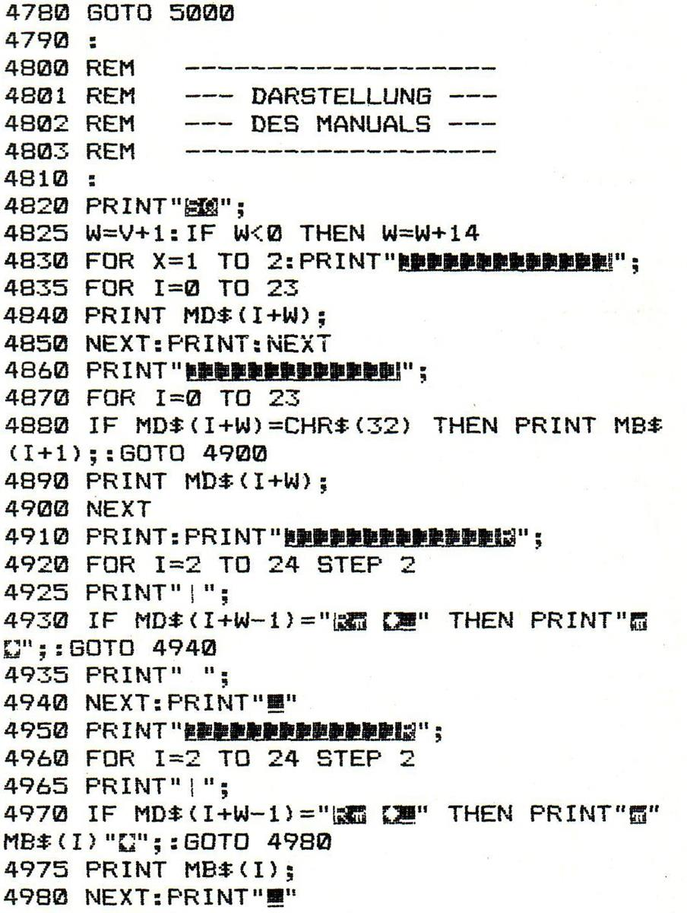
The Java Reflection API tutorial
A beginner’s journey to Java enlightenment :)

Slide 4
Contents
What is it?
Advantages
Disadvantages
What’s next!

Slide 5
What is it?
Reflection is commonly used by programs which require the ability to examine or modify the runtime behaviour of applications running in the Java virtual machine

Slide 6
Advantages
Extensibility
Class Browsers and Visual IDE’s
Debugging and Testing tools

Slide 7
Disadvantages
Performance overhead
Security Aspects
Exposure of Internals

Slide 8
What’s next?
Deep dive in accessing java classes using reflection
A great in depth material to access java methods using reflection
Finally, accessing arrays and other enumerated types using the java reflection

Slide 9
Thanks for watching
Stay tuned for more. Cheers!

