Slide 1
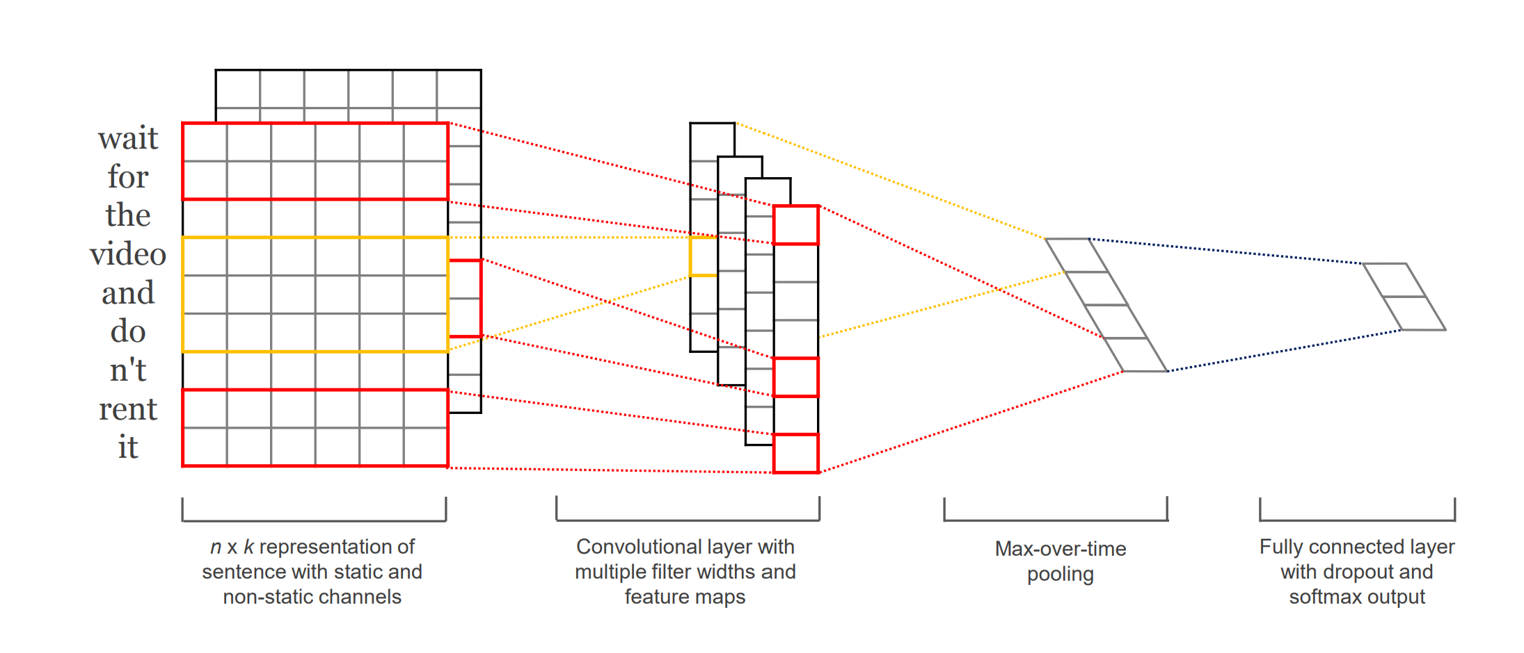
Reproducing Kim (2014):
Convolutional Neural Networks for Sentence Classification
Reimplementation on SST-2
Task: Positive vs. negative sentiment classification
Dataset: Stanford Sentiment Treebank (SST-2)
Original framework: Theano
Our framework: PyTorch
Goal: Reproduce the core architecture and compare embedding variants
Chiranjivi Panda
24cs2013

Slide 2
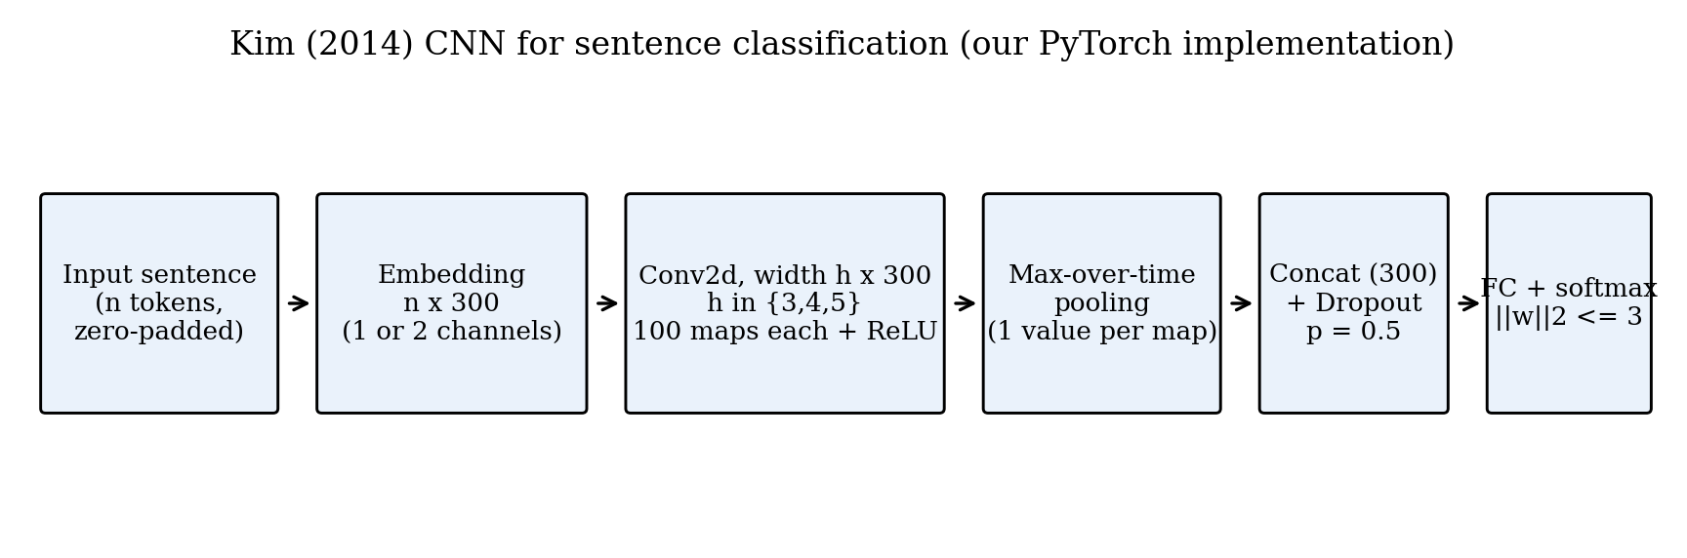
Problem, Motivation & Pipeline
The Problem
Given a sentence, classify it as positive or negative sentiment
Dataset: SST-2 (Stanford Sentiment Treebank, binary labels)
71,507 training phrases, 872 dev, 1,821 test sentences
Why This Paper Matters
Before 2014, strong text models needed hand-crafted features or parse trees
Kim proved a simple CNN with pre-trained word vectors beats much more complex models
Showed that word2vec vectors are powerful “universal features” for text
Our Goal
Re-implement the model from scratch in PyTorch
Reproduce the SST-2 results at small scale
Model pipeline: sentence → word vectors → convolution → pooling → classification

Slide 3
How the Model Works
Input Sentence
(n words)
Word Embeddings
(n × 300 matrix)
Convolution
(h = 3, 4, 5)
ReLU + Max Pool
(one value per filter)
Concatenate
(300 features)
Dropout + Linear
(2 class scores)
Key Equation
In Plain Words
Convolution over a window of h words:
Each filter looks at a short window of words (3, 4, or 5)
Computes a dot product with its learned weights
Takes the maximum over all window positions
This gives one number per filter: “how strongly did my pattern appear?”
We use 100 filters × 3 widths = 300 features per sentence
c_{i} = ReLU( w⊤ x_{i : i+h−1} + b )
Max-over-time pooling:
ĉ = max_{i} c_{i}

Slide 4
Core Module Code
class KimCNN(nn.Module):
def __init__(self, vocab_size, embed_dim=300,
num_filters=100, filter_sizes=(3,4,5),
dropout=0.5, num_classes=2):
super().__init__()
self.embedding = nn.Embedding(vocab_size, embed_dim)
self.convs = nn.ModuleList([
nn.Conv2d(1, num_filters, (h, embed_dim))
for h in filter_sizes
])
self.dropout = nn.Dropout(dropout)
self.fc = nn.Linear(num_filters * len(filter_sizes),
num_classes)
def forward(self, x):
x = self.embedding(x).unsqueeze(1)
pooled = []
for conv in self.convs:
c = F.relu(conv(x)).squeeze(3)
c = F.max_pool1d(c, c.size(2)).squeeze(2)
pooled.append(c)
z = torch.cat(pooled, dim=1)
return self.fc(self.dropout(z))
Embedding Layer
Converts token IDs to 300-dim vectors
Can be random, pre-trained, or fine-tuned
Three Conv2d Layers
Kernel shape (h, 300) spans full embedding
Slides along sentence length
100 output filters each
Pooling
max_pool1d keeps only the strongest activation per filter
Makes output size independent of sentence length
Classification Head
Concatenate 3 × 100 = 300 features
Dropout + Linear → 2 class logits
CrossEntropyLoss handles softmax internally

Slide 5
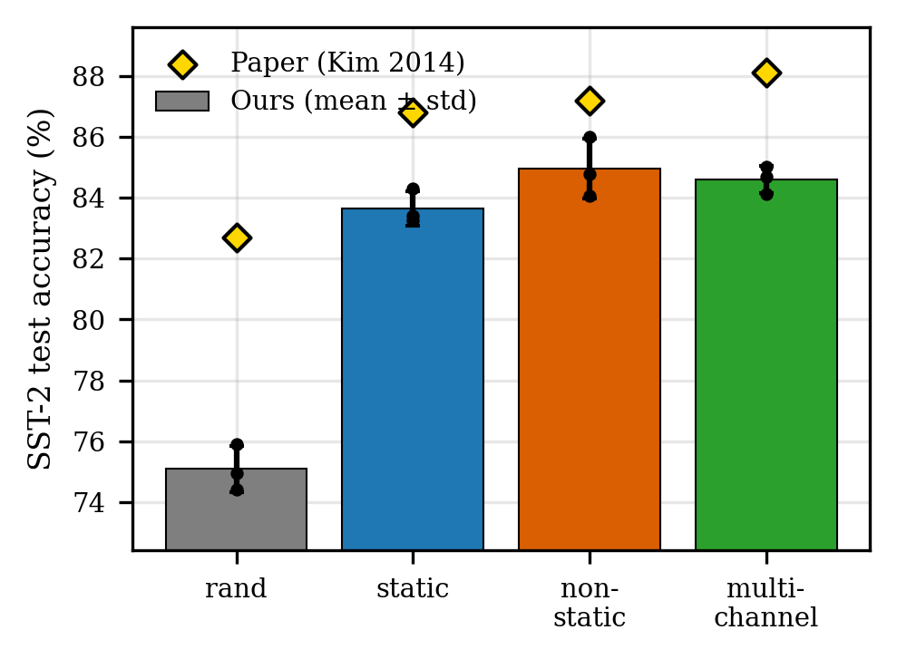
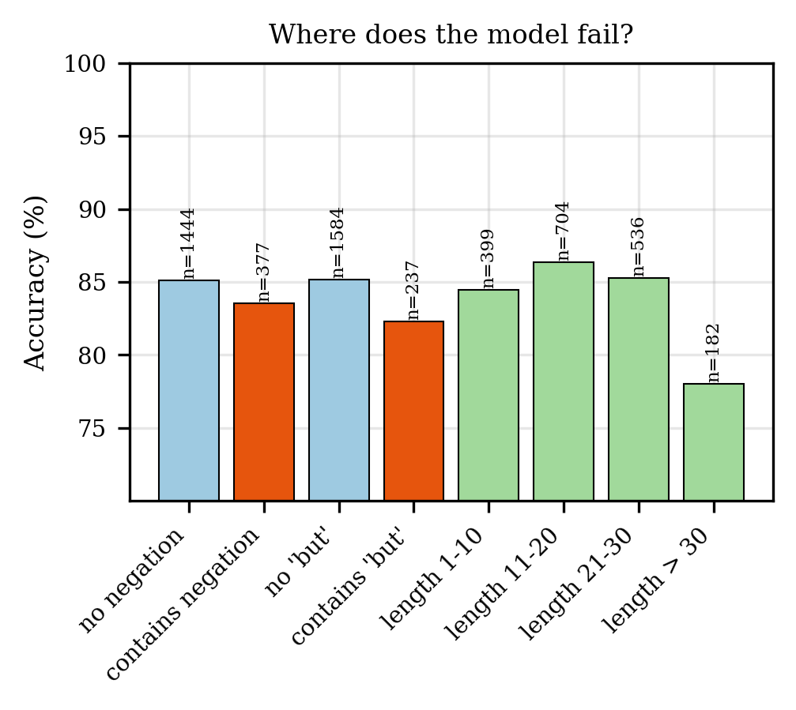
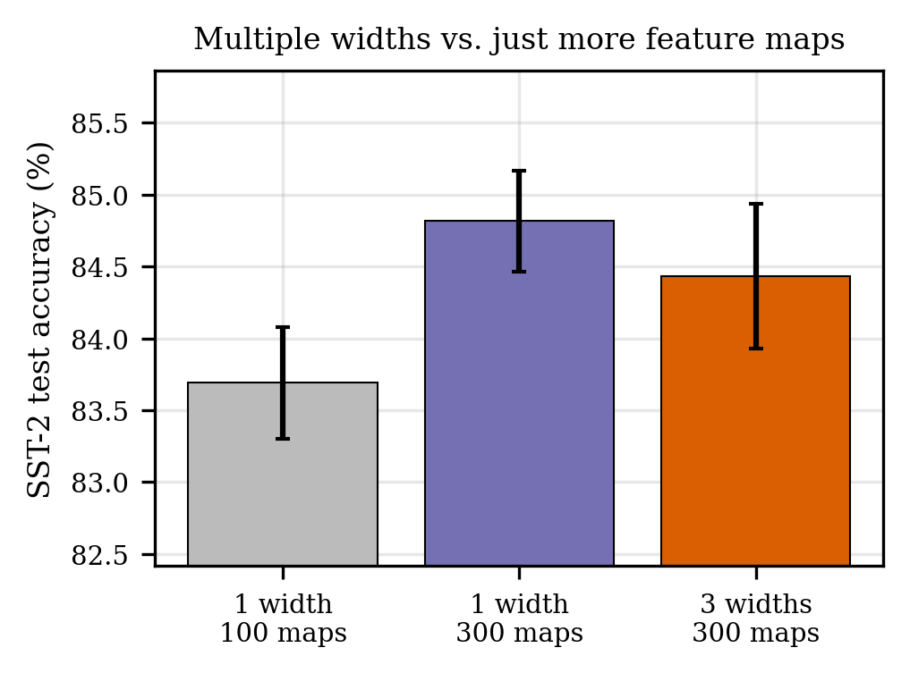
Results, Ablation & Limitations
Main Results (SST-2)
Where the Model Fails
Model | Ours (%) | Kim (%) | Δ
CNN-rand | 75.1 ± 0.7 | 82.7 | −7.6
CNN-static | 83.7 ± 0.6 | 86.8 | −3.1
CNN-non-static | 85.0 ± 1.0 | 87.2 | −2.2
CNN-multichannel | 84.6 ± 0.4 | 88.1 | −3.5
Ordering of all 4 variants matches the paper exactly
Pre-trained vectors give the biggest jump; fine-tuning adds a little more
Our absolute numbers are 2–7 points lower (explained in limitations)
Ablation: Filter Configuration
Failure patterns
Long sentences (>30 tokens): accuracy drops to 78%
Sentences with “but”: 82% vs 85% without
Expected: max-pooling can’t track long-range or contrastive structure
Limitations
SST-2 only — not all 7 datasets from the paper
rand baseline uses PyTorch default init (scale mismatch)
Only 2–3 seeds per setting (compute-limited)
Configuration | Accuracy (%)
Width 3, 100 filters | 83.7 ± 0.4
Widths 3, 4, 5, 100 each | 84.4 ± 0.5
Width 3, 300 filters | 84.8 ± 0.4
More filters help overall
Multi-width is NOT clearly better than single-width with same total filters
Kim’s “multiple widths” gain may partly be “more filters”

