Slide 1
Introduction & History of Java and
Object-Oriented Programming (OOP) in Java
Prepared By :
Chiranjivi R
“A concise and clear foundation to understand Java and its core OOP principles.”

Slide 2
The Java Language:
Java was initiated by James Gosling and others at Sun Microsystems in 1991.
Team: Mike Sheridan and Patrick Naughton
This language was initially called “OAK” .
Later it was renamed as “JAVA” in 1995.
It is one of the world’s most widely used computer language.
From practical point of view, it is an excellent language to learn.
Java was perfect for the Web.

Slide 3
The Compilation and execution process of a java program
Compilation
First, the source ‘.java’ file is passed through the compiler, which then
encodes the source code into a machine independent encoding, known as
Bytecode.
The content of each class contained in the source file is stored in a separate
‘.class’ file.
Execution
The main class file (the class that contains the method main) is passed to the
JVM,.
Class Loader:
All the other classes referenced in the program are loaded through the class
loader.
Bytecode Verifier: Check that the instructions don’t perform damaging actions.
Just-In-Time Compiler: Convert the loaded bytecode into machine code.

Slide 4
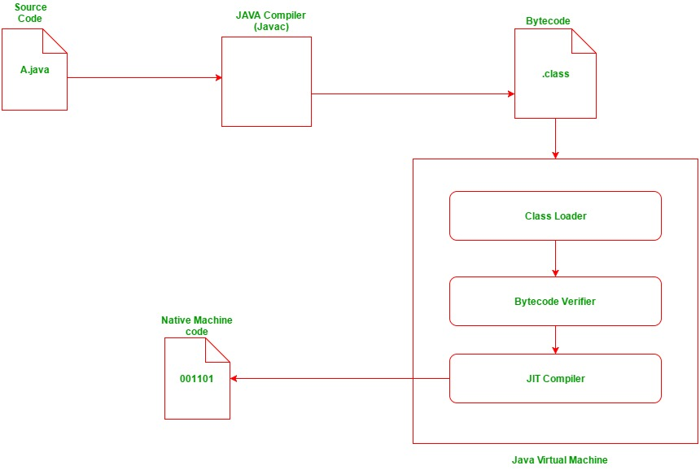
The Compilation and execution process of a java program
.

Slide 5
JVM
Java Virtual Machine is a virtual machine that enables the computer to run the Java program.
JVM acts like a run-time engine which calls the main method present in the Java code.
JVM is the specification which must be implemented in the computer system.
The Java code is compiled by JVM to be a Bytecode which is machine independent and close to the native code.

Slide 6
JAVA DEVELOPMENT KIT
Used for developing Java applications and applets. It includes the Java Runtime Environment (JRE), an interpreter/loader (Java), a compiler (javac), an archiver (jar)
JAVA RUNTIME ENVIRONMENT
JRE stands for Java Runtime Environment. It is the implementation of JVM. The Java Runtime Environment is a set of software tools which are used for developing Java applications. It is used to provide the runtime environment.
It is the implementation of JVM. It physically exists. It contains a set of libraries + other files that JVM uses at runtime.

Slide 7
Features of Java:
Simple
Object-Oriented
Portable
Platform independent
Secured
Robust
Architecture neutral
High Performance
Multithreaded
Dynamic

Slide 8
Simple:
Java is very easy to learn and its syntax is simple, clean and easy to understand.
According to Sun, Java language is a simple programming language because:
Java syntax is based on C++.
Java has removed many confusing and rarely-used features e.g. explicit pointers, operator overloading etc.
Platform Independent:
The meaning of platform-independent is that the java compiled code(byte code) can run on all operating systems.

Slide 9
Object-oriented:
Java is object-oriented programming language. Everything in Java is an object.
Object-oriented means we organize our software as a combination of different types of objects that incorporates both data and behaviour.
Object-oriented programming (OOPs) is a methodology that simplifies software development and maintenance by providing some rules.

Slide 10
Secured:
Java is best known for its security. With Java, we can develop virus-free systems. Java is secured because:
No explicit pointer
Java Programs run inside a virtual machine sandbox
Robust:
The English mining of Robust is strong. Java is robust because:
It uses strong memory management.
There is a lack of pointers that avoids security problems.
Java provides automatic garbage collection which runs on the Java Virtual Machine to get rid of objects which are not being used by a Java application anymore.
There are exception handling and the type checking mechanism in Java. All these points make Java robust.

Slide 11
Architecture-neutral:
Java is architecture neutral because there are no implementation dependent features, for example, the size of primitive types is fixed.
In C programming, int data type occupies 2 bytes of memory for 32-bit architecture and 4 bytes of memory for 64-bit architecture. However, it occupies 4 bytes of memory for both 32 and 64-bit architectures in Java.
Portable:
Java is portable because it facilitates you to carry the Java bytecode to any platform. It doesn't require any implementation.
Multi-threaded:
A thread is like a separate program, executing concurrently. We can write Java programs that deal with many tasks at once by defining multiple threads. The main advantage of multi-threading is that it doesn't occupy memory for each thread. It shares a common memory area. Threads are important for multi-media, Web applications, etc.

Slide 12
Interpreted: Java uses the Just-in-time (JIT) interpreter along with the compiler for the program execution.
Dynamic: Java is a dynamic language. It supports dynamic loading of classes. It means classes are loaded on demand. It also supports functions from its native languages, i.e., C and C++.

Slide 13
The Java Development Kit
Before you can compile and run java programs, the Java Development Kit must be installed on the computer.
The JDK supplies two primary programs.
The first is javac,which is the Java compiler. It converts your source code into bytecode.
The second is java, this is the program you will use to run a java program.

Slide 14
A First Simple Program
To create a simple java program, you need to create a class that contains main method.
Ex1:
class Simple
{
public static void main(String args[])
{
System.out.println("Hello Java");
}
}
save this file as Simple.java
To compile:javac Simple.java
To execute: java Simple

Slide 15
Contd….
class keyword is used to declare a class in java.
public keyword is an access modifier which represents visibility, it means it is visible to all.
static is a keyword, if we declare any method as static, it is known as static method. The core advantage of static method is that there is no need to create object to invoke the static method. So it saves memory.
void is the return type of the method, it means it doesn't return any value.
main represents startup of the program.

Slide 16
The History of Java
1991: Project Oak started by James Gosling.
1995: Officially renamed and released as Java.
1998: Java 2 (J2SE 1.2) released with major improvements.
2010: Oracle acquired Sun Microsystems.
Today: Java powers Android apps, enterprise systems, banking software, cloud platforms, and millions of applications worldwide.

Slide 17
Object-Oriented Programming (OOP) in Java
OOP helps structure programs using objects and classes, allowing code to be organized, reusable, and easier to maintain.
Java follows four main OOP principles, namely: Encapsulation, Inheritance, Polymorphism, and Abstraction, which together define how objects behave and interact in a well-designed program.
OOP in Java also promotes modularity, allowing large applications to be developed, tested, and debugged in smaller, manageable components.

Slide 18
1. Encapsulation
Encapsulation is the mechanism that binds together code and the data it manipulates, and keeps both safe from outside interference and misuse.
One way to think about encapsulation is as a protective wrapper that prevents the code and data from being arbitrarily accessed by other code defined outside the wrapper.
Access to the code and data inside the wrapper is tightly controlled through a well-defined interface.
Since the purpose of a class is to encapsulate complexity, there are mechanisms for hiding the complexity of the implementation inside the class.
Each method or variable in a class may be marked private or public.
The public interface of a class represents everything that external users of the class need to know, or may know.
The private methods and data can only be accessed by code that is a member of the class. Therefore, any other code that is not a member of the class cannot access a private method or variable

Slide 19
Example-1
class Student {
private int age;
public void setAge(int a){
  age = a; }
public int getAge() {
return age; }
}
Explanation:
The variable age is kept private, and access is given only through setAge() and getAge().
This protects the data and ensures it can be changed only through controlled methods.

Slide 20
2. Inheritance
Inheritance is the process by which one object acquires the properties of another object.
This is important because it supports the concept of hierarchical classification.
For example, a Golden Retriever is part of the classification dog, which in turn is part of the mammal class, which is under the larger class animal.
Without the use of hierarchies, each object would need to define all of its characteristics explicitly.
By use of inheritance, an object need only define those qualities that make it unique within its class.
It can inherit its general attributes from its parent. Thus, it is the inheritance mechanism that makes it possible for one object to be a specific instance of a more general case

Slide 21
Example-1
class Animal {
void sound(){
System.out.println("Animal sound"); }
}
class Dog extends Animal{
void sound() {
System.out.println("Bark"); }
}
Explanation:
Dog inherits the sound() method from Animal and overrides it with its own version.
This shows how a child class can reuse and customize parent class behavior.

Slide 22
3. Polymorphism
Polymorphism (from Greek, meaning ―many forms‖) is a feature that allows one interface to be used for a general class of actions.
More generally, the concept of polymorphism is often expressed by the phrase ―one interface, multiple methods.‖
This means that it is possible to design a generic interface to a group of related activities. This helps reduce complexity by allowing the same interface to be used to specify a general class of action
Two types:
Method Overloading (Compile-time Polymorphism) – Multiple methods with the same name but different parameters inside the same class.
Method Overriding (Runtime Polymorphism) – A subclass provides its own implementation of a method already defined in the parent class.

Slide 23
Example-1
class Shape {
void draw() {
System.out.println("Shape"); }
}
class Circle extends Shape {
void draw() {
System.out.println("Circle"); }
}
Explanation:
Circle overrides draw() from Shape, so the method call depends on the object type at runtime.
This allows the same method name to show different behavior.

Slide 24
4. Abstraction
Abstraction means showing only the essential features of an object while hiding unnecessary implementation details, making programs easier to understand and maintain.
It helps developers focus on what an object does rather than how it does it.
Achieved using:
1.Abstract Classes – Provide partial implementation and allow subclasses to define specific behaviors.
2.Interfaces – Define a contract of methods that classes must implement, supporting complete abstraction and multiple inheritance.

Slide 25
Example-1
abstract class Vehicle {
abstract void start();
}
class Car extends Vehicle {
void start() {
System.out.println("Car starts");
}
}
Explanation:
Vehicle provides an abstract method without details, and Car gives the actual implementation.
This hides unnecessary code and shows only the essential functionality.

Slide 26
Conclusion
Java is a powerful, secure, and flexible programming language that remains widely used because of its strong design and platform independence. Its OOP principles—Encapsulation, Inheritance, Polymorphism, and Abstraction—help developers write modular, reusable, and easy-to-maintain code.
Thanks to its reliability and large ecosystem, Java continues to be a leading choice in industries such as banking, web development, mobile apps, cloud services, and enterprise software. Java’s consistency and long-term stability make it one of the most trusted languages in the world.
With continuous updates and an active community, Java keeps evolving to meet modern development needs.

Slide 27


