Slide 1
CS G516 • ADVANCED DATABASE SYSTEMS
Campus Food Delivery
A Spatio-Temporal Database for Campus Food Delivery
RESTAURANT
LOCATION
TIME
Team: Vatsal • Chirantan • Sajal • Ayush
PostgreSQL 15 + PostGIS 3.3

Slide 2
OVERVIEW
Project Scope & Milestones
Core Problem
Database Goal
Track food orders and dynamic driver GPS trajectories across campus drop-offs and time windows for operational and analytical monitoring.
Model campus delivery operations across space and time to serve operational, spatial, temporal, and telemetry query workloads.
MILESTONE 1
MILESTONE 2
MILESTONE 3
Problem & Workloads
Data & DB Design
DB Implementation
Introduced the Entities, delivery event definitions, Spatial/temporal tables along with the respective queries for each problem statement
ER schema-Designing,
3NF normalization
PostGIS/TIMESTAMPTZ modeling.
PostGIS instance
Spatial GiST indexing, seed data,
Baseline query validation.

Slide 3


MILESTONE 1
Why Spatio-Temporal Data?
SPATIAL-Components:
TEMPORAL-Components:
Instants (t): Timestamped high-frequency GPS telemetry pings (recorded_at).
Points (SRID 4326):
Exact pickup and delivery drop-off coordinate geometries.
Pickup-Resturaunts , Canteens
Drop-Off-Customers
Derived Intervals:
Order lifecycle durations from created_at to fulfilled_at.
Polygons (SRID 4326):
Campus boundary geofences
Academic and Hostel zones.
Restricted Areas
✓ Geodesic distances & topological containment
✓ Turnaround analysis & trajectory tracking
Example: Trajectory reconstruction in Hostel Zone A during peak dinner hours

Slide 4
CAMPUS FOOD DELIVERY • SPATIO-TEMPORAL QUERIES
Ask WHERE. Know WHEN. Predict WHAT’S NEXT.
Location + time data turn everyday delivery events into smarter, safer decisions.
01 SPATIAL
02 TEMPORAL
03 SPATIO-TEMPORAL
WHERE • Points & polygons
WHEN • Instants & intervals
WHERE + WHEN • Moving entities
PROXIMITY
SLA MONITORING
LIVE TRAJECTORY
Find open canteens within a 500 m walking radius
of the hostel.
Measure order duration: created_at →
fulfilled_at during lunch peaks.
Compare recent driver GPS pings with
campus zones and traffic bottlenecks.
GEOFENCING
DISPUTE EVIDENCE
PREDICT & ALERT
Block checkout when the drop-off pin falls inside a restricted zone.
Retrieve a driver’s GPS pings from 8:00–8:15 PM.
Detect likely delays and send a proactive customer
notification.
CUSTOMER VALUE
CUSTOMER VALUE
CUSTOMER VALUE
Hotter food • Lower fees • Fewer failed drops
More accurate ETAs • Clear delivery evidence
Fewer surprises • Better delivery transparency
OUTCOME → Reliable ETAs, restricted-zone compliance, and proactive delay communication

Slide 5
MILESTONE 1
System Scope & Main Entities
Core Operational Tables
Delivery & Telemetry Tables
restaurant: Point locations of campus dining facilities.
driver: Fleet personnel status (AVAILABLE, BUSY, OFFLINE).
menu_item: Catalog items with preparation times and pricing.
order: Transactional backbone linking customers, restaurants, drivers, and endpoints.
customer: Students, staff, and faculty placing orders.
delivery_location: Campus drop-off points linked to zones.
order_item: Line items with quantities and historical snapshot prices.
campus_zone: Boundary polygons for spatial partitioning.
location_trace: High-frequency streaming GPS coordinates.
Core distinction: order records discrete transactional milestones; location_trace captures driver motion through discrete GPS pings.

Slide 6





MILESTONE 1
Expected Workloads
Operational
Spatial
Temporal
Spatio-Temporal
Analytical
Active order lookups, menu browsing, and driver state validation.
ST_Contains geofencing and geodesic metric distances in meters.
Fulfillment duration intervals and peak ordering window queries.
Reconstructing trajectory paths with ST_MakeLine ordered by timestamp.
Aggregations of order volume by campus zone and restaurant.
OLTP Primary Keys
PostGIS GiST
B-Tree Indexes
Composite Indexing
Group-By Aggs
Design Principle: The database is designed around the questions it must answer — not just the records it stores.

Slide 7
MILESTONE 1
Representative Query Workload
# | Representative Question | Workload Type
1 | Find menu items and prices for Canteen 1 | Operational
2 | Find all drop-off points located inside the Academic Zone | Spatial
3 | Find orders placed between 18:00 and 20:00 | Temporal
4 | Reconstruct driver trajectories and ping counts between 18:00 and 18:45 | Spatio-Temporal
5 | Find the most frequently ordered menu items | Analytical
6 | Find campus zones with highest volume of deliveries | Analytical
7 | List active orders currently in state PREPARING or IN_TRANSIT | Operational
8 | Calculate average delivery fulfillment time per restaurant | Temporal / Analytical

Slide 8
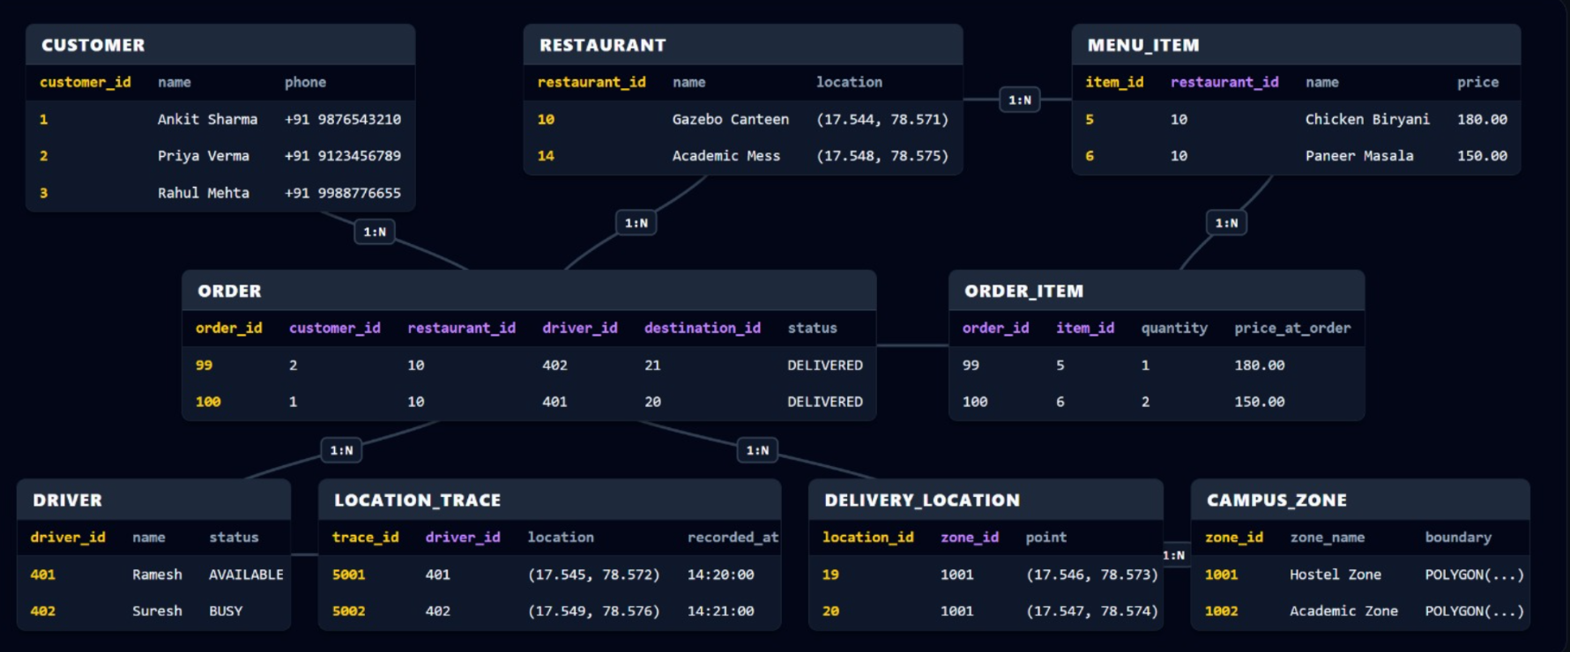
ER-Diagram
https://chirantan17.github.io/campus-spatiotemporal-delivery-Mid-Sem/

Slide 9
MILESTONE 2
Key Relations & Attribute Specifications
campus_zone
restaurant & delivery_location
zone_id (PK), zone_name, boundary (GEOMETRY(Polygon, 4326)).
IDs (PK), zone_id (FK), name, location/point (GEOMETRY(Point, 4326)).
driver
location_trace
driver_id (PK), name, phone, status (CHECK: AVAILABLE, BUSY, OFFLINE).
trace_id (BIGINT, PK), driver_id (FK), location (Point, 4326), recorded_at (TIMESTAMPTZ).
order (Central Transaction)
order_id (PK), customer_id (FK), restaurant_id (FK), driver_id (FK), destination_id (FK), status (CHECK: PENDING, PREPARING, IN_TRANSIT, DELIVERED, CANCELLED), created_at (TIMESTAMPTZ), fulfilled_at (TIMESTAMPTZ).
Add description of every table what and why it is storing..

Slide 10
MILESTONE 2
Simplify in leyaman terms—developer pov
Spatial Data Representation
Geometries (SRID 4326)
Spatial Capabilities Enabled
restaurant.location: Point geometry of food preparation outlets.
Topological Ingestion: Validate drop-offs within geofences using ST_Contains.
delivery_location.point: Point geometry of designated drop-offs.
campus_zone.boundary: Polygon geofences of campus sectors.
Metric Distance: Cast to geography (::geography) for accurate meter calculations (ST_Distance).
location_trace.location: High-frequency GPS observations.
KNN Search: Index-accelerated operator (<->) to find the nearest driver.
WGS 84 STANDARD COORDINATES
POSTGIS NATIVE FUNCTIONS

Slide 11
MILESTONE 2
Temporal Data Representation
order.created_at
order.fulfilled_at
location_trace.recorded_at
Order placement timestamp.
Order fulfillment timestamp in UTC epoch.
Timestamped GPS telemetry observation.
DELIVERY LIFECYCLE & TIME-WINDOW SLICING
[18:00]
In-Transit Telemetry Stream
[18:15]
Derived Delivery Interval
[18:35]
Created
In Transit
Delivered
Interval calculation: fulfilled_at - created_at • Slicing: recorded_at BETWEEN T_start AND T_end

Slide 12
MILESTONE 2
Unified Spatio-Temporal Event
Telemetry Event Instance
Real Time Driver Location
Driver / Customer: Driver Anita (ID: 3) / Amit Verma (ID: 104)
Synthesize continuous motion trajectories from discrete pings using PostGIS trajectory aggregators:
Location (Point): ST_MakePoint(78.5480, 17.5230)
Zone (Polygon): Hostel Zone A Geofenced Boundary
ST_MakeLine(location ORDER BY recorded_at)
Time (Instant): 2026-09-23 18:26:40+00
Each telemetry observation combines a spatial point (x, y) with a timestamp (t).

Slide 13
MILESTONE 2
Design Justification
3NF Normalization
PostGIS Types
Geodesic Math
CHECK Constraints
BIGINT Telemetry
Customer, restaurant, and menu catalogs separated into 3NF, eliminating modification anomalies.
Native geometry types enable topological evaluation (ST_Contains) over raw float pairs.
Casting geometry to geography avoids flat-plane distortion and yields accurate meters on WGS 84.
Restricts status values to the valid lifecycle-state domain.
64-bit sequence IDs prevent key exhaustion on high-frequency streaming GPS tracking tables.
Reduced Redundancy
Native Spatial Ops
Metric Accuracy
Domain Integrity
Telemetry Scaling

Slide 14



MILESTONE 3
Implementation Stack & Pipeline
PostgreSQL 15
PostGIS 3.3
Docker Pipeline
Enterprise relational DBMS
Spatial extension & GiST indexing
postgis/postgis:15-3.3 image
EXECUTION LIFECYCLE PIPELINE
sql/01_schema.sql
sql/02_seed.sql
GiST & B-Tree Indexes
Baseline Query Validation

Slide 15
MILESTONE 3
Constraints & Indexing Strategy
Relational Integrity
Performance Indexing
PRIMARY KEY: Enforces entity uniqueness on order IDs, customer IDs, and trace IDs.
SPATIAL (GiST): Spatial indexes support boundary, restaurant, and telemetry-location queries.
FOREIGN KEY: Referential integrity with ON DELETE CASCADE on order line items.
TEMPORAL (B-Tree): Composite index on location_trace(driver_id, recorded_at) for efficient driver time-window queries.
CHECK (status IN ('PENDING', 'PREPARING', 'IN_TRANSIT', 'DELIVERED', 'CANCELLED'))
CREATE INDEX ON location_trace USING GIST(location);

Slide 16
CS G516 • ADVANCED DATABASE SYSTEMS
Thank You
Campus Food Delivery Database
A Spatio-Temporal Campus Order & Telemetry Database
Team Members: Vatsal • Chirantan • Sajal • Ayush

