Slide 1


Department of ISE
DESIGN AND ANALYSIS OF ALGORITHMS LABORATORY
WITH MINI PROJECT
[18IS4DLADA]
Presentation
On
“Intelligent Parking System”
Presented By:-
Student Name USN
Yash Agarwal 1DS18IS119
Chiranthana.M 1DS18IS124
Surya.R 1DS19IS410
LAB IN-CHARGE
Dr. Chandrakala B M
Mrs. RadhikaT.V
Mr. Dheemanth Urs R

Slide 2

CERTIFICATE
DAYANANDA SAGAR COLLEGE OF ENGINEERING
Shavige Malleshwara Hills, Kumaraswamy Layout-560078
Department of Information Science and Engineering
2019-20
This is to certify that Design and Analysis of Algorithms Laboratory with Mini Project Work entitled “Intelligent parking system” is a bona fide work carried out by Yash Agarwal(1DS18IS119), Surya.R(1DS19IS410), Chiranthana.M(1DS18IS124) in the partial fulfillment for the 4th semester of Bachelor of Engineering in Information Science and Engineering of the Visvesvaraya Technological University, Belgavi during the year 2019-20.
------------------------------ ------------------------------ ---------------------------
Signature of Lab-In charge | Signature of Lab-In charge | Signature of Lab-In charge
[ Dr. Chandrakala B M] | [Mrs.Radhika T V] | [Mr. Dheemanth Urs. R]
Name of the Examiners Signature with Date
1._____________________ _____________________
2._____________________ _____________________

Slide 3
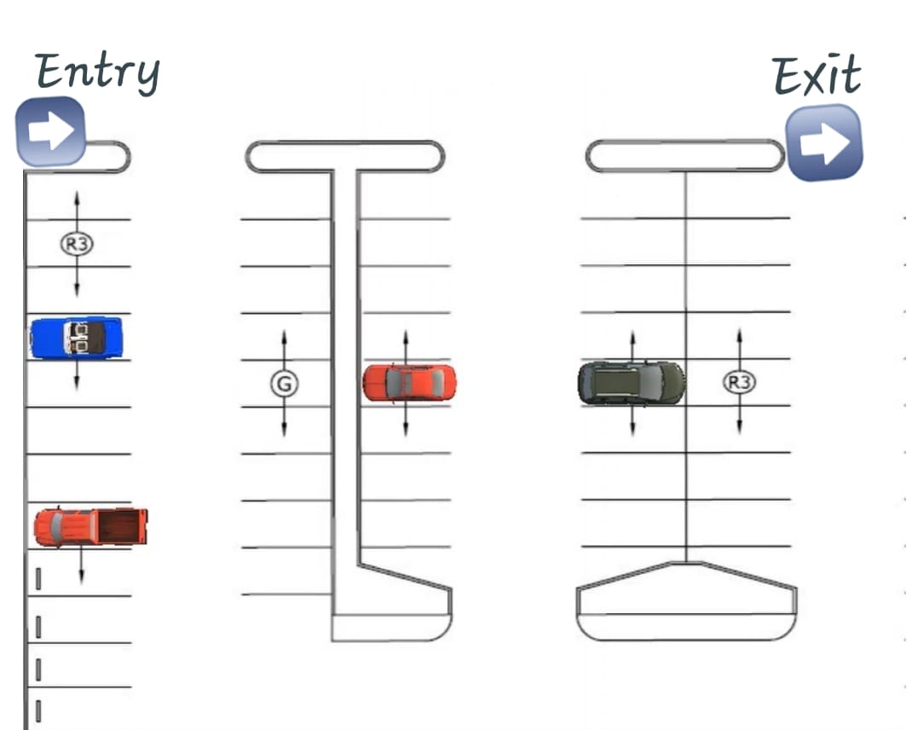
CONTENTS
Introduction
Algorithm used
Implementation
  Pseudo Code
  Source Code
  Snapshots of Result
Time Complexity

Slide 4
Introduction
As urban centers are becoming increasingly more populated and congested, the management of public parking places, according to local mobility policies, is a key strategic issue with high economic impact. Academia and industry are well aware of the potential gains that can be obtained taking advantage of information and communication technologies applied to this field. An efficient smart parking system will favor drivers, by reducing the time to find a parking place and by optimizing parking spaces’ utilization rate, thus increasing the revenues for the urban parking operators.
The importance of applying the adequate strategy for the management of parking places can also be found in the estimate that during the day a typical vehicle stays in idle 95% of the time.
The driver’s behavior, when choosing the type and the location of the parking place as well as making the final decision, depends on many factors and represents a considerably more complex process, which should be paid much more attention than before. The usage of advanced technologies is unavoidable in achieving selected combination of strategies.

Slide 5
Introduction
A simple coding and design pattern has been used to automate the browsing through the parking lots, checking out empty spots, finding out whether it is available for advance booking, and fare.
Features -
Login Register: Users and parking lot owners can register into the portal and will be allowed to browse through the list of places-> parking lots-> parking spots
Current Booking: Users can check out the availability of empty spots currently and book the spot immediately.
Future Booking: If a user needs an advance booking, he can do so by booking the car/bike from a fixed time to a fixed time.

Slide 6
Algorithm used
Distance of nearest cell:-
Given a binary matrix of N x M, containing at least a value 0. The task is to find the distance of nearest 1 in the matrix for each cell. The distance is calculated as |i1 – i2| + |j1 – j2|, where i1, j1 are the row number and column number of the current cell and i2, j2 are the row number and column number of the nearest cell having value 0.
Approach: The idea is to traverse the matrix for each cell and find the minimum distance, To find the minimum distance traverse the matrix and find the cell which contains 0 and calculates the distance between two cells and store the minimum distance.
STEP 1. Traverse the matrix from start to end (using two nested loops)
STEP 2. For every element find the closest element which contains 0. To find the closest element traverse the matrix and find the minimum distance.
STEP 3. Fill the token number in the matrix.

Slide 7
Algorithm used
Sparse Matrix:-
A matrix is a two-dimensional data object made of m rows and n columns, therefore having total m x n values.
2D array is used to represent a sparse matrix in which there are three rows named as :
Row : Index of row, where non-zero element is located
Column: Index of column, where non-zero element is located
Value : Value of the non zero element located at index – ( row, column )

Slide 8
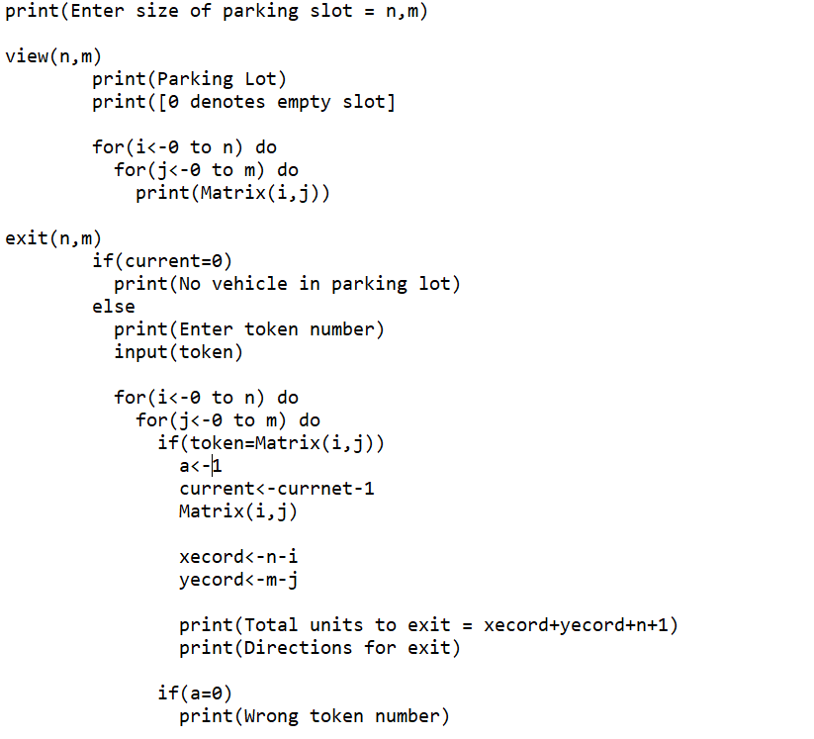
Pseudo Code

Slide 9
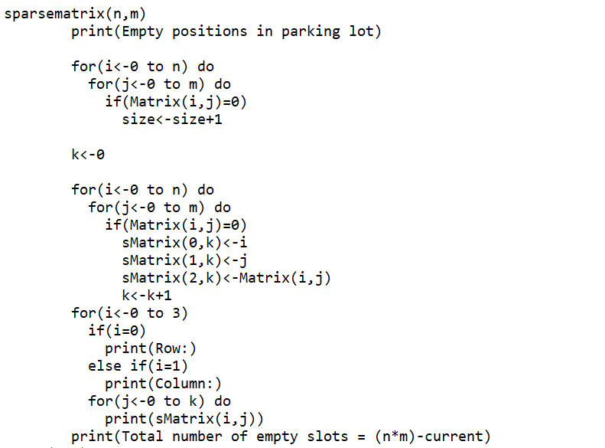
Pseudo Code

Slide 10
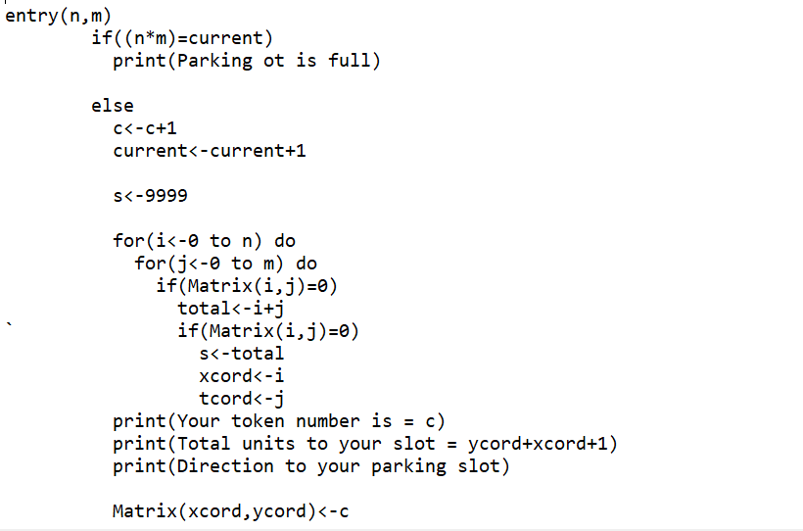
Pseudo Code

Slide 11
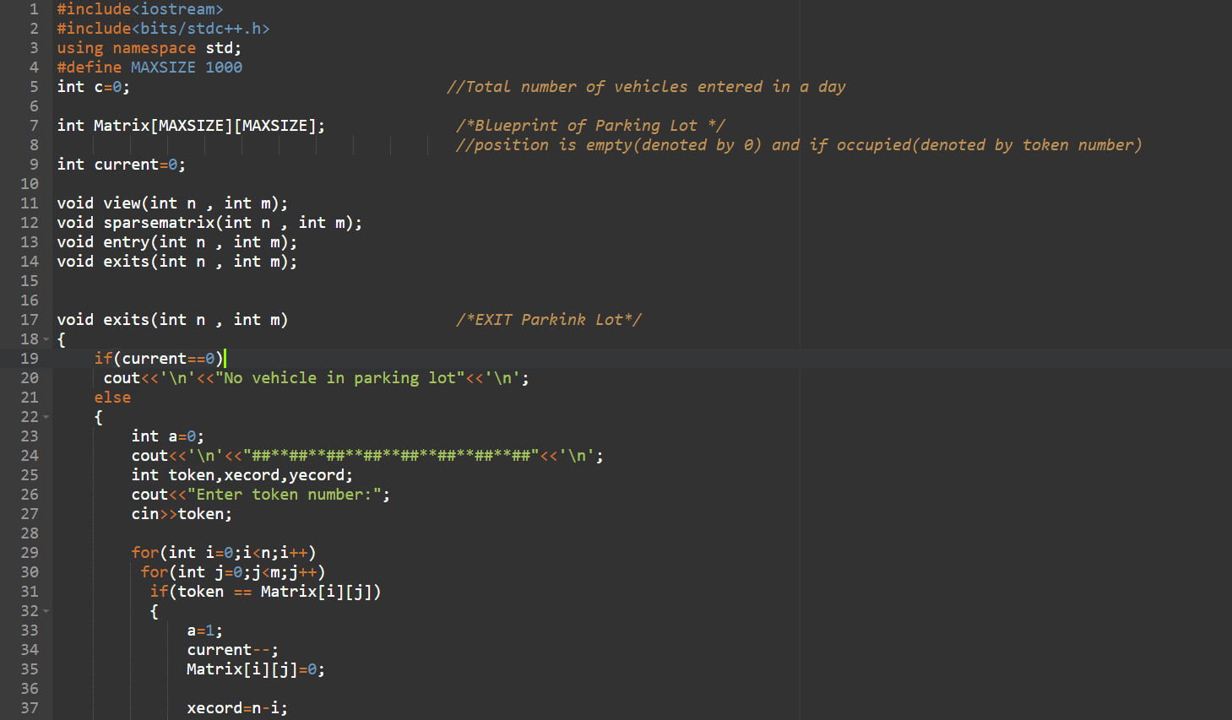
Source Code

Slide 12
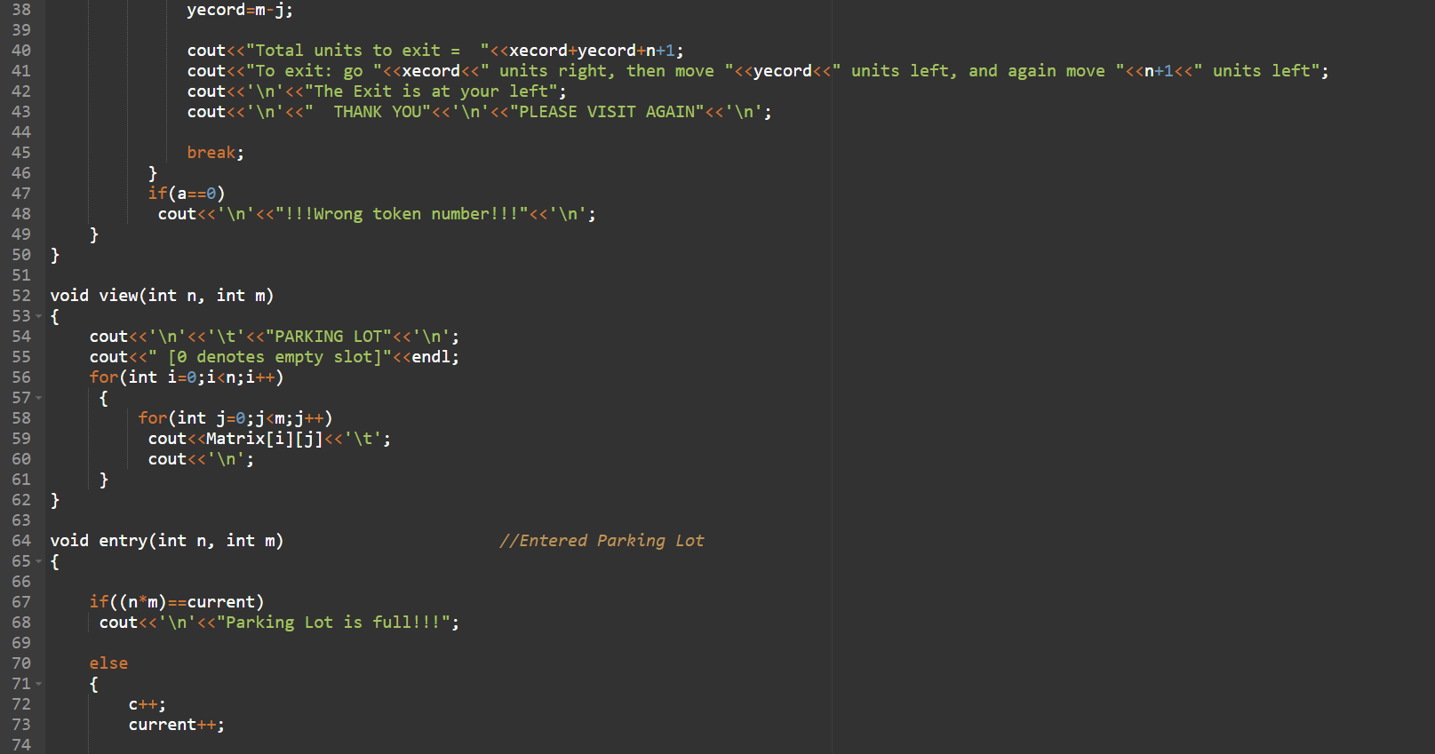
Source Code

Slide 13
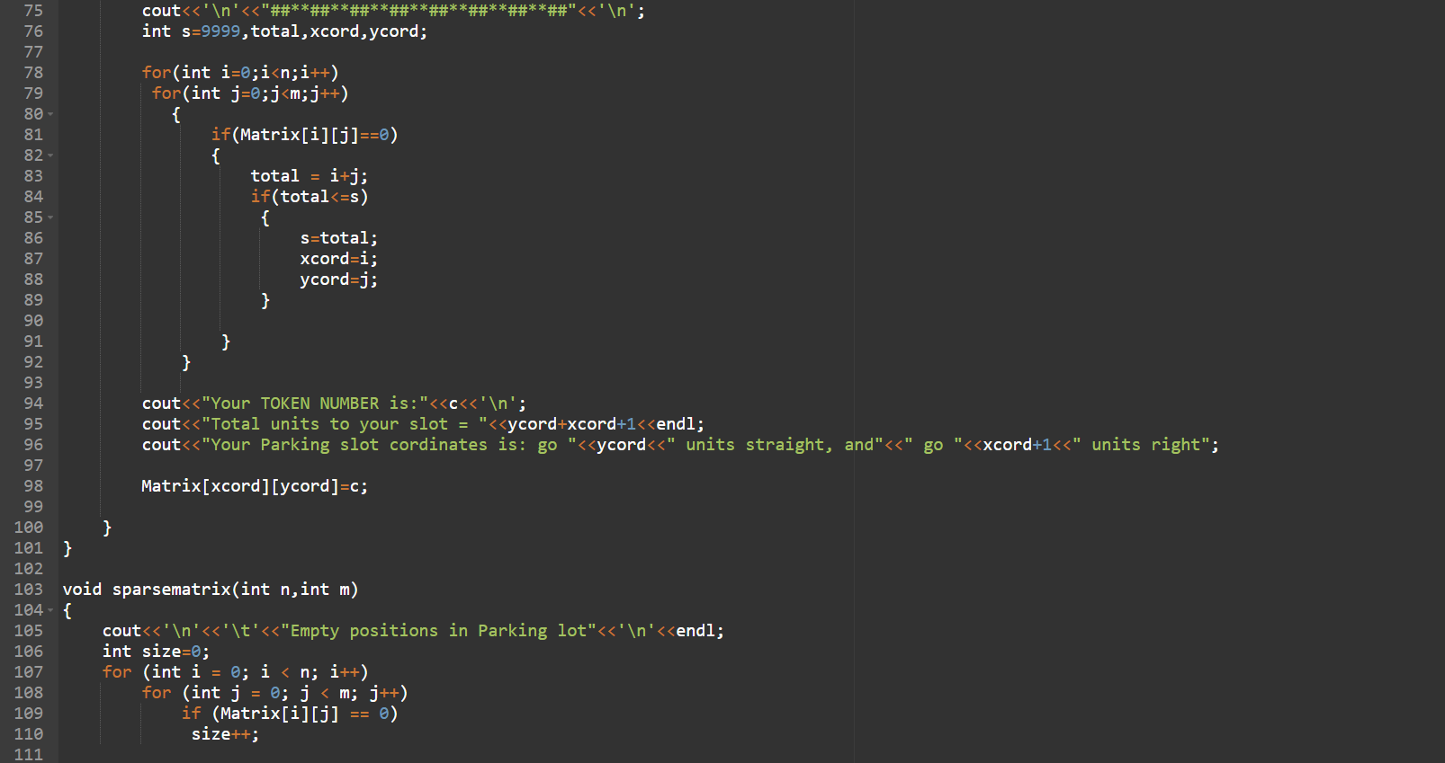
Source Code

Slide 14
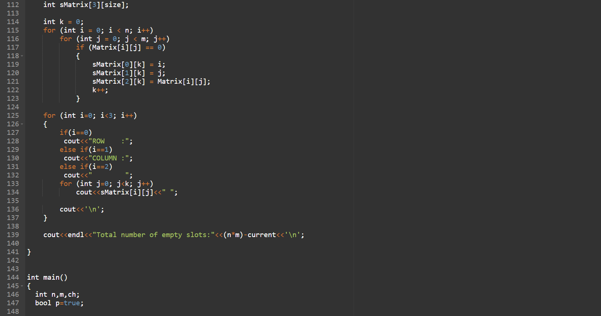
Source Code

Slide 15
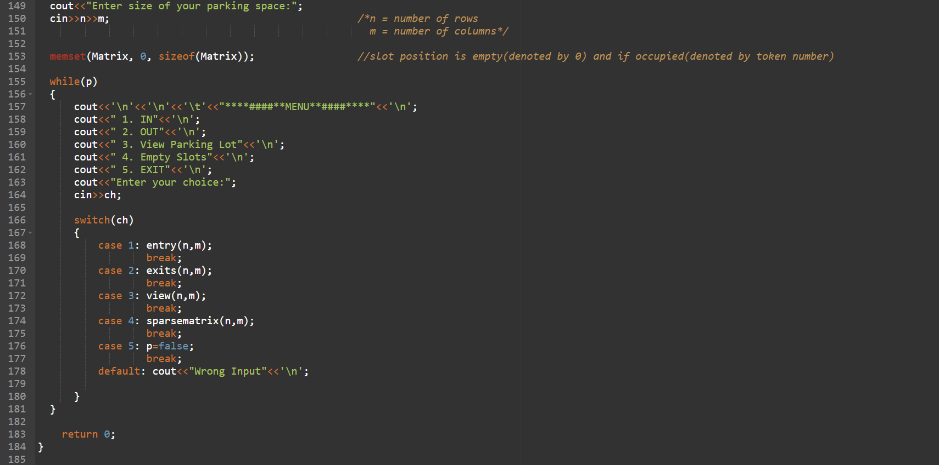
Source Code

Slide 16
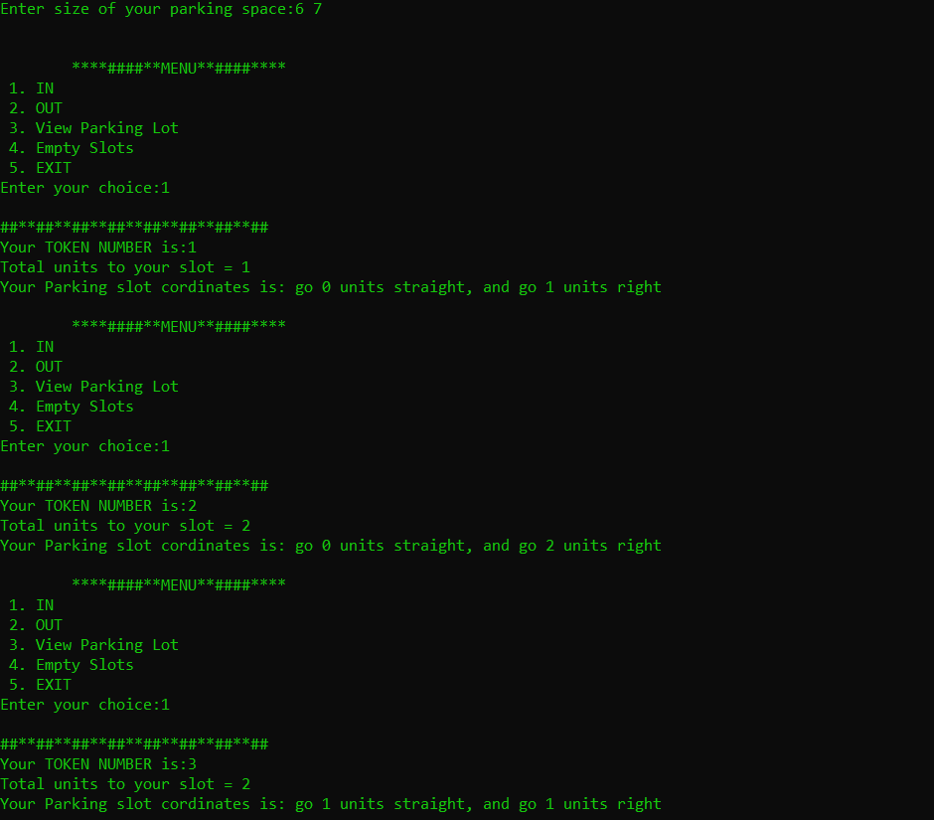
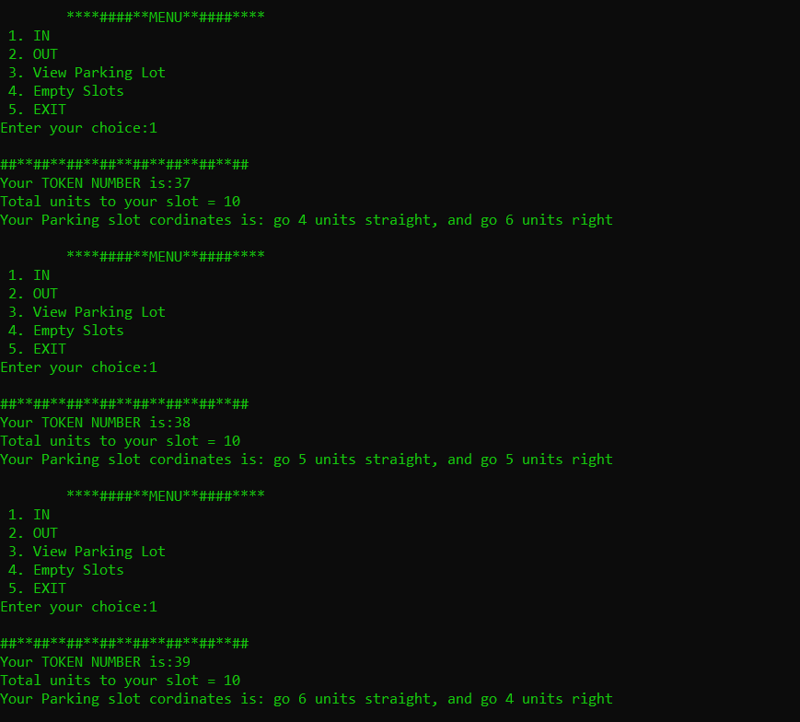
Snapshots of Result

Slide 17
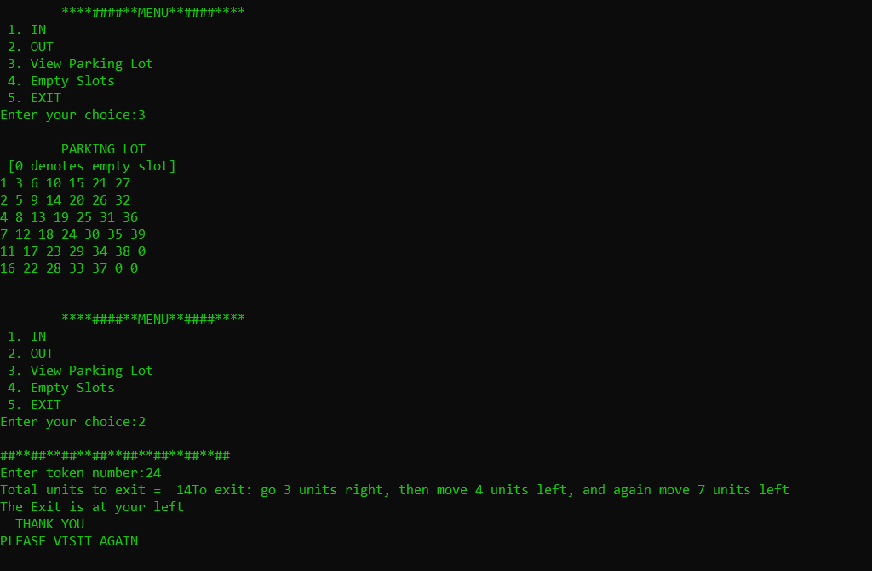
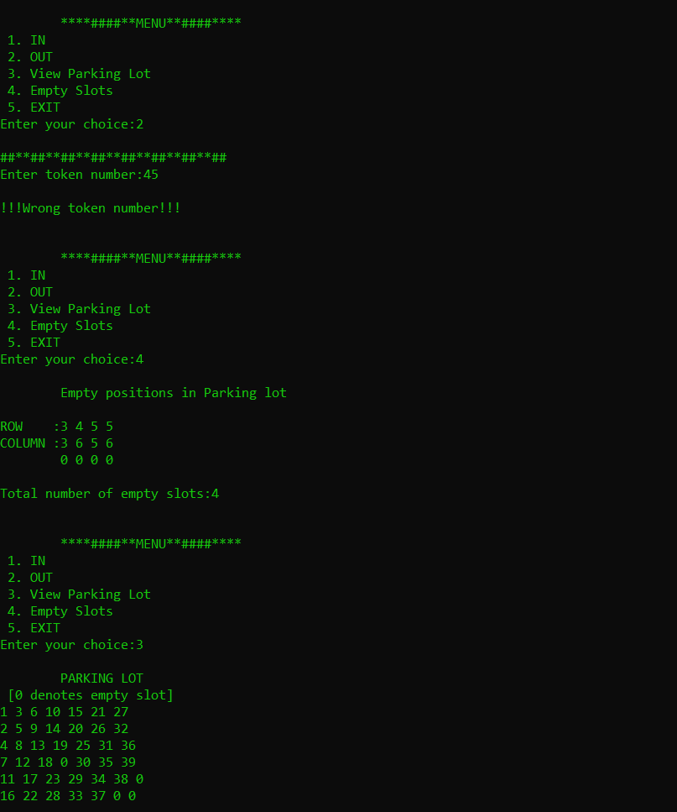
Snapshots of Result

Slide 18
Time Complexity
Time complexity is calculated during entry of a vehicle for searching the nearest empty slot for parking.
n=number of rows in parking lot
m=number of columns in parking lot
Worst time complexity: O(n*m) :- last slot is empty
Average time complexity: any slot between first and last position is empty
Best time complexity: O(1) :- first slot is empty

Slide 19
THANK YOU
ANY QUESTIONS ?

