Slide 1
Project Name: Final Project HCDR - FP Phase 4 (Neural Networks) Group Name: FP_GroupN_9
Dhanush Bharath Raj
dbraj@iu.edu
Hrithik P B
hripb@iu.edu
Chiranthan Shadaksharaswami cshadaks@iu.edu
Jitesh Bhandari
jitbhand@iu.edu

Slide 2
Project Abstract
The course project is based on the Home Credit Default Risk (HDR) (https://www.kaggle.com/c/home-credit-default-risk/). In order to appropriately award loans to those who can repay them and turn away those who cannot, the Home Credit Default Risk program was created. In other words, the goal is to predict whether or not a client would pay back a debt. We will examine and model the Home Credit Default Risk data that is currently hosted on Kaggle throughout this round of the research. The objective of this project phase is to perform exploratory data analysis on the data, which involves characterizing the data, computing summary statistics on the data to highlight its key features, displaying the results, and computing missing item counts for all categories. Before modeling the data and conducting preliminary investigations on the data to find patterns, discover anomalies and biases, and test hypotheses using summary statistics, this approach demonstrates what the data can tell us. The columns with the greatest number of missing value counts were also eliminated throughout the DA operation. Then, in order to find and exclude strongly linked variables that would render our model ineffective, we developed a correlation matrix. To prevent errors, we separate the dataframe into train and test subsets. In order to individually impute numerical and categorical values, we then construct pipelines. We make use of one-hot encoding to modify the values of the category variables. Finally, we forecasted our goal variable based on our input variable using Logistic Regression and Random Forest.
Project Description
There are 7 different sources of data:
application_train/application_test: The data for training and testing with information about each loan application at Home Credit. Each loan has its row as feature SK_ID_CURR as an identifier or a unique key. The TARGET of training application data has two values indicating 0: indicated the loan was repaid or 1: the loan was not repaid.
bureau: data from other financial organizations about the client's prior credit. Each previous credit has its own row in the bureau.
bureau_balance: monthly information about past credit history in the bureau. A previous credit can include numerous rows, one for each month of the credit period.

Slide 3
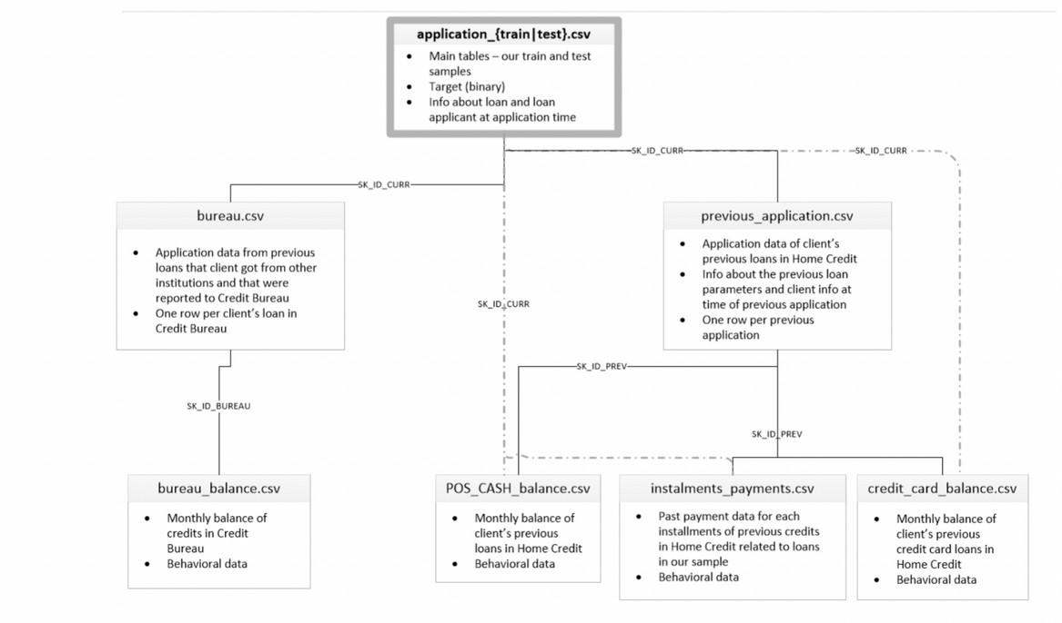
Project Description (Contd)
previous_application: Past loan applications made by customers with loans at Home Credit are included in the application data. The application data allows for many prior loans for each current loan. The feature SK ID PREV serves to distinguish each previous application, which contains one row.
POS_CASH_BALANCE: monthly information on prior point-of-sale or cash loans that customers have taken out through Home Credit. A single previous loan can have numerous rows, each representing a month from a previous point of sale or cash loan.
credit_card_balance: data about prior credit cards that Home Credit customers have had on a monthly basis. Every row represents a month's worth of credit card debt, and a single credit card may have several rows.
installments_payment : history of payments for prior loans with Home Credit. Every made payment has its own row, and every missed payment has its own row.
Here is the Visual representation of the data sources and its relationships

Slide 4
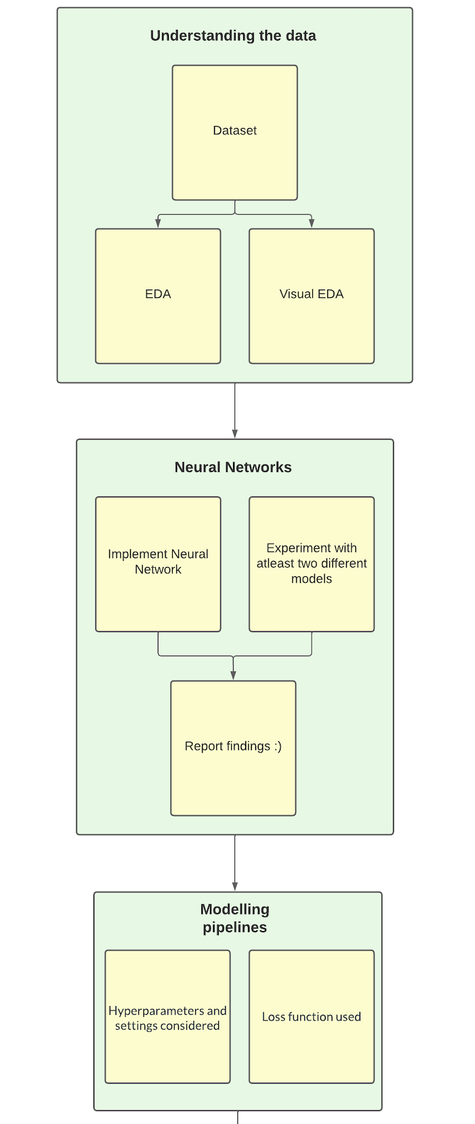
Present Visual Workflow Representation

Slide 5
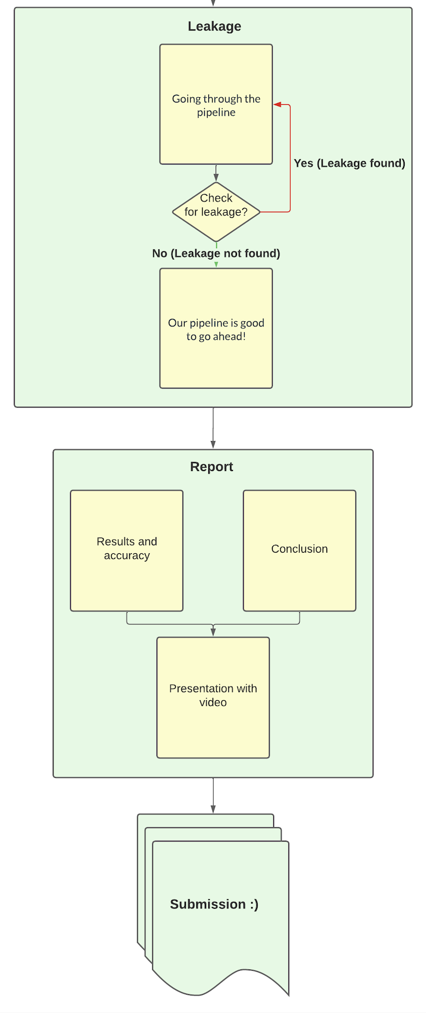
Present Phase Workflow Representation

Slide 6
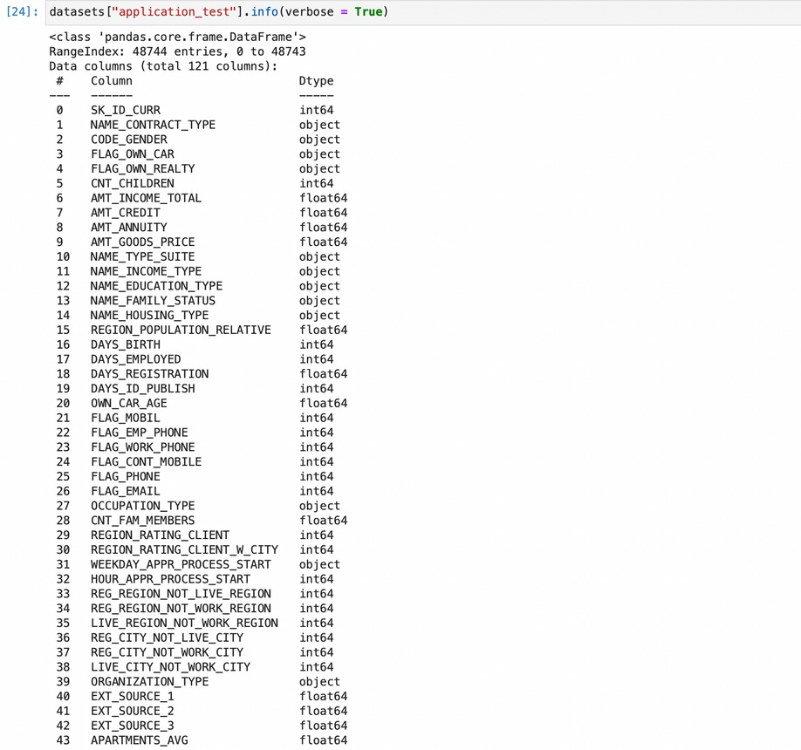
Present Tasks that are done
Explore and Analyze the Data (EDA)
Check for the possible errors that could render inaccurate calculations Standardize the data by discovering the missing values and correlated features Split the data into training and testing sets
Process the categorical and numerical variables separately
Calculate and validate the results by building Baseline Models using Logistic Regression and Random Forest
Summary EDA (Exploratory Data Analysis)
1. Determining the shape of the data
Initially, we Import all the packages and modules, the data is imported and loaded into the database
The dimensionality of the of the dataset should be comprehended before preprocessing it. The shape property is used to determine the number of rows and columns

Slide 7
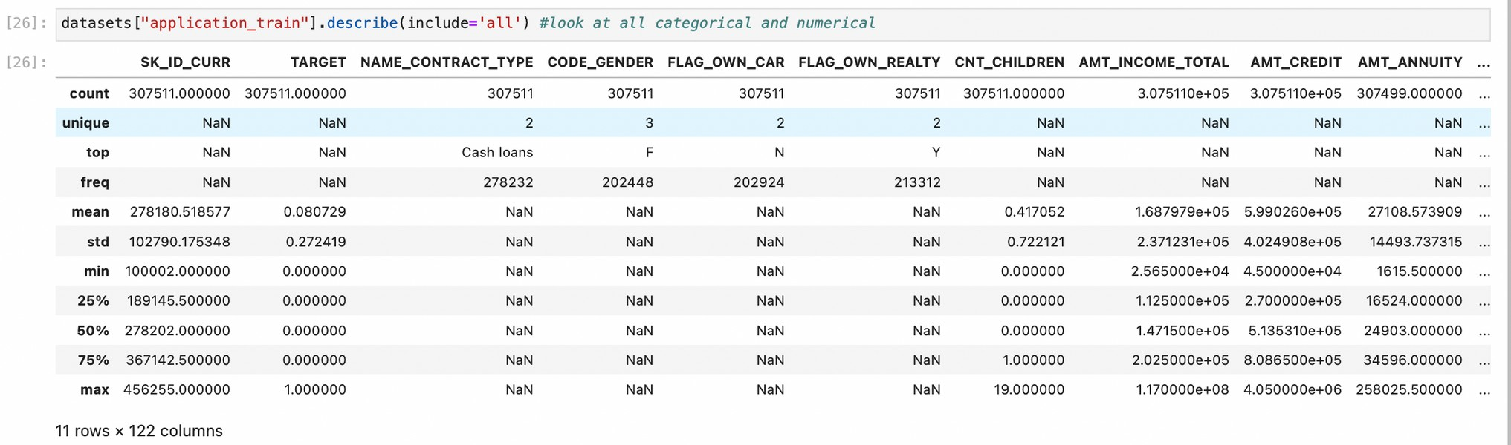
1. Determining the statistical information
The central tendencies of the data in the dataset is measured to know the average value of the data. describe property is used understand the statistics that summarize the central tendency.

Slide 8
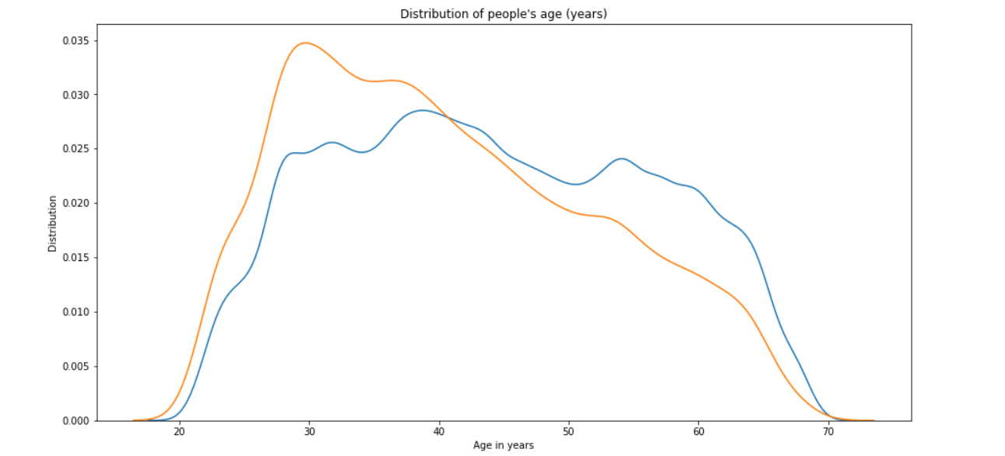
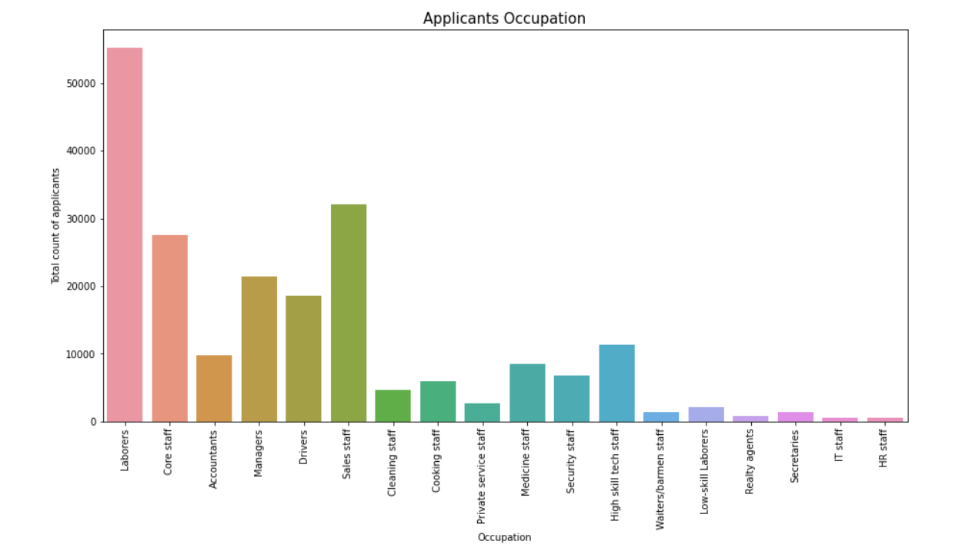
Visual EDA
Understanding the distribution of people’s age.
Introspecting the total count of applicants based on their occupation

Slide 9
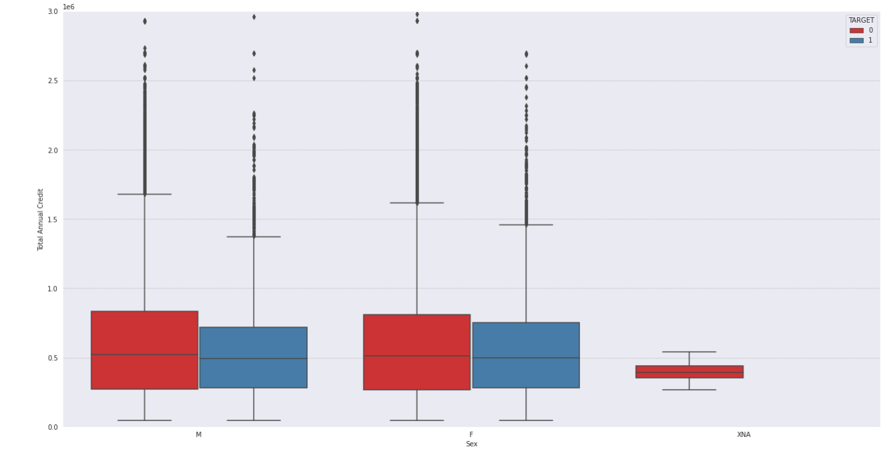
Visual EDA (cont.)
Total Annual Credit depending on gender.

Slide 10
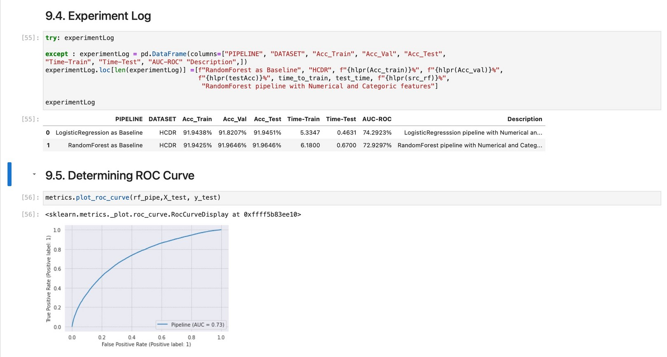
Models Used & Overview of Modeling Pipelines
The Baseline modes Used in this project currently is :
Logistic Regression Random Forest
The experiment log recorded by using these models and the ROC Curve obtained is snapped below

Slide 11
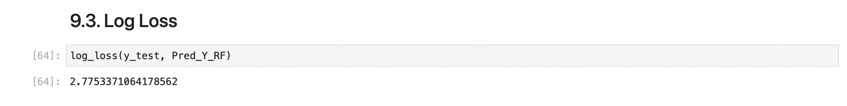
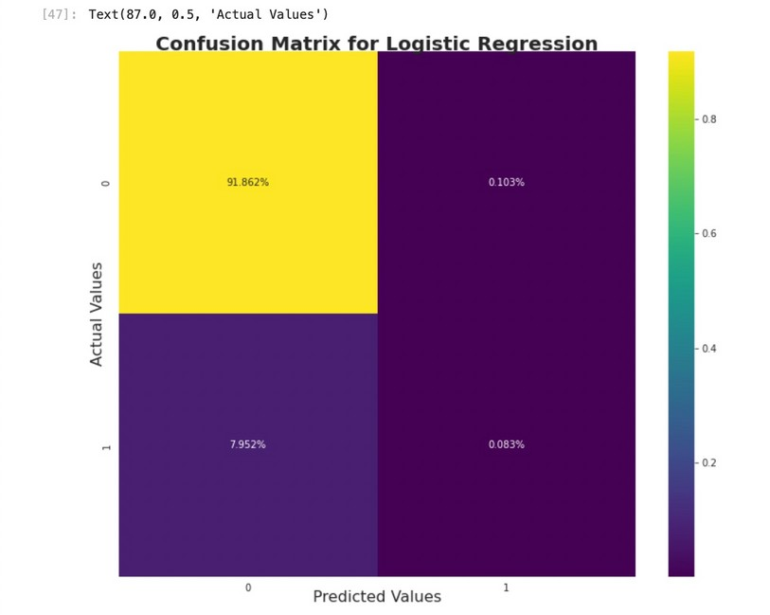
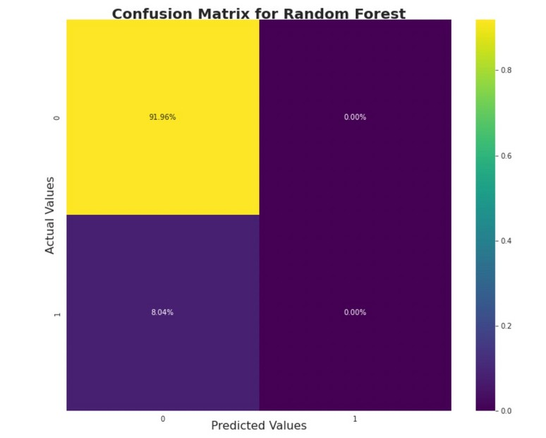
Log Loss Values & Confusion Matrix for the Model Used
The prediction probability is to the corresponding actual/true value is measured here
The correct and incorrect predictions are summarized with count values and broken down by each class in the form of confusion Matrix
The Confusion matrix for Logistic Regression The Confusion matrix for Random Forest

Slide 12
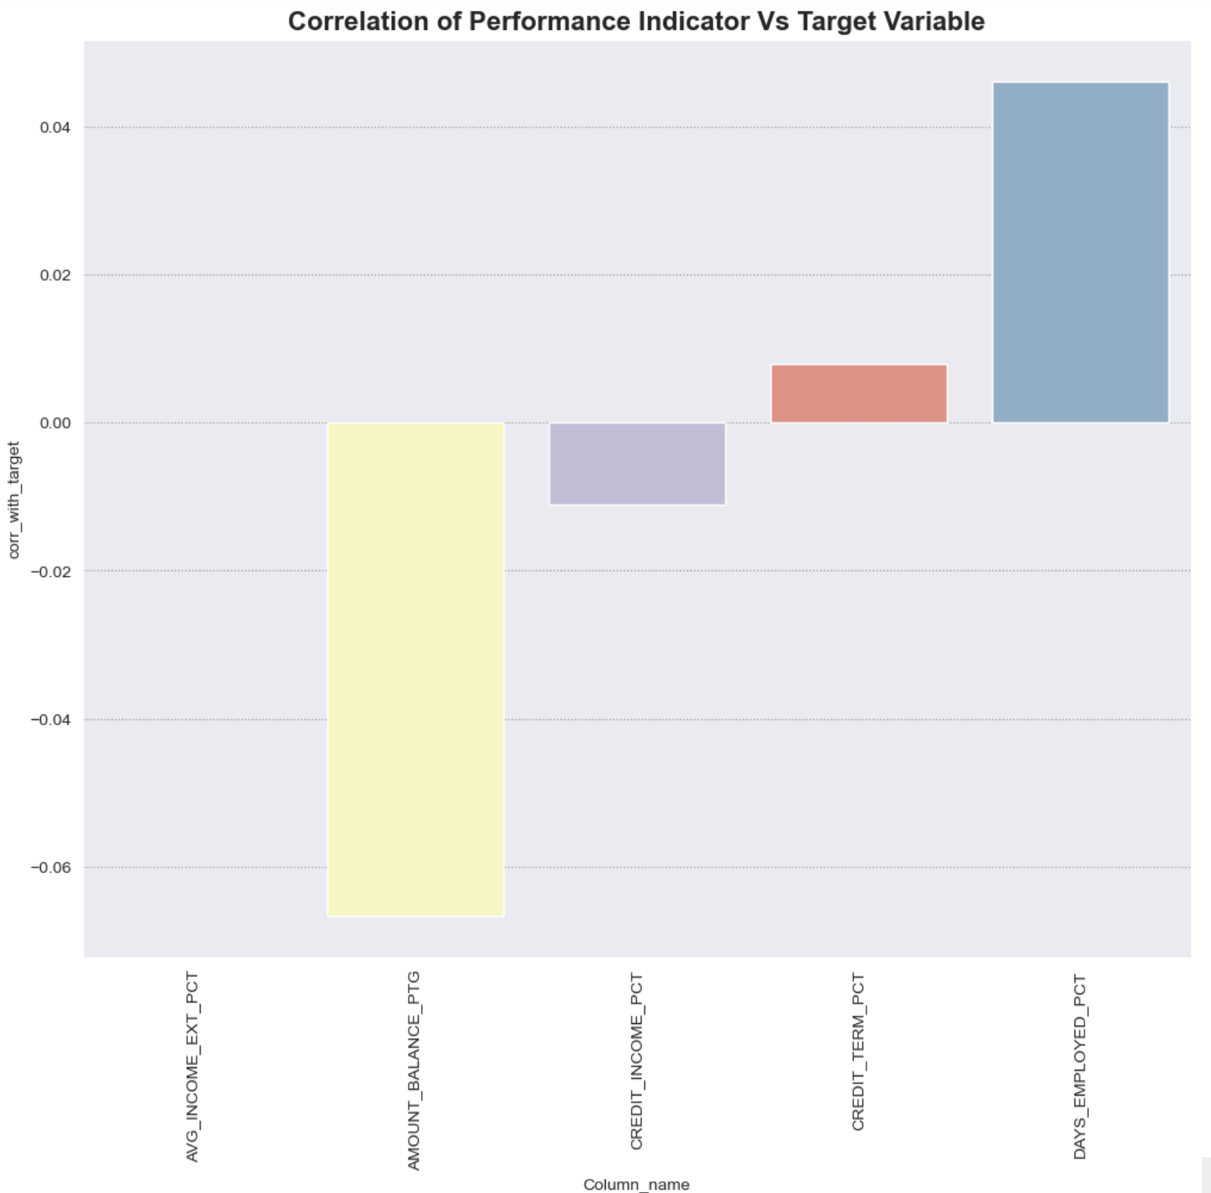
Feature Engineering

Slide 13
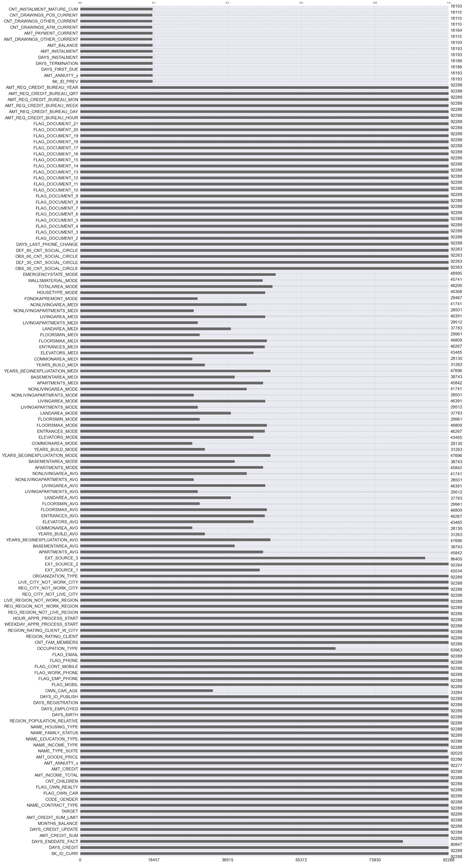
New features we engineered

Slide 14
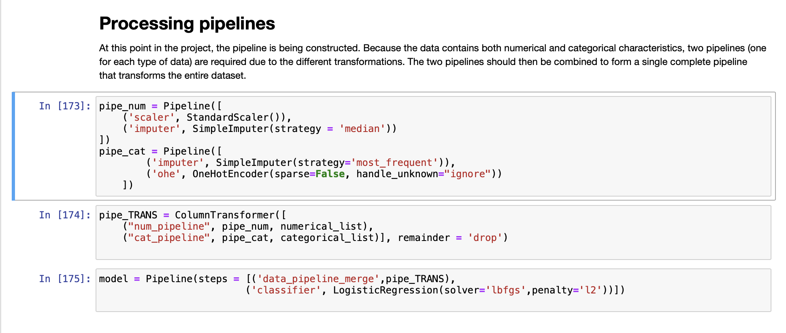
Hyperparameter tuning
Hyperparameters contain the data that govern the training process itself. Hyperparameter tuning works by running multiple trials in a single training job. In this part of the phase, we fit and store our result with GridSearchCV.

Slide 15
Neural Networks used:
We have designed two neural network models in total.
1st neural network architecture in string form: 161 – 55 – Relu – 15 – Relu – 5 – Relu – 1 – Sigmoid.
1st Neural Network:
Hidden layers used: 3
Activation functions used: ReLU and Sigmoid
Epochs: 40
Optimizer selected: SGD
Learning rate: 0.0001
2nd neural network architecture in string form: 161 – 25 – Relu – 12 – Relu – 1 – Sigmoid.
2) 2nd Neural Network:
Hidden layers used: 2
Activation functions used: ReLU and Sigmoid
Epochs: 28
Optimizer selected: SGD
Learning rate: 0.0011

Slide 16
Data Leakage:
Data leaking occurs when the model is created using data that is not part of the training dataset. Data leakage frequently results in unrealistically high levels of performance on the test set since the model is being run on data that it has already seen. To ensure that there is no data leakage, we run the model multiple times. Through multiple runs, we consistently came to the same conclusions, and the accuracy has not significantly improved. To ensure that the outcomes were consistent, we also ran the model independently numerous times on test and validation data. In addition, we did not see any improvement in accuracy throughout the course of those several runs. Additionally, we checked for any duplication.
Cardinal Sins:
As the application_train and application_test datasets were provided to us separately. We did not make a rookie mistake of abusing the data and model. Further we have not performed any cross fold validation on the application_train dataset after splitting it so we have refrained from exposing test dataset to be part of training.

Slide 17
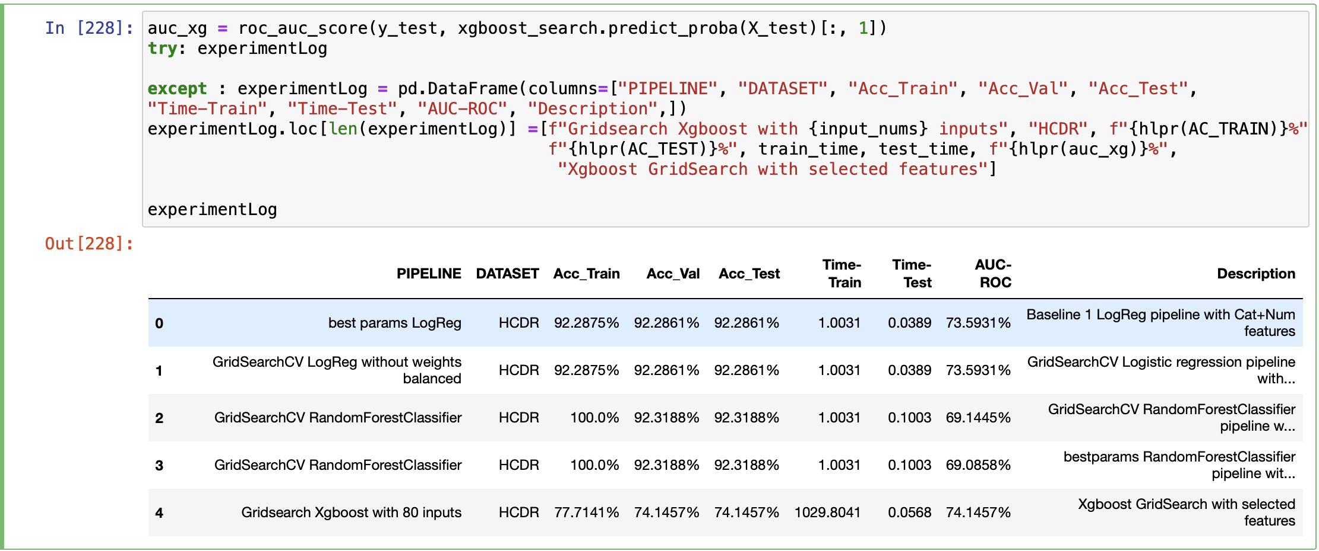
Results
Metrics used - AUC

Slide 18
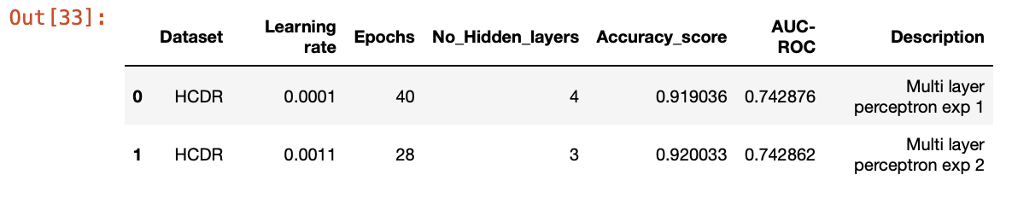
Results
Metrics used – AUC.
The major aim of the project was to determine if the client is creditworthy or not. In phase 1 of our project we trained the model using logistic regression and random forest regressor without performing any feature engineering or modifications on the dataset and obtain the accuracy of 91.94% on the dataset, later in the next phase after performing hyperparameter tuning and feature engineering to generate a new data frame after combining multiple tables the model was able to predict with an accuracy of 92.2% and finally in this phase of the project we chose to utilize the dataset from the feature engineered data frame exported to csv as final_features, we preprocessed this dataset before using it in our multilayer perceptron, later 75% of the data from this table was used for training the neural network model to obtain the accuracies as stated above for different networking models.

Slide 19
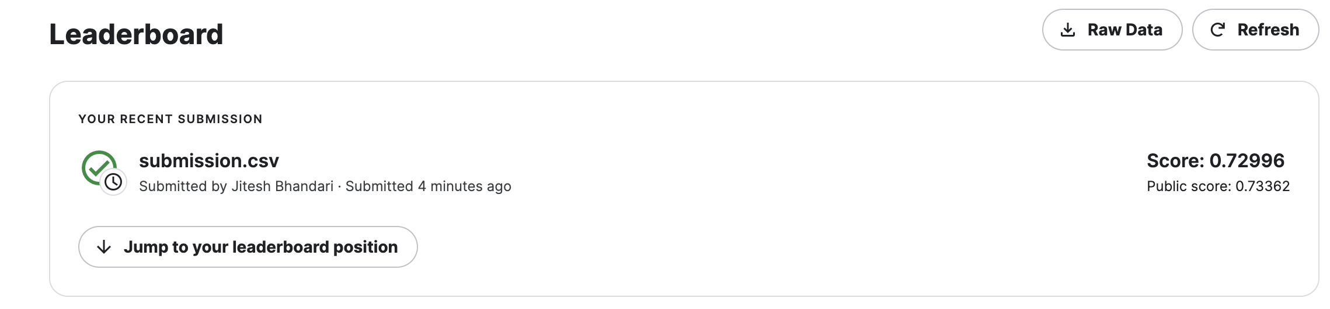
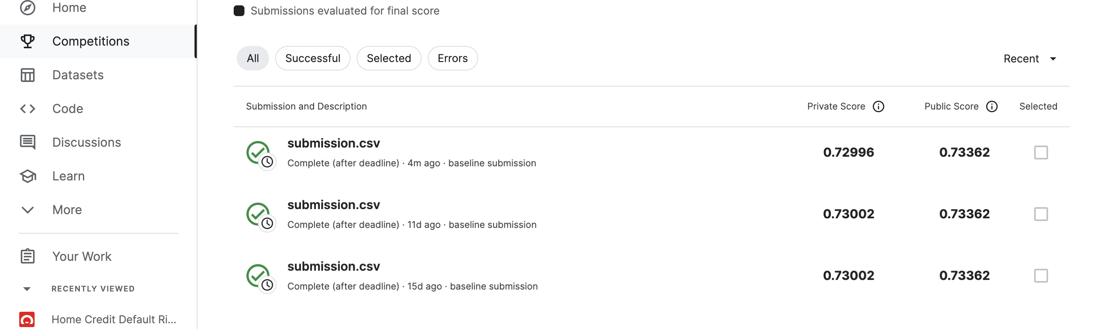
Results – Kaggle Submission

Slide 20
Conclusion
The HCDR project's goal is to forecast the repayment capacity of the affected population. This is a significant project because both the lender and the borrower require well-established projections. Because the data includes people's lives, HomeCredit will require the highest level of precision to ensure that it is forecasted accurately.
We did Exploratory Data Analysis in phase one, where we discovered several insights into the data and learned a lot about how to extract significant information from it. Following that, we built a baseline model with pipelines and Logistic Regression, learning how to build models, train them, and test them using various metrics. In Phase 3, we finished feature engineering and learned how to design significant features to improve the model. Then we used GridSearchCV to perform Hyperparameter tuning, which taught us how to improve accuracy by combining multiple models. In Phase 4, we created an MLP model and tested it with AUC ROC score, but we did not get the anticipated AUC ROC score by training the dataset with the neural network by the comparison made from the kaggle submissions we can see our neural networks AUC ROC score is slightly less than Logistic Regression AUC ROC score.

