Slide 1
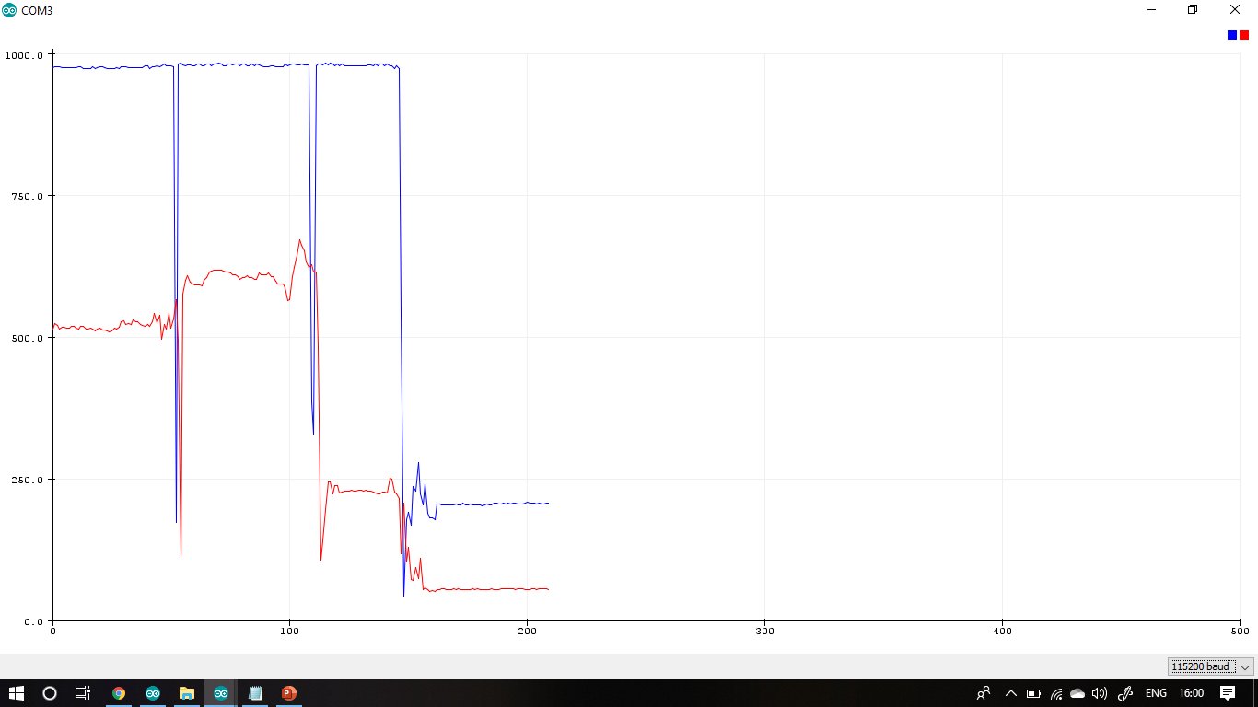
RED & Infrared LED

Slide 2
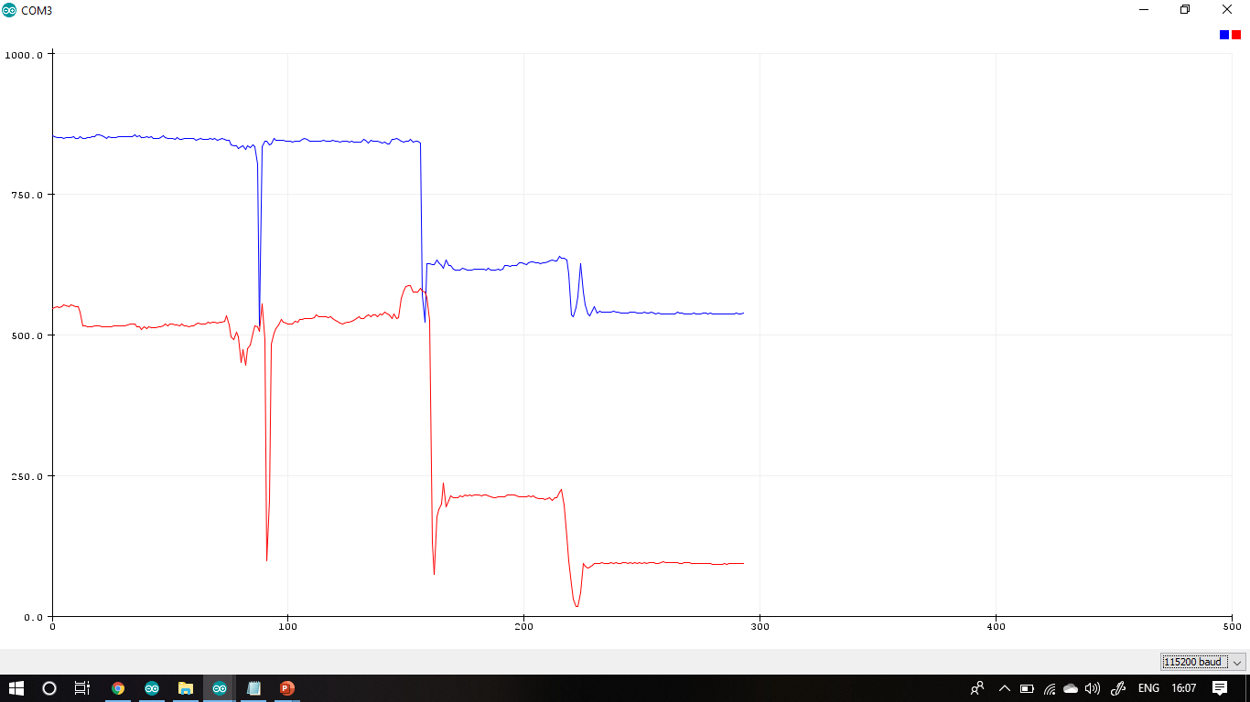
RED (Small) & RED (Big) LED

Slide 3
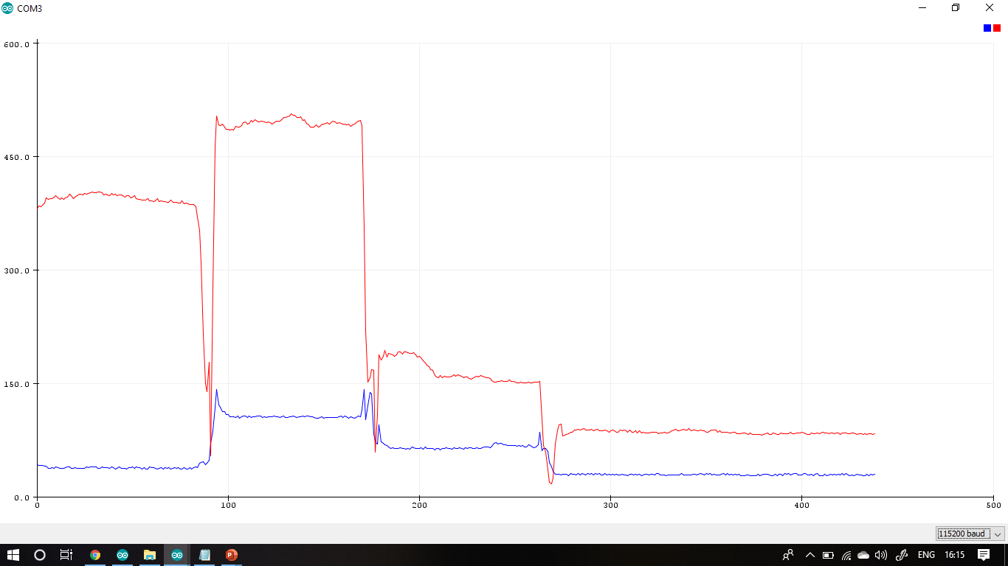
RED & GREEN LED

