Slide 1
BDDA End Term Project
Submitted To - Prof. Anuj Saini
Submitted By- Group 6
Abhisekh Das- 025003
Dipu Kumar- 025013
Sonansh Gaur- 025025
Harsh Chauhan- 025045
Kriti Suri - 025047
Chirayu Jain- 025049

Slide 2
Objective
In FY 2016, the OFLC processed 775,979 employer applications for 1,699,957 positions for temporary and permanent labor certifications. This was a nine percent increase in the overall number of processed applications from the previous year. The process of reviewing every case is becoming a tedious task as the number of applicants is increasing every year.
The increasing number of applicants every year calls for a Machine Learning based solution that can help in shortlisting the candidates having higher chances of VISA approval. OFLC has hired the firm EasyVisa for data-driven solutions. You as a data scientist at EasyVisa have to analyze the data provided and, with the help of a classification model:
Facilitate the process of visa approvals.
Recommend a suitable profile for the applicants for whom the visa should be certified or denied based on the drivers that significantly influence the case status.

Slide 3
Task Performed
Importing Required Libraries
Loading Dataset
Visualization
Exploratory Data Analysis
Logistic Regression Model
Parameter Tuning
Decision Tree Classifier
XG Boost Classifier
Recommendations

Slide 4
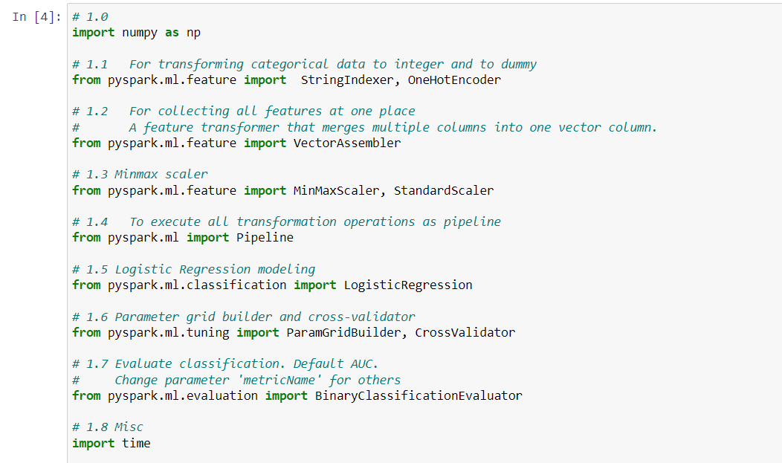
Importing Required Libraries

Slide 5
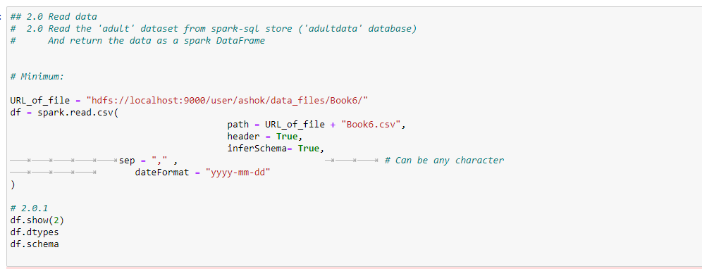
Loading Dataset

Slide 6
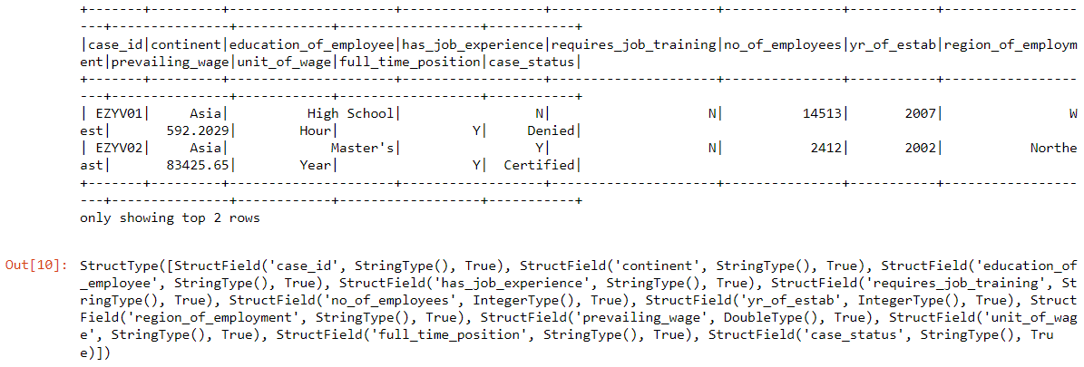
Output

Slide 7
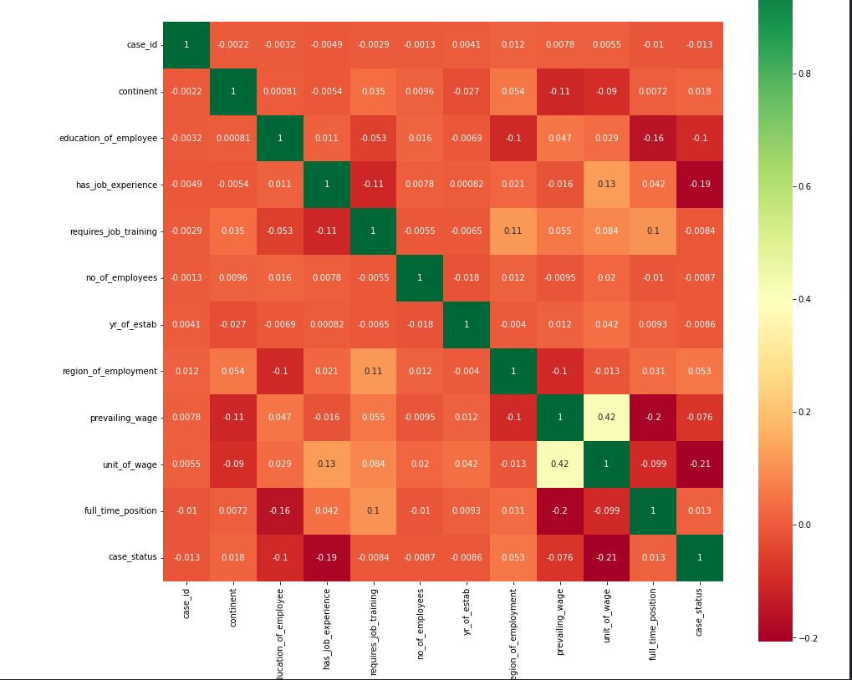
Visualization
We did heatmap visualization to find the correlation between different Labels of the Dataset

Slide 8
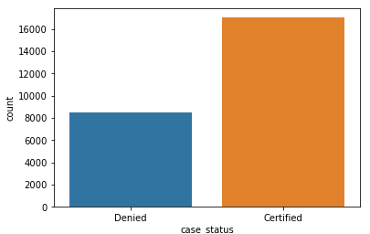
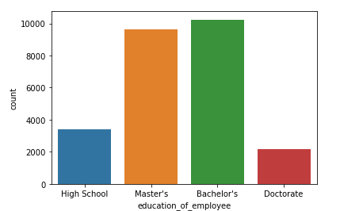
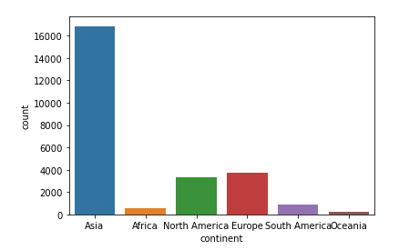
Visualization

Slide 9
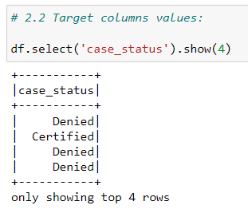
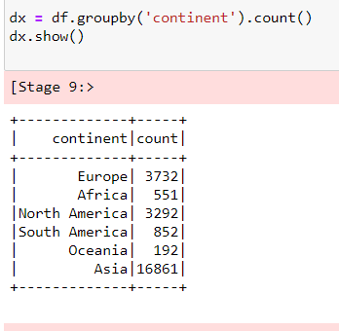
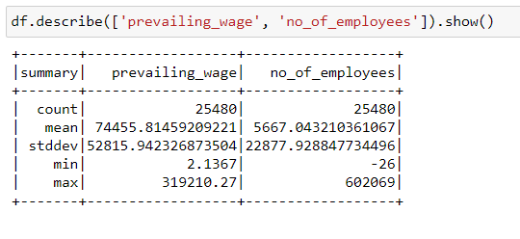
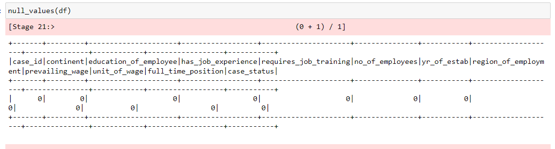
Exploratory Data Analysis

Slide 10
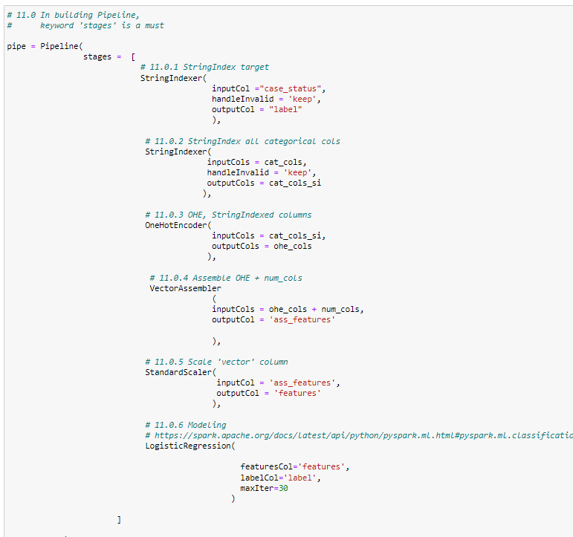
Pipeline

Slide 11
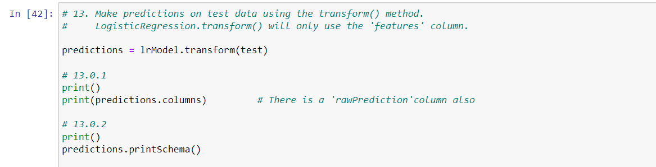
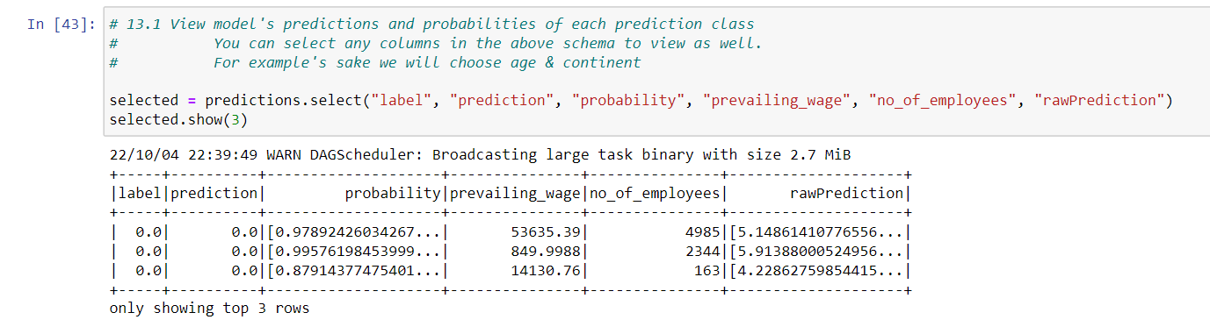
Logistic Regression Model

Slide 12
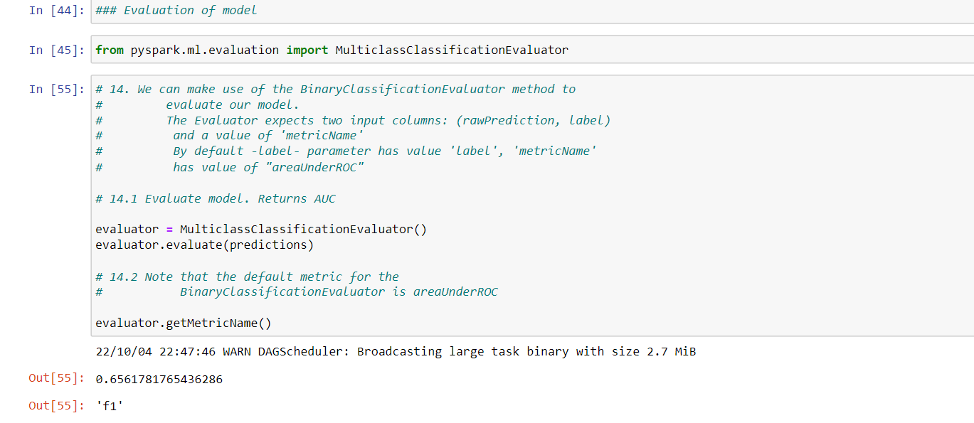
Logistic Regression Model

Slide 13
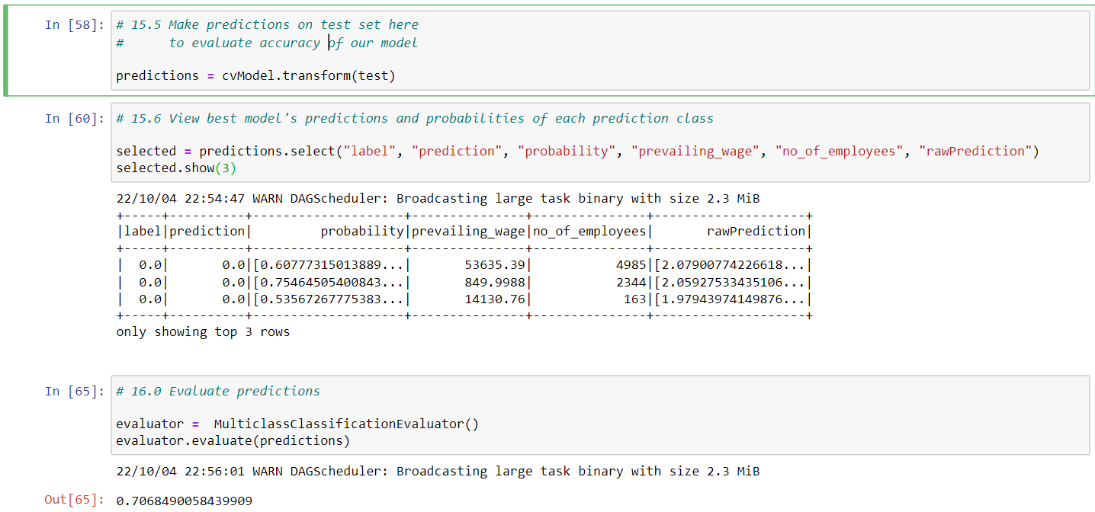
Parameter tuning GridSearch based parameter Selection Regression Model

Slide 14
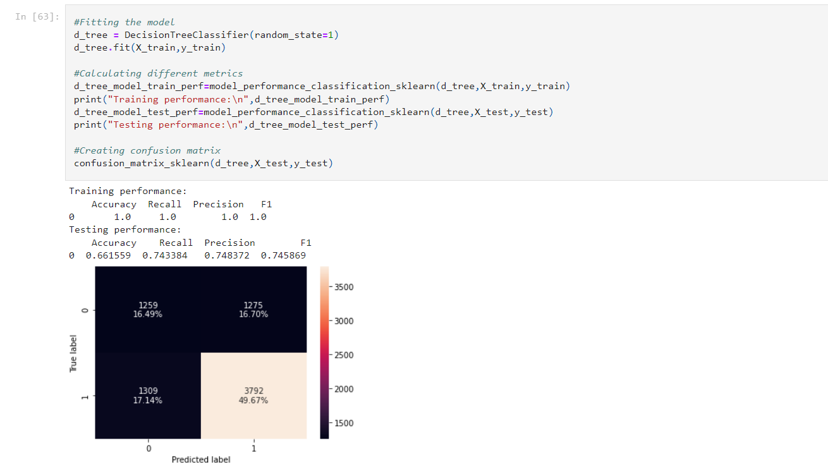
Decision Tree Classifier

Slide 15
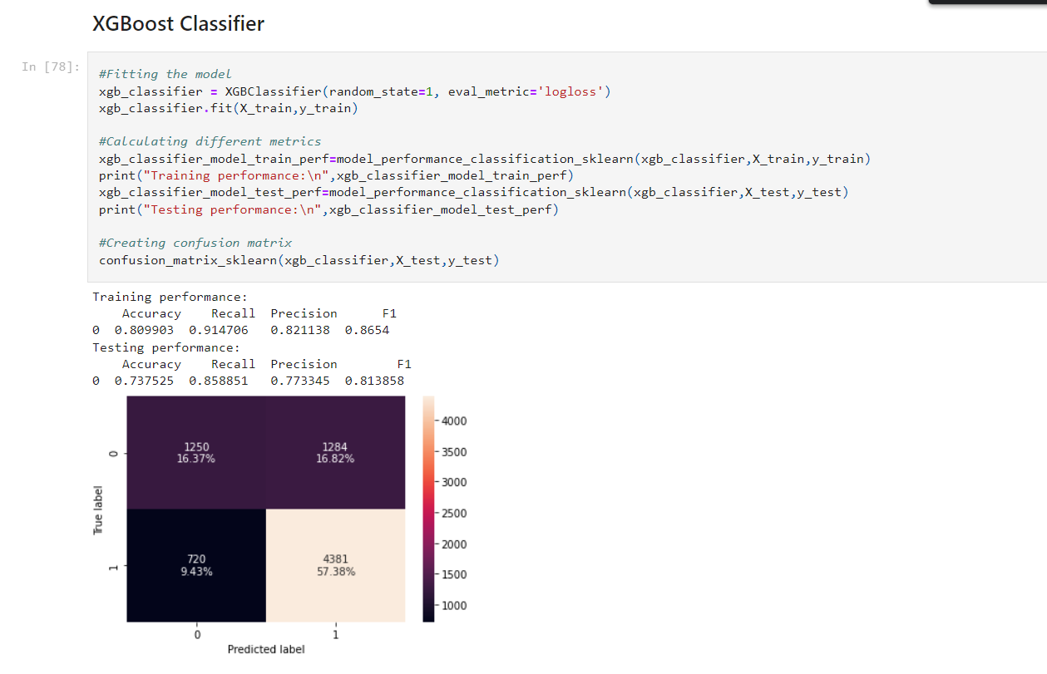
XGBoost Classifier

Slide 16
Recommendation
Based on the EDA and the XGBoost(tuned) model, the following characteristics were found to be crucial for visas to be approved as opposed to denied:
(1) Employee education; an employee with only a high school diploma has over 65% chance of having their visa denied, compared to an employee with a doctorate degree, who has over 85% chance of having their visa approved;
(2) Unit of wage; an employee with hourly pay also has over 65% chance of having their visa denied, in comparison to an employee
(3) The continent the employee is from (e.g., if Europe, over 80% chance of visa getting certified), if the employee has prior job experience (over 75% chance of visa getting approved if an employee has prior work experience but 50% chance of visa getting denied if an employee has no work experience) are other important attributes
(4) Likewise, the region of the US the employment opportunity is in is also an important deciding factor with over 70% cases getting certified if the region is Midwest or South
The XGBoost hyperparameter optimised ML model can explain over 80% of data (accuracy of 75% on test dataset & F1 score of 82% on test dataset) and can provide generalised predictions on training & testing datasets (not prone to overfitting).
The recall and precision are also both quite good (77% and 88%, respectively).
The confusion matrix can accurately predict a higher percentage of cases that are certified but only a lesser percentage of cases that are rightly denied. This restriction must be kept in mind, and if there is a current lack of human resources in the US, it may be possible to reevaluate cases that have been denied. The model is still useful because only a tiny subset of the data will require considerable further reevaluation.

Slide 17
Thank You!!!!

