Slide 1

R.N.S INSTITUTE OF TECHNOLOGY
DEPARTMENT OF ISE
2-PLAYER
CHESS PROGRAM
Nikunj Pathak 1RN16IS057
Gowtham V Bhat 1RN16IS034
Harish Kumar 1RN16IS035
Chirayu Gupta 1RN16IS028

Slide 2
INTRODUCTION

Slide 3
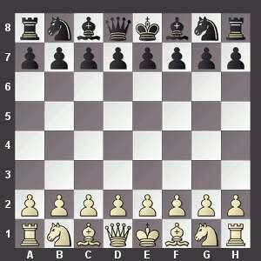
Chess is a two player strategy game played on a chessboard, a checkered
with 64 squares arranged in 8*8 grid.
Each player begins with 16 units : 1 king ,1 queen,2 rooks,2 knights,2 bishops
and 8 pawns.
A normal chess board looks like this →

Slide 4
Common Rules->
By convention the game pieces are divided into white and black sets.
The player with the white pieces always start the game
The king moves one square in any direction.
The rook can move any no of squares along a row or column but cannot leap over
other pieces.
The bishop can move any no of squares diagonally but cannot leap over pieces.
The queen combines the power of rook and bishop but cannot leap over other pieces.
The knight moves in L-shape and can leap over other pieces.
The pawn can move forward to an unoccupied square immediately in front of it
on the same column or on its first move it can advance 2 squares along the same
column provided both the squares are unoccupied.
Pawn can capture an opponent’s piece on a square diagonally in front of it on an
adjacent column.
When a pawn advances to the last row , it is promoted and must be exchanged for
The player’s choice of queen , rook , bishop or knight.
You cannot move a unit if it puts your king under attack.

Slide 5
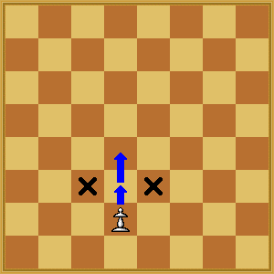
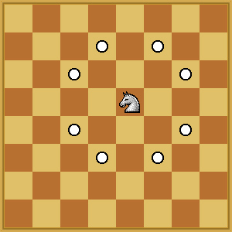
Pawn moves
Knight moves

Slide 6
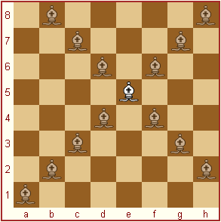
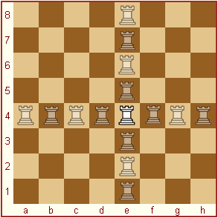
Bishop moves
Rook moves

Slide 7
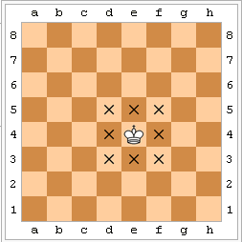
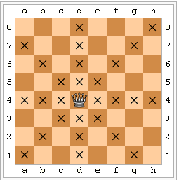
King moves
Queen moves

Slide 8
What is a CHECK ?
When a King is under direct attack from opponent
but there are legal moves left.
What is a CHECKMATE ?
When a king is under direct attack from opponent
and no legal moves are left.
What is a STALEMATE ?
When a king is not under attack but there are no
legal moves left.

Slide 9
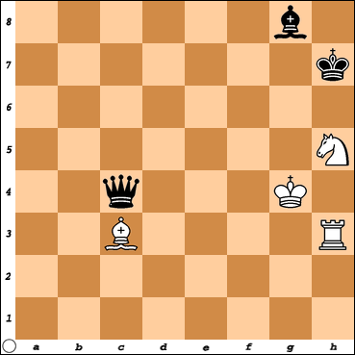
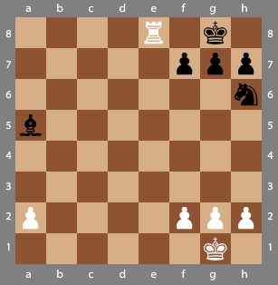
An example of CHECKMATE
An example of CHECK

Slide 10
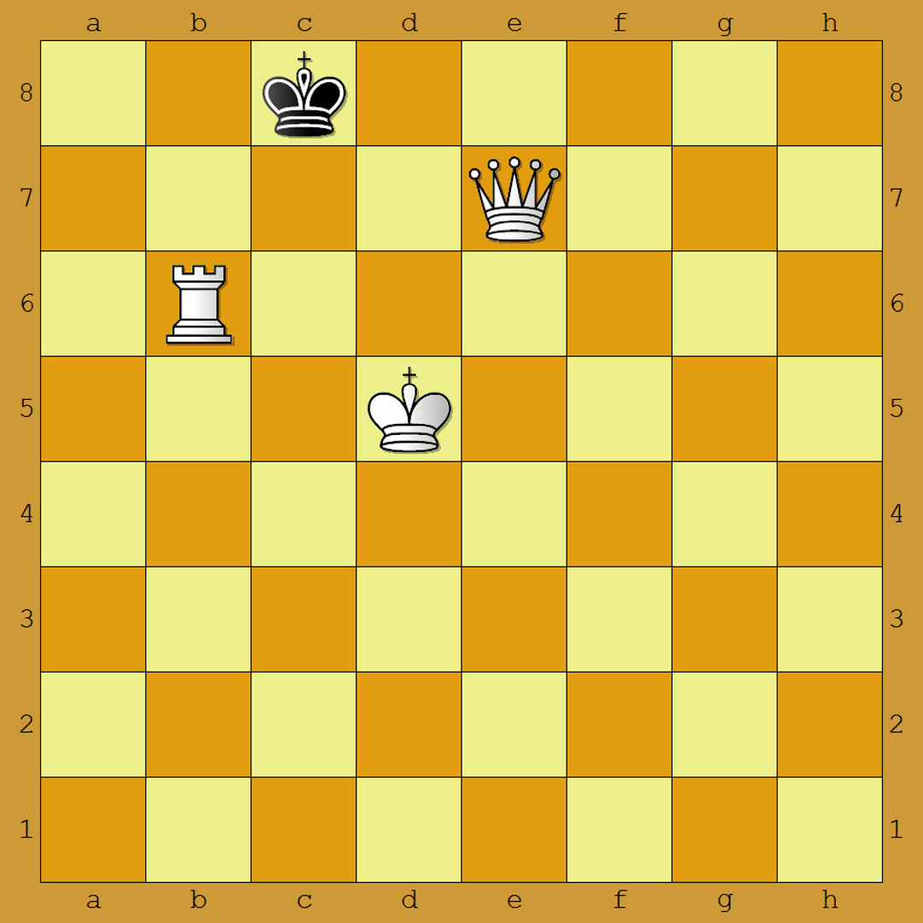
An example of stalemate

Slide 11
OBJECTIVE
Objective of the program is to conduct a
fair 2 player chess game which implements
all the mentioned rules.

Slide 12
DATA STRUCTURES USED
char square[8][8]={’r’,’n’,’b’,’q’,’k’,’b’,’n’,’r’,
’p’,’p’,’p’,’p’,’p’,’p’,’p’,’p’,
’\0’,’\0’,’\0’,’\0’,’\0’,’\0’,’\0’,’\0’,
’\0’,’\0’,’\0’,’\0’,’\0’,’\0’,’\0’,’\0’,
’\0’,’\0’,’\0’,’\0’,’\0’,’\0’,’\0’,’\0’,
’\0’,’\0’,’\0’,’\0’,’\0’,’\0’,’\0’,’\0’,
’P’,’P’,’P’,’P’,’P’,’P’,’P’,’P’,
’R’,’N’,’B’,’Q’,’K’,’B’,’N’,’R’};
This is a 2D array of characters which represents the chess board.
Black units are represented by small characters.
White units are represented by capital characters.
Example , Q -> white queen q -> black queen

Slide 13
struct COORDS
{ int row;
int col;
};
This structure is used to represent the coordinates of units on the board.

Slide 14
DESIGN AND IMPLEMENTATION

Slide 15
int valid_move2(struct COORDS Curr , struct COORDS New);
It takes two arguments , current coordinates stored in Curr and the new coordinates
stored in New. Player moves from current coordinates to the new coordinates.
It return 1 if move is correct and 0 if move is not correct.
Two character variables unit and newunit stores the chess units present at Curr and
New resp.
An integer variable color is made , it is positive if black piece is present at New ,
it is 0 if white piece is present at New , it is negative if nothing is present at New.
If unit = ‘K’
Check whether New is one of eight positions around Cur or not.
If not then return 0.
If it is , then check color . If color != 0 then return 1 otherwise return 0.
If unit = ‘Q’
Replace ‘Q’ with ‘R’ and recursively call the function.
Replace ‘Q’ with ‘B’ and recursively call the function.
If 1 is returned in any one of the two cases then return 1.
If 0 is returned in both cases then return 0.

Slide 16
If unit = ‘P’
If New is diagonally one block left or right w.r.t Curr then,
if color>0 then return 1 otherwise return 0.
else if New is one block up in the same column w.r.t Curr then,
if color<0 then return 1 otherwise return 0.
else if New is two blocks up in the same column w.r.t Curr and Curr = 6 then,
if these two blocks are empty then return 1 otherwise 0.
else return 0.
If unit = ‘R’
If New is in same column as Curr
Run a loop to check if all blocks in b/w are empty
if empty then
if color != 0 then return 1 otherwise return 0.
else if not empty
then return 0.
else If New is in same row as Curr
Run a loop to check if all blocks in b/w are empty
if empty then
if color != 0 then return 1 otherwise return 0.
else if not empty
then return 0.
else return 0.

Slide 17
If unit = ‘N’
If New is one of the eight positions where a knight can move from Curr
then if color != 0 then return 1 otherwise return 0
else return 0.
If unit = ‘B’
if New is diagonally positioned w.r.t Curr
if all the blocks in b/w the New and Curr are empty
if color !=0 then return 1 otherwise return 0.
else return 0
else return 0.
Similarly check for all black pieces.
int wk_underattack2(struct COORDS Curr);
Check whether the white king is under attack from position passed to it or not.
Return 1 if it is under attack otherwise return 0.

Slide 18
int bk_underattack2(struct COORDS Curr);
Takes a position as an argument and stores it in Curr , return 1 if black king is
under attack from that position , otherwise return 0.
Stores the position of black king in struct COORDS variable bkpos.
Char variable unit stores the chess unit present at Curr.
If unit = ‘K’
If bkpos is one of eight positions surrounding Cur
return 1
else
return 0.
If unit = ‘Q’
Replace ‘Q’ with ‘R’ and recursively call the function.
Replace ‘Q’ with ‘B’ and recursively call the function.
If 1 is returned in any one of the two cases then return 1.
If 0 is returned in both cases then return 0.
If unit = ‘P’
If bkpos is diagonally one block left or right w.r.t Curr then
return 1
else
return 0.

Slide 19
If unit = ‘R’
if bkpos is in same column as Curr then
if all the blocks in b/w are empty then
return 1
else return 0
else if bkpos is in same row as Curr then
if all the blocks in b/w are empty then
return 1
else return 0
else
return 0.
If unit = ‘N’
if bkpos is one of eight possible positions where a knight can move from Curr then
return 1
else
return 0
If unit = ‘B’
if bkpos is diagonally positioned w.r.t Curr then
if all the blocks in b/w are empty then
return 1
else
return 0
else
return 0
Else if unit is something else then return 0.

Slide 20
int wk_underattack();
A struct COORDS variable pos is created.
Run a loop to traverse pos from 1st block to 64th block,
if wk_underattack2(pos) return 1 then,
return 1
break
else if wk_underattack2(pos) return 0 then,
continue.
Return 0
int bk_underattack();
A struct COORDS variable pos is created.
Run a loop to traverse pos from 1st block to 64th block,
if bk_underattack2(pos) return 1 then,
return 1
break
else if bk_underattack2(pos) return 0 then,
continue.
Return 0

Slide 21
int valid_move(struct COORDS Curr , struct COORDS New);
Take 2 arguments , Curr is current position , New is position where user moves.
Char variable unit and newunit stores the chess units at Curr and New.
valid_move2(Curr , New) is called ,
if it return 1 then,
if Curr contain a white piece then,
move the white piece from Curr to New
if wk_underattack() return 1 then ,
move the white piece back to Curr
return 0
else if wk_underattack() return 0 then ,
move the white piece back to Curr
return 1
else if Curr contain a black piece then,
move the black piece from Curr to New
if bk_underattack() return 1 then ,
move the black piece back to Curr
return 0
else if bk_underattack() return 0 then ,
move the black piece back to Curr
return 1
else if it return 0
return 0

Slide 22
int w_total_valid_moves();
It counts the total no of valid moves that every white piece can make.
struct COORDS variables Curr , New are created to store current and new positions.
Run a loop to traverse Curr from 1st block to 64th block,
if white piece is found on Curr position then,
run another loop to traverse New from 1st to 64th block,
if valid_move(Curr , New) = 1
++w_count
int b_total_valid_moves();
It counts the total no of valid moves that every black piece can make.
struct COORDS variables Curr , New are created to store current and new positions.
Run a loop to traverse Curr from 1st block to 64th block,
if black piece is found on Curr position then,
run another loop to traverse New from 1st to 64th block,
if valid_move(Curr , New) = 1
++b_count

Slide 23
void w_promote();
Traverse the first row and look for a white pawn,
if white pawn is found then,
run an infinite loop
take input from user
if input is ‘Q’ then replace ‘P’ with ‘Q’ and return
else if input is ‘R’ then replace ‘P’ with ‘R’ and return
else if input is ‘B’ then replace ‘P’ with ‘B’ and return
else if input is ‘N’ then replace ‘P’ with ‘N’ and return
void b_promote();
Traverse the last row and look for a black pawn,
if black pawn is found then,
run an infinite loop
take input from user
if input is ‘q’ then replace ‘p’ with ‘q’ and return
else if input is ‘r’ then replace ‘p’ with ‘r’ and return
else if input is ‘b’ then replace ‘p’ with ‘b’ and return
else if input is ‘n’ then replace ‘p’ with ‘n’ and return

Slide 24
void w_checkmate();
If wk_underattack() = 1 and w_total_valid_moves() = 0
clear screen
display()
print “Checkmate ! Black wins”
exit
void b_checkmate();
If bk_underattack() = 1 and b_total_valid_moves() = 0
clear screen
display()
print “Checkmate !White wins”
exit
void w_check();
If wk_underattack() = 1 and w_total_valid_moves() > 0
clear screen
display()
print “Check!!”
void b_check();
If bk_underattack() = 1 and b_total_valid_moves() > 0
clear screen
display()
print “Check!!”

Slide 25
void w_stalemate();
If wk_underattack() = 0 and w_total_valid_moves() = 0
clear screen
display()
print “Stalemate! It’s a draw”
exit
void b_stalemate();
If bk_underattack() = 0 and b_total_valid_moves() = 0
clear screen
display()
print “Stalemate! It’s a draw”
exit
void display();
Run a loop for i = 0 to 7
Run a loop for j=0 to 7
print square[i][j]
move to next line

Slide 26
void main();
turn = 0
struct COORDS Curr , New
Run an infinite while loop
if(turn is even)
take input Curr.row , Curr.col , New.row , New.col
if(Curr contain a white piece)
if valid_move(Curr , New) = 1 then ,
move the piece from Curr to New
w_promote()
b_checkmate()
b_stalemate()
b_check()
else
print “invalid move”
++turn
else
print “Try again it’s white turn”
++turn
clear screen
display()
++turn

Slide 27
if(turn is odd)
take input Curr.row , Curr.col , New.row , New.col
if(Curr contain a black piece)
if valid_move(Curr , New) = 1 then ,
move the piece from Curr to New
b_promote()
w_checkmate()
w_stalemate()
w_check()
else
print “invalid move”
++turn
else
print “Try again it’s black turn”
++turn
clear screen
display()
++turn

Slide 28
SCREENSHOTS OF OUTPUT

Slide 29
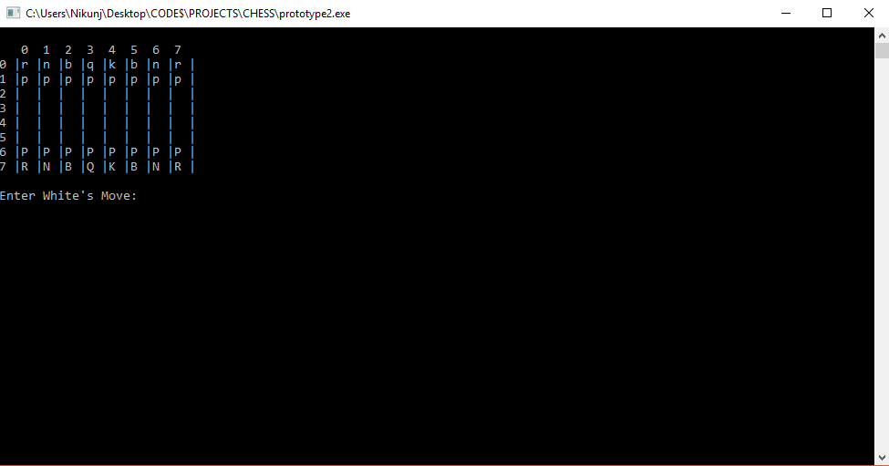
OUTPUT 1

Slide 30
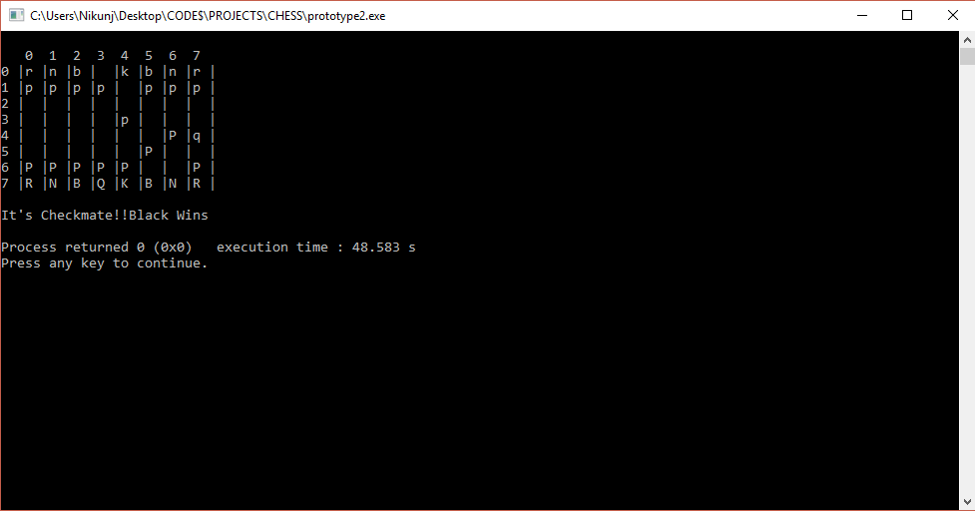
OUTPUT 2

Slide 31
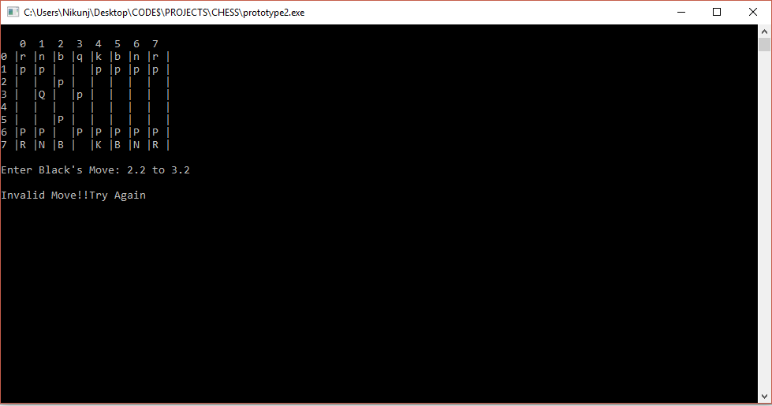
OUTPUT 3

Slide 32
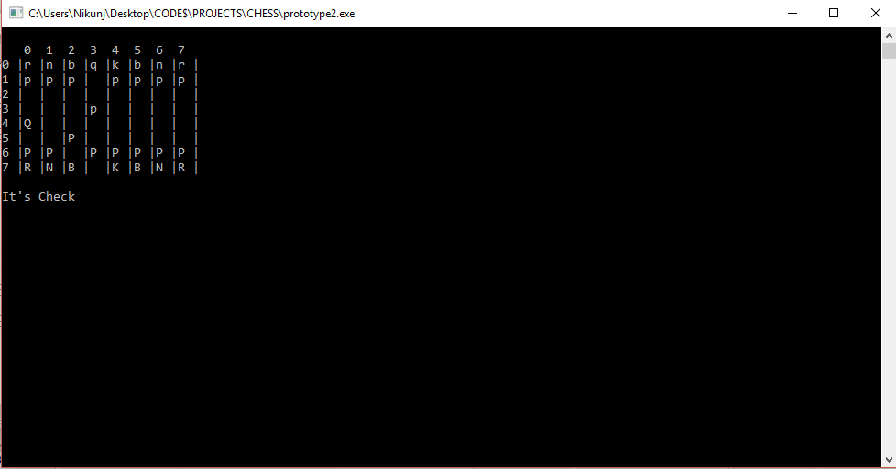
OUTPUT 4

Slide 33
Conclusion And Future enhancement
We can improve our program by adding graphics to it , so that it becomes
more appealing and interactive .
We can improve our program by including more rules of chess , like
castling and en passant.
We can improve our program by adding a single player option to it , in which
computer will play as the second player.

Slide 34
References
“ Ultimate Guide To Chess ” , a book by the author Bruce Pandolfini .

