Slide 1

Machine Learning with Python
WEBSITE PHISHING
Team members:
Shashikant : 1RN16IS095
Chirayu Gupta : 1RN16IS028
Sailesh Khandelwal : 1RN16IS083

Slide 2
INTRODUCTION
Phishing is a major threat to all internet users and is difficult to trace or defend against since it does not present itself as malicious in nature.
Phishing has a fairly simple approach – send an email containing phished URL, this URL takes victim to an illegitimate site, this site then steals information from the user.
In today's society, everything is put online and the safety of personal credentials is at risk.

Slide 3
Project Goal
Vivek received a message attached with a URL. When he tried to visit that URL he was redirected to a fraud website unknowingly, where his all private information were stolen by the attacker.
To avoid this discrepancy, we will classify URLs as legitimate or phished or suspicious so that users like Vivek do not become a victim of Phishing. If the URL is classified as phished, we will update the URL to phishtank.com(a site containing list of phished URLs).

Slide 4
Language used
Python programming language
Machine learning is the kind of programming which gives computer the capability to automatically learn from data without being explicitly programmed. In simple words, ML is a type of artificial intelligence that extract patterns out of raw data by using an algorithm or method. Python is a perfect choice for the field of machine learning and data science. It is a minimalistic and intuitive language with a full-featured library line (also called frameworks) which significantly reduces the time required to get the results.

Slide 5
Algorithm/technique used
RANDOM FOREST Algorithm
Random forests or random decision forests are an ensemble learning method for classification, regression and other tasks that operates by constructing a multitude of decision trees at training time and outputting the class that is the mode of the classes (classification) or mean prediction (regression) of the individual trees. Random decision forests correct for decision trees' habit of over fitting to their training set.

Slide 6
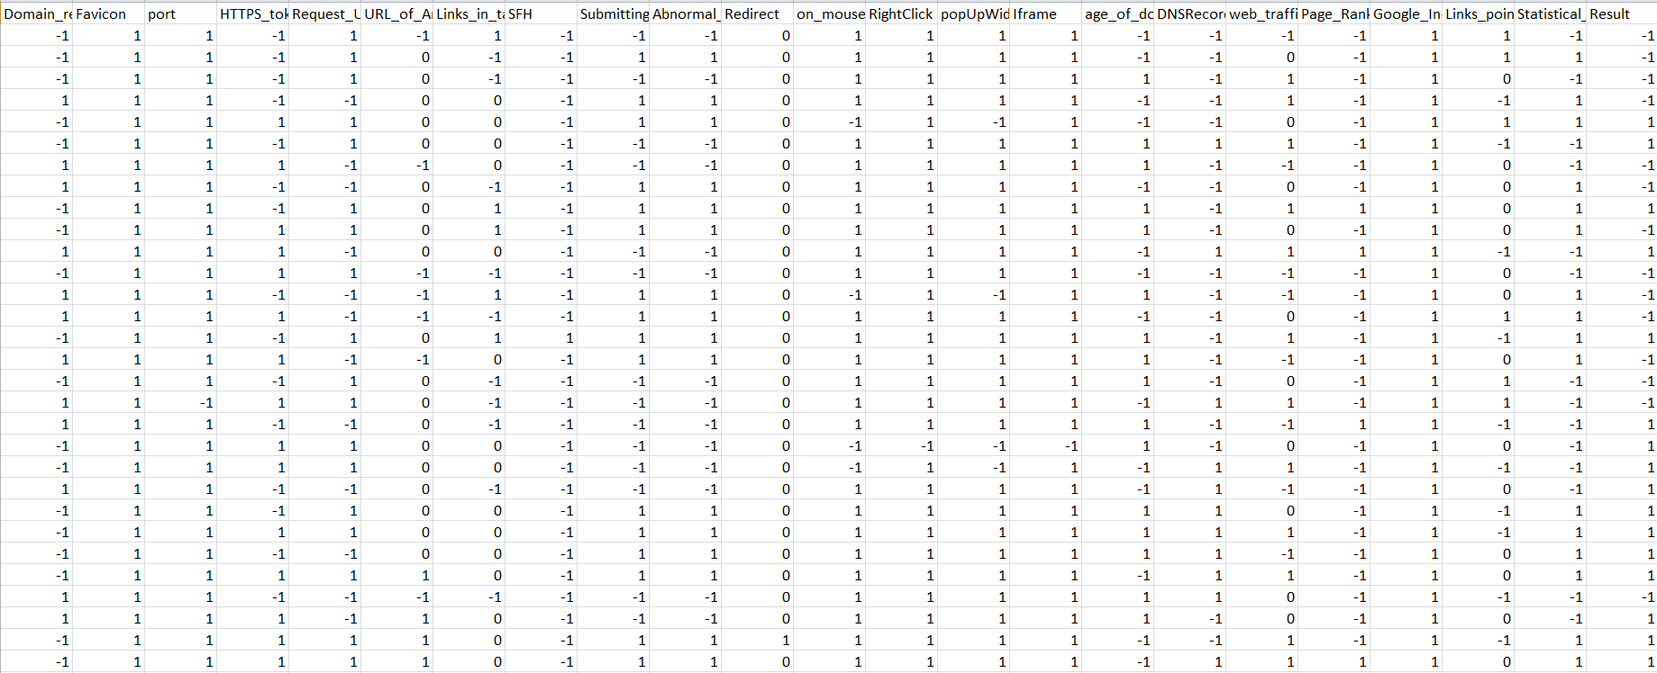
DATASET used

Slide 7
OUTPUT PARAMETERS
Value 1 in case of a legitimate URL, 0 for suspicious URL and -1 for a phished URL.

Slide 8
STEP BY STEP GUIDE TO THE PROJECT

Slide 9
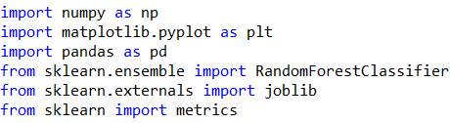
IMPORT LIBRARIES

Slide 10
STEP-1
At first we import the dataset using read_csv function of pandas library.
The read_csv function takes in the location of the dataset as the parameter.
The dataset is loaded onto the program after the correct location has been provided
After the loading of the dataset we remove unwanted columns using drop function available in library “pandas”.

Slide 11
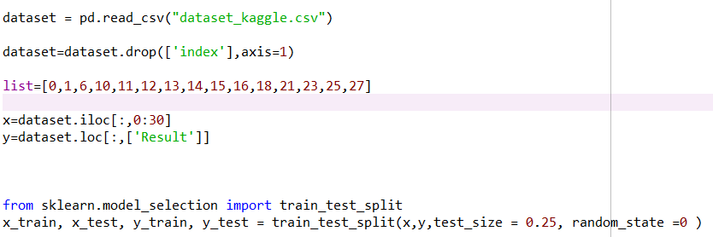

Slide 12
Step-2
Since our dataset had both the training attributes as well as the output class we separate the output class from the parameters
All the attribute names except the output class (which was stored under the column name class) is stored in a list called columns using simple for loop logic
The output class is stored under the variable name target
After this the dataset is separated into training part and testing part with 75% of the dataset taken as the training set.

Slide 13
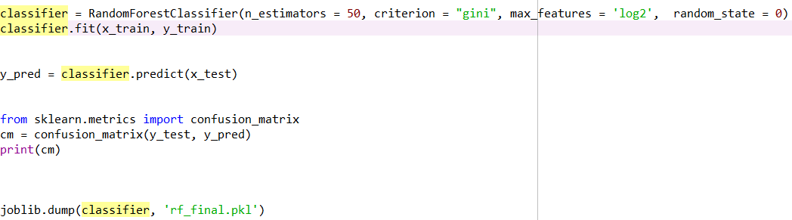

Slide 14
Step-3
The number of phished URLs and the number of legitimate URLs in the dataset is found.
Using the number of phished URLs and the number of legitimate URLs the model is created.
The results turned out as shown in the next slide.

Slide 15
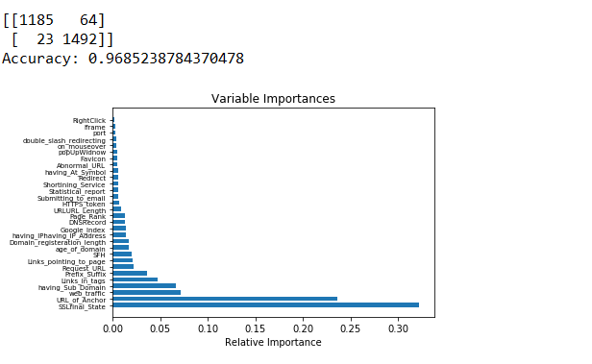

Slide 16
Step-4
The model is trained using the fit function and the prediction values are found.
Using the prediction values the accuracy score and the classification report are found.
The accuracy score and the classification report were as shown on the previous slide.

Slide 17
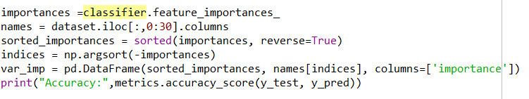

Slide 18
CONCLUSION
Our goal to classify URLs as legitimate, suspicious, or phished was implemented successfully and we were able to upload the classified phished URLs to phishtank.com(a site containing list of phished URLs).

Slide 19
THANK YOU

