Slide 1
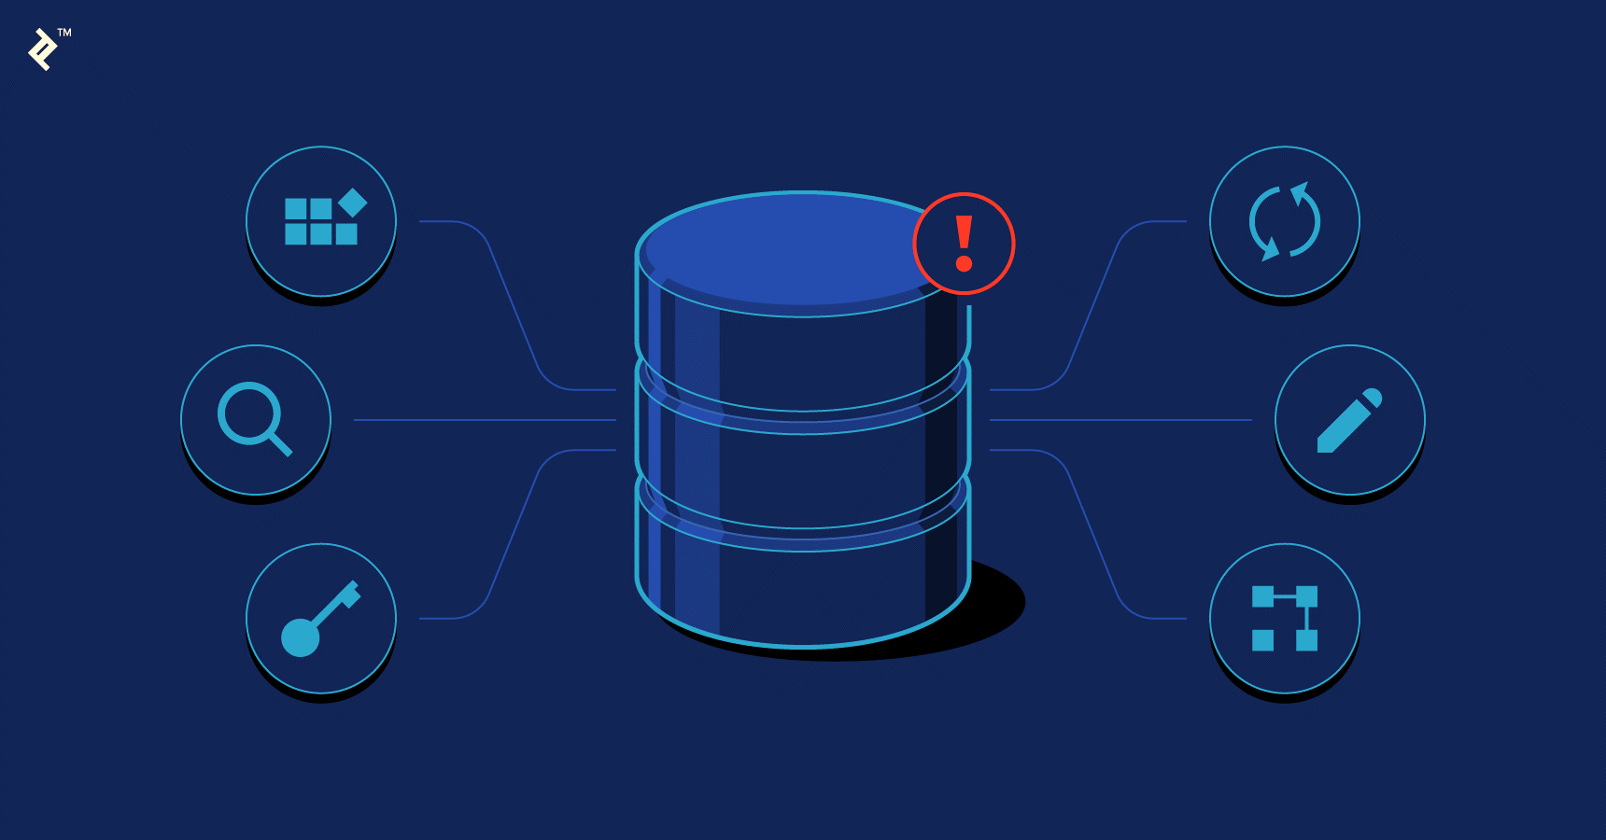
Chiraz GOUISSEM
Introduction to data base checkpoint

Slide 2
Introduction
SQL, or Structured Query Language, is the standard language for interacting with relational databases. With SQL, you can query, or ask questions of, the data in a relational database. Working with SQL and relational databases is an invaluable skill set for a data analyst, data engineer, or a data scientist.
If you have started looking for ways to learn SQL, you may have noticed the many different dialects of SQL available to learn with some clear (and less clear) distinctions between the different dialects. So where do you begin? Which version of SQL is most helpful to you if you haven’t used it before? In this article, we will focus on three of the most popular database management systems: PostgreSQL, MySQL and SQL Server

Slide 3

MySQL is a database management system . Its role is to store the data, in the form of tables, and to allow the manipulation of this data through the SQL query language.
It is one of the most widely used database management software in the world 3 , both by the general public (mainly web applications) and by professionals, in competition with Oracle , PostgreSQL and Microsoft SQL Server .
Its name comes from the first name of the daughter of co-creator Michael Widenius. SQL refers to the Structured Query Language , the query language used.

Slide 4

PostgreSQL is a relational and object database management system ( RDBMS ).
This RDBMS uses modern types of data, known as composed or enriched according to the terminologies used in the usual computer term. This means that PostgreSQL can store more data types than the traditional simple types integers, characters, etc. User can create types, functions, use type inheritance, etc.

Slide 5
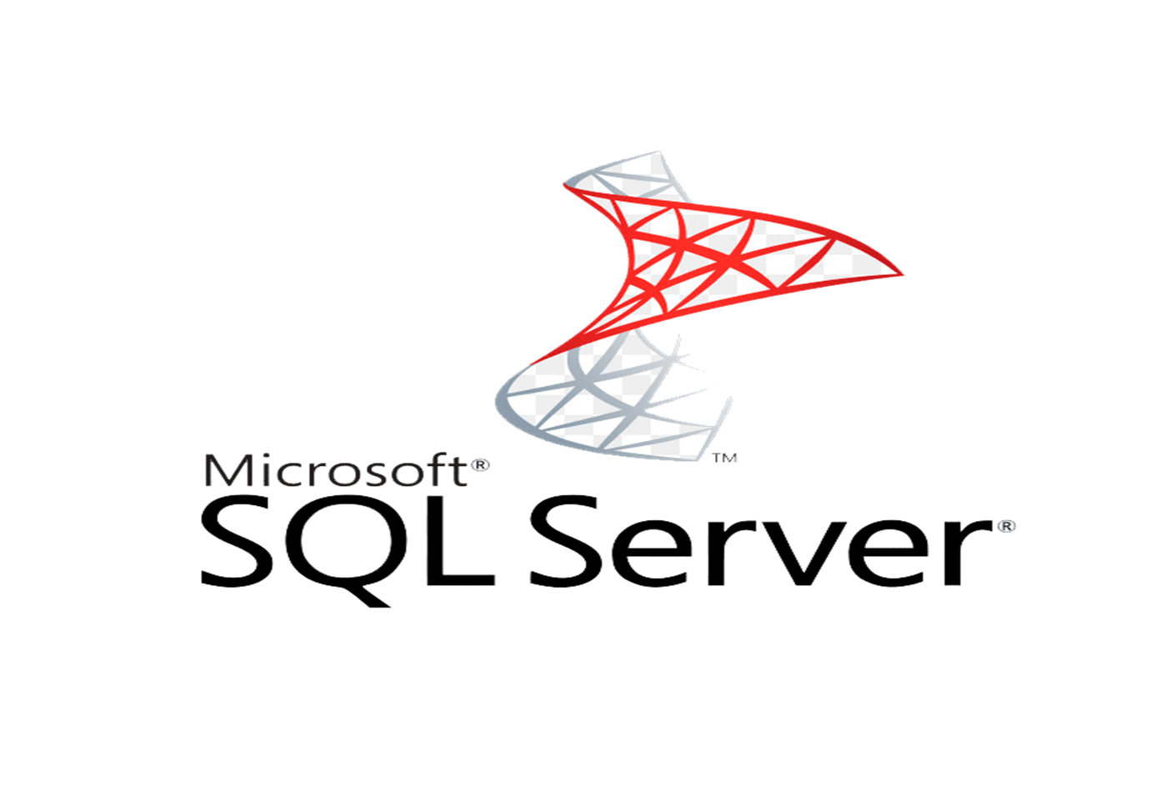
Microsoft SQL Server is a database management system (DBMS) in SQL language incorporating, among other things, an RDBMS ( relational DBMS ") developed and marketed by the Microsoft company.
SQL Server is distinguished by the fact that it is an RDBMS (Relational Database Management System) [ archive ] originally multibase and multi schema.

Slide 6
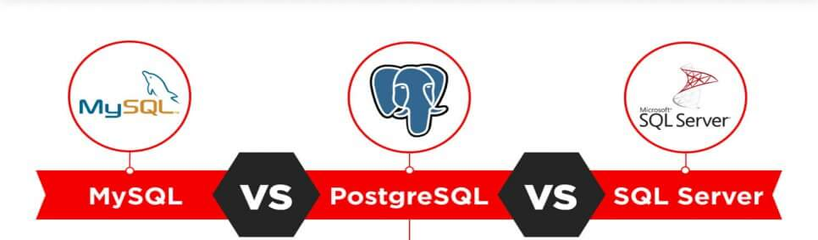
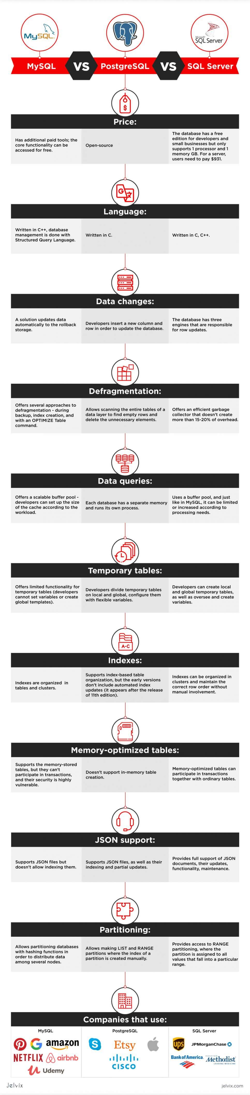

Slide 7
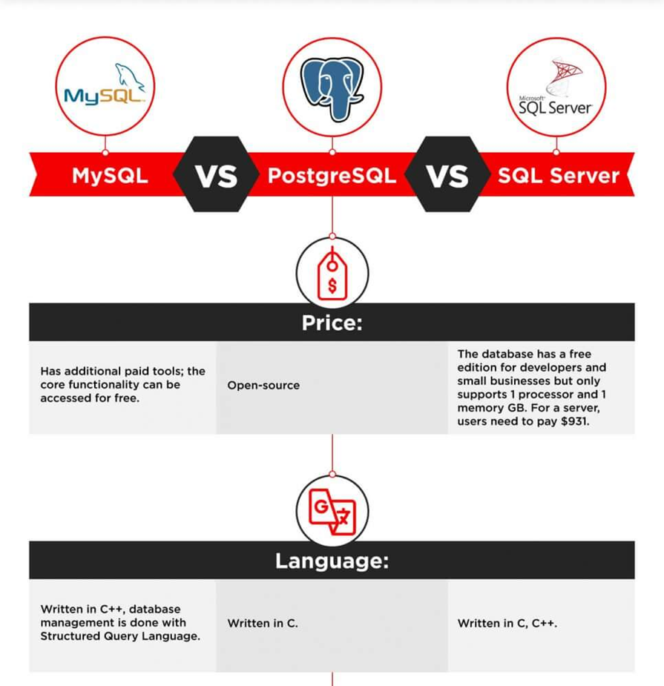

Slide 10
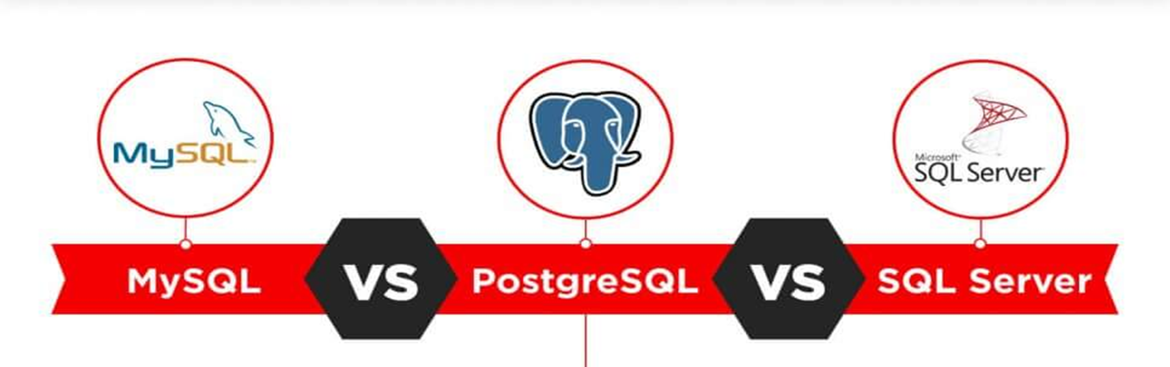

Slide 17
Conclusion
The choice between the three most popular databases ultimately boils down to the comparison of the functionality, use cases, and ecosystems. Companies that prioritize flexibility, cost-efficiency, and innovation usually choose open-source solutions. They can be integrated with multiple free add-ons, have active user communities, and are continuously updated.
For corporations that prefer traditional commercial solutions, software like SQL Server backed up by a big corporation and compatible with an extensive infrastructure, is a better bet. They have access to constant technical support, personalized assistance, and professional management tools.

