Slide 1


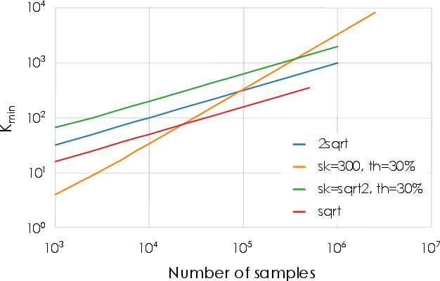
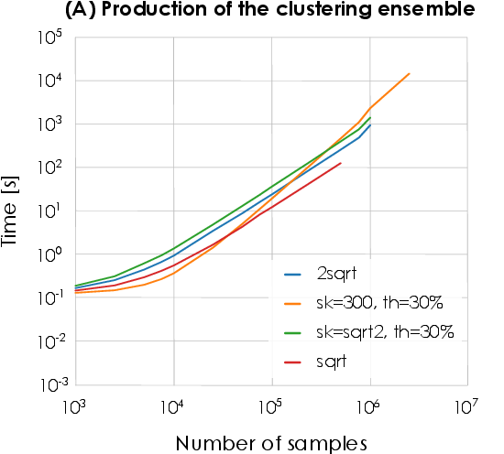
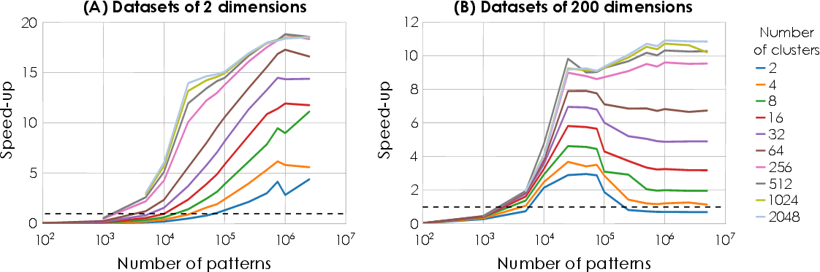
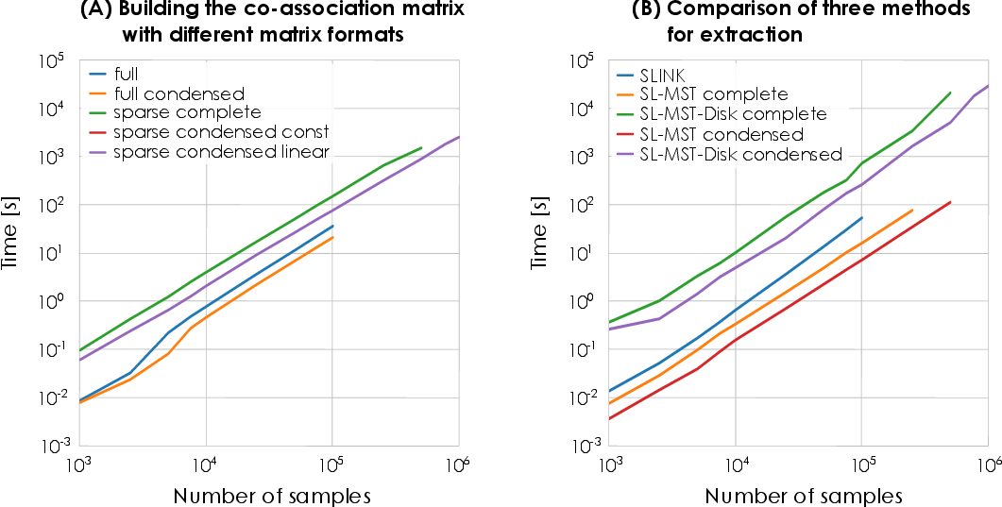
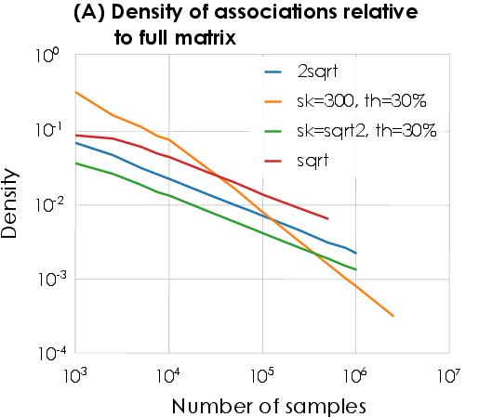
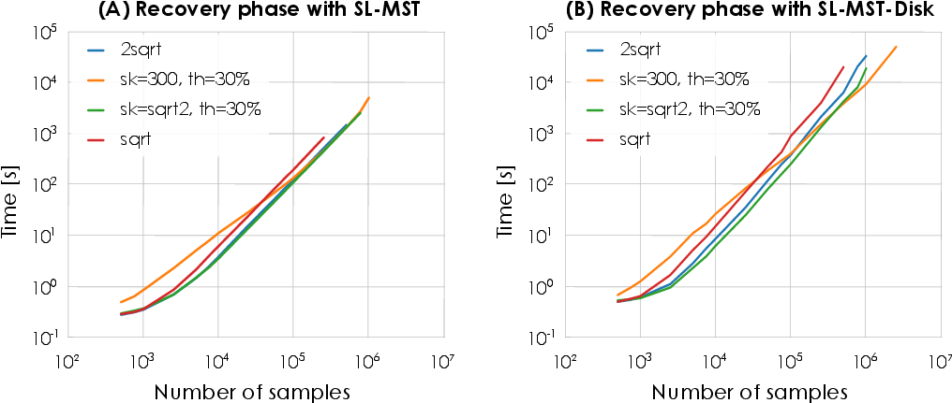
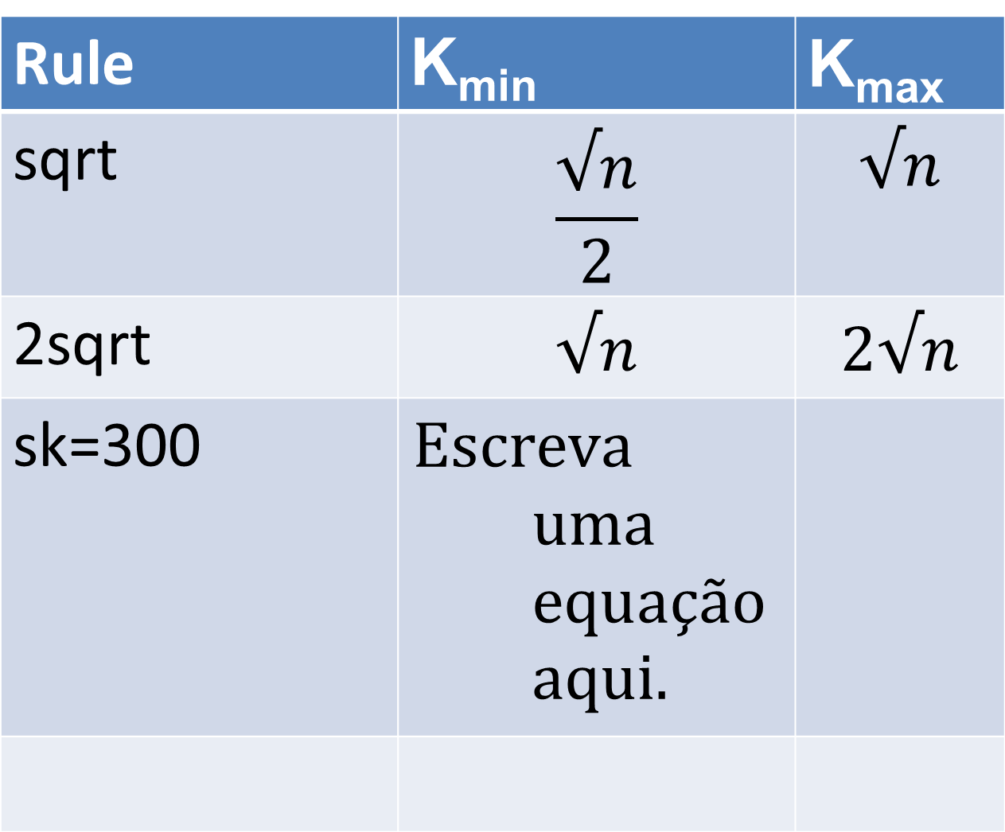
Efficient Evidence Accumulation Clustering
for large datasets
Diogo Silva¹, Helena Aidos² and Ana Fred²
¹Portuguese Air Force Academy, Sintra Portugal
²Instituto de Telecomunicações, Instituto Superior Técnico, Lisbon, Portugal
dasilva@academiafa.edu.pt, {haidos, afred}@lx.it.pt
Introduction
EAC is a robust ensemble method but its computational complexity restricts its use to small datasets.
We propose an optimized implementation of the different EAC steps for faster execution and decreased memory usage.
Validation and Speed-up
The clustering accuracy of the optimized version relative to the original on several small benchmark datasets is negligible, validating its use on large datasets.
Speed-up over the original version on small datasets varied between 6 and 200 on the different EAC phases.
Rules
Four rules for the minimum and maximum number of clusters of the ensemble were tested.
Rule | K_{min} | K_{max}
sqrt | $$\frac{√n}{2}$$ | $$√n$$
2sqrt | $$√n$$ | $$2√n$$
sk=300
Evolution of K_{min} with different rules
Dataset
Challenge
Fast generation of ensemble.
Production of ensemble
Partition 1
GPU K-Means speed-up
Partition P
Solution
Parallel GPU K-Means
Challenge
O(n²) space complexity
Combination of partitions
Co-association
matrix
Solution
CSR sparse matrix with optimized building
Recovery of final partition
Challenge
O(n²) space complexity
Conclusions
EAC is now applicable to a wider spectrum of datasets.
Speed-up from 6 to 200 compared to original implementation on the different phases.
Single-Link (SL)
Solution
MST based SL
MST disk-based SL

