Slide 1


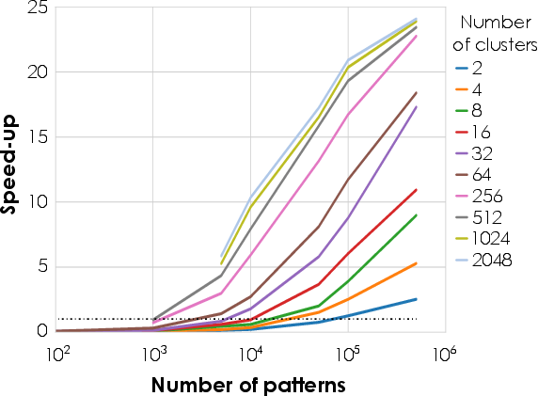
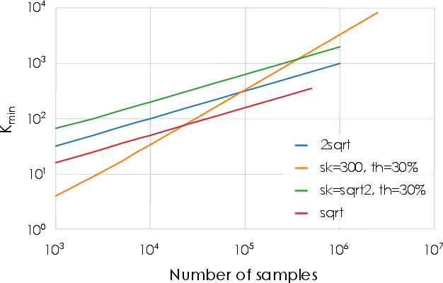
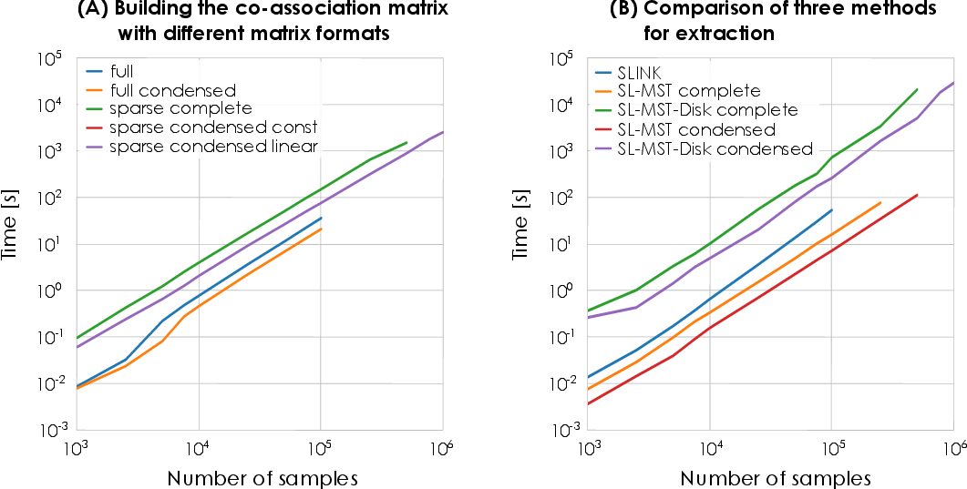
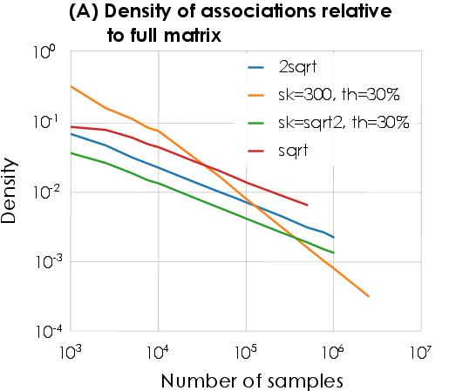
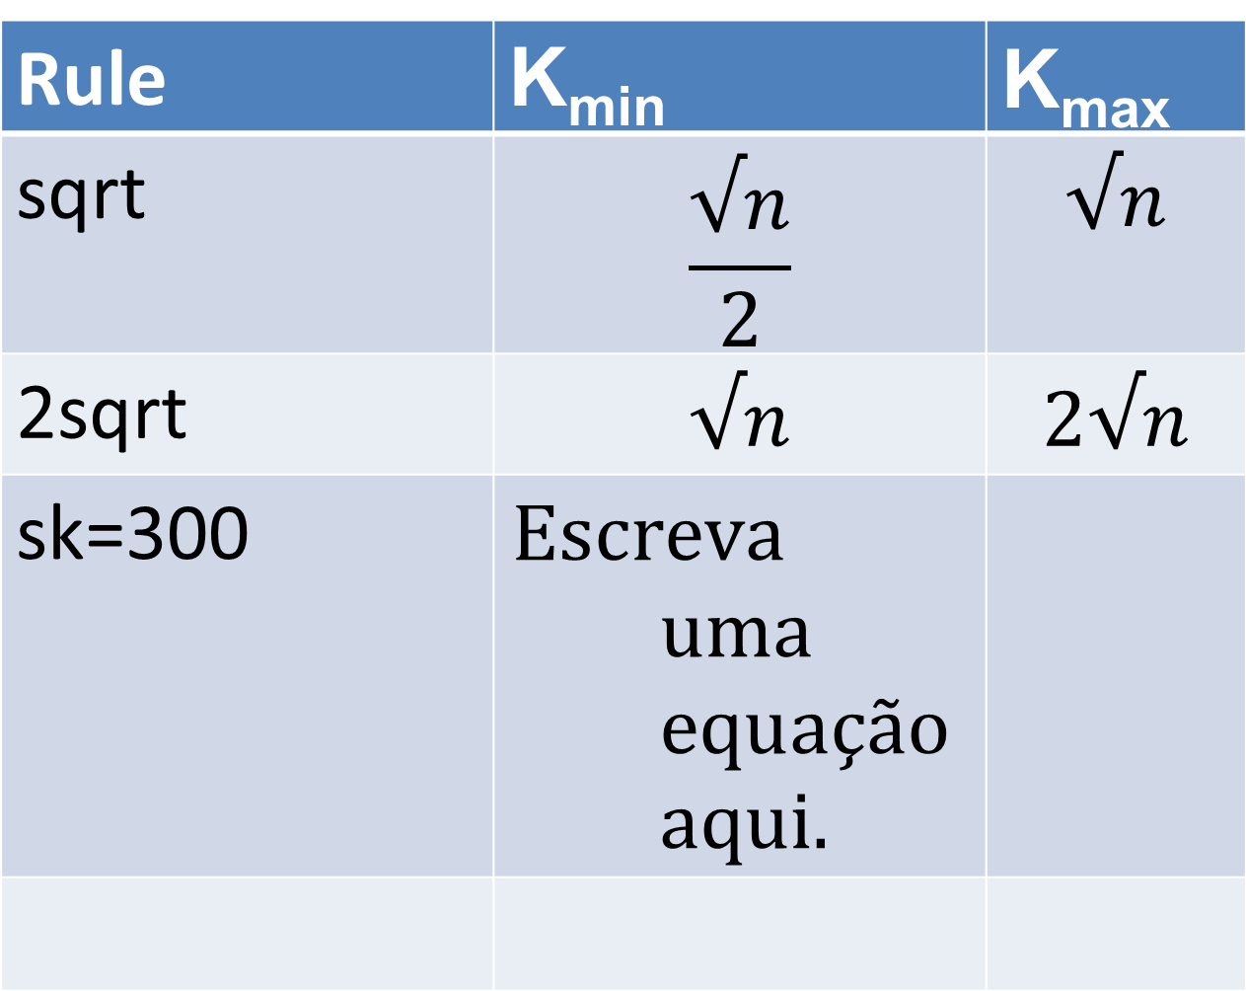
Efficient Evidence Accumulation Clustering
for large datasets
Diogo Silva¹, Helena Aidos² and Ana Fred²
¹Portuguese Air Force Academy, Sintra Portugal
²Instituto de Telecomunicações, Instituto Superior Técnico, Lisbon, Portugal
dasilva@academiafa.edu.pt, {haidos, afred}@lx.it.pt
Introduction
EAC is robust but its computational complexity restricts is use to small datasets.
We propose an optimized implementation of the different EAC steps for faster execution and decreased memory usage.
Validation and Speed-up
The clustering accuracy of the optimized version relative to the original on several small benchmark datasets is negligible.
Speed-up over the original version on small datasets varied between 6 and 200 on the different EAC phases.
Rules
Four rules for the minimum and maximum number of clusters of the ensemble:
Name K_{min} K_{max}
Rule | K_{min} | K_{max}
sqrt | $$\frac{√n}{2}$$ | $$√n$$
2sqrt | $$√n$$ | $$2√n$$
sk=300
Dataset
Challenge
Fast generation of ensemble.
Production of ensemble
Partition 1
Partition P
Solution
Parallel GPU K-Means
Combination of partitions
Challenge
O(n²) space complexity
Co-association
matrix
Solution
CSR sparse matrix with optimized building
Recovery of final partition
Challenge
O(n²) space complexity
Conclusions
EAC is now applicable to a wider spectrum of datasets.
Speed-up from 6 to 200 compared to original implementation on the different phases.
Single-Link
Solution
MST based SL
MST disk-based SL

