Slide 1



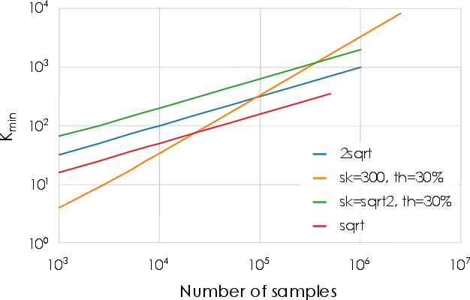
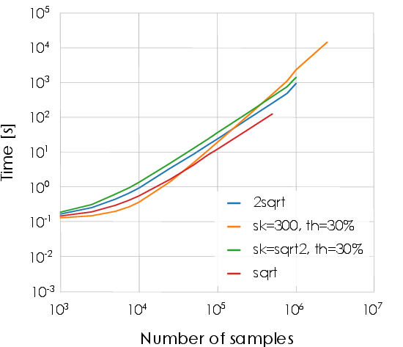
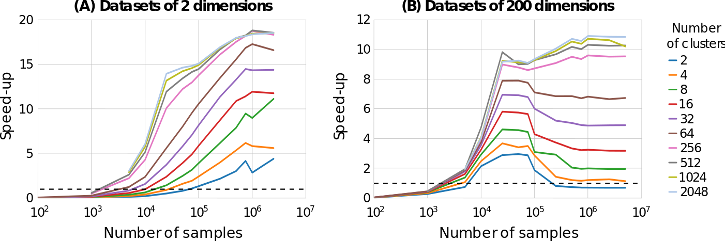
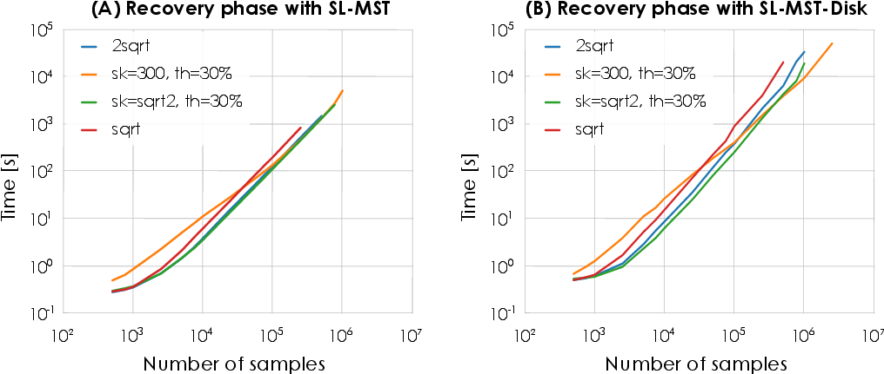
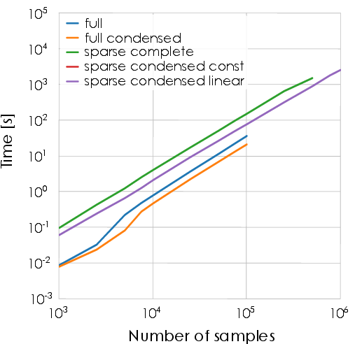
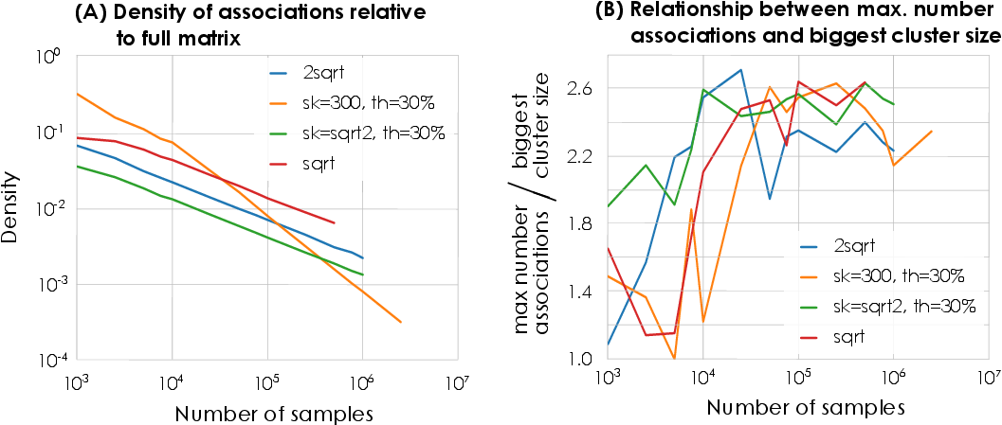
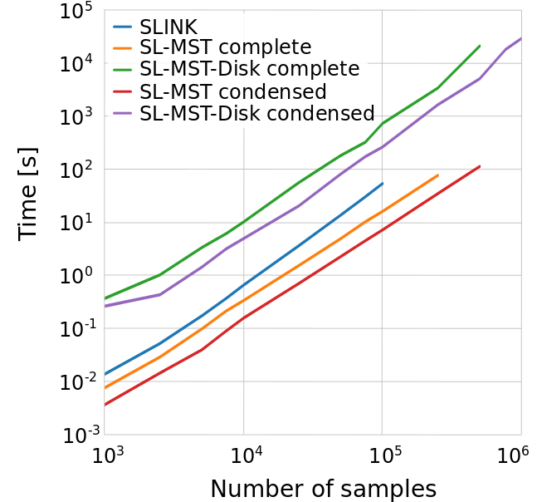
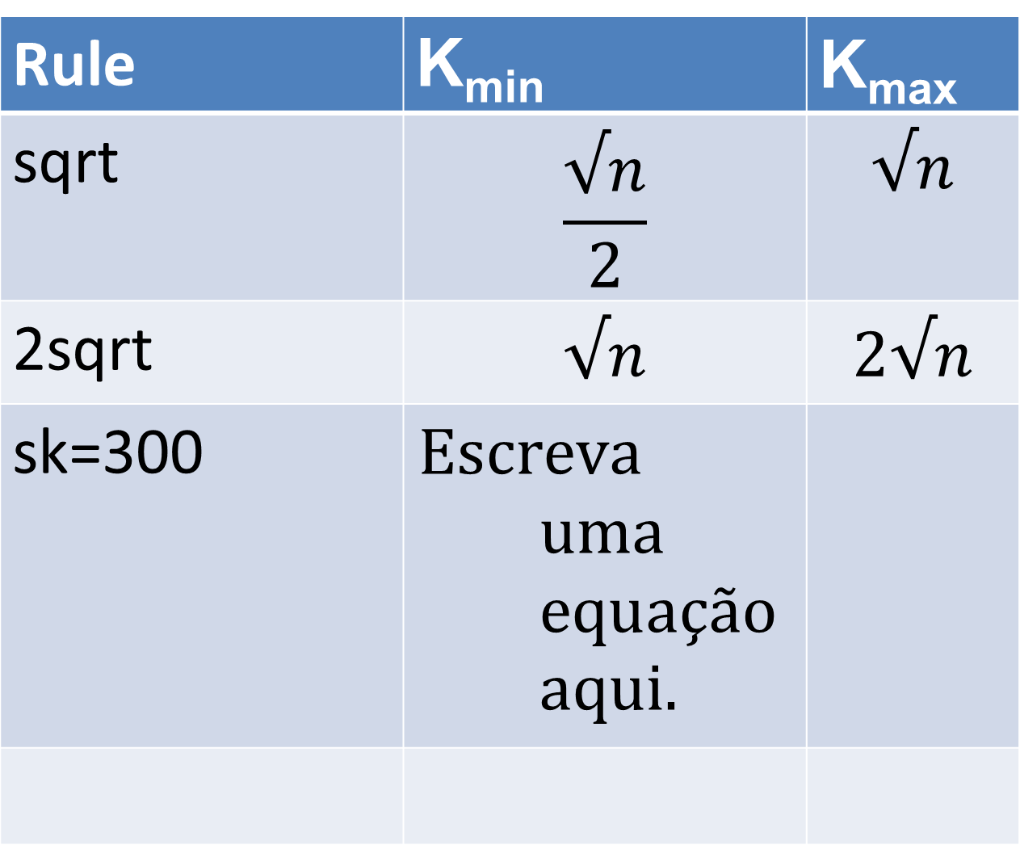
Efficient Evidence Accumulation Clustering
for large datasets
Diogo Silva¹, Helena Aidos² and Ana Fred²
¹Portuguese Air Force Academy, Sintra, Portugal
²Instituto de Telecomunicações, Instituto Superior Técnico, Lisbon, Portugal
dasilva@academiafa.edu.pt, {haidos, afred}@lx.it.pt
Introduction
Evidence Accumulation Clustering (EAC) is a robust ensemble method but its computational complexity restricts its use to small datasets.
We propose an optimized implementation of the different EAC steps for faster execution and decreased memory usage.
Validation and Speed-up
The clustering accuracy of the optimized version relative to the original on several small benchmark datasets is negligible, validating its use on large datasets.
Speed-up over the original version on small datasets varied between 6 and 200 on the different EAC phases.
Rules for ensemble
The rules for the minimum and maximum number of clusters of the ensemble have a big impact on performance and memory usage. Four rules were tested.
Rule | K_{min} | K_{max}
sqrt | $$\frac{√n}{2}$$ | $$√n$$
2sqrt | $$√n$$ | $$2√n$$
sk=300
Evolution of K_{min} with different rules
Dataset
Challenge
Fast generation of ensemble.
Production of ensemble
Partition 1
Production of the ensemble
GPU K-Means speed-up
Random datasets.
We used a 2-dimensional mixture of 6 Gaussians for most tests.
Partition P
Solution
Parallel GPU K-Means
Challenge
O(n²) space complexity
Combination of partitions
Total time
Building with different matrix formats
Density of associations relative to the full square matrix
Co-association
matrix
Upper triangular matrices are referred to as condensed.
Solution
CSR sparse matrix with optimized building
Recovery of final partition
Challenge
O(n²) space complexity
Comparison of three methods for extraction
Conclusions
EAC is now applicable to a wider spectrum of datasets – we clustered datasets of up to 10 times bigger what was before possible and the implementation supports bigger.
Speed-up from 6 to 200 compared to original implementation on the different phases for small datasets.
Better understanding of how ensemble rules affect the performance of the overall algorithm.
Single-Link (SL)
SLINK is a fast implementation of SL that works over non-sparse matrices.
Solution
MST based SL
MST disk-based SL

