Slide 1




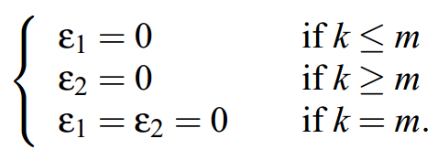
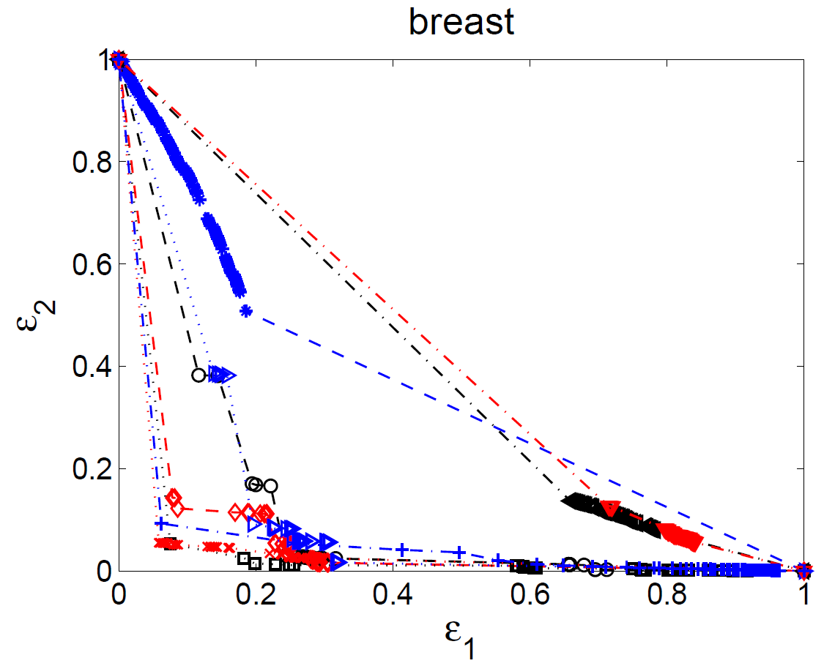
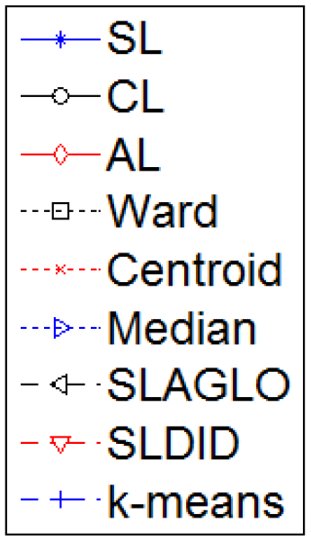
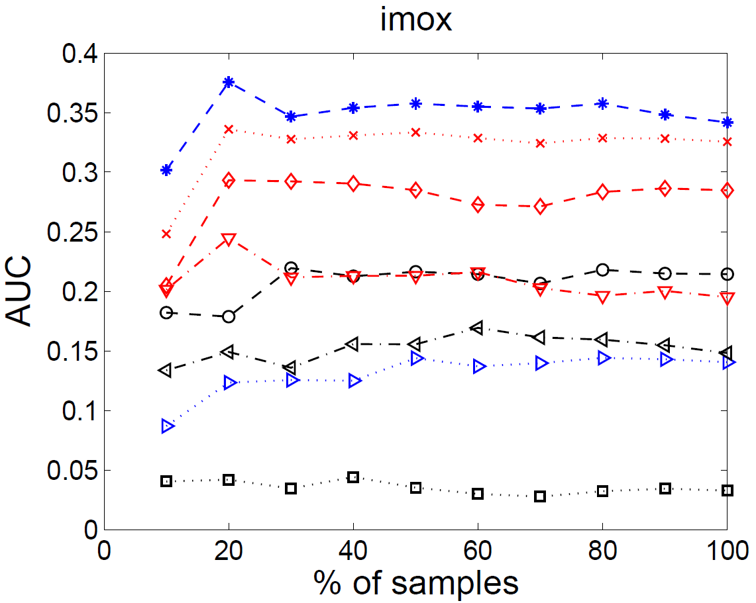
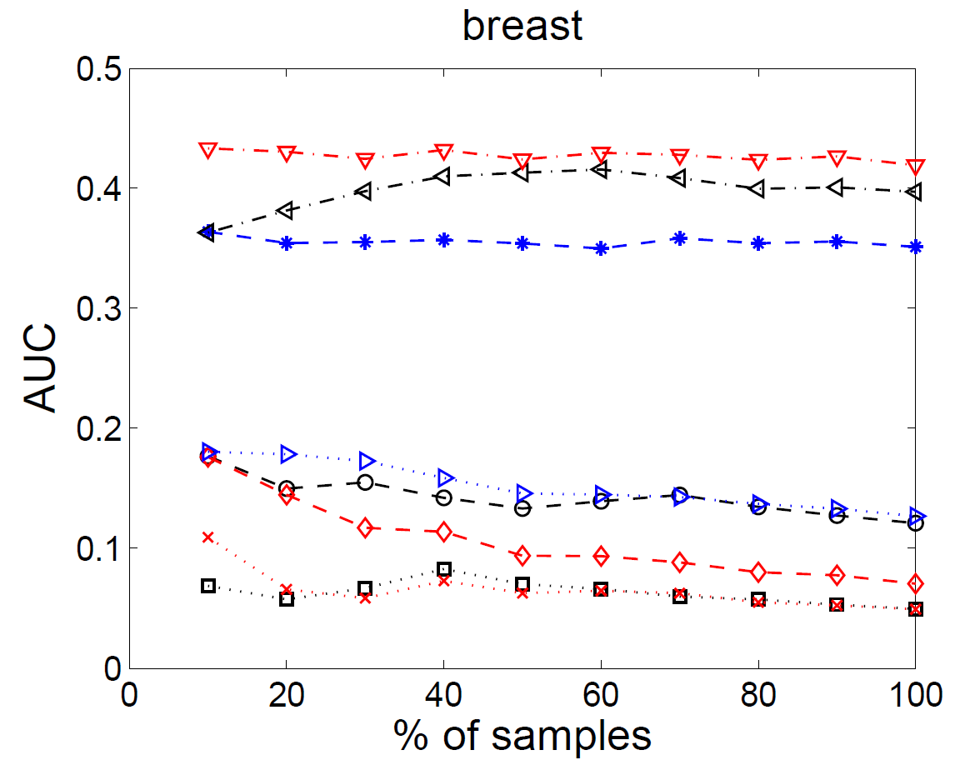
The Area under the ROC Curve as a Criterion
for Clustering Evaluation
Helena Aidos¹, Robert P. W. Duin² and Ana Fred¹
¹Instituto de Telecomunicações, Instituto Superior Técnico, Lisbon, Portugal
²Pattern Recognition Laboratory, Delft University of Technology, The Netherlands
{haidos, afred}@lx.it.pt , r.duin@ieee.org
based on the data only, such as the average intra-cluster distance
Internal criteria
e.g., Silhouette Index, Davies-Bouldin Index, Dunn Index
Advantages/disadvantages:
Do not need to have the true class label.
Biased towards one clustering algorithm.
ROC curve and AUC
(to study the robustness of clustering algorithms for several number of clusters, k)
Consider two given points x_{a}, x_{b}.
Type I error:
Type II error:
A clustering partition C is concordant with the true labeling, P, of the data if
A ROC curve is proper if, when varying k, ԑ₁ increases whenever ԑ₂ decreases and vice-versa.
Evaluate Robustness: A clustering algorithm is more robust to the choice of k than another algorithm if the former’s AUC is smaller than the latter’s.
Validation Criteria for Clustering
Designed for a fixed number of clusters
External criteria
e.g., Rand Statistics, Jaccard Coefficient, Fowlkes and Mallows Index
Advantages/disadvantages:
Need to have the true class label for each object.
AUC
SL | 0.351
CL | 0.121
AL | 0.070
Ward | 0.049
Centroid | 0.049
Median | 0.127
SLAGLO | 0.397
SLDID | 0.419
K-means | 0.064
ROC curve and AUC when we have access to all labeling information
Conclusions
In the literature, external and internal criteria are designed to evaluate clustering algorithms for a fixed number of clusters.
The proposed measure quantifies the performance of an algorithm for several k simultaneously.
This allows measuring how robust a clustering algorithm is to the choice of k.
In the semi-supervised context, the whole dataset is used to perform clustering, whereas the AUC is computed with only a part of the data.
The measure proposed can be used to automatically detect whether the currently labeled data is already enough.
Allow us to extrapolate classes from the labeled data to the unlabeled data, if one can find a clustering algorithm which yields low and consistent AUC value for the labeled portion.
Semi-supervised Context
We might have only labels for a small part of the entire dataset.
This work was supported by the Portuguese Foundation for Science and Technology, grant PTDC/EIA-CCO/103230/2008.

