Slide 1


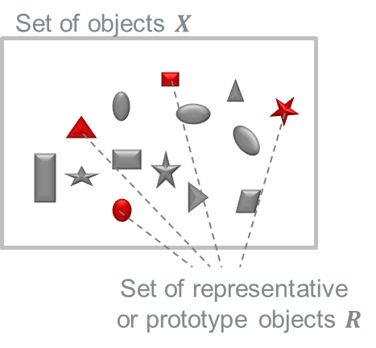
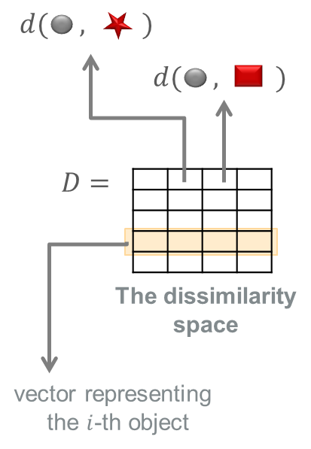
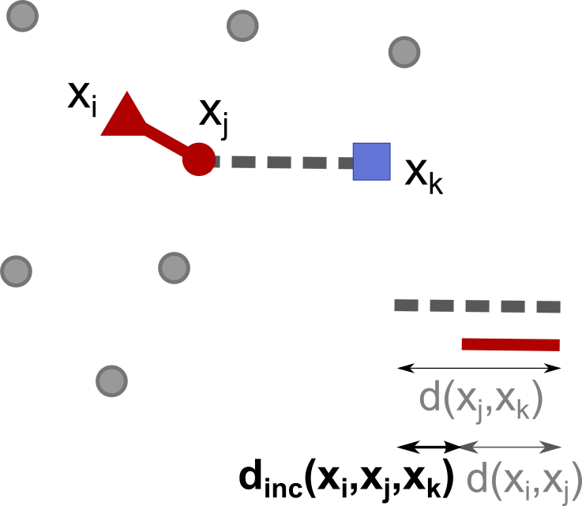
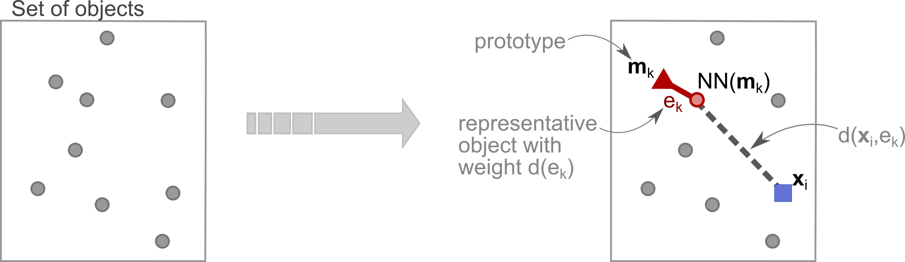
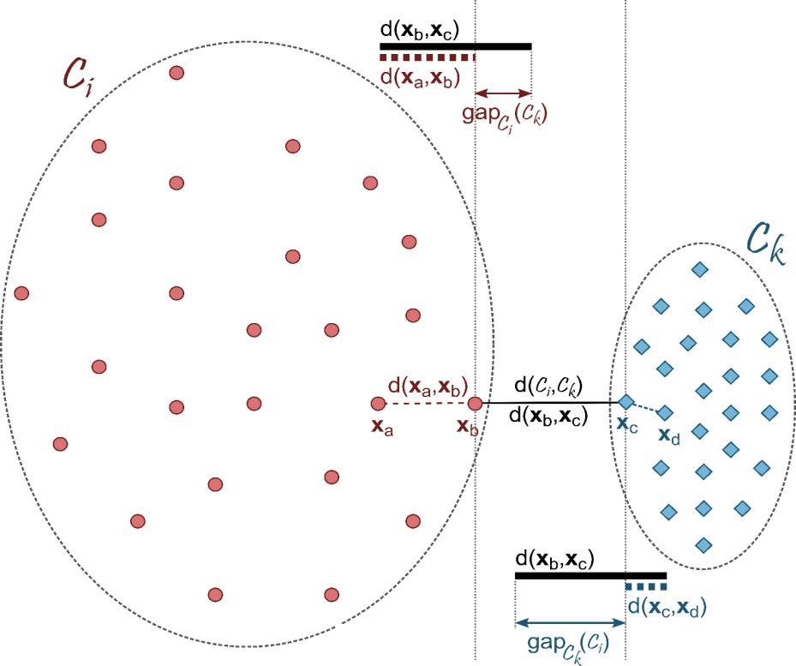
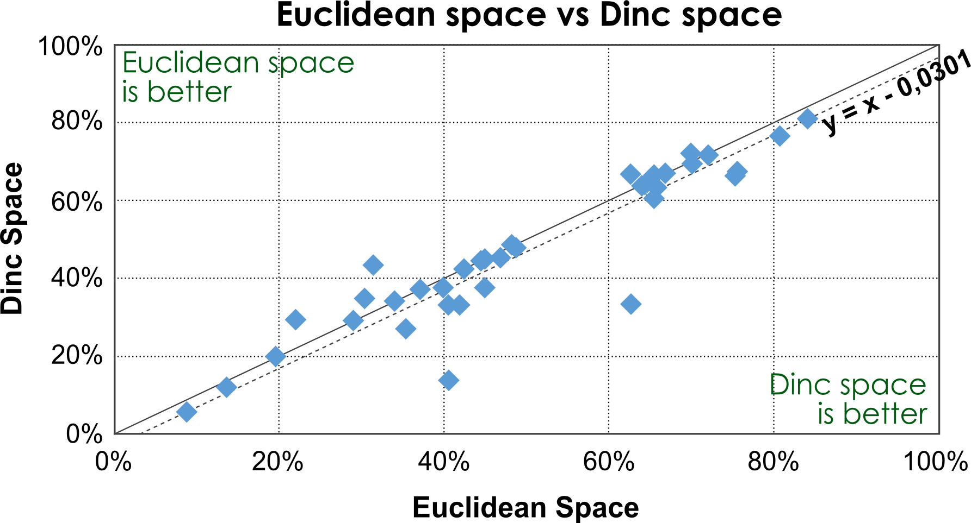
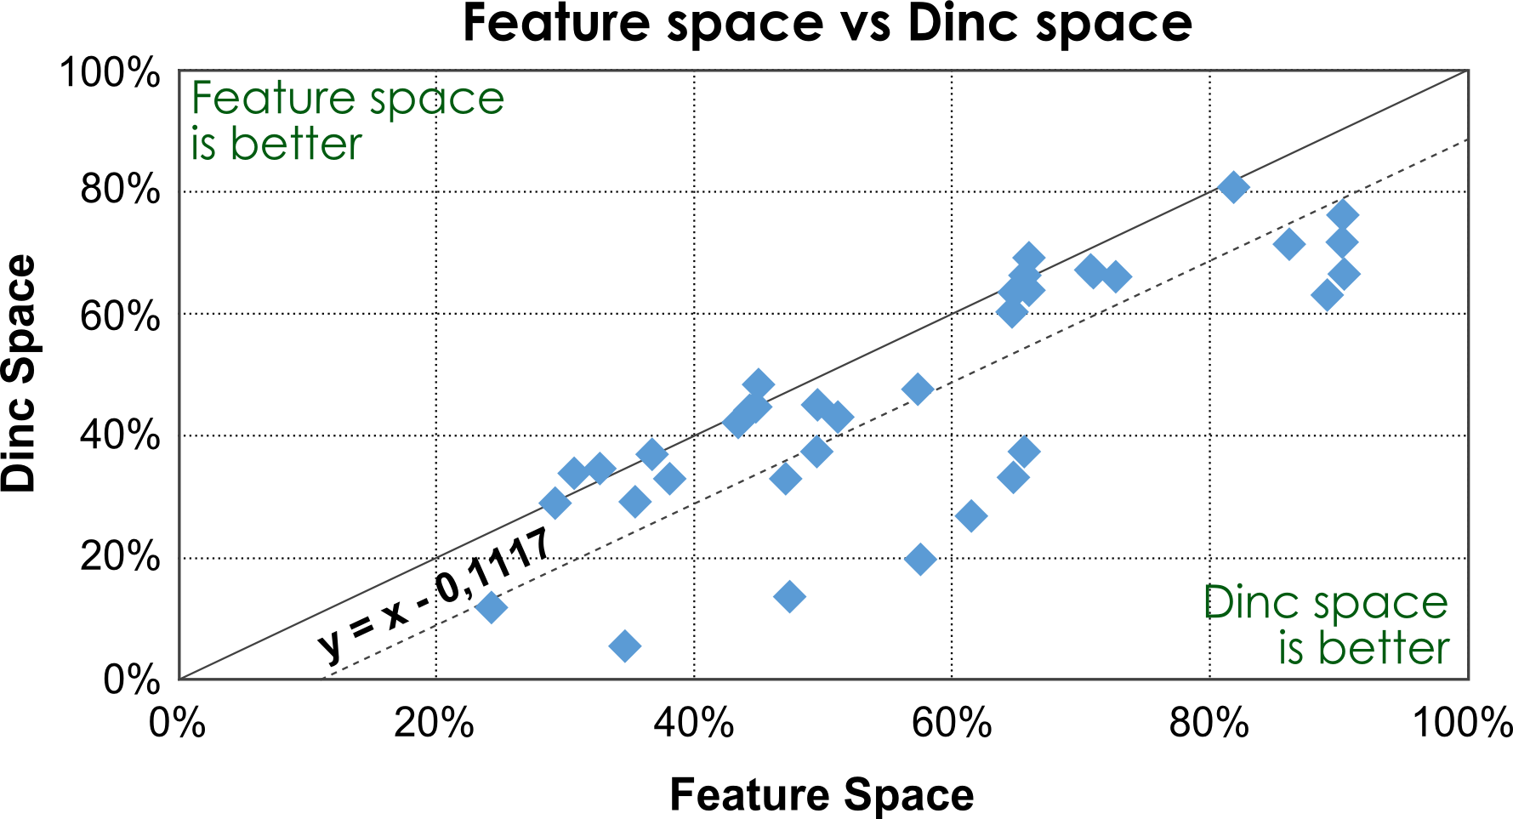
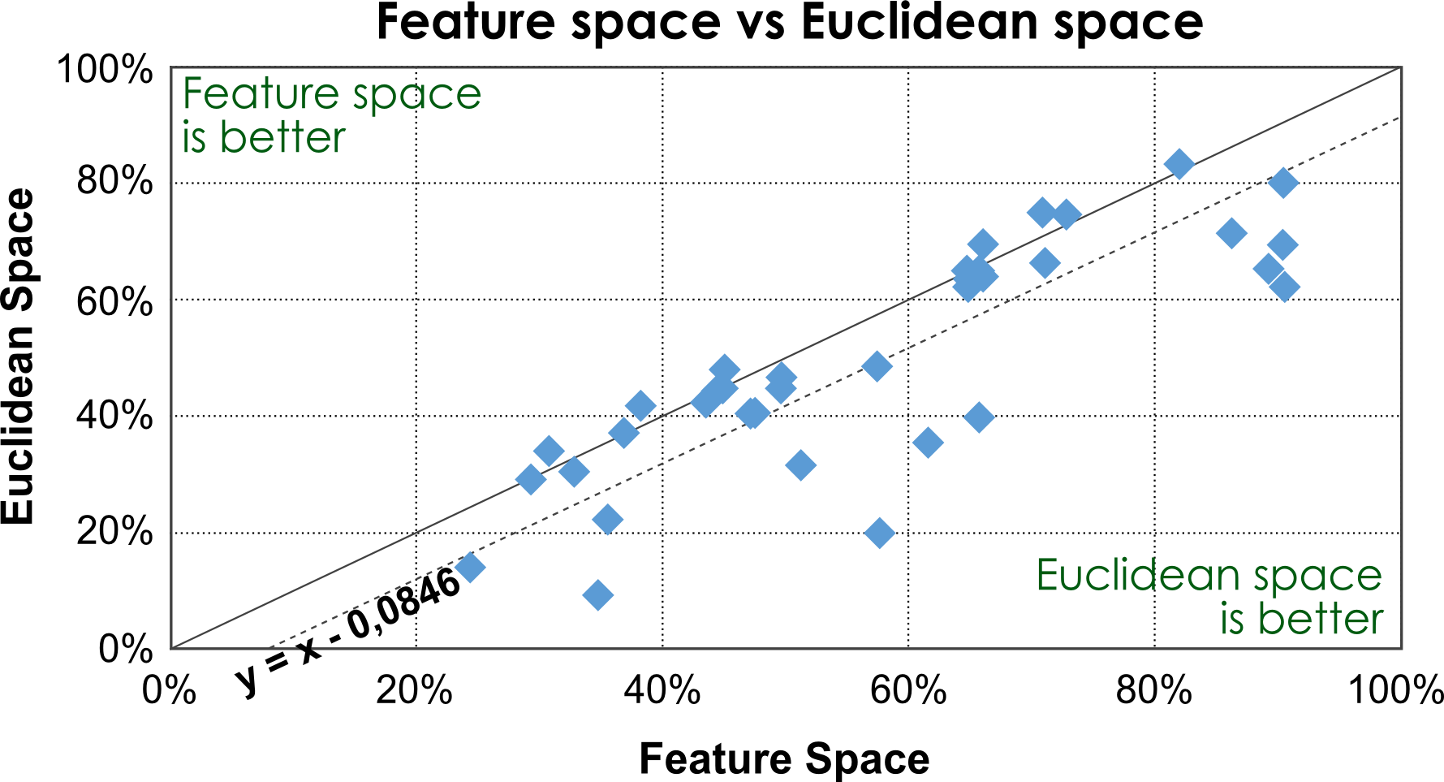

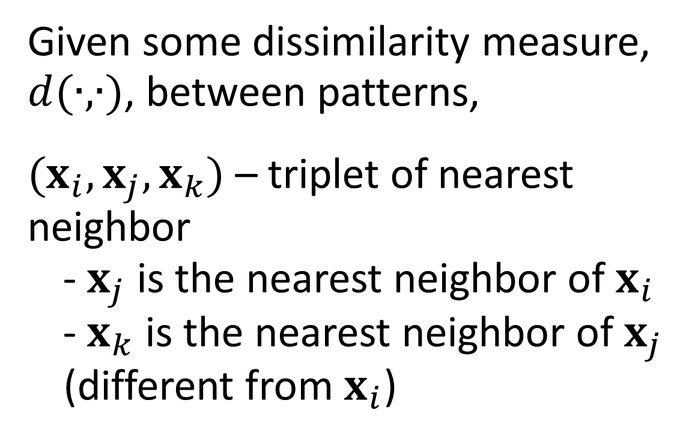
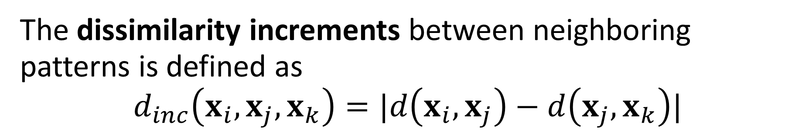

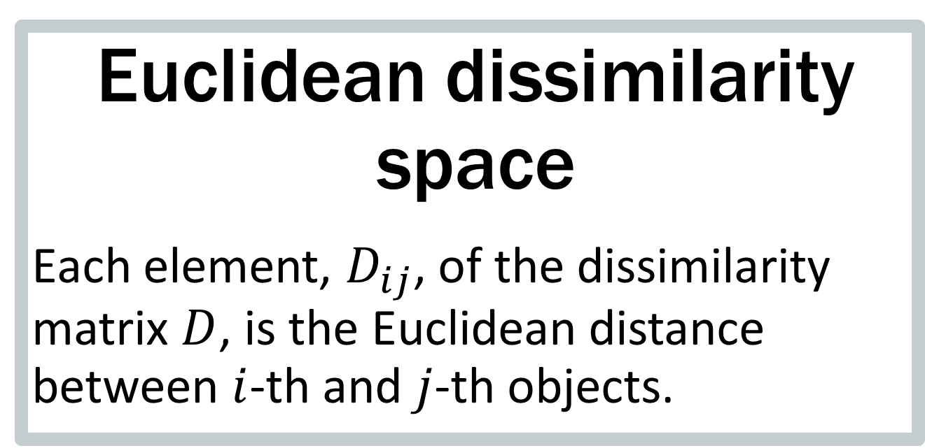

A Novel Data Representation based on
Dissimilarity Increments
Helena Aidos and Ana Fred
Instituto de Telecomunicações
Instituto Superior Técnico, Universidade de Lisboa, Portugal
{haidos, afred}@lx.it.pt
Motivation
Typically, objects are represented by a set of features, which should characterize the objects and be relevant to discriminate among the classes.
Problem: difficult to obtain a complete description of objects:
forces an overlap of the classes
leads to an inefficient learning process.
Solution: Use a dissimilarity representation, which is based on comparisons between pairs of objects:
Solves the problem of class overlap, since only identical objects have a dissimilarity of zero.
Dissimilarity representation
$X=\{x_{1},…,x_{n}\}$ set of objects
$R=\{e_{1},…, e_{r}\}$ set of representative or prototype objects, such that $R⊆X$
Each object $x_{i}$ is described by a $r$-dimensional dissimilarity vector
$$D\left(x_{i},R\right)=[d\left(x_{i},e_{1}\right)…d(x_{i},e_{r})]$$
where $d(∙,∙)$ is a dissimilarity measure
$D(x_{i},R)$ is a row of the $n×r$ dissimilarity matrix $D$, the dissimilarity space
Define a vector space $Y$ by $Y=D$, where the $i$-th object is represented by the dissimilarity vector of the $D_{ij}$ values.
PROPOSAL: A novel dissimilarity representation of data, based on a second-order dissimilarity measure.
Second-order dissimilarity measure:
the dissimilarity increments
Dissimilarity increments space
$R=\{e_{1},…, e_{r}\}$ set of prototype objects, with $e_{j}$ an edge between a prototype $m_{j}$ and its nearest neighbor $x_{m_{j}}=NN(m_{j})$
$d\left(e_{j}\right)=d\left(m_{j},x_{m_{j}}\right)$ weight of edge $e_{j}$
Distance between any object $x_{i}$ and the representative object $e_{j}$ is
$$d\left(x_{i},e_{j}\right)=\min_{}\left\{d\left(x_{i},m_{j}\right),d\left(x_{i},x_{m_{j}}\right)\right\}$$
The $(i,j)$-th element of the Dinc space is defined as
$$D\left(x_{i},e_{j}\right)=|d\left(x_{i},e_{j}\right)−d\left(e_{j}\right)|$$
Given some dissimilarity measure, $d(∙,∙)$, between patterns,
$(x_{i},x_{j}, x_{k})$ – triplet of nearest neighbor
- $x_{j}$ is the nearest neighbor of $x_{i}$
- $x_{k}$ is the nearest neighbor of $x_{j}$ (different from $x_{i}$)
The dissimilarity increments between neighboring patterns is defined as
$$d_{inc}\left(x_{i},x_{j},x_{k}\right)=|d\left(x_{i},x_{j}\right)−d\left(x_{j},x_{k}\right)|$$
Characterization
Dissimilarity spaces have higher discriminant power of features in separating the classes.
Dissimilarity spaces have less overlap between the classes, which may facilitate the learner to separate the samples of different classes.
Even if the classes are more separable, they are nonlinearly separable by 1-NN classifier.
Assume that $R=X$, meaning that all objects of $X$ are used as prototypes.
Experimental
results
8 datasets for Euclidean space
Best on average 4.0% than Dinc space
18 datasets for Dinc space
Best on average 7.1% than Euclidean space
Euclidean dissimilarity space
Each element, $D_{ij}$, of the dissimilarity matrix $D$, is the Euclidean distance between $i$-th and $j$-th objects.
Datasets: 36 real-world datasets from the UCI
Machine Learning repository
Evaluation: Error rates of median-link, when
the true number of clusters is known
28 datasets for Dinc space
Best on average 13.6% than Feature space
6 datasets for Feature space
Best on average 2.2% than Dinc space
25 datasets for Euclidean space
Best on average 11.8% than Feature space
9 datasets for Feature space
Best on average 2.6% than Euclidean space
This work was supported by the Portuguese Foundation for Science and Technology scholarship number SFRH/BPD/103127/2014, and grant PTDC/EEI-SII/2312/2012.

