Slide 1
Dynamic programing 2
Lê Hoài Thương - 21520474
Nguyễn Hoàng Hải - 21522034

Slide 2
Remind of dynamic programing
1
Definication of dynamic programing

Slide 3
Dynamic programming is defined as a computer programming technique where an algorithmic problem is first broken down into sub-problems, the results are saved, and then the sub-problems are optimized to find the overall solution

Slide 4
Question
Which problems can be solved using dynamic programming?

Slide 5

A problem that have these condition
Optimal substructure
The optimal solution can be derived from the optimal solutions of its subproblems.
Overlapping subproblems
Subproblems’ solution are used multiple times.
Is it necessary to have both 2 conditions for a problem to be solvable using DP?

Slide 6
Dynamic programing on tree
2

Slide 7
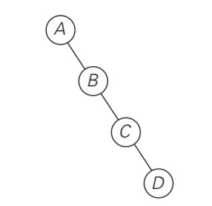
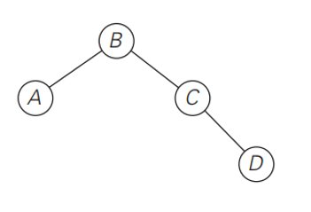
Vertex cover problem
You are given an unweighted, undirected tree. Write a program to find a vertex set of minimum size in this tree such that each edge has as least one of its end-points in that set.

Slide 8
INPUT
The first line of the input file contains one integer N - number of nodes in the tree (0 < N <= 100000). Next N-1 lines contain N-1 edges of that tree - Each line contains a pair (u, v) means there is an edge between node u and node v (1 <= u,v <= N).
OUTPUT
Print number of nodes in the satisfied vertex set on one line.

Slide 9
Dynamic programing approach
F[i][0 or 1] is a minimum size of satisfied vertex set when it comes to the subtree with root node i. (0: node i is not in vertex set, otherwise, 1):
F[i][0] = ΣF[j][1] (j is a child node of i)
F[i][1] = Σmin(F[j][0], F[j][1])

Slide 10
Pseudo code
Def dfs(i):
For j in child_node_list[i]:
Dfs(j)
F[i][0] = ΣF[j][1]
F[i][1] = Σmin(F[j][1], F[j][0])
Result: min(F[root][0], F[root][1])

Slide 11
Question
Does this problem have both mentioned conditions?

Slide 12
Dynamic programing with bitmask
3

Slide 13






Job assignment problem
There are N people and N tasks. $Cost[i][j]$denotes how much a person $i$ will be receive doing job$j$.
Assign each task to a person with minimum total cost.
$Cost[i][j$]
$i−th$ person
$j−th$ task

Slide 14
Naive approach for job assignment problem
Find all possible ways to assign jobs.
Question:
What is the complexity of this algorithm?
Is there any way to solve this problem?
How to decrease the complexity?
Notes:
Answer: N! Hungarian algorithm . If student answer that dp can be used for this problem, ask them why

Slide 15
Question
Can this problem be solved using dynamic programing?

Slide 16

Dynamic programing approach for job assignment problem
dp[mask][n] : Lowest cost to assign first n people to n tasks ,with mask is the state assigned/not assigned of tasks.
Ex: dp[11000][2] : lowest cost to assign first 2 peoples with task 0 and task 1.
1
1
0
0
0
Notes:
Answer: N! Hungarian algorithm . If student answer that dp can be used for this problem, ask them why

Slide 17
Dynamic programing approach for job assignment problem
assign(N, cost):
for i = 0 to power(2,N)
dp[i] = INFINITY
dp[0] = 0
for mask = 0 to power(2, N)
x = count_set_bits(mask)
for j = 0 to N
if jth bit is not set in i
dp[mask|(1<<j)] = min(dp[mask|(1<<j)], dp[mask]+cost[x][j])
return dp[power(2,N)-1]
Notes:
Answer: N! Hungarian algorithm . If student answer that dp can be used for this problem, ask them why

Slide 18
Advanced dp techinique
2
Let’s start with the first set of slides

Slide 19
Advance dp technique
Convex Hull trick
Knuth’s Optimization Problems
Connected-Component Dp
DP on Broken Profiles
X 2, + 1 trick
Open close interval trick
Change the object to dp
Notes:
Answer: N! Hungarian algorithm . If student answer that dp can be used for this problem, ask them why

Slide 20
Disscusion
4

Slide 21
Question
What is the different between greedy and dp?

Slide 22
Homework
Chỉ ra đâu là optimal substructure và overlapping subproblems trong 3 bài toán mà nhóm đăng trên wecode.

Slide 23
Thanks!
ANY QUESTIONS?

