Slide 1


Parallel implementation of a Memcached system using CUDA architecture
University „Politehnica” of Bucharest
Faculty of Electronics, Telecommunications and Information Technology
Thesis advisor
S.L. Dr. Ing. George Valentin STOICA
Student
Ionuț Alexandru CUȚA

Slide 2
Summary
Thesis objectives
Previous attempts
Short overview of theoretical concepts
Initial concept
Implementation
Test & results
Conclusion

Slide 3
Thesis objectives
Acceleration of server-side operations required by a Memcached system using CUDA interface
Performance analysis

Slide 4
Previous attempts
MICA: lower latency and higher throughput using CPU multithreading
Over 4x faster compared to base implementation
LegUP (Xilinx): cloud-hosted FPGAs
10x better throughput / cost
GPU attempts:
Same FPGA throughput with 80% increase in energy efficiency

Slide 5
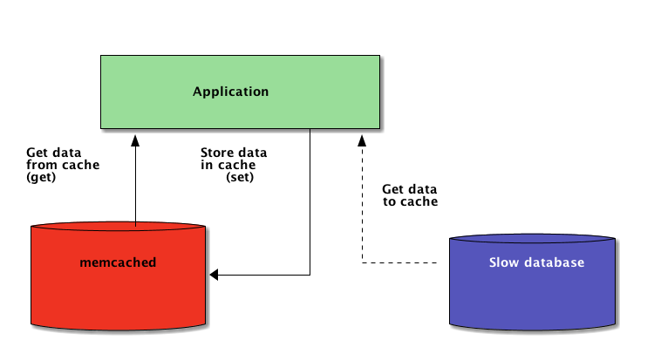
Short overview of theoretical concepts
Memcached system overview and commands
Main database is used to store all data
Memcached is used as a middle layer
Commands: GET, SET, DELETE
Data: pairs of key-value

Slide 6
Short overview of theoretical concepts
Slab memory
used to store the cache data items
Hash table
works as an index table
used for quickly locating the data
LRU Cache
performs maintenance operations
Memcached server architecture

Slide 7
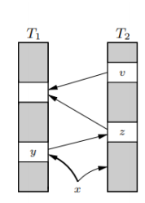
Short overview of theoretical concepts
Hash table: associative array that uses hash functions to map keys to values
Example: hash(“abc”) -> 15 – index value
Cuckoo hashing
uses N tables and N hash functions
each key can be assigned to N different buckets
Parallel Cuckoo hash table

Slide 8
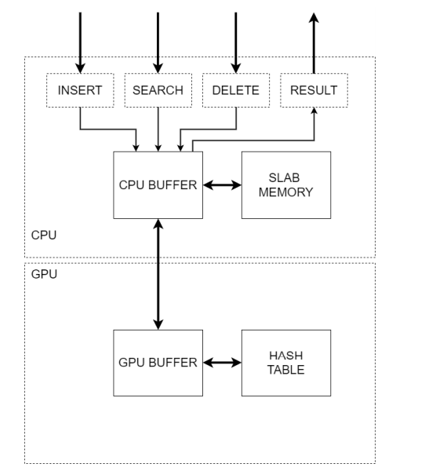
Initial concept
SET (insert) on CPU side:
Data is written to the slab memory
“location” descriptors are computed and written to the CPU buffer
Hash values are computed based on the keys
SET (insert) on GPU side:
An empty bucket is found for each element
“location” is written along with an identifier

Slide 9
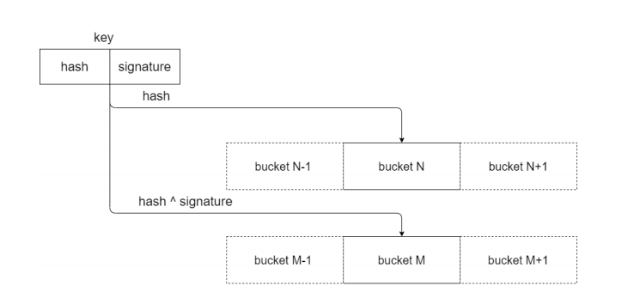
Implementation
30-bit address -> 1GB total data
formatted using a bucket structure -> 16 million buckets
Hash table design
int first_hash = (key->hash) & HASH_TABLE_MASK;
bucket_t *bucket = &(hash_map[first_hash]);

Slide 10
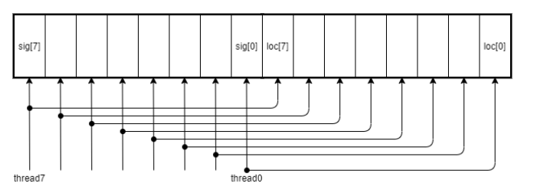
Implementation
bucket can hold 8 entries
a group of 8 threads is assigned for accessing a bucket
signatures are used to identify the “location” value
Bucket access
int warp_state = __ballot_sync(
ballot_mask,
bucket->signature[bucket_offset] == 0
);

Slide 11
Implementation
Items are processed in parallel per batch
Search: maximum 32k items
Insert: maximum 512 items
GET = 99.8% of all accesses
Write conflict, assuming hash uniformity -> 0.0032%
Batching

Slide 12
Implementation
typedef struct key_insert {
hash_t hash;
signature_t signature;
location_t location;
}key_insert_t;
typedef struct elem_buffer {
key_search_t *key_search;
key_insert_t *key_insert;
key_delete_t *key_delete;
location_t *locations;
uint32_t nr_search_keys;
uint32_t nr_insert_keys;
uint32_t nr_delete_keys;
} elem_buffer_t;
CPU/GPU buffer

Slide 13
Implementation
void fill_insert_buffer(
FILE** file_pointer,
elem_buffer_t** cpu_buffer,
slab_block* slab[]
);
Example: filling hash values
2 x 32bit hash values are generated using a 64-bit XOR hash
Computing the hash values
char key[KEY_LEN];
uint64_t hash_result;
hash_result = *(uint64_t*) (&key[0]);
hash_result = hash_result XOR ..(rest of the char array)

Slide 14
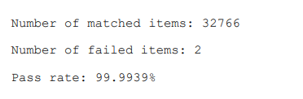
Test setup
Input files are generated using a Python script
Output file is generated by the application
Another Python script is used to compare the results to the original input
Test setup of 32k items inserted + retrieved
Less than 1% chance of failed write

Slide 15
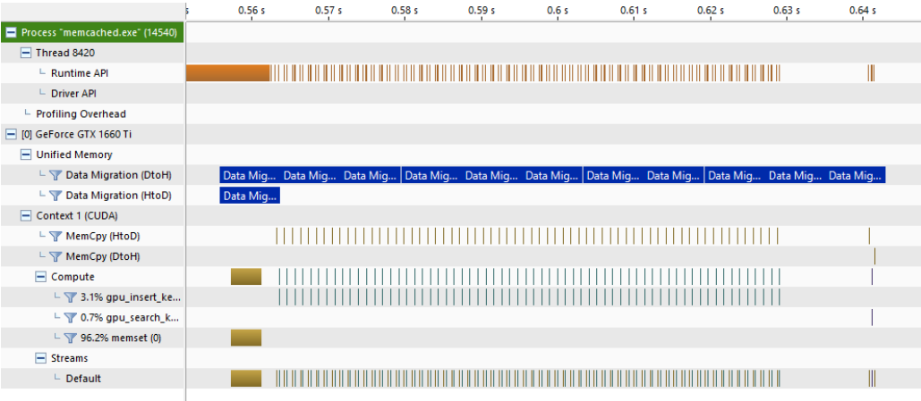
Performance
NVVP (system level)
Kernel | Data transfer | Execution time | Kernel launches | Total (including CPU)
Insert | 1.664 us | 3.36 us | 64 | 0.06 s
Search | 21.85 us | 31.83 us | 1 | 0.01 s
~3 million requests / second

Slide 16
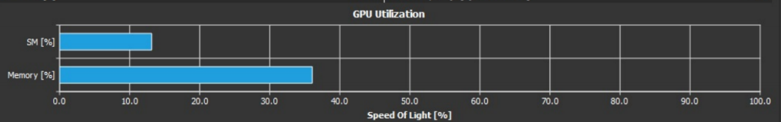
Performance
GPU SMs not fully used
Increasing the batch size will add more latency
Nsight Compute
Utilization

Slide 17
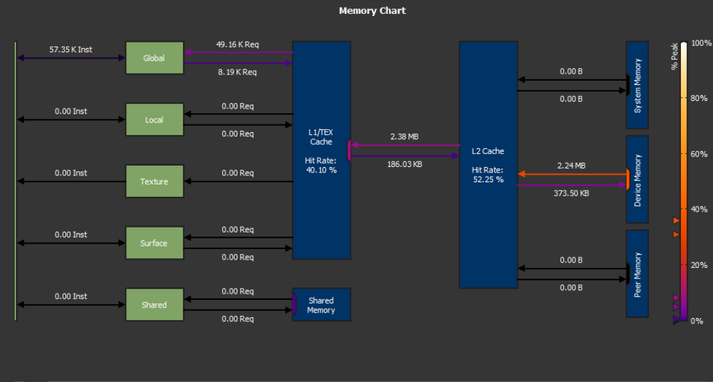
Performance
Nsight Compute
Memory access
Traffic goes straight to global memory
Average cache hits

Slide 18
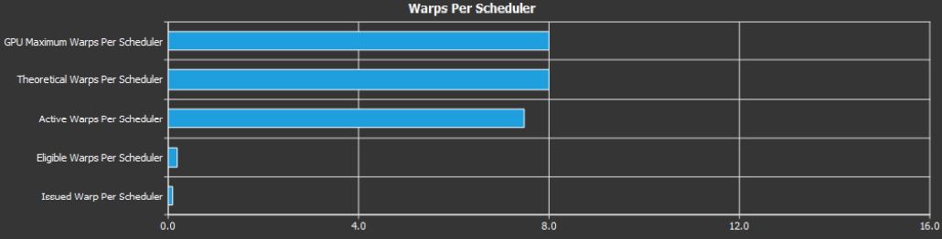
Performance
Active number of warps per scheduler is close to theoretical maximum
Number of eligible warps per scheduler is low
Thread stalling (__syncthreads)
Nsight Compute
Scheduling

Slide 19
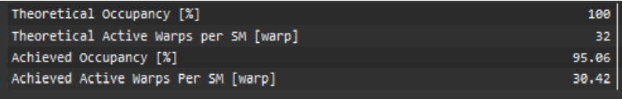
Performance
Achieved occupancy is close to theoretical maximum – 95%
Result:
Workload is well balanced
Threads are not active all the time
Nsight Compute
Occupancy

Slide 20
Further work
Pipeline
Eliminate insert write collisions
Network support
Redesign the hash table to use shared memory

Slide 21
Conclusion
Initial goal met: exploring an alternative implementation of an In-memory Key-Value store
Data integrity and performance have been analysed
Advantages:
High throughput
Energy efficiency
Disadvantages:
Batching adds latency

