Slide 1
Understanding Customer Sentiment
on Twitter
An NLP analysis of tweets about Apple & Google products
Phase 4 Final Project | Davido

Slide 2
The Business Problem
Brands need to know how people feel about their products — fast
Thousands of tweets are posted about Apple and Google products every day
Reading every tweet by hand to gauge public reaction is not realistic
Marketing and product teams need a fast, automated way to know: is the public reaction positive, negative, or neutral?
Goal: build a model that reads a tweet and classifies the sentiment automatically

Slide 3
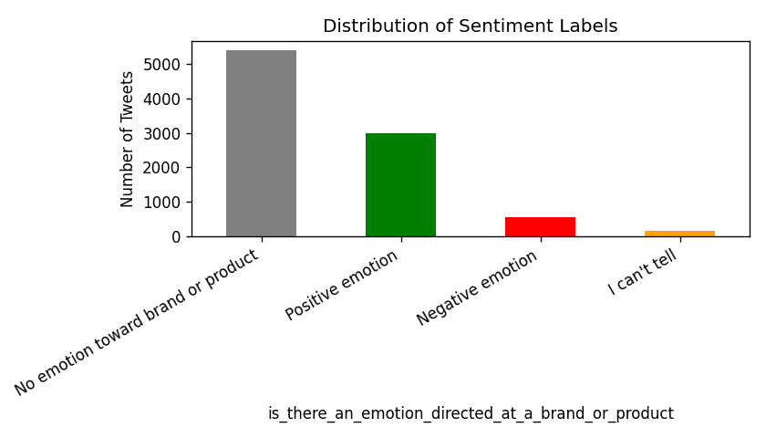
The Data
~9,000 real tweets, hand-labeled for sentiment
Source: tweets collected during a major tech event (SXSW), mentioning Apple and Google products
Each tweet was hand-labeled by a human as Positive, Negative, or No emotion
Most tweets (about 6 in 10) show no clear emotion — they're just factual or informational
About 1 in 3 tweets are positive, while only about 1 in 16 are clearly negative
This imbalance matters: negative tweets are rare, but they're the ones a brand most needs to catch

Slide 4
Preparing the Tweets
Cleaning the text so the model can focus on what matters
Converted all text to lowercase
Removed links, @usernames, and # symbols — these don't carry sentiment
Removed punctuation and numbers
Removed common filler words ("the", "and", "is"...) so the model focuses on meaningful words
Result: clean, simple text ready to be turned into numbers the model can learn from

Slide 5
Comparing Three Models
From a simple baseline to more advanced approaches
Naive Bayes
Logistic Regression
Linear SVC
A simple, fast baseline model used as a starting point for comparison.
A widely-used model that weighs words to predict sentiment — and tells us how confident it is.
A more advanced model that draws clear boundaries between sentiment categories.
All three models were trained on 80% of the tweets and tested on the remaining 20% they had never seen before.

Slide 6
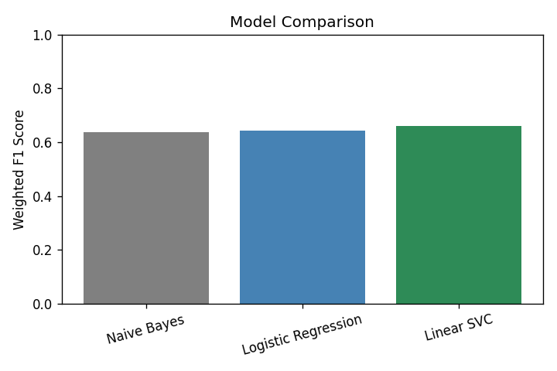
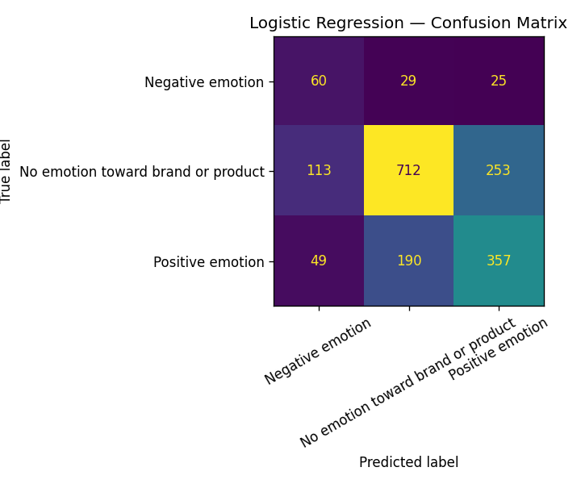
Results
Logistic Regression and Linear SVC both outperform the baseline
Logistic Regression was chosen as the final model — it performs as well as the more complex SVC, while also telling us how confident it is in each prediction.

Slide 7
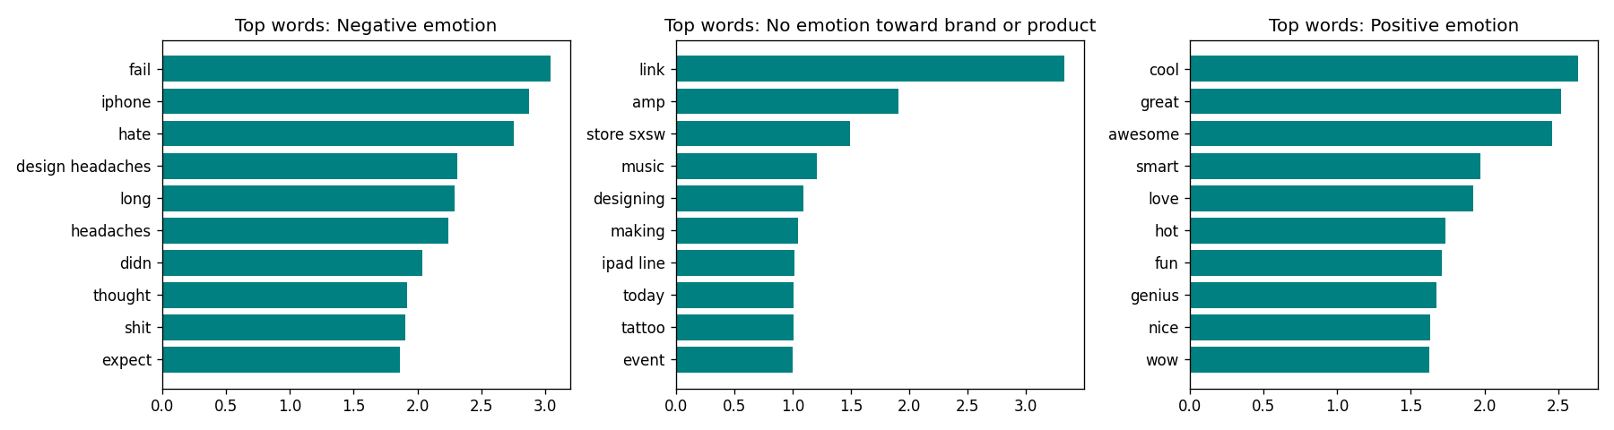
Can We Trust the Model?
Looking inside the model's decisions
Using a technique called LIME, we can see exactly which words drove each prediction
Positive predictions are driven by words like "great", "love", and "awesome"
Negative predictions are driven by words like "hate", "fail", and "broken"
This matches human intuition — the model has learned genuine sentiment signals, not noise

Slide 8
Recommendations & Next Steps
Use it as a first pass, not a final answer
Let the model sort incoming tweets, then have a person review anything flagged as negative.
Prioritize catching negative tweets
Missing a complaint is costlier than double-checking a false alarm — tune the model to favor catching negatives.
Collect more negative examples over time
Negative tweets are rare in this dataset; more examples will help the model get even better at spotting them.
Consider more advanced language models later
Newer AI language models could better handle sarcasm and subtle tone in future versions.

