Slide 1



Orion-CB & POI-DP integration using Generic Configurable Dynamic POI’s
Timo Mukari & Ari Okkonen
University of Oulu/Center for Internet Excellence
Adminotech Oy
29.4.2015

Slide 2
Orion-CB & POI-DP integration demo
FILAB Orion Context Broker with Santander city sensor data (sound meters and traffic monitors) used as an example case
Initiate the demo using Chrome or Firefox browser: http://dev.cie.fi/FI-WARE/demos/dyn_poi/edit_poi.html
Enter “Santander” as position and click “Go to position”
Select category as “Sensor” on the left window pane
Click visible POIs to view sensor values and/or right click to edit the POI data
A specific JSon POI data editor will open in case you choose to modify the POI data
The demo was implemented using the new Dynamic POI feature: http://dev.cie.fi/FI-WARE/poi_dp_dyn/poi_dp_dyn_spec.docx
The FILAB Orion CB Santander demo configuration is found here: http://dev.cie.fi/FI-WARE/poi_dp_dyn/poi_dp_dyn_conf.json

Slide 3
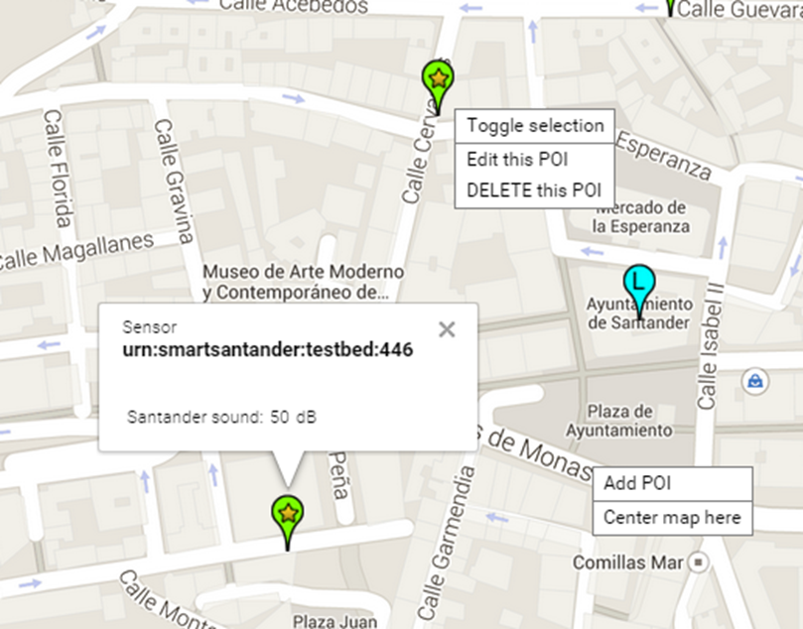
Orion-CB & POI-DP integration demo
Santander city traffic monitors and sound sensors shown as POIs on the map

Slide 4
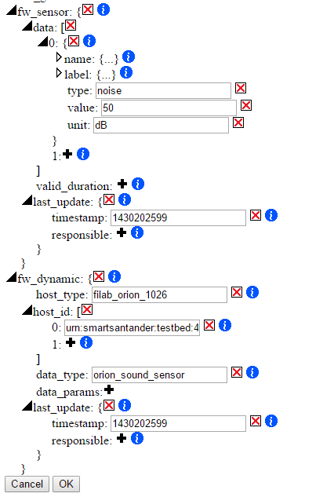
Orion-CB & POI-DP integration demo
Right clicking a POI opens up a POI editor allowing to modify POI data structures and values
New values of generated fw_sensor structure shown
based on added fw_dynamic definitions and configuration file presented on next slide

Slide 5
Content of the FILAB Orion CB host configuration:
"host_type": {
"filab_orion_1026": {
"method": "REST_GET",
"params": {
"url": "http://orion.lab.fi-ware.org:1026/ngsi10/
contextEntities/",
"params": "?attributeFormat=object",
"headers": {"Content-Type":"application/json", "Accept":"application/json”, ”X-Auth-Token”:”….”}
}
}
}

Slide 6
Content of the Orion Santander sound sensor data mapping:
"data_mapping": {
"orion_sound_sensor": {
"fw_sensor": {
"data": [ {
"name": {"en":"Santander sound"},
"type": "noise",
"value": ["_fw_json", {"contextElement":{"type":"santander:sound","attributes":{"sound":{"value":"?"}}}}],
"unit": ["_fw_json", {"contextElement":{"attributes":{"sound":{"metadatas":[{"value":"?"}]}}}}]
}] /* ?-marks above indicates data to be returned*/
}
}
}

