Slide 1



POI-DP ngsi10 lookalike API Demo
Timo Mukari & Ari Okkonen
University of Oulu/Center for Internet Excellence
Adminotech Oy
11.5.2015

Slide 2
POI-DP ngsi10 lookalike API Demo
An Orion Context Broker NGSI-10 lookalike API for POI-DP
Initiate the demo using Chrome or Firefox browser: http://dev.cie.fi/FI-WARE/poi_dp_dyn/ngsi10
Select/Edit the desired URL
Select/Edit the desired POST data if needed
A JSon data editor window is also available in case you wish to modify the JSon data.
Click GET or POST method depending on the request type
View the Host Response together with JSon pretty print (if available) at the bottom of the page
The demo was implemented using the new NGSI POI API: http://dev.cie.fi/FI-WARE/poi_dp_dyn/ngsi10/poi_dp_ngsi_spec.docx

Slide 3
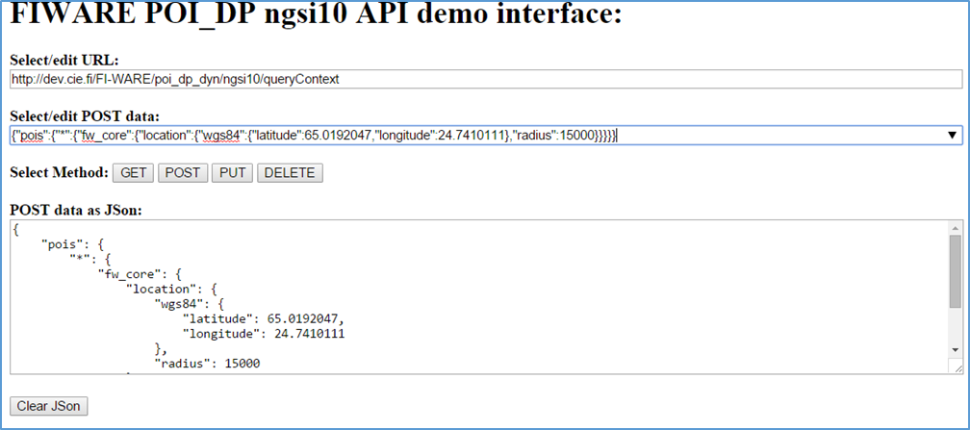
POI-DP ngsi10 lookalike API Demo

Slide 4
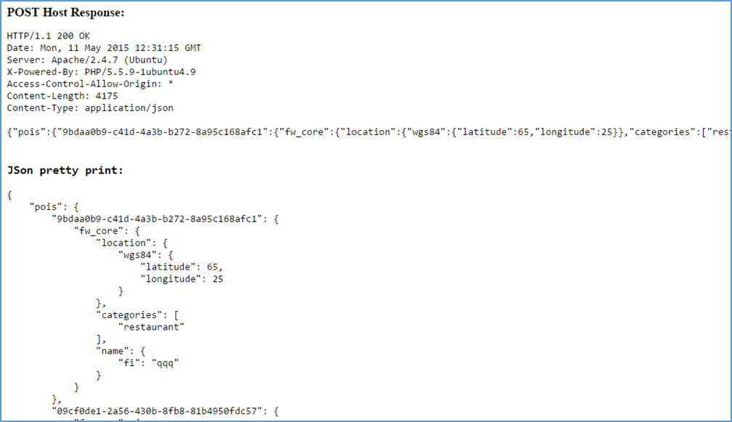
POI-DP ngsi10 lookalike API Demo

Slide 5
POI-DP ngsi10 lookalike API Demo
Convenience GET operations:
http://<host>/poi_dp_dyn/ngsi10/contextEntities/<latitude>/ <longitude>/<radius>[/<category>]
http://<host>/poi_dp_dyn/ngsi10/contextEntities/<poi_id> [/component/<component>]
NGSI10 POST operations:
http://<host>/poi_dp_dyn/ngsi10/queryContext
See the required JSon query/response string format next page

Slide 6
POI-DP ngsi10 lookalike API JSon Query String/Response:
{
"pois": {
"<poi-id>": {
"fw_core": {
"location": {
"wgs84": {
"latitude": <latitude>,
"longitude": <longitude>
}
“radius”: <radius>
},
"categories": [
"<category>",…
],
“<field>”: <value>,
"name": {
"": "<name>"
}
},
"<component>": {
“<field>”: <value>
}
},
<poi_id>...
}
}
where:
<poi_id> Universally Unique ID (UUID) of the desired POI, or “*” to query several
<latitude/longitude> Coordinates of the desired POIs in wgs84 decimal degrees
<radius> Radius of the spatial search in meters for the desired POIs
<category> Desired POI category/categories
<component> Data components the desired POIs need to have
<field> Value fields of the components the desired POIs need to have
<value> Value of the component field required POIs need to match or “.*” to match all values or any other regular expression.

