Slide 1

FI-WARE Points of Interest (POI) Data Provider R5.4
Why and How
Nonprofit educational material. Fair use of copyrighted content, if any, is assumed.
Notes:
This is an introduction to FI-WARE points of interest data provider.

Slide 2
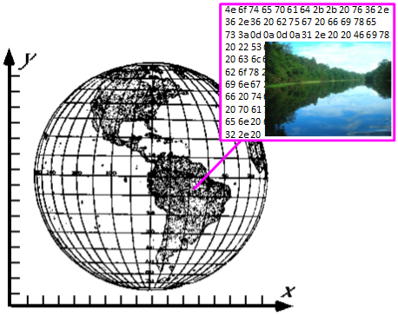
Points of Interest - POI
A POI system
Relates information to places
Supports searches by location and other criteria, e.g. time
Notes:
A points of interest, or POI, system relates information to places. The information related to a place can be whatever you need for your application:
- restaurants and scenic places for tourists,
- maintenance instructions and logs related to a location for maintenance
business,
- photos from your trips,
- actually any information you want to find by the location.

Slide 3
Contents of this Presentation
This presentation has two parts
Where a POI system might be useful
Developing a POI system using FI-WARE POI GE
Notes:
This presentation consists of two parts. The first part gives some ideas about utilisation of POI systems, The second, more technical, part introduces you to developing an application on top of the FI-WARE POI generic enabler.

Slide 4
Where a POI System Might be Useful
The following slides illustrate possible uses of POI data
What does a POI data provider do
Why to use FI-WARE POI Data Provider
Using POI information – Map
Using POI information – Augmented Reality
Using POI information – Your own needs
Notes:
This first part illustrates the area of application of POI technology in general. It also presents special benefits of FI-WARE POI technology. Examples of possible uses shown here are augmented reality and a map application.

Slide 5
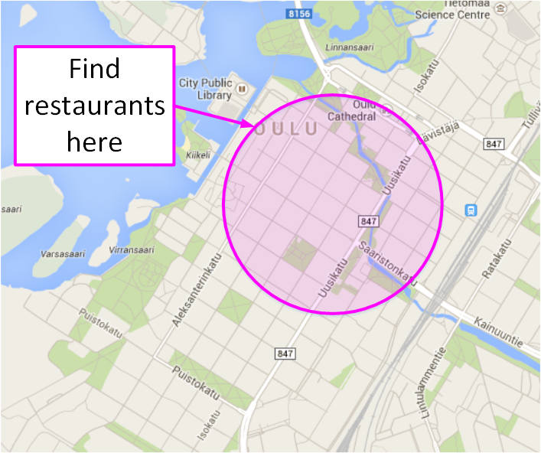
What does a POI Data Provider do
A POI data provider stores and provides information based on location
Searches based on area e.g. circle or bounding box.
Filtering of results using other data values e.g. category or tags
Notes:
A POI system is used to store and retrieve data by location. Data retrieval arguments may include different kinds of area descriptions and other conditions. A useful example may be finding restaurants near to you, when you are visiting a new town.

Slide 6
Why to use FI-WARE POI Data Provider
FI-WARE POI Data Provider uses modular and distributed data. This allow you to
Combine your own data with public POI data
Speed up mobile operation by fetching only the data your application needs
Use your own data structures, if need for extra flexibility
Notes:
There are several other POI data and API definitions proposed and in use. However, it seems that there is room for one more with special features. The FI-WARE POI definitions are developed to avoid complexity and bloated data of other POI systems.
Due to modular structure of the FI-WARE POI system the amount of data transferred from the server is kept minimal, which is significant benefit in mobile use.
Using FI-WARE POI system the architecture allows you to create your - public or proprietary - system on top of existing - public or proprietary - POI service. Your system may enhance existing POIs with your data and add your special POIs to existing selection of POIs. Of course, your specialities are visible only to the users of your system.

Slide 7
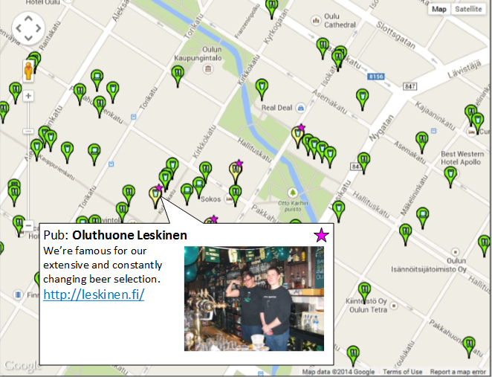
Using POI Information - Map
Show place information of selected categories, like restaurant and other criterias, like open times on the map.
Notes:
POIs on the map is a very common way to present location dependent information. There are several systems using this approach. Google Maps and OpenStreetMap are familiar examples of this approach.

Slide 8
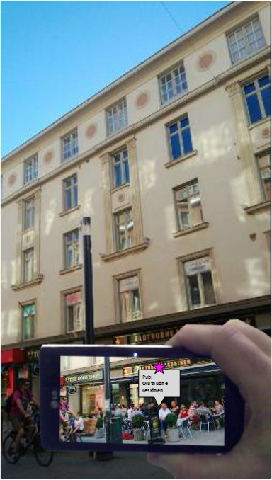
Using POI Information – Augmented Reality
Augment the view with place information of your interest
Notes:
A POI system can be used to supply the location dependent information to an augmented-reality application. The application obtains the relevant information from the server by e.g. location and category and shows it on top of the real view. Nokia/Here City Lens is an example of an application that helps to find interesting places in a strange town.

Slide 9

Using POI Information – Your own needs
Attach the information you need to the locations
Use or show the information as you need
Search information based on the location, and the extra data you provided
Notes:
In general, if the information needs to be found by location, a POI database is a good candidate for the back-end system. Specifically, FI-WARE POI back end is designed to be easily adaptable to your information needs. For a special purpose you may need a special purpose web client. One thing you have to implement in your special purpose client is the POI API. A key benefit of the FI-WARE POI API is that you can implement it with a straightforward and compact piece of code.

Slide 10
Developing a POI system using FI-WARE POI GE
Content
Development prerequisites
Modular and distributed data
Components in JSON format
Multilingual data items
Default language in multilingual data
Spatial searches
Additional data retrieval
Creating a new POI
Updating POI data
Deleting a POI
Notes:
This second part of the presentation introduces you to using FI-WARE POI GE in your web client. The presentation starts from development prerequisites and continues through technical principles that are behind the special capabilities of the FI-WARE POI architecture. These include modular and distributed data, components, and multilingual data needed for internationally available systems. Finally the details of client side code of POI search, update, and delete operations are covered. This should give you the necessary information and pointers to utilize a FI-WARE POI Generic Enabler.

Slide 11
Development prerequisites
Basic JavaScript knowledge
E.g. from here: http://www.w3schools.com/js/
To show maps you may use e.g.
Google Maps API https://developers.google.com/maps/
OpenStreetMap http://wiki.openstreetmap.org/wiki/OpenLayers_Simple_Example
Detailed instructions
http://fiware-poidataprovider.readthedocs.org/en/latest/POI_Data_Provider__User_and_Programmers_Guide/- later referred The Manual
Notes:
In order to write FI-WARE POI API to your web client using the method presented here you need to know some JavaScript. If you want to show the POI information on a map, you need to find some map provider and its API documentation. Google Maps and OpenStreetMap are good, public generic purpose choices. Detailed step-by-step instructions and code examples are found in the User_and_Programmers_Guide later referred as The Manual.
- Links:
JavaScript http://www.w3schools.com/js/
Google Maps https://developers.google.com/maps/
OpenStreetMap http://wiki.openstreetmap.org/wiki/OpenLayers_Simple_Example
FI-WARE POI GE - The Manual http://forge.fi-ware.org/plugins/mediawiki/wiki/fiware/index.php/POI_Data_Provider_-_User_and_Programmers_Guide

Slide 12
Modular and Distributed Data
Modular data to avoid unnecessary data transmission, by requesting only the data components you want
Data of a POI consists of components
E.g. fw_core, fw_time, fw_contact, fw_media, …
HTTP Request defines wanted data components
Different data components of the same POI may reside in different servers.
Application specific proprietary data components can be used
Notes:
The data of a POI consists of modules for different purposes. This is
* to avoid coding, storing, and transmitting unnecessary data,
* to make introducing new data for new needs easy and controlled,
* to enable distributed storage for POIs and their data items
* to avoid bloating of application code
The data for a POI consists of components. Examples of components are:
* fw_core - core information needed in most POIs: name, location, category,...
* fw_time - times of availability. Can be used e.g. to tell, when a shop, tourist attraction etc. is open for customers.
* fw_contact - address, phone number, email, etc. to contact a service related to the POI
* fw_media - pictures, videos, voice recordings, etc. related to the POI
Modularity of POI data is used so that the components, that the client needs, are listed in the HTTP request used to query the data.
Different POIs, specially their fw_core components, of the system may reside in different servers. Moreover, the different components of the same POI may reside in different servers. In these cases the client send queries to all relevant servers. This is easy, because the components are identified by the UUID of the POI.
If the application needs data that is not suitably contained in already defined components, it is fine to introduce new components to meet the need. Naming rules of the components try to prevent naming conflicts.

Slide 13
Components in JSON Format
POI is identified by its UUID
component is identified by its name
"8e57d2e6-f98f-4404-b075-112049e72346": {
"fw_core": {
<location, identity & other core information>
},
"fw_time": {
<availability times>
},
<other requested components>
}
Notes:
This is the upper structure of a POI in JSON format. The UUID of the POI is used as the key of the data object. The POI data object consists of properties having component names as their keys.

Slide 14
Multilingual Data Items
Most texts and web links (URLs) are for several languages
{
"__": "<default or language independent data>", "<lang_ID1>": "<data in language lang_ID1>", "<lang_ID2>": "<data in language: lang_ID2>", …
}
ISO 639-1 language code identify the language
Example:
"label": {
"__": "Uniresta Lobby Restaurant at University of Oulu",
"fi": "Unirestan Aularavintola Oulun yliopistolla.",
"en": "Uniresta Lobby Restaurant at University of Oulu",
"es": "Restaurante Aularavintola"
}
Notes:
Multilingual data items are objects that contain properties for different languages. ISO 639-1 language codes are used as keys to the properties. Default or language independent property is identified as two underscores as its key. Examples of multilingual items are texts and URLs.

Slide 15
Default language in Multilingual Data
No need to duplicate text for the default
A specific language can also be the default
{
"_def": "<lang_IDn>",
… "<lang_IDn>": "<default data in language: lang_IDn>", …
}
Example (previous example without duplicate):
"label": {
"_def": "en",
"fi": "Unirestan Aularavintola Oulun yliopistolla.",
"en": "Uniresta Lobby Restaurant at University of Oulu",
"es": "Restaurante Aularavintola"
},
Notes:
If a specific language is also the default language, duplication of data is needed, if no special trick is available. The special trick is a possibility to define one of the languages as the default. The property with special key "_def" defines the default language. The content of the property is the language code of the default language. This helps to reduce amount of data and to avoid inconsistencies that often result from updates of duplicate data.

Slide 16
Spatial Searches
Example of radial search – GET request
http://<your_poi_server>/radial_search?lat=65.01255&lon=25.47133&radius=250&category=cafe,restaurant&auth_t=<a_token>
gives restaurants and cafes in the center of Oulu Finland
Code snippets in JavaScript to send the request and to receive the results can be found in The Manual
Available categories are server dependent – values of OpenStreetMap Amenity-key are used in demo servers
See The Manual for bounding box search
Notes:
A typical interaction with a POI server begins with spatial search: "what do we have here". For spatial searches FI-WARE POI GE provides radial searches and bounding box searches. In radial search the client supplies coordinates of the center point in decimal degrees and the radius of the area in decimal meters. Limiting conditions e.g. accepted categories and languages can be used too. Available categories are system/server dependent. See possible server related documentation for categories. Syntax and other details of the spatial search REST query are defined in The Manual. Default spatial search results the core data components, only.

Slide 17
Additional Data Retrieval
Example of extra information retrieval – GET request
http://<your_poi_server>/get_pois?poi_id=30ddf703-59f5-4448-8918-0f625a7e1122&component=fw_media&auth_t=<a_token>
gives media links associated to the POI
Code snippets in JavaScript to send the request and to receive the results can be found in The Manual
Notes:
When the client has sifted through the results of the spatial search, it may need some more information about some interesting POIs: "tell me more about these". Additional data components are queried using the UUIDs of the POIs and the names of interesting components. Again, see The Manual for exact syntax and examples.

Slide 18
Creating a New POI
Example of adding a new POI – POST request
http://<your_poi_server>/add_poi?auth_t=<a_token>
data content is components of the POI in JSON format
response is the UUID created for the POI
Code snippets in JavaScript to send the request and to receive the results can be found in The Manual
Notes:
A new POI is introduced to the POI server using add_poi request. This is a POST request that delivers the POI description in JSON format. The description contains at least the fw_core component and possible other components depending on the purpose and implementation. Response from the server contains the UUID of the newly created POI. See The Manual for details.

Slide 19
Updating POI Data
Retrieve POI data for update – GET request
http://<your_poi_server>/get_pois?poi_id=30ddf703-59f5-4448-8918-0f625a7e1122&get_for_update=true&auth_t=<a_token>
This brings all language versions and last_update info
Modify the data as needed – retain the last_update info unchanged
Send updated data – POST request
http://<your_poi_server>/update_poi&auth_t=<a_token>
data content is the modified data in JSON format
response tells success or not
update fails if a conflict happens
Code snippets in JavaScript to send the request and to receive the results can be found in The Manual
Notes:
Updating the POI data is a little more complex exercise. First you have to retrieve the POI data for update. Then the updated data is sent back to the server. Finally, the server reports the success or failure of the update.
Because of the distributed nature of the system, there might occur update conflicts: two clients get the same POI for update and then send independently and differently updated data back. Depending on the purpose of the system this may lead to undesired or worse consequences, if not acted properly upon.
The FI-WARE POI GE uses update stamps to catch conflicts. If an update conflict occurs the conflicting - the latter - request is rejected, and the client is notified accordingly. In order to complete the rejected update the client must fetch the POI again to get the new data for a new update attempt. See The Manual for the details.

Slide 20
Deleting a POI
Example of deleting a POI – DELETE request
http://<your_poi_server>/delete_poi?poi_id=30ddf703-59f5-4448-8918-0f625a7e1122&auth_t=<a_token>
Code snippets in JavaScript to send the request and to receive the results can be found in The Manual
Notes:
Deleting a POI is easy. Send a DELETE request with the UUID of the POI. See The Manual for the details.

Slide 21
The End
by Ari Okkonen, Center of Internet Excellence, University of Oulu
Notes:
This completes the lesson. Good luck for your project!
A presentation by Ari Okkonen, Center of Internet Excellence, University of Oulu

