Slide 1

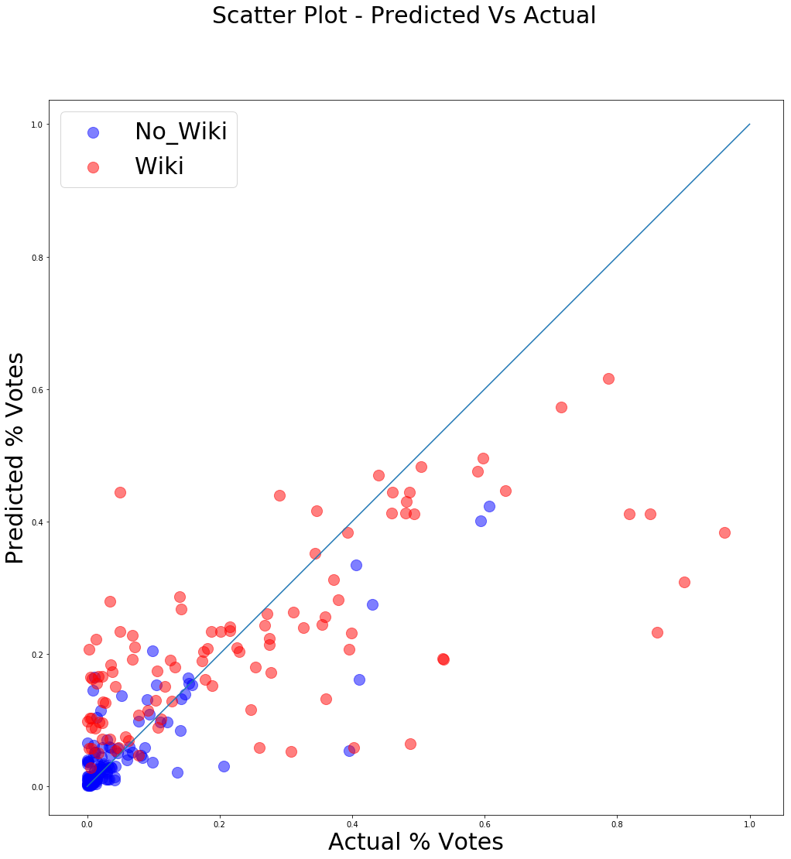
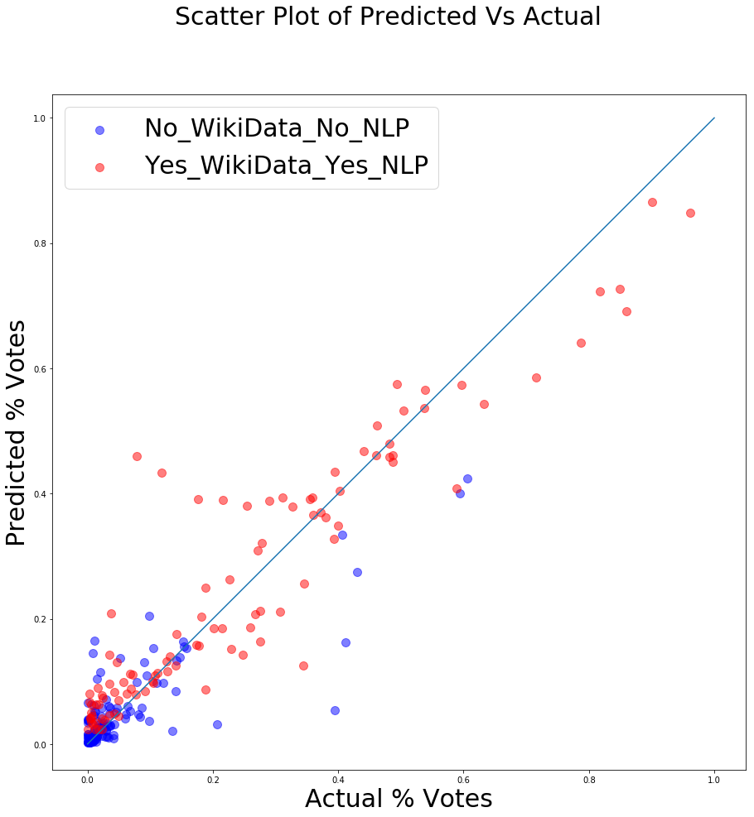
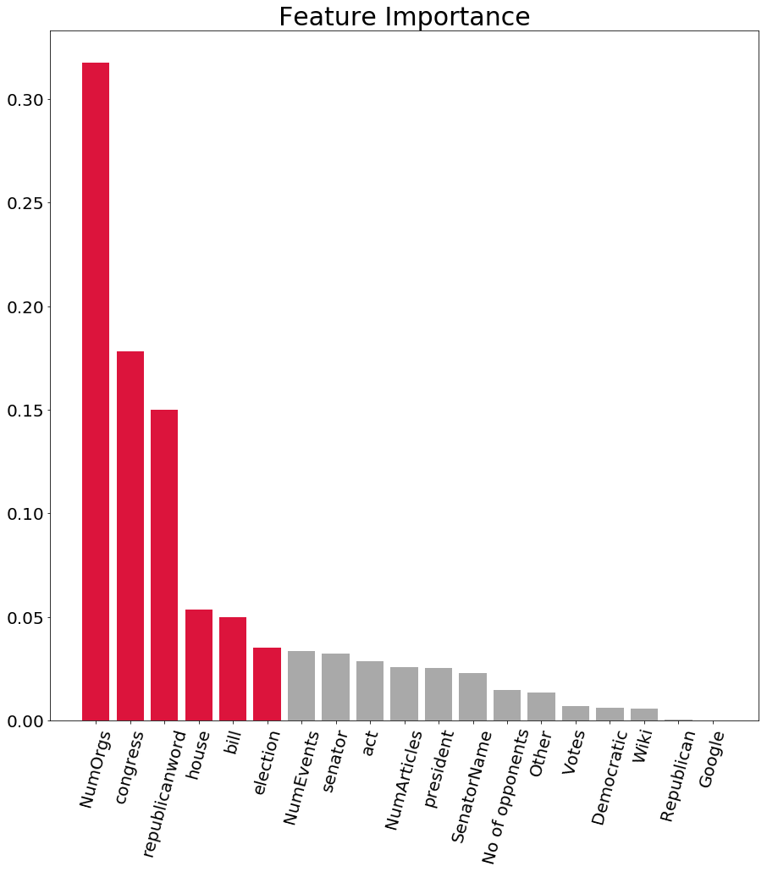
Political Profiling using Feature Engineering and NLP
Chiranjeevi Mallavarapu, Ramya Mandava, Sabitri KC
Master of Science in Data Science
Southern Methodist University, Dallas, TX 75275, USA
Introduction
Model Assessment and Results
Political election results are important media topic
The election outcomes are in general determined based upon sample telephone surveys, online polls and paper mailings
Political parties spend considerable amount of their campaign budget on swing constituencies based on initial polls
Fig. 1 : RF Model predictions
Prior to NLP – features in Table 1
Fig. 2 : RF Model predictions
Post NLP – features in Tables 1,2
Optimized Random Forest regression with 5 fold CV, 150 estimators
After 2nd revision, including No. of Opponents and Party resulted in a Pearson correlation of 0.796, MSE 0.02 as shown in Fig.1
After 3rd revision of the model, including additional feature set as shown in Table 2 for candidates with Wiki page, resulted in a Pearson correlation of 0.709 and MSE 0.019. The predictions are as illustrated in Fig.2
Model is an ensemble model of 2 feature sets depending on whether a politician has a wiki page (NLP) or not (no NLP)
Problem
Inaccuracy of political election predictions due to
  Voter opinion clarity
  Participation during polling: Telephonic surveys are refused by one third of sample ^{[1]}
Non-optimal political campaign spending
Disappointment to voters, media and political analysts due to unanticipated outcomes
Ethics
All 3 data sources are public and open data
No authentication by entity or company was required
No public data was included from social media platforms that might have legal implications
Data is anonymized across the board
Table 1 : Features prior to NLP
Data Acquisition
Google | No of Articles
Wiki | No of Opponents
No of Events | Party
No of Orgs
Fig. 3 : Feature Importance
Theme: Open Data + Schematic Data + Big Data
List of candidates and votes that ran for 2016 senate is obtained from Wikipedia^{[2]}. Features are sourced from
  Google’s Knowledge Graph API - Schemas : Person, Events and Organizations related to politicians
  Wikipedia API, Pywikibot - Wiki page of candidate
  NewsAPI – articles from almost 30,000 news sources
Conclusions & Future Work
Candidates with wiki presence are more likely to win
Top 6 features of importance are indicated in red as shown in Fig 3
Future work : take user input to give recommendation
Include NLP features of News articles
Table 2 : Additional NLP Features
Feature Engineering and NLP
congress | president
republicanword | bill
election | act
house | committee
senator | senate
References
Top identified features are listed in Table 1 for candidates with no Wikipedia page
Top identified additional NLP features (words) are listed in Table 2 for candidates with Wikipedia page
For NLP, term frequency was used to extract features as listed in Table 2 and their TF-IDF scores were used as feature inputs
[1] Robert M. Groves and Lars E. Lyberg, “An Overview of Non-response Issues in Telephone Surveys,” in Robert Groves et al., eds., Telephone Survey Methodology (New York: John Wiley & Sons, 1988), pp. 203-205.
[2] Wikipedia contributors. (2018, October 20). United States Senate elections, 2016. In Wikipedia, The Free Encyclopedia. Retrieved 18:43, October 24, 2018, from https://en.wikipedia.org/w/index.php?title=United_States_Senate_elections,_2016&oldid=864918942

