Slide 1
Political Profiling using
Feature Engineering
and
NLP
Chiranjeevi Mallavarapu
Ramya Mandava
Sabitri KC
Master of Science in Data Science, SMU
Ginger Holt
Facebook

Slide 2
Introduction
Political election results is an important media topic. The election outcomes are in general determined based on sample telephone surveys, online polls and paper mailings.
Political parties spend considerable of their campaign budget on swing constituencies based on initial polls.

Slide 3
Problem Statement
Determine the likelihood of a candidate to win an election.
The outcome of elections are generally predicted by media and political analysts based upon voter surveys and polls which are sometimes biased or inaccurate.

Slide 4
Problem Statement
Determine the likelihood of a candidate to win an election.
The outcome of elections are generally predicted by media and political analysts based upon voter surveys and polls which are sometimes biased or inaccurate.
Voter opinion clarity
Participation during polling: Telephonic surveys are refused by one third of sample

Slide 5
Motivation
Political parties always look for better predicting the election outcomes to properly spend their campaign budgets in swing constituencies and also for TV, News media to predict who is likely to win.

Slide 6
Solution
To collect open public data about politicians that ran for US Senate in 2016, identify features to predict the percentage of votes for each candidate.

Slide 7
Data Sources
Google Knowledge Graph API
Wikipedia API
News API
Open Data + Schematic Data + Unstructured Data

Slide 8
Data Sources
Google Knowledge Graph API
Wikipedia API
News API
Open Data + Schematic Data + Unstructured Data

Slide 9
Data Sources
Google Knowledge Graph API
Wikipedia API
News API
Open Data + Schematic Data + Unstructured Data

Slide 10
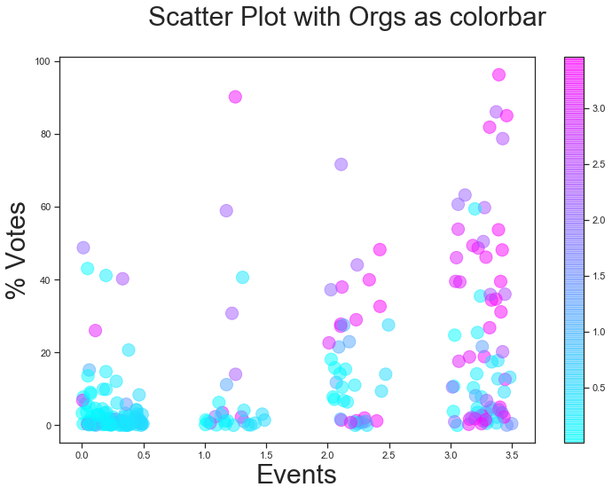
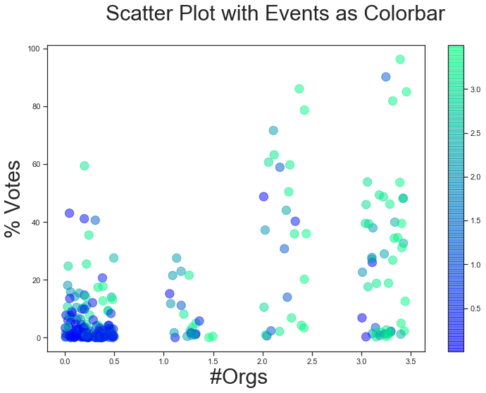
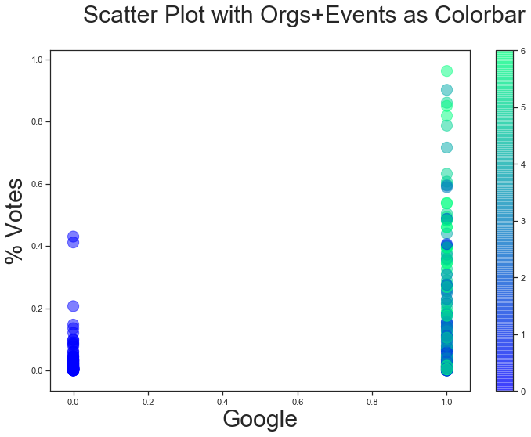
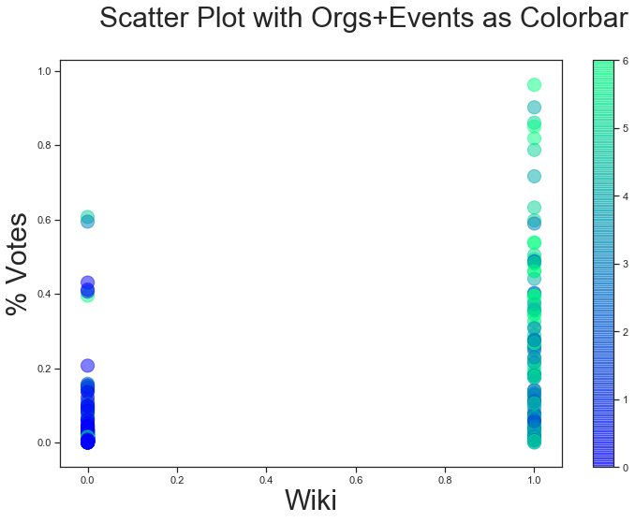
Feature Data Exploration
Notes:
GH comments: Include histograms and summary statistics.

Slide 11
Feature Data Exploration
Notes:
GH comments: Include histograms and summary statistics.

Slide 12
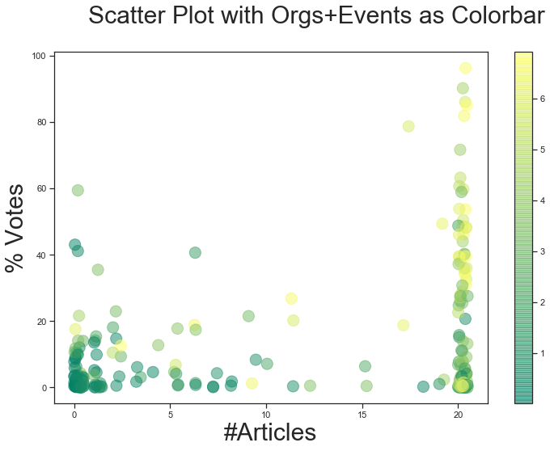
Feature Data Exploration [continued]
Notes:
Articles - 30 train: accurate/not -accurate ; lesser priority
NLTK
Input - article
Word freq / TfIdf -
Classification - Yes/No
Politician - article - 30 - Yes / No
80-20 of the 30 -
90%
244 politicians - articles - 278 articles predict
Yes consider, No drop

Slide 13
Feature Engineering - iteration 1.0
Initial Data Exploration gave below features
Present on Google Knowledge Graph[Google]
Present on Wikipedia[Wikipedia]
Number of Organizations politician associated [Google]
Number of Events a politician is part of [Google]
Number of Articles a politician is mentioned [NewsAPI]

Slide 14
Feature Engineering - iteration 1.0
Initial Data Exploration gave below features
Present on Google Knowledge Graph[Google]
Present on Wikipedia[Wikipedia]
Number of Organizations politician associated [Google]
Number of Events a politician is part of [Google]
Number of Articles a politician is mentioned [NewsAPI]

Slide 15
Random Forest - iteration 1.0
Model Parameters and Results
Train Test Split - 50/50
No Cross Validation
Number of estimators - 150
Out-of-bag R-2 score estimate: 0.0941 Test data R-2 score: 0.278 Test data Spearman correlation: 0.53 Test data Pearson correlation: 0.5493
Mean Squared Error 0.0355

Slide 16
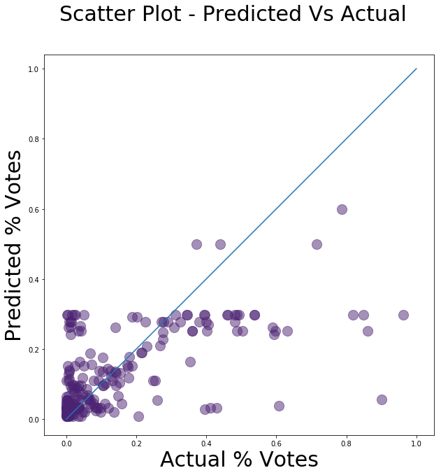
Model Predictions rev1
Notes:
Open question? State
Look at 60,40 points to understand the features
How many opponents ; does that affect.
Candidates entered into race late? data from wikipedia;
Table of model/s : parameters for model

Slide 17
Model Predictions rev1
Notes:
Open question? State
Look at 60,40 points to understand the features
How many opponents ; does that affect.
Candidates entered into race late? data from wikipedia;
Table of model/s : parameters for model

Slide 18
Model Conclusions rev1
What next?
Address the prediction capping at 30%
Better Pearson’s correlation than 0.54
Add new Features
Notes:
Open question? State
Look at 60,40 points to understand the features
How many opponents ; does that affect.
Candidates entered into race late? data from wikipedia;
Table of model/s : parameters for model

Slide 19
Feature Engineering iteration 2.0
Present on Google Knowledge Graph[Google]
Present on Wikipedia[Wikipedia]
Number of Organizations politician associated [Google]
Number of Events a politician is part of [Google]
Number of Articles a politician is mentioned [NewsAPI]
Party affiliation (Democratic/Republican/Other) [Wikipedia]
Number of opponents [Wikipedia]
Notes:
Open question? State
Look at 60,40 points to understand the features
How many opponents ; does that affect.
Candidates entered into race late? data from wikipedia;
Table of model/s : parameters for model

Slide 20
Random Forest
Iteration 2 Parameters and Results
CV - splits - 5 (optimized)
Number of estimators - 150
Out-of-bag R-2 score estimate: 0.39 Test data R-2 score: 0.616
Test data Spearman correlation: 0.75 Test data Pearson correlation: 0.796
Mean Squared Error 0.0204 (reduced)

Slide 21
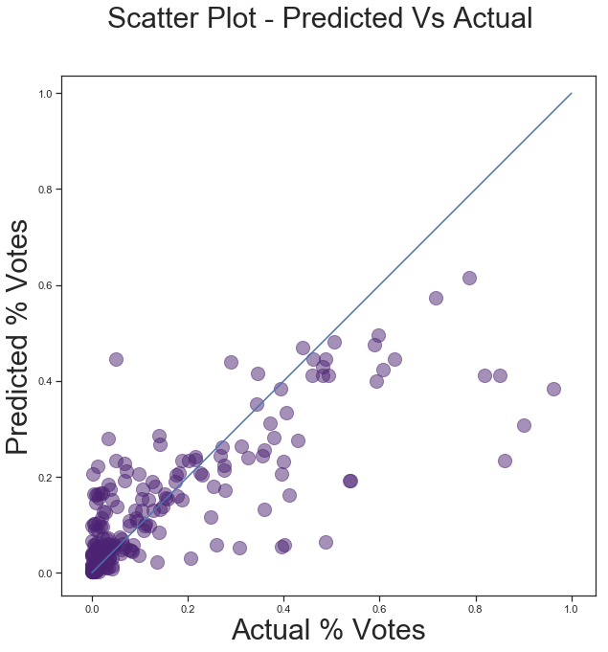
Model Predictions rev2
rev1
Notes:
Open question? State
Look at 60,40 points to understand the features
How many opponents ; does that affect.
Candidates entered into race late? data from wikipedia;
Table of model/s : parameters for model

Slide 22
Model Predictions rev2
rev1
Notes:
Open question? State
Look at 60,40 points to understand the features
How many opponents ; does that affect.
Candidates entered into race late? data from wikipedia;
Table of model/s : parameters for model

Slide 23
Additional Next Steps
Add additional Features
Wikipedia NLP feature extraction (Term frequency/tf-idf) for 103 profiles that include top performers
Wikipedia Education , Profession , DOB, sex

Slide 24
Feature Engineering - iteration 3.0
Wikipedia NLP feature extraction
Top 10 features [TF] identified are:
Senate [552] | Senator [219]
Committee [273] | House [213]
Act [246] | Election [211]
Bill [239] | Republicanword [200]
President [227] | congress [189]

Slide 25
Feature Engineering - iteration 3.0
Wikipedia NLP feature extraction
Top 10 features [TF] identified are:
Senate [552] | Senator [219]
Committee [273] | House [213]
Act [246] | Election [211]
Bill [239] | Republicanword [200]
President [227] | congress [189]

Slide 26
Random Forest
Iteration 3 Parameter and Results
Out-of-bag R-2 score estimate: 0.529
Test data R-2 score:0.408
Test data Spearman correlation:0.705 Test data Pearson correlation:0.709
Mean Squared Error 0.019 (reduced)
CV - splits - 5 (optimized)
Number of estimators - 150

Slide 27
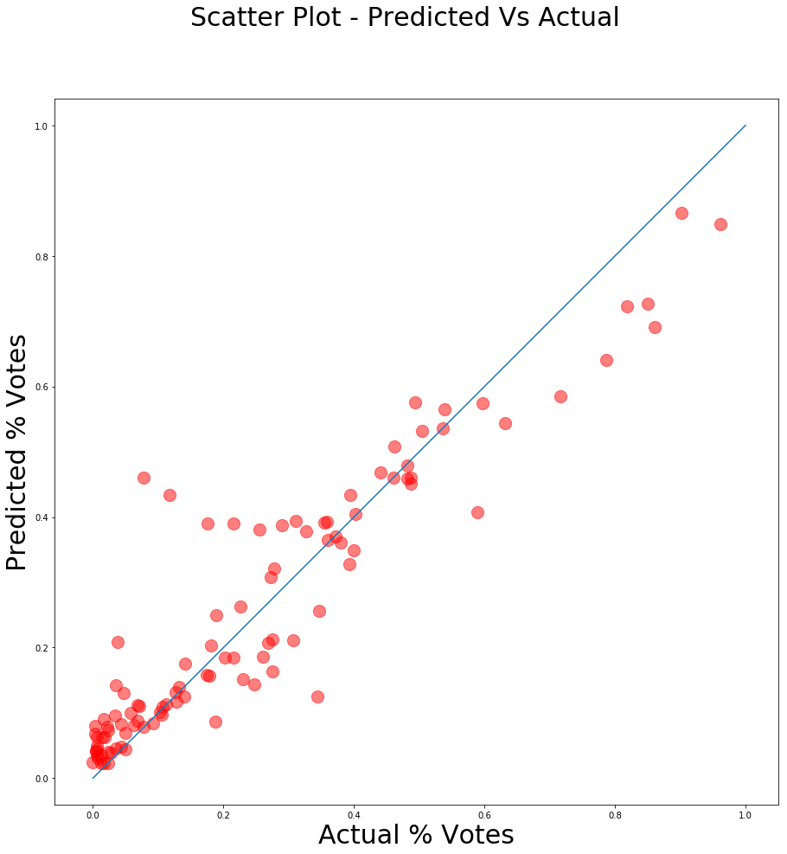
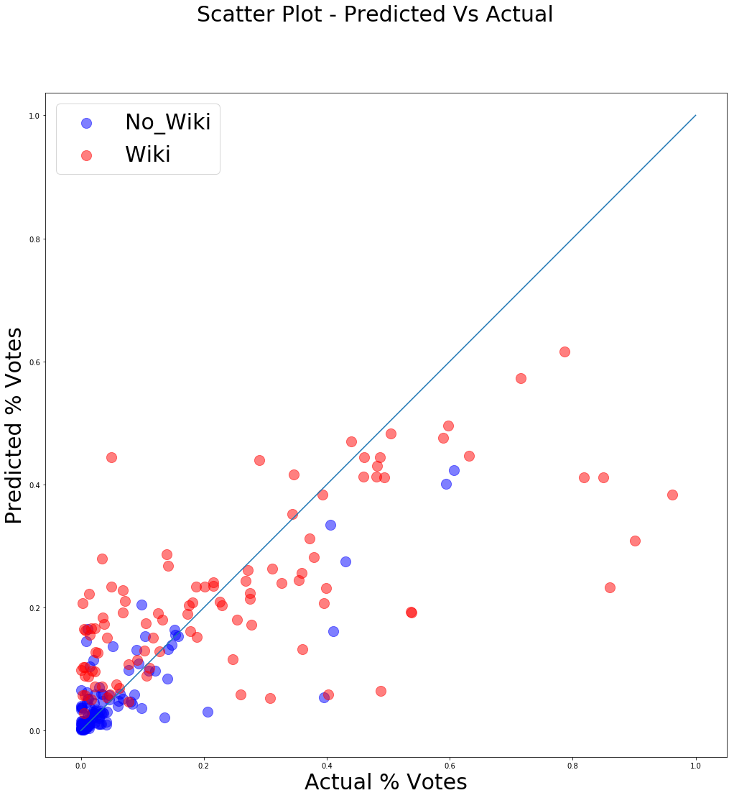
Model Predictions rev3[NLP]
rev2

Slide 28
Model Predictions rev3[NLP]
rev2

Slide 29
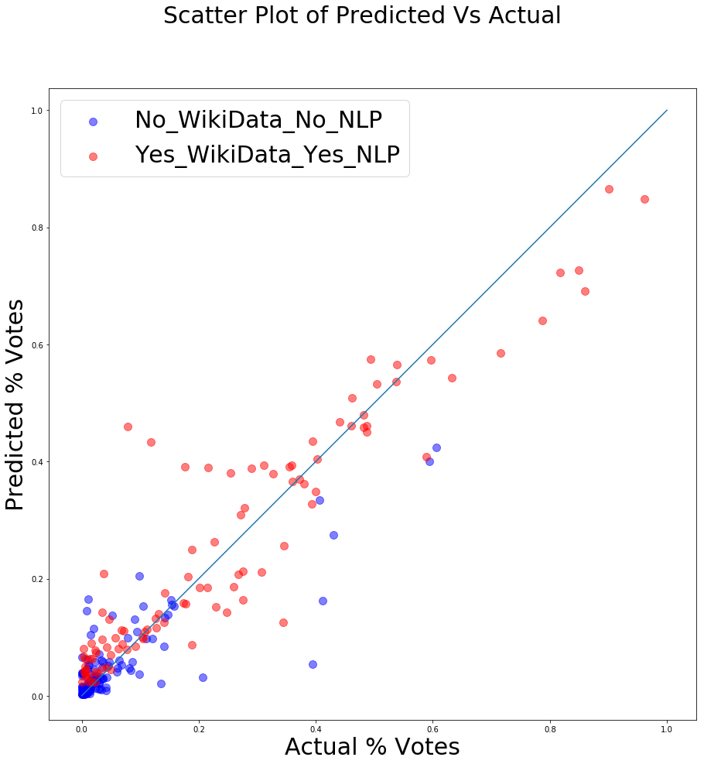
Final Model
Pearson correlation: 0.709
Pearson correlation: 0.796

Slide 30
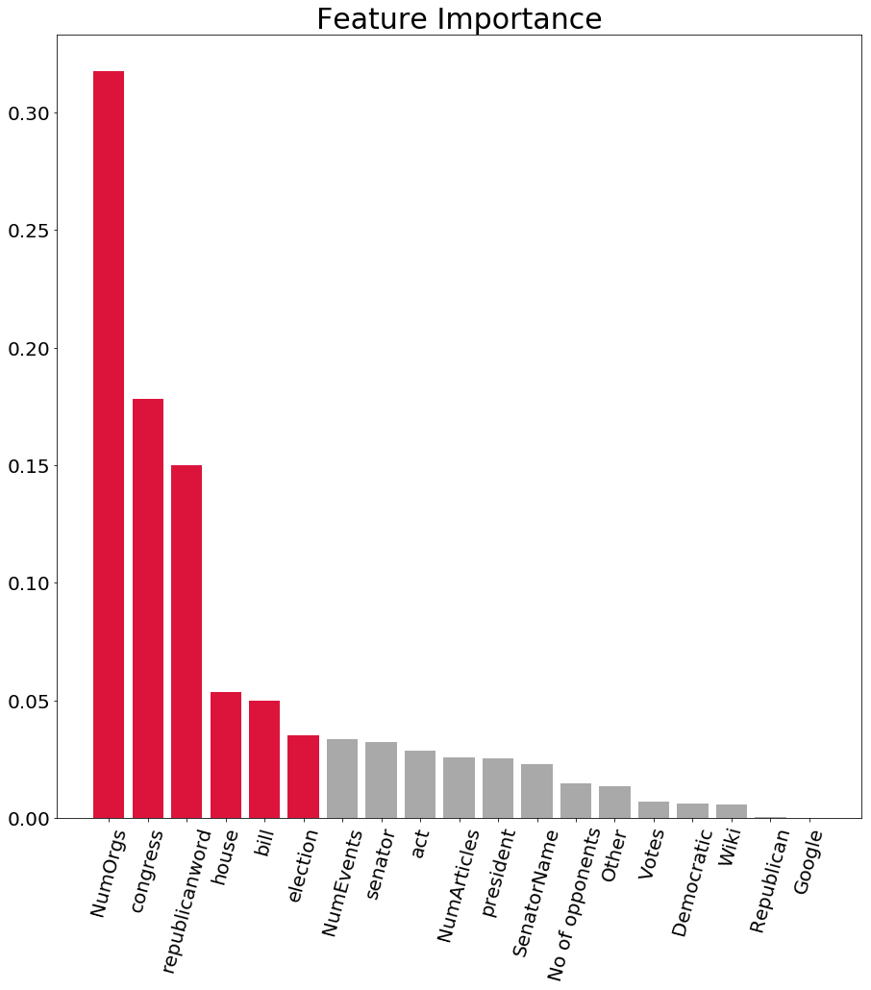
Feature Ranking

Slide 31
Feature Set
Features for all candidates
Additional Features for candidates with Wikipedia
Google | No of Articles
Wiki | No of Opponents
No of Events | Party
No of Orgs
congress | president
republicanword | bill
election | act
house | committee
senator | senate

Slide 32
Ethics and Conclusions
Data sources that are public and open data are used(without needing any entity’s authentication)
At no point, any data that has potential legal implications in future has been used
Model is an ensemble of 2 feature sets depending on whether a politician has a Wikipedia page or not
Having Wikipedia presence also indicates that candidate is more likely to win than a candidate that doesn’t have Wikipedia presence

Slide 33
Future Applications
Future work : take user input to give recommendations
Include NLP of article content
Tweak the model for Presidential elections

