Slide 1

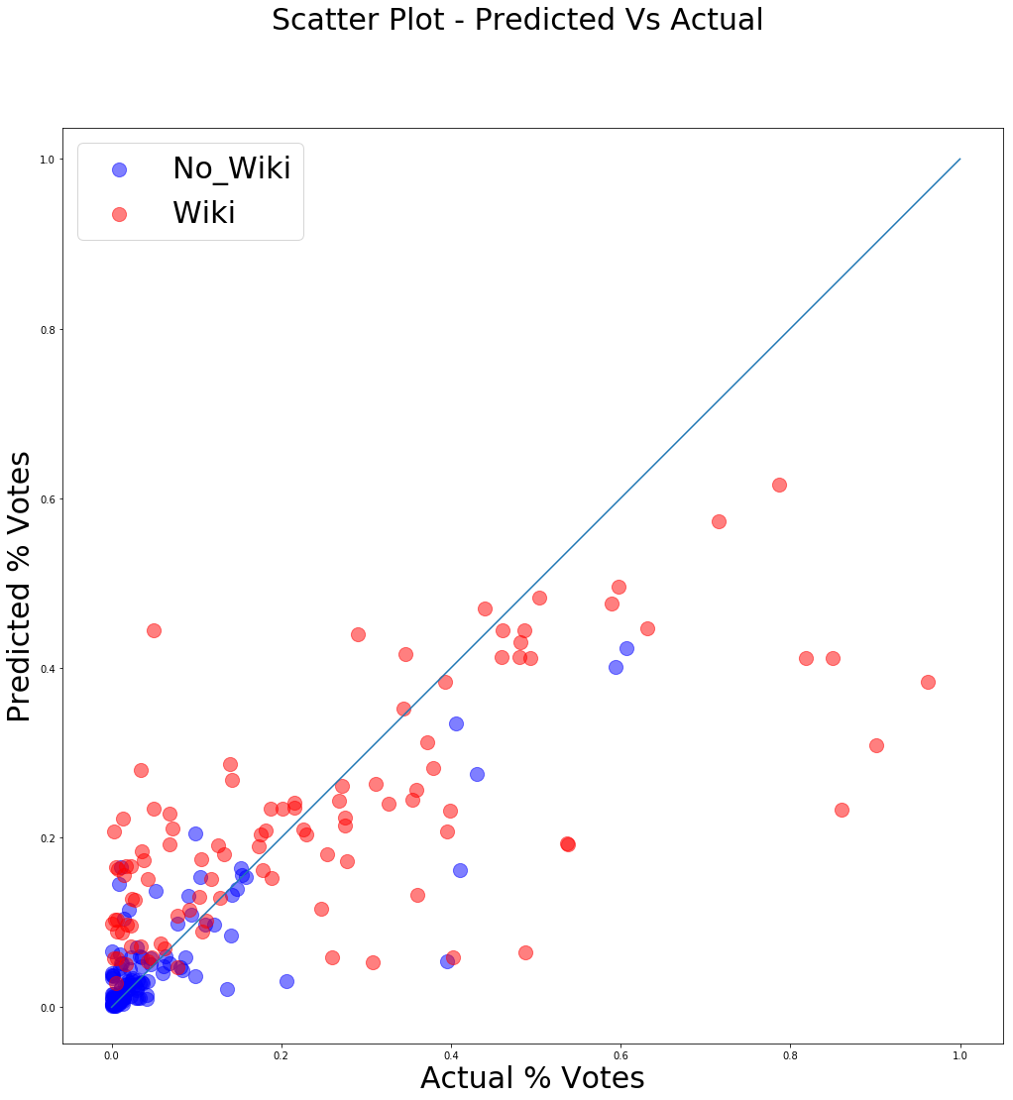
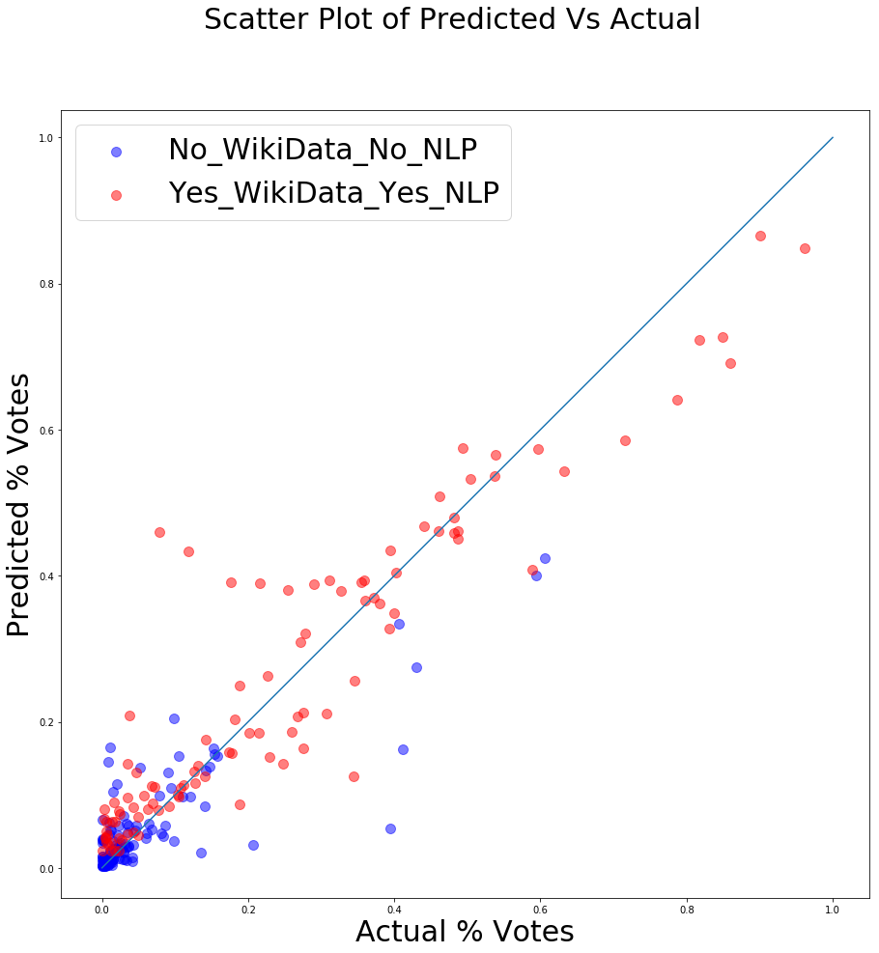
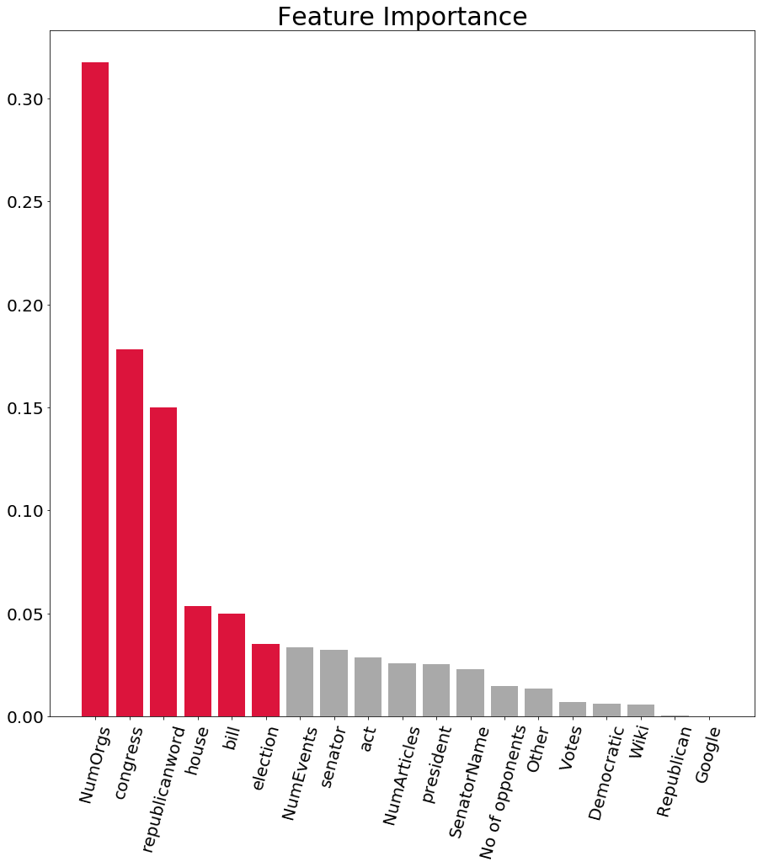
Political Profiling using Feature Engineering and NLP
Chiranjeevi Mallavarapu, Ramya Mandava, Sabitri KC
Master of Science in Data Science
Southern Methodist University, Dallas, TX 75275, USA
Introduction
Model Assessment and Results
Political election results are important media topic discussed
The election outcomes generally are determined based on sample telephone surveys, online polls and paper mailings
Political parties spend most of their campaign budgets on swing constituencies based on initial polls
Fig. 1 : RF Model predictions
Prior to NLP – features in Table 1
Fig. 2 : RF Model predictions
Post NLP – features in Tables 1,2
Optimized Random Forest regression with parameters of 5 fold CV, 150 estimators
After 2 revisions, including Opponents, Party, resulted in a Pearson correlation of 0.796, MSE 0.02 as in fig.1
Revision 3 of the model for candidates with Wiki page including additional feature set as shown in Table 2 resulted in a Pearson correlation of 0.709 and MSE 0.019. The predictions are as illustrated in fig.2
Model is an ensemble model of 2 feature sets depending on whether a politician has a wiki page (NLP) or not (no NLP)
Problem
Inaccuracy of political election predictions due to
  Voter opinion clarity
  Participation during polling: Telephonic surveys are refused by one third of sample ^{[1]}
Non-optimal political campaign spending
Disappointment to voters, media and political analysts due to unanticipated outcomes
Ethics
All 3 data sources are public and open data
No authentication by entity or company was required
No public data was included from social media platforms that might have legal implications
Data is anonymized across the board
Table 1 : Features prior to NLP
Data Acquisition
Google | No of Articles
Wiki | No of Opponents
No of Events | Party
No of Orgs
Fig. 3 : Feature Importance
Conclusions & Future Work
Theme: Open Data + Schematic Data + Big Data
List of candidates and votes that ran for 2016 senate is obtained from Wikipedia^{[2]}. Features are sourced from
  Google’s Knowledge Graph API - Schemas : Person, Events and Organizations related to politicians
  Wikipedia API, Pywikibot - Wiki page of candidate
  NewsAPI – articles from almost 30,000 news sources
Candidates with wiki presence are more likely to win
Top 6 features of importance are as indicated in fig 3
Future work : take user input to give recommendations
Include NLP of article content
Table 2 : Additional NLP Features
References
Feature Engineering and NLP
congress | president
republicanword | bill
election | act
house | committee
senator | senate
[1] Robert M. Groves and Lars E. Lyberg, “An Overview of Non-response Issues in Telephone Surveys,” in Robert Groves et al., eds., Telephone Survey Methodology (New York: John Wiley & Sons, 1988), pp. 203-205.
[2] Wikipedia contributors. (2018, October 20). United States Senate elections, 2016. In Wikipedia, The Free Encyclopedia. Retrieved 18:43, October 24, 2018, from https://en.wikipedia.org/w/index.php?title=United_States_Senate_elections,_2016&oldid=864918942
Top identified features are listed in the table 1 for candidates with no Wikipedia page
Top identified NLP features (words) are listed in table 2 for candidates with Wikipedia page
For NLP, term frequency was used to extract features as listed in table 2 and their TF-IDF scores were used as feature inputs

