Slide 1
Driving the Future: A Deep Learning Approach to Car Racing
Chirudeep Gorle
Adbul Vahed Shaik

Slide 2
Abstract
This project involves implementing and testing Deep Q-Networks (DQN) and PPO in car racing simulations to compare its performance with the Actor2Critic model.
We aim to see if DQN and PPO is better at learning and navigating the challenges of the racing environment. Through practical experimentation, we'll assess how well DQN and PPO performs and whether it outshines the Actor2Critic model in the specific context of car racing.
This project offers a hands-on exploration to understand the strengths of DQN and PPO, providing insights into its effectiveness for reinforcement learning in dynamic scenarios like car racing.
The project's findings will contribute valuable insights into the practical applicability of DQN and PPO in dynamic scenarios, offering a nuanced understanding of its potential advantages over alternative models like Actor2Critic.

Slide 3
Problem Statement
The current challenge lies in achieving optimal performance for a car racing environment using reinforcement learning.
Previous attempts employing the Actor-Critic model have not yielded satisfactory results, indicating a need for a more effective approach.
The limitations of the Actor-Critic model, characterized by suboptimal learning and performance outcomes, prompt the exploration of alternative strategies.
Specifically, we aim to implement the Deep Q-Network (DQN) and PPO in the car racing environment to ascertain whether it can overcome the shortcomings observed with the Actor-Critic model.
The objective is to improve learning efficiency, enhance decision-making in dynamic scenarios, and ultimately achieve superior results in the context of car racing simulations.
This research addresses the identified inadequacies and seeks to advance the understanding of reinforcement learning methodologies for optimized autonomous navigation in complex, dynamic environments.

Slide 4
Motivation
Choosing to implement Deep Q-Networks (DQN) and PPO in car racing simulations is straightforward: to see how well it works compared to the Actor2Critic model.
The motivation is practical exploration, aiming to understand if DQN and PPO stands out in learning and navigating the challenges of dynamic racing scenarios.
The project seeks to provide straightforward insights into DQN's and PPO potential advantages over Actor2Critic in the specific realm of car racing.
It's a focused effort to optimize learning algorithms for real-world applications, offering a clearer understanding of effective strategies for training autonomous agents in high-stakes, dynamic environments like car racing simulations.
This project is all about hands-on exploration and gaining practical insights for advancing reinforcement learning in the context of dynamic and complex scenarios.

Slide 5
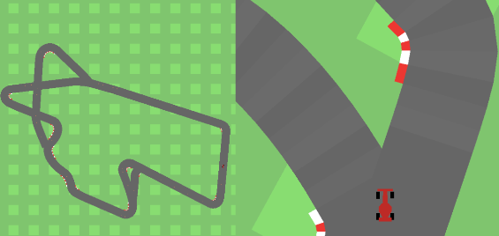
CarRacing-V0 Environment
State Representation: The game displays a simple 2D view with a resolution of 96x96 pixels, using the standard RGB color scheme.
Rewards and Penalties: For every frame, a slight penalty of -0.1 is applied. The main goal is to drive over track tiles, earning +1000 divided by the total number of tiles. Crossing the outer barrier results in a hefty -100 penalty, ending the game.

Slide 6
CarRacing-V0 Environment
Success Criteria: To succeed, the player must consistently gather a total reward of 900 within a maximum time frame of 1000 frames.
Terrain Challenges: The environment includes grass patches outside the track. While they don't give rewards, they make it difficult for the car to get back on the track due to increased friction.
Simplicity Compared to 3D Environments: CarRacing-v0 is simpler than 3D environments, making it more accessible for learning and experimentation in reinforcement learning.

Slide 7

Implementation - Enhancing Model Training Efficiency with Google Colab GPU
Training time is an essential part of deep learning, due to the fact that learning takes lots of time to be able to learn whatever process the model is being applied upon. For many situations, GPUs are a must as they exponentially increase the speed of training, thus training the model quicker, allocating the additional training time for perfecting the model, and tweaking the extra changes.

Slide 8
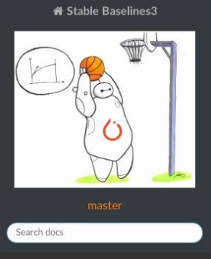
Stable Baselines3 Library .1
We are going to utilize brand new version of library Stable Baselines3, which contains improved implementations of Reinforcement Learning algorithms, in native Pytorch.

Slide 9
Implementation - DQN
Import necessary libraries, including DQN from stable-baselines 3, and relevant components for handling the environment.
Create a CarRacing environment using the gym library. Wrap the environment with DummyVecEnv to handle vectorized environments. Apply frame stacking (VecFrameStack) to capture temporal information.
Initialize the DQN model using the "CnnPolicy" (convolutional neural network policy) suitable for image-based observations. Set the environment and enable verbose logging for better feedback during training.
Set Training Parameters
Use the learn method to train the DQN model for the specified number of steps.
Save the trained model
Evaluate the performance of the trained model over a specified number of evaluation episodes.
Visualize the trained agent interacting with the CarRacing environment.

Slide 10
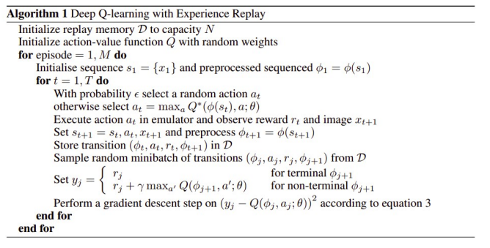
DQN Algorithm

Slide 11
Implementation - Experiments
Experiment 1 | Experiment 2 | Experiment 3
Buffer_size: 100000 | Buffer_size : 150000 | Buffer_size : 150000
Maximum_steps_per_episode : 10000 | Maximum_steps_per_episode : 2000 | Maximum_steps_per_episode : 5000
Log_interval : 20 | Log_interval : 50 | Log_interval : 50
Episodes : 1000 | Episodes : 900 | Episodes : 500

Slide 12
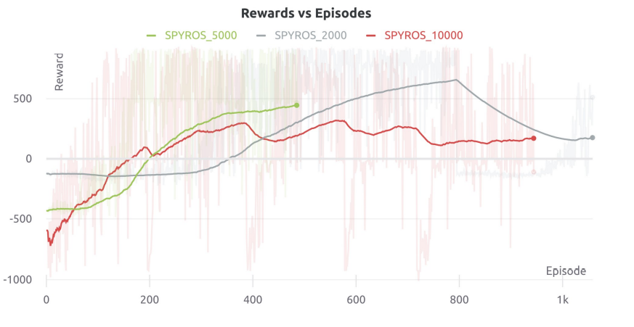
Results

Slide 13
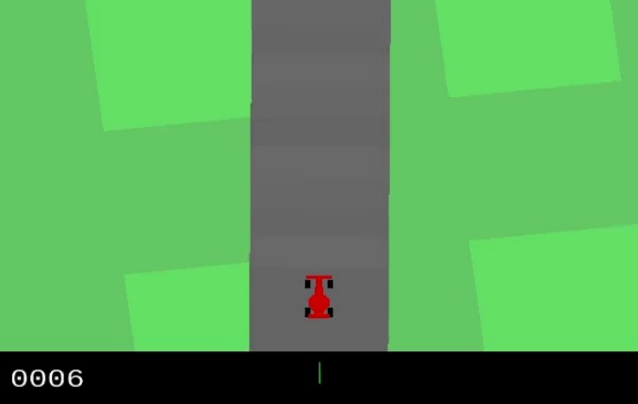
Evaluation of our best DQN model

Slide 14
Catastrophic Forgetting .1
We aimed to gather some significant information about DQN's performance, from this project Implementing Deep Q-Network (Brown University), which are going to verify our experiment's results.
A common belief for new users of DQN is that performance should fairly stably improve as more training time is given. Indeed, average Q-learning learning curves in tabular settings are typically fairly stable improvements and supervised deep-learning problems also tend have fairly steady average improvement as more data becomes available.
However, it is not uncommon in DQN to have “catastrophic forgetting” in which the agent’s performance can drastically drop after a period of learning. For example, the DQN agent may reach a point of averaging a high score over 400, and then, after another large batch of learning, it might be averaging a score of only around 200.

Slide 15
PPO
“Proximal Policy Optimization (PPO), which perform comparably or better than state-of-the-art approaches while being much simpler to implement and tune.”

Slide 16
Why use PPO?
Solves problems like:
Unstable Policy Update
Data Inefficiency
Advantages:
Ease of Implementation
Sample Efficiency
Ease of Tune
Unlike popular Q learning approaches, like DQN, that can learn from stored offline data, PPO learns online. This means that it doesn't use a replay buffer to store past experiences, but instead it learns directly from whatever its agent encounters in the environment. Once a batch of experience has been used to do a gradient update, the experience then is discarded and the policy moves on. This also means that Policy Gradient Methods are typically less sample efficient than Q learning methods because they only use the collected experience once for doing an update.

Slide 17
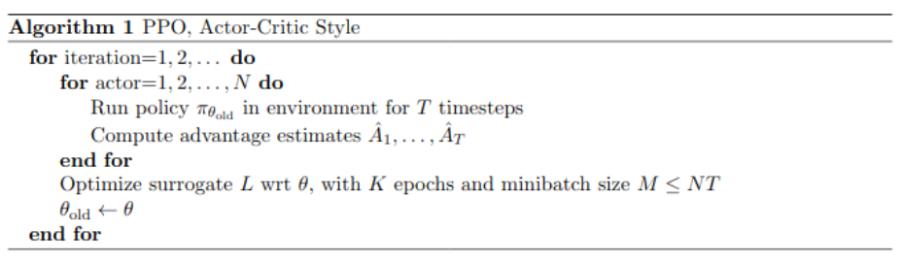
Algorithm

Slide 18
Experiments with PPO
We used the Open Source Library, Stable Baselines instead of Stable Baselines 3.
We used the PPO2 model, instead of PPO1, as it is the implementation of OpenAI made for GPU.
PPO2 version is 3 times faster than the implementation of PPO1.

Slide 19
Hyperparameters
gamma = 0.99
n_steps = 64
ent_coef = 0.01
learning_rate = 0.00025
vf_coef = 0.5
max_grad_norm = 0.5
lam = 0.95
nminibatches = 4
noptepochs = 4
cliprange = 0.2

Slide 20
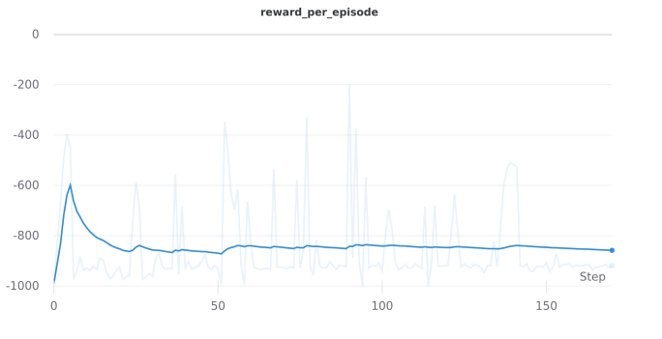
1st Experiment
Here is our first attempt with 10.000 timesteps and 150 episodes

Slide 21
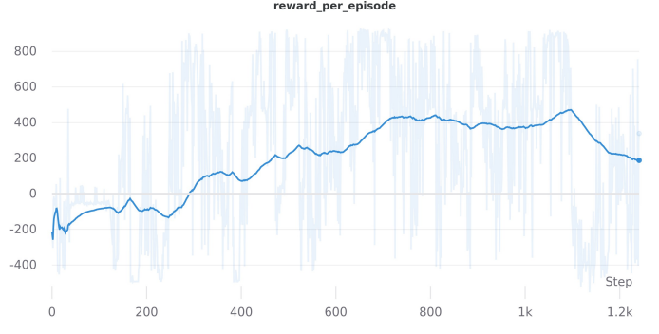
Best Experiment
Here is our best attempt with 5000 timesteps and 1.2k episodes

Slide 22
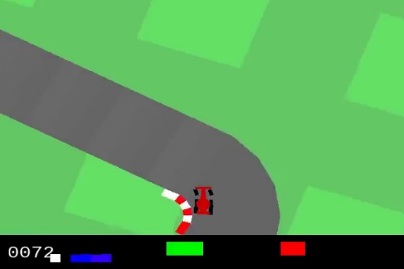
Evaluation

Slide 23
Conclusion
In conclusion, the utilization of Deep Q-Networks (DQN) has proven to be a successful choice for the car-racing project, outperforming the Actor-Critic model.
The robustness and simplicity inherent in DQN contributed to more stable and effective learning in the complex racing environment. However, recognizing the imperfections and areas for enhancement, the focus in future work will be on mitigating catastrophic forgetting.
By addressing this challenge, there is a clear path towards further refining the performance of DQN in the car-racing domain.
This commitment to continuous improvement aligns with the evolving landscape of reinforcement learning and underscores a dedication to pushing the boundaries of what is achievable in autonomous agent training for dynamic scenarios like car racing.

