Slide 1
BABEȘ-BOLYAI UNIVERSITY · FACULTY OF MATHEMATICS AND COMPUTER SCIENCE
CalorieTrack
An AI-Assisted Mobile Application for Nutrition Tracking, Food Ordering and Complaint Verification
AUTHOR Chis Denis
SUPERVISOR Lect. PhD. Horea Bogdan Mureșan
Cluj-Napoca · 2026
Notes:
~45s. Good morning. My thesis is CalorieTrack, an AI-assisted mobile app that does three things in one place: it tracks nutrition, it lets you order food, and it helps restaurants verify complaint photos. My supervisor is Lect. PhD. Horea Bogdan Mureșan. I'll walk through the idea, how it's built, the problems I hit and how I solved them.

Slide 2
THE TITLE, IN THREE PARTS
01
Nutrition Tracking
Log every meal with a full macronutrient breakdown — from objective USDA data, not crowd-sourced guesses.
USDA FoodData Central
6 macros
Daily totals
CalorieTrack · Chis Denis
02 / 14
Notes:
~40s. Part one — nutrition tracking. You record meals with a full macro breakdown: calories, protein, carbs, fat, fiber, sugar. The food data comes from the USDA official database, not user-submitted entries, so the numbers are objective and consistent.

Slide 3
THE TITLE, IN THREE PARTS
02
Food Ordering
Ordering a meal is logging it. One atomic checkout writes the order, debits the wallet, and logs every item as a meal.
76 restaurants
One transaction
Simulated wallet
CalorieTrack · Chis Denis
03 / 14
Notes:
~40s. Part two — food ordering. The key idea: ordering and logging are the SAME action. At checkout, the order is saved, the wallet is debited, and every item is logged as a meal — all in one atomic database transaction. If any step fails, the whole thing rolls back. You never re-enter what you ordered.

Slide 4
THE TITLE, IN THREE PARTS
03
Complaint Verification
A tool for restaurant owners: is this complaint photo a real camera capture, edited, or AI-generated?
On-device
EXIF
C2PA credentials
CalorieTrack · Chis Denis
04 / 14
Notes:
~40s. Part three — complaint verification. This one is for the business owner. When a customer sends a complaint photo, the app decides whether it's a genuine camera photo, an edited one, or AI-generated — so an owner can tell a real complaint from a faked or recycled picture.

Slide 5
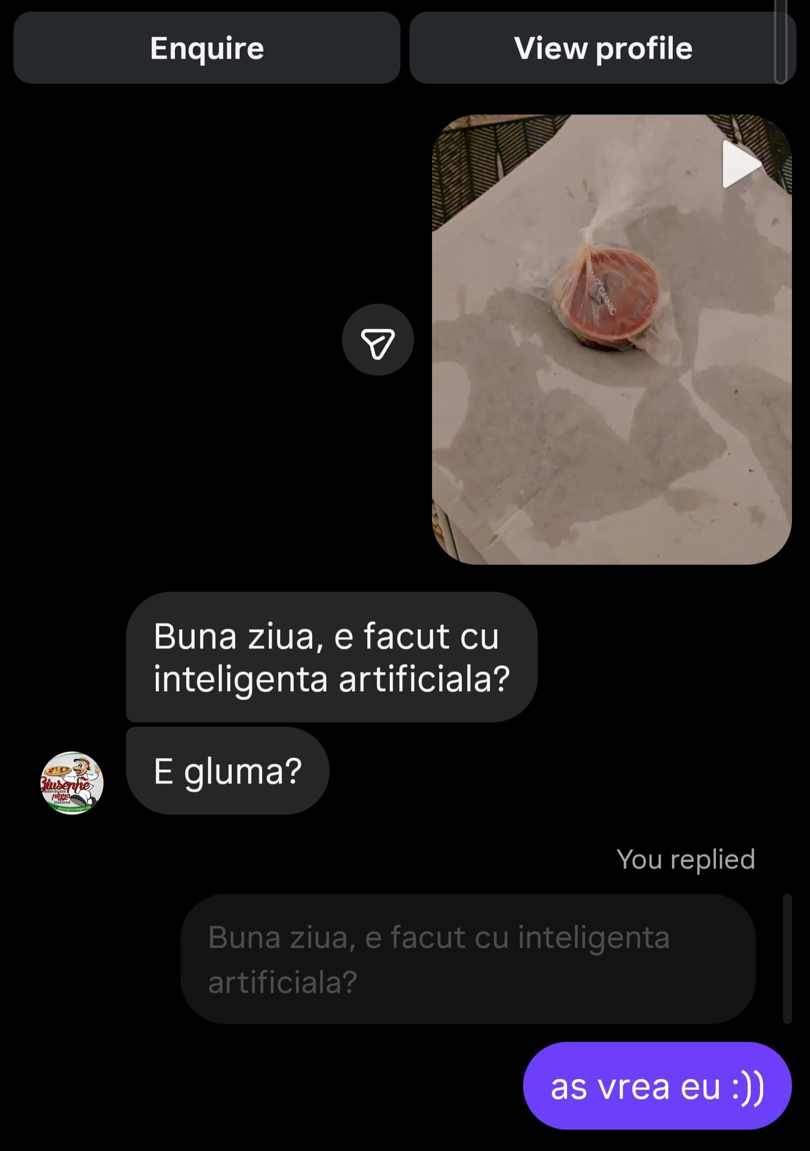
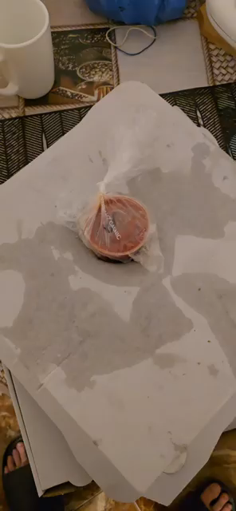

WHERE THE IDEA STARTED
The problem I ran into myself
CalorieTrack · Chis Denis
05 / 14
Notes:
~60s. PLAY THE VIDEO. This is the moment the idea started. I ordered food through a delivery app, and then had to open a separate calorie tracker and type the whole meal back in by hand — guessing the numbers. The tracker knew my goals but nothing about tonight's menu; the delivery app knew the menu but nothing about my day. The two never talk to each other. That gap is exactly what CalorieTrack closes.

Slide 6
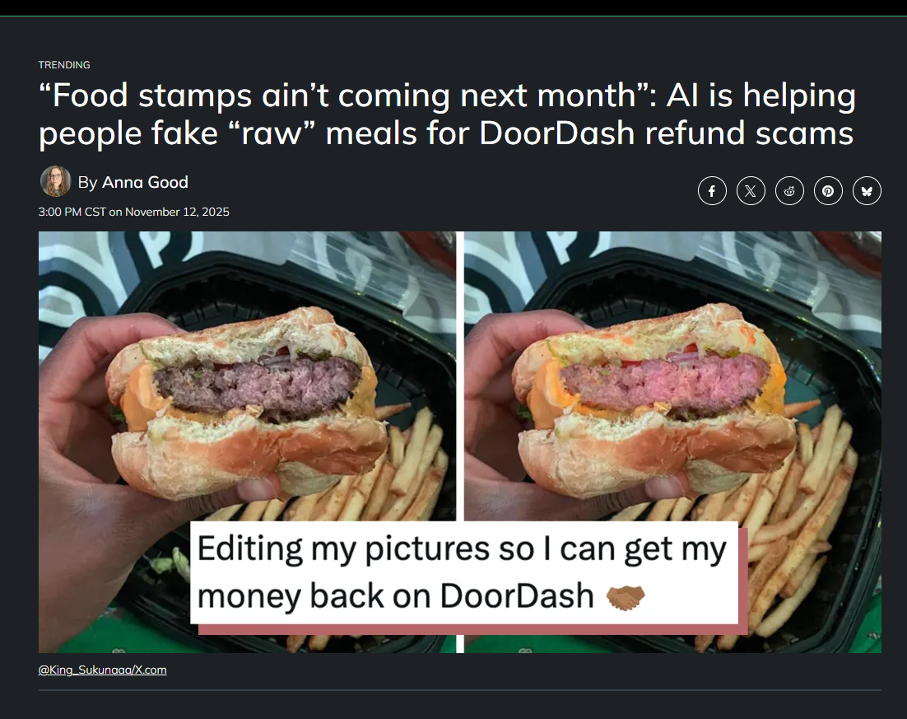

SOURCES
What it looks like
CalorieTrack · Chis Denis
06 / 14
Notes:
~40s. Here's the built app running on an Android emulator. On the left, the home screen with the day's meals and macro totals. In the middle, a restaurant menu and the ordering flow. On the right, the complaint verification screen for owners. Same design language throughout — I'll drop real screenshots in here.

Slide 7
STATE OF THE ART
Everyone solves half of it
TRACKERS
DELIVERY
FORENSICS
MyFitnessPal · Lifesum Yazio · Cronometer
Uber Eats · Glovo Bolt Food · Tazz
EXIF · C2PA deepfake detectors
Track well — but can't order. Often lean on crowd-sourced data.
Order well — but never track. Calories stop at the screen.
The tools exist — but live in neither the tracker nor the app.
CalorieTrack unifies all three — and enforces safety in code, not in a prompt.
CalorieTrack · Chis Denis
07 / 14
Notes:
~55s. Where does this sit? Trackers like MyFitnessPal, Lifesum, Yazio, Cronometer track well but can't order, and many rely on crowd-sourced data that's often wrong. Delivery apps — Uber Eats, Glovo, Bolt Food, Tazz — order well but never track; the calorie number just sits on screen. And image forensics tools exist but aren't inside either app. CalorieTrack brings all three together.

Slide 8
ARCHITECTURE
Clean, layered — a domain with zero framework code
PRESENTATION
INFRASTRUCTURE
implements the domain's interfaces
SQLite (sqflite)
USDA client
OpenAI client
PBKDF2 hasher
Screens · view-models · design system
APPLICATION
Use cases · stores · DTOs
DOMAIN
Entities · value objects · rules — no Flutter imports
Dependencies point inward. The domain knows no database, no HTTP, no Flutter — one composition root wires the concrete pieces in.
CalorieTrack · Chis Denis
08 / 14
Notes:
~55s. It's built on clean, layered architecture. Presentation depends on application, application on domain. The domain — the entities and business rules — has zero framework code: no database, no HTTP, no Flutter. Infrastructure sits outside and implements the interfaces the domain defines: SQLite, the USDA and OpenAI clients, the password hasher. A single composition root wires it all together. That's what makes the core logic testable and the constraints enforceable.

Slide 9
THE CORE IDEA
Filter first in code — let the model only rank
User context
today's meals · goal wallet · history
Filter in Dart
drop unsafe: allergy · diet · budget
Model ranks
orders only the dishes that survived
Validate IDs
invented dishes are thrown away
4 ranked meals
with a one-line reason each
The constraint is a structural guarantee.
temperature 0 · seed derived from the request · strict JSON schema → the same situation always yields the same suggestions. A dish that isn't on the menu — or that breaks an allergy — can never reach the screen.
CalorieTrack · Chis Denis
09 / 14
Notes:
~65s. This is the heart of the thesis. Most apps put allergies and budget into the prompt and hope the model obeys — but a language model can ignore instructions or invent dishes. So I flip it: FIRST, in plain Dart, I discard every dish that breaks an allergy, a diet, or the budget. Only the safe set is sent to the model, and its only job is to rank them. Then I validate the returned IDs and throw away anything invented. The call fixes temperature to zero, seeds from the request, and pins a strict schema — so it's reproducible. Safety is enforced by the architecture, not requested from the model.

Slide 10
PROBLEM → SOLUTION
USDA is accurate — and overwhelming
PROBLEM
SOLUTION
Search “chicken” across 300,000+ USDA foods and the first hits were oils, powders, cakes and juices. Technically matches. Practically useless.
A FoodRankingService scores every result by how well the name matches, and penalises derivatives — oil, powder, cake, syrup, juice. The food you actually meant floats to the top.
CalorieTrack · Chis Denis
10 / 14
Notes:
~50s. First problem. The USDA database is authoritative, but it's huge — over three hundred thousand items. When I searched 'chicken', the top results were chicken oil, chicken powder, chicken-flavored cake. Correct matches, useless suggestions. So I wrote a ranking service: it scores each result on name-match quality and penalises derivative words like oil, powder, cake, juice. The real food rises to the top. It's a pure function in the domain layer, so I can unit-test it.

Slide 11
PROBLEM → SOLUTION
You can't order from two restaurants at once
PROBLEM
SOLUTION
Users tried to add dishes from several restaurants into one cart — an order no single kitchen could ever deliver together.
The cart is bound to one restaurant. Switching asks for confirmation and starts fresh — so checkout stays a single, deliverable, atomic order.
CalorieTrack · Chis Denis
11 / 14
Notes:
~45s. Second problem. Early on you could add dishes from different restaurants into the same cart — but no kitchen can deliver a burger from one place and sushi from another in one order. So the cart is bound to a single restaurant. If you pick something from another one, it asks you to confirm and starts a fresh cart. This is enforced right in the Cart domain object — trying to mix restaurants raises a conflict. It keeps checkout a single, atomic, actually-deliverable order.

Slide 12
COMPLAINT VERIFICATION
How a photo is judged — from the file, not the pixels
Read: EXIF camera make & model + capture time · software tag · C2PA content credential (byte scan)
Likely AI-generated
C2PA credential or generator tag found
0.95
Possibly edited
software tag names a photo editor
—
Likely genuine
real camera make + model (higher if a capture date is present)
—
Inconclusive
no usable signal — metadata can be stripped, so this is not “genuine”
0.40
Deterministic — same file, same verdict. The model never sees the image; it only puts the verdict into words. A missing signal is a reason to abstain, not to accuse.
CalorieTrack · Chis Denis
12 / 14
Notes:
~60s. How does the photo check actually work? It reads the FILE, not the pixels — that's what lets it answer instantly on the phone. It pulls the EXIF camera make and model and capture time, any software tag, and scans for a C2PA content credential. Then it maps those signals to one of four verdicts, strongest first: a C2PA credential or generator tag means likely AI-generated, high confidence. An editor tag means possibly edited. A real camera make and model means likely genuine. And crucially — no signal means INCONCLUSIVE, not genuine, because metadata can be stripped. It's deterministic, and the model never sees the image, so a convincing fake can't fool it.

Slide 13
CONTRIBUTIONS
Three decisions that make it trustworthy
01
Ordering = logging
One atomic transaction writes the order, debits the wallet and logs every item. The daily totals can't drift.
02
Safety by architecture
AI recommendations enforce allergies, diet and budget in code — and are reproducible, not random.
03
Verifiable evidence
Complaint photos judged deterministically from the file; the model never sees the image.
CalorieTrack · Chis Denis
13 / 14
Notes:
~45s. To sum up the contributions. One: ordering and tracking are unified in a single atomic transaction, so nothing drifts. Two: the AI recommender enforces safety in the architecture, not the prompt, and it's reproducible. Three: complaint photos are verified deterministically from the file, with the model kept away from the image. One app that records what you eat, ties it to real ordering, and defends the trust that ordering depends on.

Slide 14
Thank you
Questions?
CalorieTrack · Nutrition Tracking · Food Ordering · Complaint Verification
Chis Denis · Supervisor: Lect. PhD. Horea Bogdan Mureșan · 2026
Notes:
~15s. Thank you — I'm happy to take questions. Likely questions: why not put constraints in the prompt (reliability + reproducibility); why metadata not pixel analysis (instant, on-device, no trained model); why a local SQLite / no backend (scope of a thesis, local-first, atomic transactions).

