Slide 1
Social Buzz
Data Analytics Report
By Chisom Ibezim

Slide 2
Agenda
Data Preparation
Data Visualization
Data Storytelling

Slide 3

Data Preparation
Data Preparation
involves identifying and creating new data points which can be calculated from existing entries.
From the dataset provided, there was need for data cleaning and pre-processing. From the dataset, we worked on the users age and made sure the data item contained only reasonable range of values useful for generation of insights. Also, a new data item - Age group, was generated to capture group interactions with the contents.

Slide 4

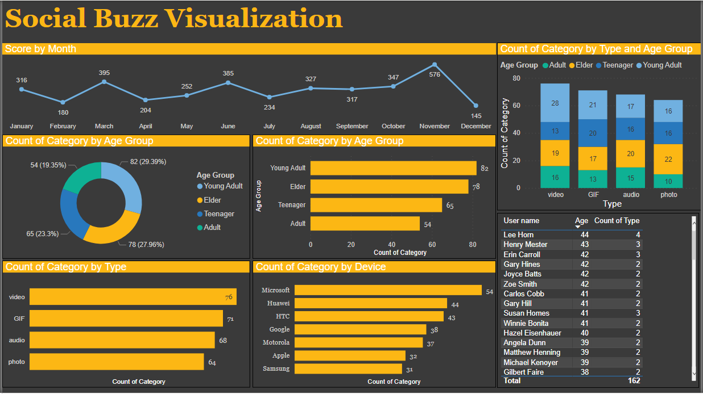
Data Visualization

Slide 5
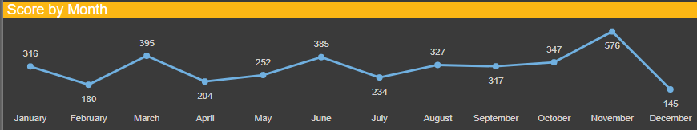
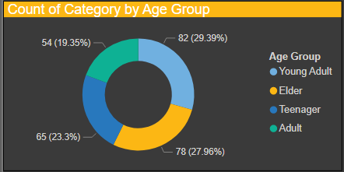
Data Storytelling
There is something about November and December…
In November, a high score of
576
was recorded, and the following month showed a drastic decline with a score of
145
AS EXPECTED…
About
29.4%
of those who interact with our contents are
Young Adults
THIS IS SURPRISING…
About
28%
Of those viewing our contents are Elders

Slide 6
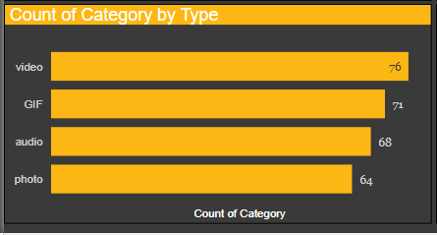
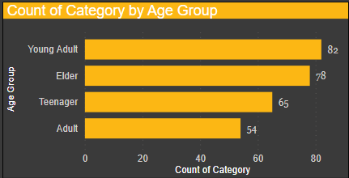
Data Storytelling
HUMANS ARE VISUAL LEARNERS…
75.6%
of those who use our contents come to view either video, GIF or photo
compared to 24.4% who view audio contents.
THERE IS NEED TO MODIFY OUR CONTENT…
Only
65 teenagers
interact with our contents. We need to concentrate on the younger ones and meet their needs.

Slide 7
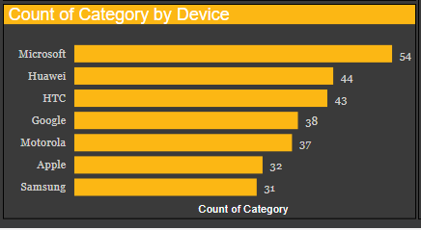
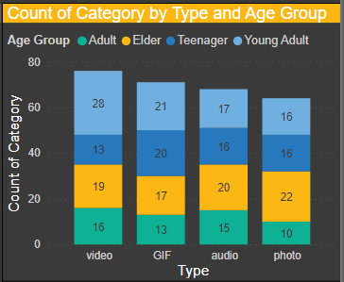
Data Storytelling
MICROSOFT DOMINATES….
19.4%
of those who use our contents use a Microsoft device
compared to 11.1% who use a Samsung device.
FURTHER NEED TO MODIFY OUR CONTENT…
Only
13 teenagers
interacted with our video contents. This demands the need to find out what content our teenagers are interested in.

