Slide 1


VIDEO RENTAL STORE DATABASE ANALYSIS
Chisom Ibeneme Juan

Slide 2
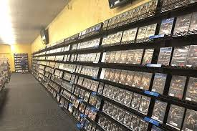
INTRODUCTION
The DVD rental industry has witnessed significant transformation over the past few decades, driven by advancements in technology and shifting consumer preferences. This project focuses on analyzing the database of a video rental store to gain insights into the store's operations and customer behaviour. PostgreSQL was utilized for data extraction, transformation and analysis.

Slide 3
OBJECTIVES
Analyze the database schema and understand the relationships between different tables.
Retrieve relevant data using SQL queries to answer specific business questions.
Perform data manipulation and transformation to prepare the data for analysis.
Generate insights and recommendations based on the rental patterns, customer behavior, and inventory management to drive decision making.

Slide 4
DATA SET DESCRIPTION
actor: Table to store information about actors, with actor_id as the primary key.
address: Table to store address information, with address_id as the primary key and a foreign key city_id referencing the city table.
category: Table to store film categories, with category_id as the primary key.
city: Table to store city information, with city_id as the primary key and a foreign key country_id referencing the country table.
country: Table to store country information, with country_id as the primary key.
customer: Table to store customer information, with customer_id as the primary key and a foreign key address_id referencing the address table.
film: Table to store film information, with film_id as the primary key and a foreign key language_id referencing the language table.

Slide 5
DATA SET DESCRIPTION
film_category: Table to store the relationship between films and categories, with a composite primary key (film_id, category_id) and foreign keys to the film and category tables.
film_rating: Likely a table to store film ratings, but the columns are not defined in this script.
inventory: Table to store inventory information, with inventory_id as the primary key and a foreign key film_id referencing the film table.
language: Table to store language information, with language_id as the primary key.
payment: Table to store payment information, with payment_id as the primary key and foreign keys to the customer, rental, and staff tables.
rental: Table to store rental information, with rental_id as the primary key and foreign keys to the customer, inventory, and staff tables.
staff: Table to store staff information, with staff_id as the primary key and a foreign key address_id referencing the address table. The staff table also has a self-referencing foreign key manager_staff_id that references the staff table.

Slide 6
APPROACH
The analysis will involve the following steps:
Data Source Identification
Creation of Database (dvdrental)
Import Data into pgAdmin
Data cleaning (Checked for missing values, duplicates, data type and outliers)
Data Manipulation and Transformation (Converted data types as necessary (e.g., dates,
numerical values).
Data Analysis
Interpretation: Drawing meaningful insights from the data analysis.

Slide 7
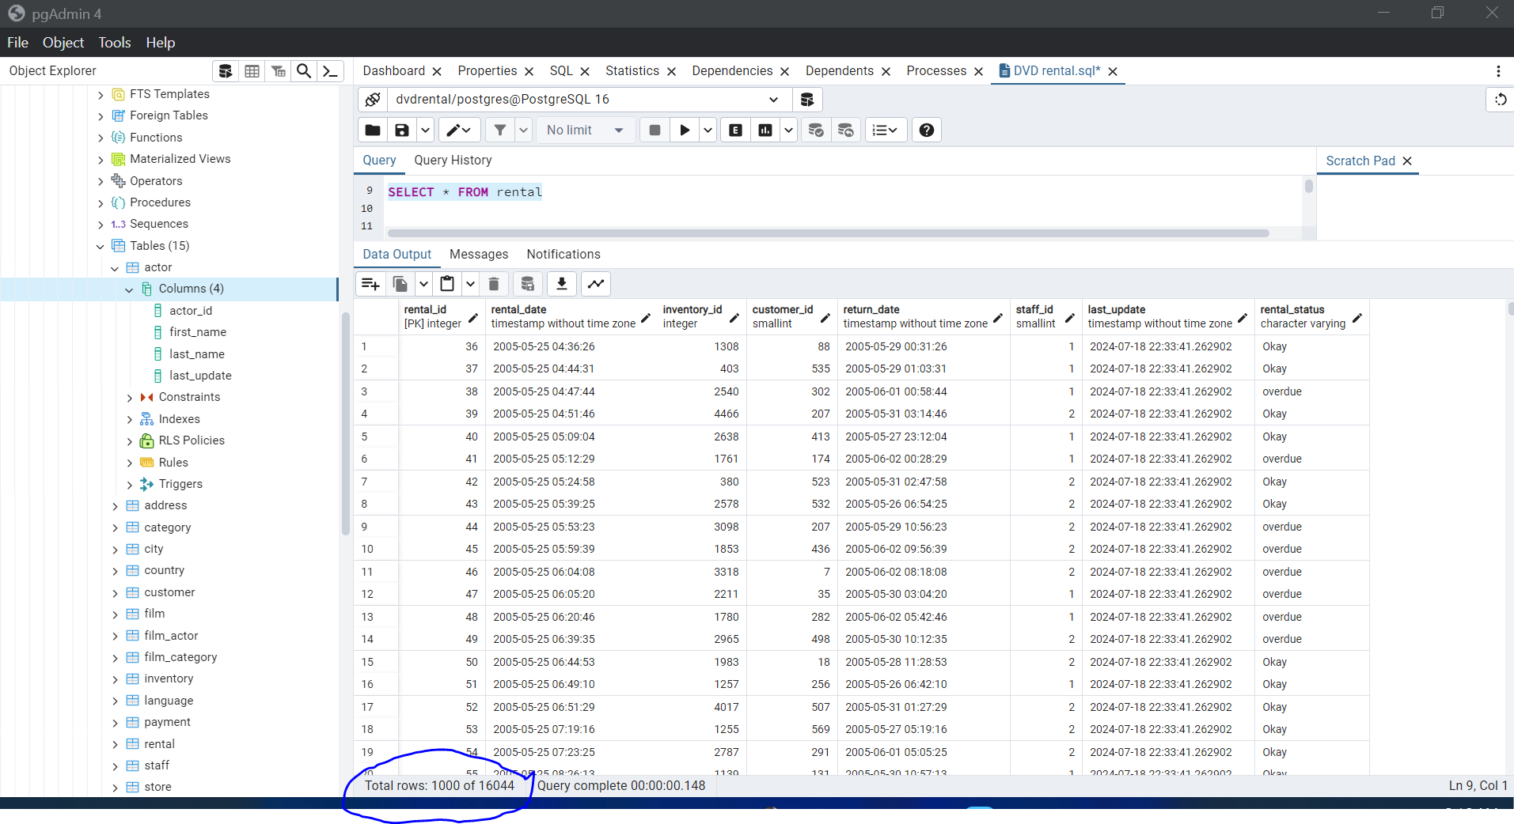
EXAMINING THE DATASET IN PGADMIN
Knowing the total rows in a dataset is important for several reasons:
✓ Data Integrity
✓ Quality Assurance
✓ Performance Tuning
✓ Data Analysis
✓ Auditing and
Compliance

Slide 8
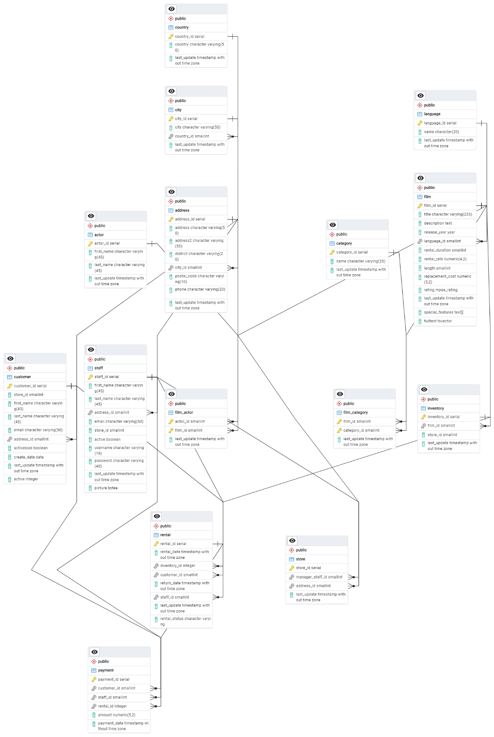
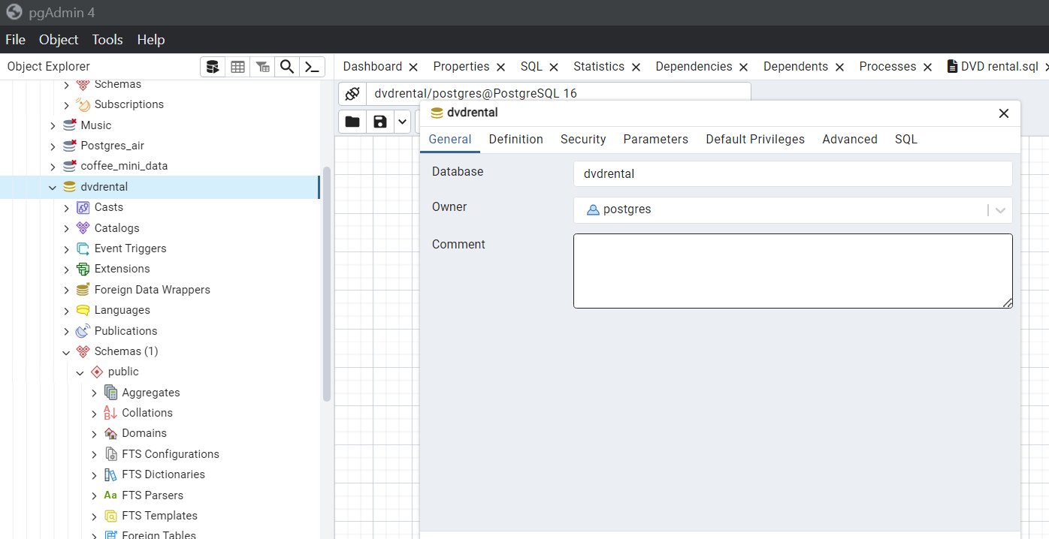
DATABASE & ERD
DVDRENTAL DATABASE
Entity relationship diagram that shows how the tables are connected to the primary keys and secondary keys

Slide 9
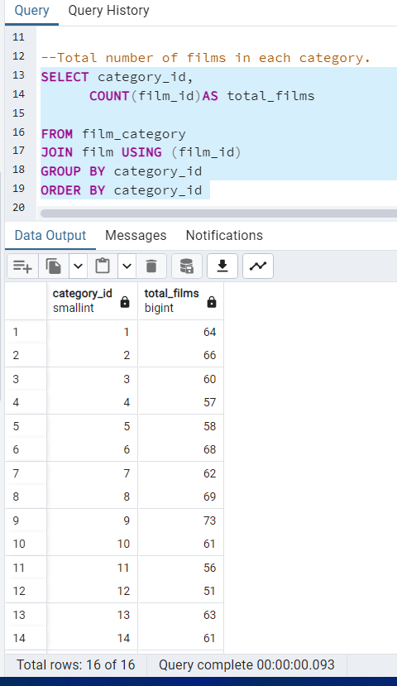
DATA RETRIVAL AND ANALYSIS
Total number of films
in each category.

Slide 10
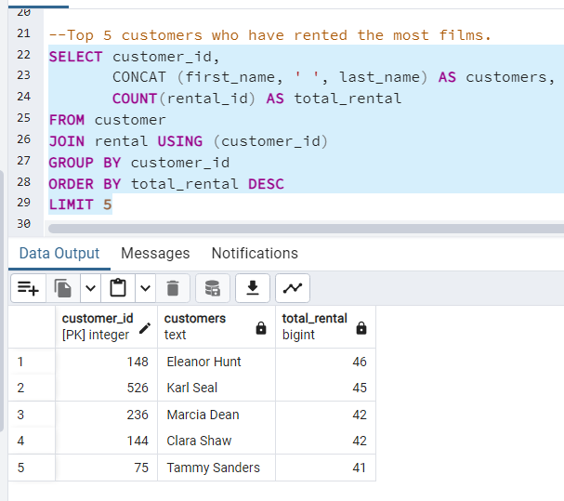
TOP 5 CUSTOMERS WHO HAVE RENTED THE MOST FILMS.
This provides insight on who the top customers are and will drive decision making for the company.

Slide 11
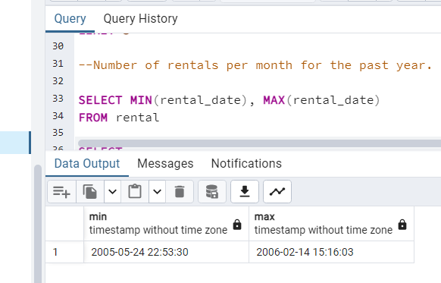
THE MIN AND MAX DATE.
Ensuring that the min date and max date are within expected ranges helps maintain data integrity.
It prevents incorrect or invalid dates from being entered into the dataset, which can affect the accuracy of analyses and reports.
It helps identify inconsistencies such as end dates that precede start dates, which can indicate data entry errors or anomalies.

Slide 12
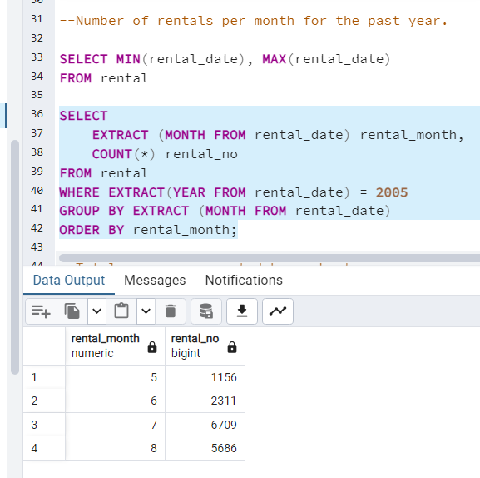
NUMBER OF RENTALS PER MONTH FOT THE PAST YEAR.
Calculating number of rental per month helps to identify trend which provides insight for decision making

Slide 13
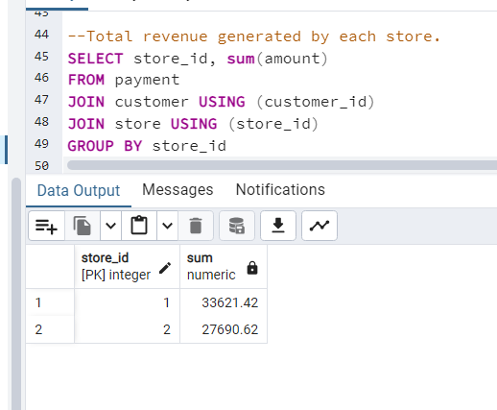
TOTAL REVENUE GENERATED BY EACH STORE.
Knowing store that generate more revenue is a very important insight in a video rental store. This will help drive decision making.

Slide 14
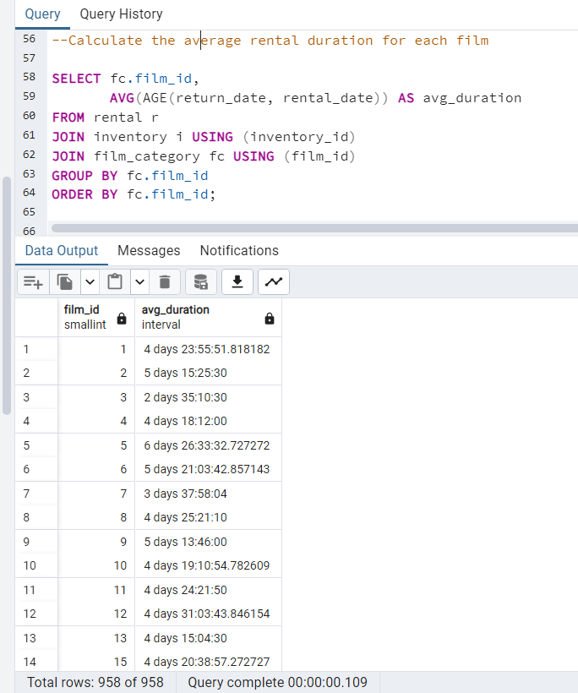
AVERAGE RENTAL DURATION FOR EACH FILM.
Calculating average rental duration helps to understand the trend. It provides insight as to whether a film rental duration should be increased or not.

Slide 15
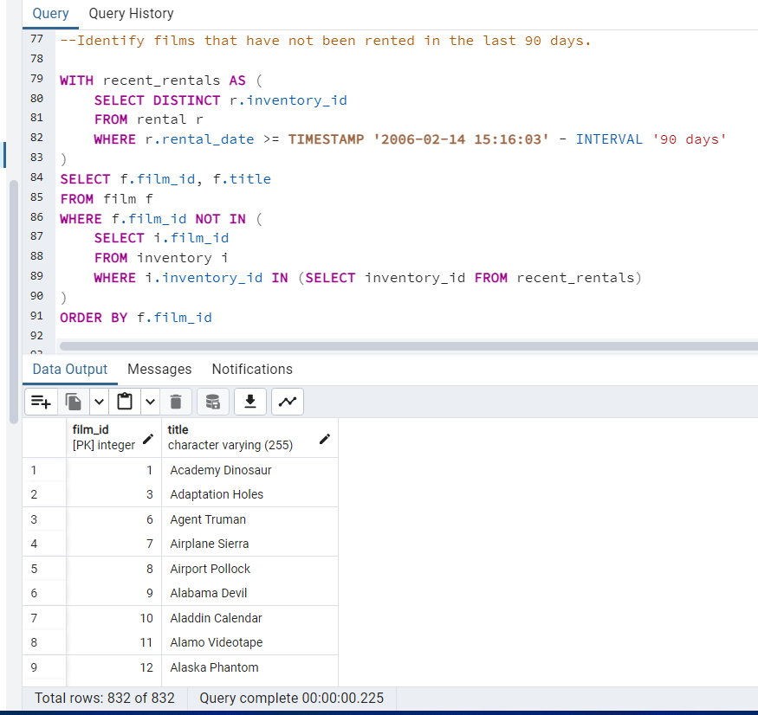
FILMS THAT HAVE NOT BEEN RENTED IN THELAST 90 DAYS.
Knowing films that have not been rented for sometime provides insight and helps drive business decision.

Slide 16
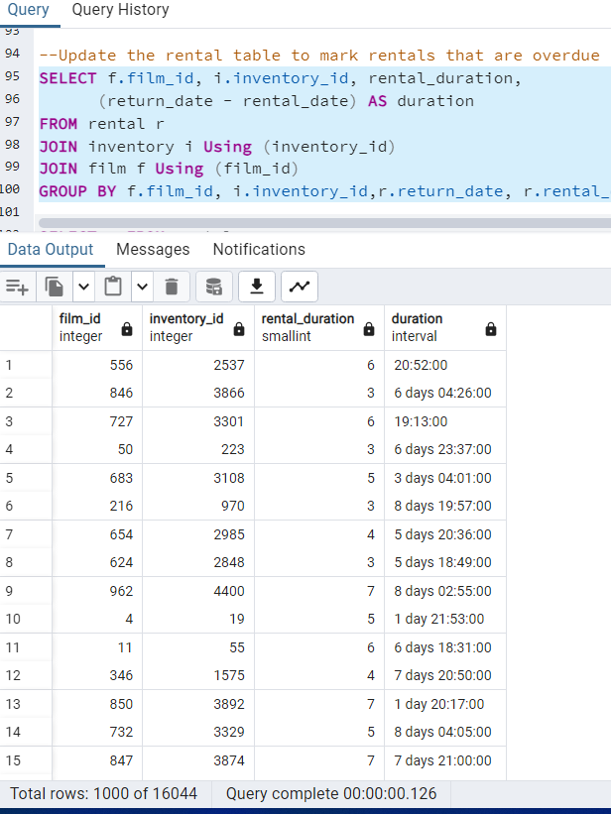
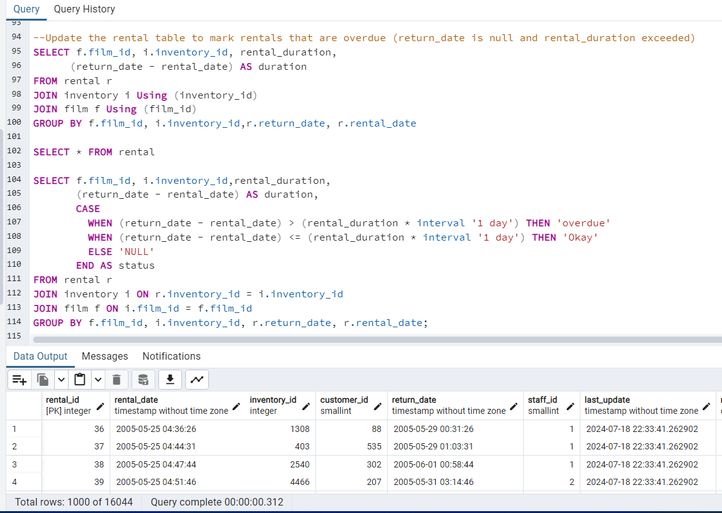
DATA MANIPULATION ON RENTAL TABLE.
Step 1
Rental table overview. And query to see the exceeded duration

Slide 17
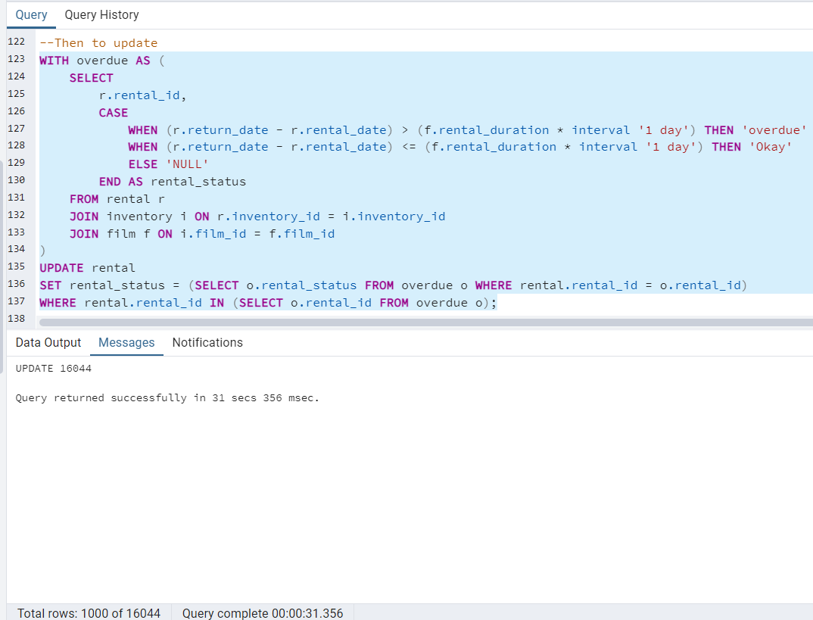
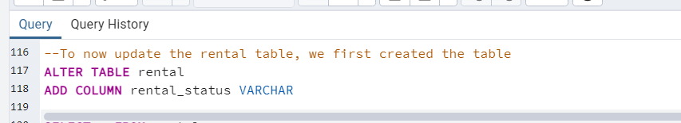
UPDATE RENTAL TABLE TO MARK RENTALS THAT ARE OVERDUE.
Step 2
This query was used to create a new table and then populated it

Slide 18
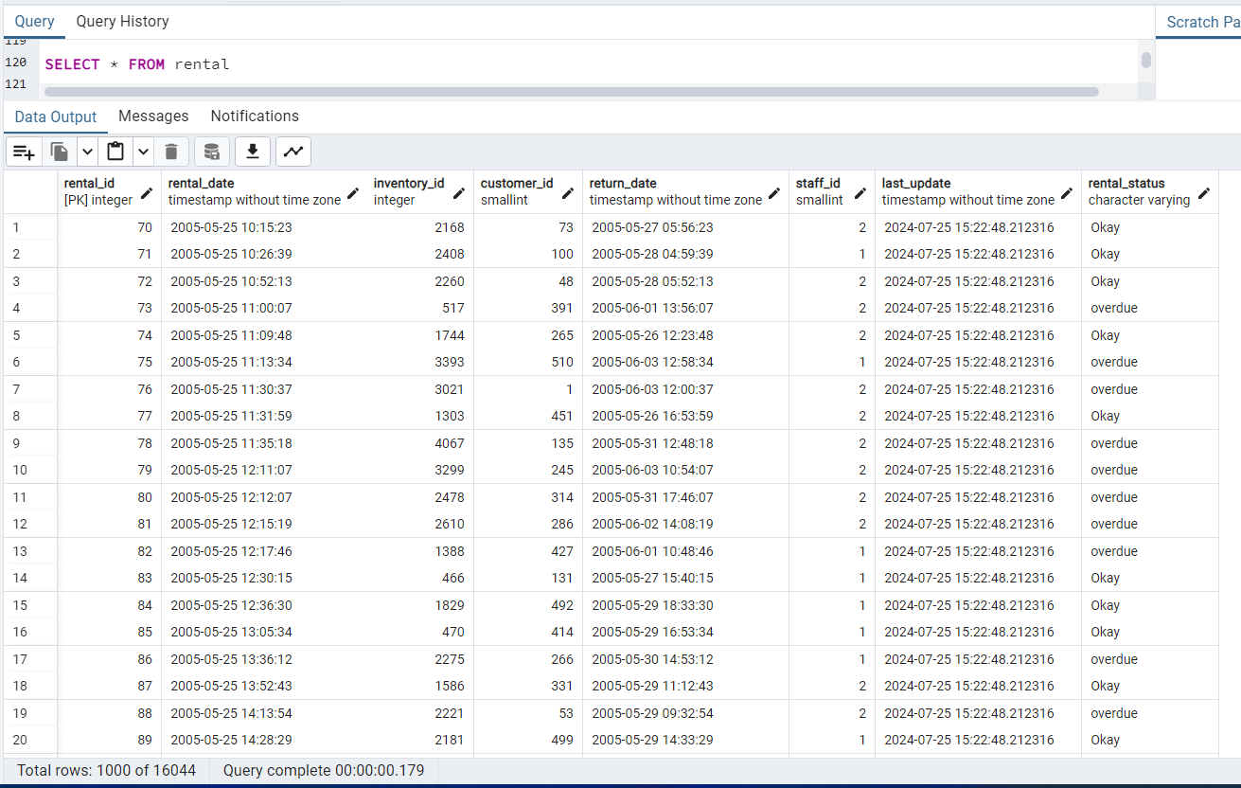
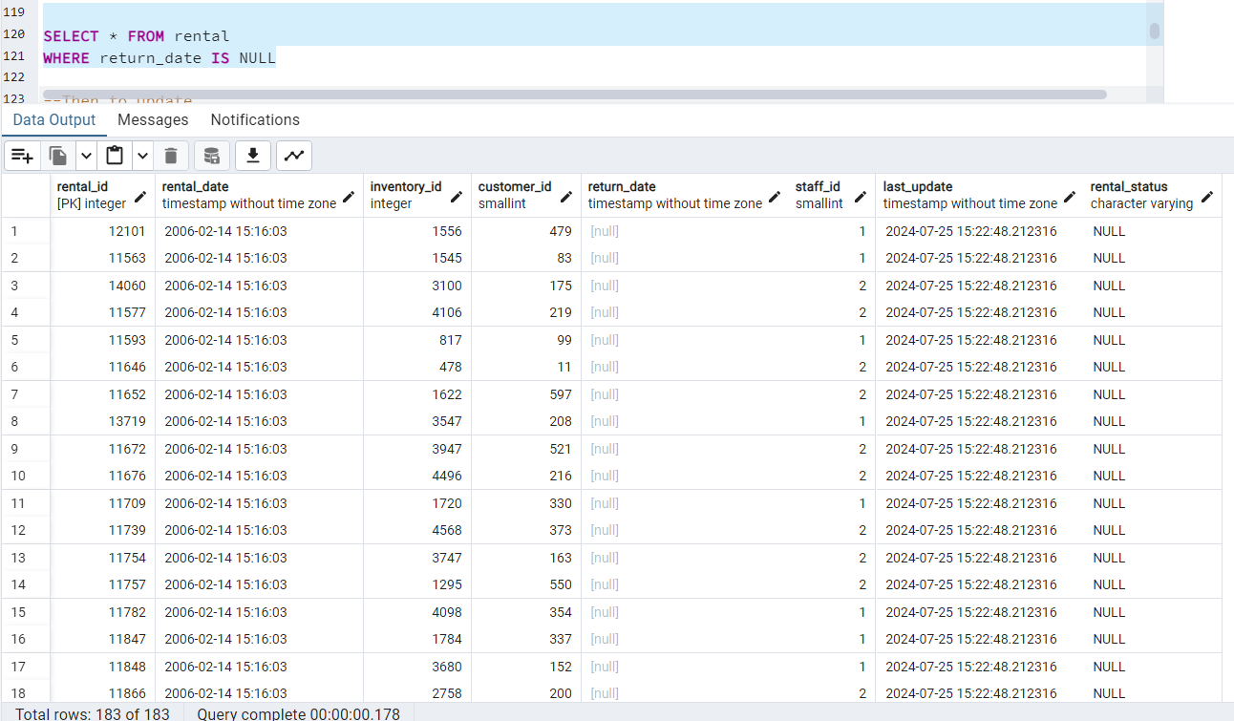
UPDATE RENTAL TABLE TO MARK RENTALS THAT ARE OVERDUE.
Step 3
Updated Table Overview

Slide 19
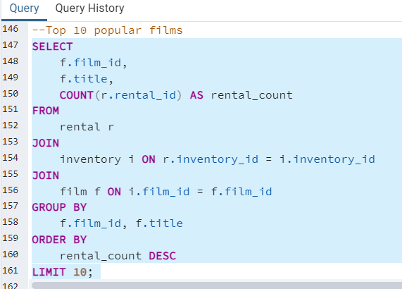
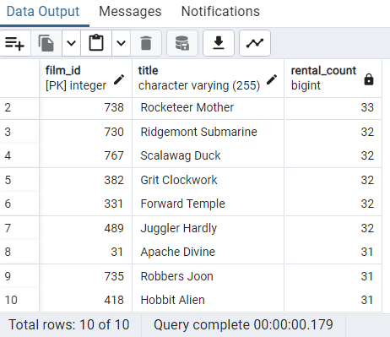
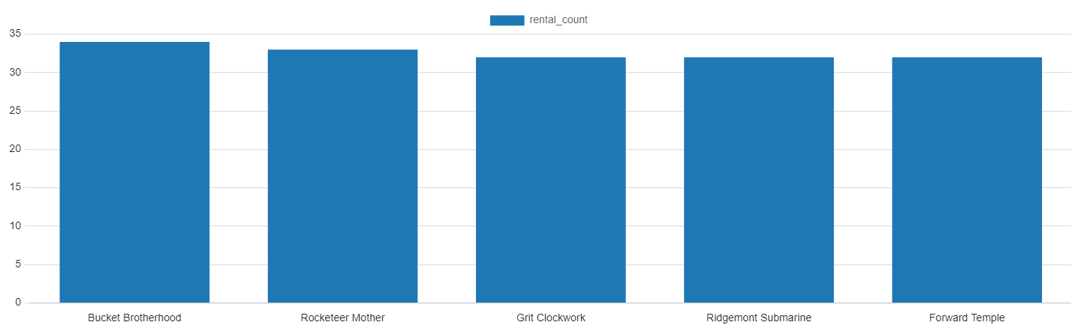
ANALYSIS, VISUALIZATION AND INSIGHT.
Top 10 rented films
I generated all my visuals from PgAdmin. The alternative will be to import the data into excel or Power Bi and visualize with them
Bucket Brotherhood holds the highest rental count followed by Rocketeer Mother. From this bar chart, it is concluded that our rental data demonstrates a varied and vibrant interest in different types of movies. The high rental counts for these specific movies indicate trends that could guide future film acquisitions and marketing strategies ensuring continuous meeting the diverse taste of customers in order to increase revenue.

Slide 20
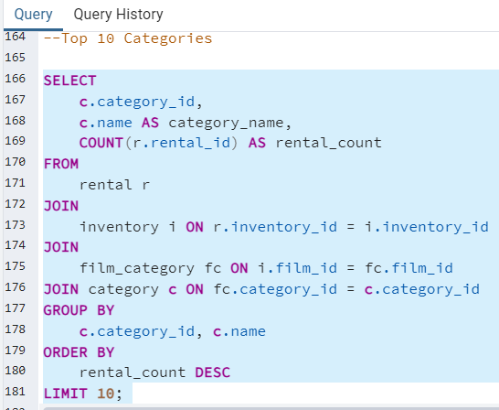
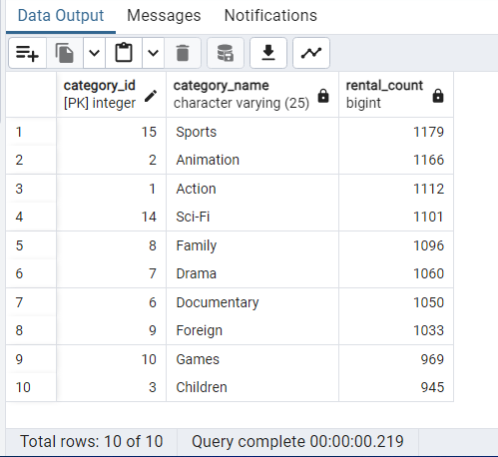
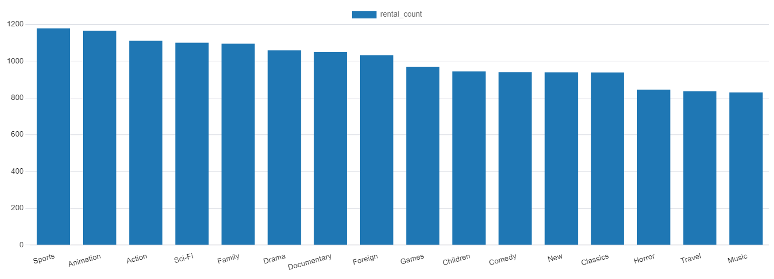
ANALYSIS AND INSIGHT.
Top 10 rented categories
Sports films have the highest rental count while Music films have the least rental
This significantly shows customers preference and shows insight that could guide future film acquisitions and marketing strategies ensuring continuous meeting the diverse taste of customers in order to increase revenue.

Slide 21
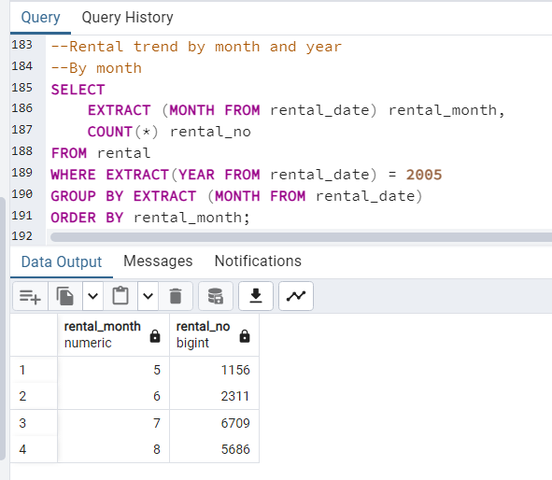
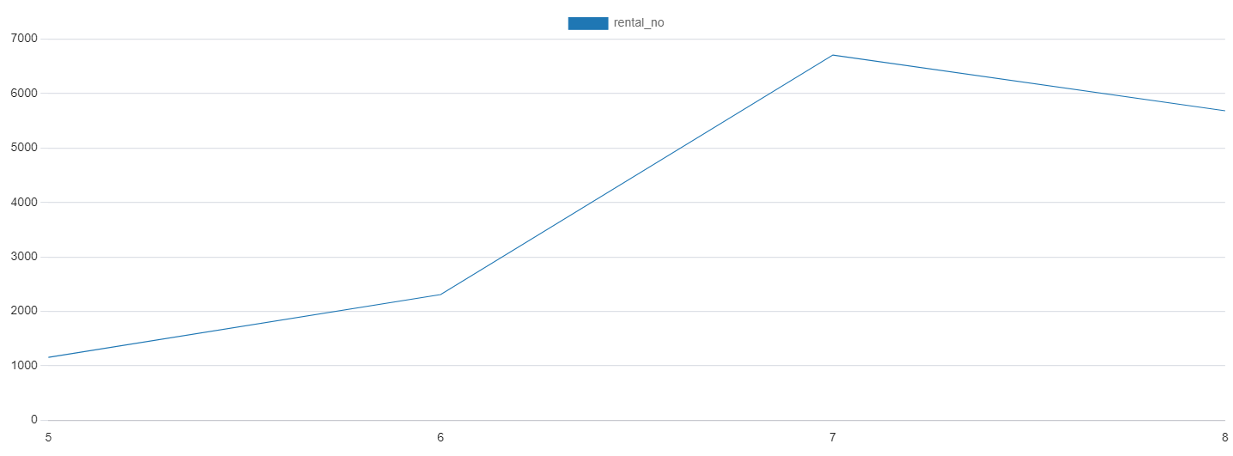
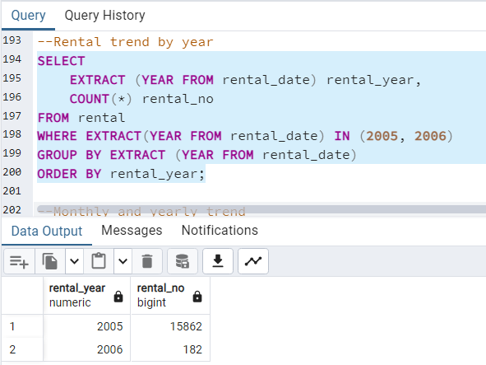
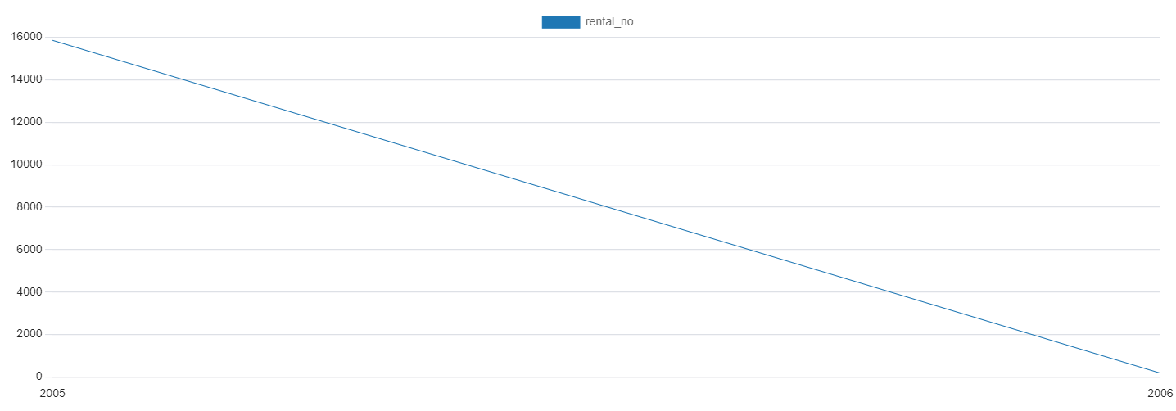
ANALYSIS AND INSIGHT.
Rental trend by Month
2005 has more rental records. Digging deep I observed that 2006 only rented movies in February. Month of July 2005, has highest rental number followed by August while the least is in may. This shows that people rent more movies during summer and holiday season
Rental trend by Year

Slide 22
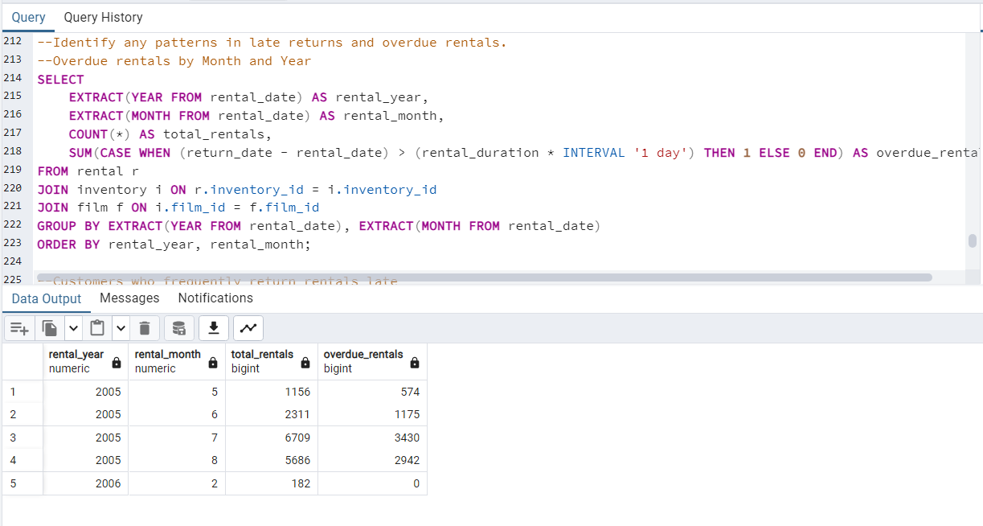
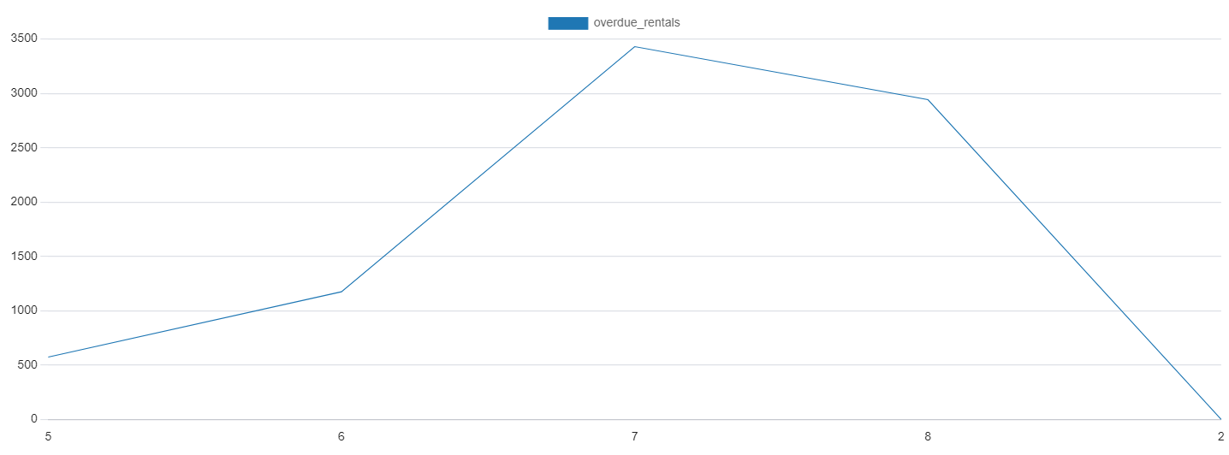
ANALYSIS AND INSIGHT.
Overdue and late return pattern
Month of July 2005, has highest late return pattern followed by August while the least is in may which could be as a result of high rentals in those months

Slide 23
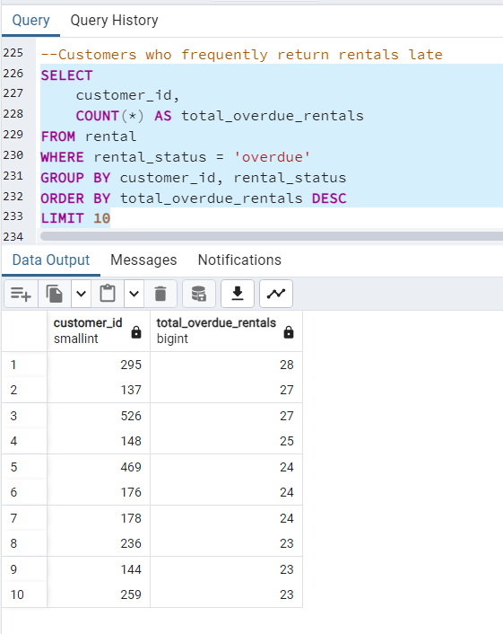
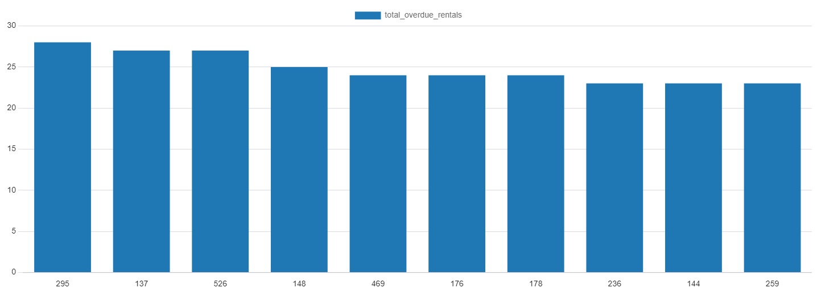
ANALYSIS AND INSIGHT.
Top 10 customer that always return films late with their ID
Customer ID 295 is the cutomer with highest over due rental of 28. This insight is necessary such that company can take decision on how to handle the customers.

Slide 24
INSIGHT AND RECOMMENDATION.
From the analysis, Bucket Brotherhood holds the highest rental count followed by Rocketeer Mother. The high rental counts for these specific movies indicate trends that could guide future film acquisitions and marketing strategies ensuring continuous meeting the diverse taste of customers in order to increase revenue. More of these type of should be stored.
Sports films have the highest rental count while Music films have the least rental
This significantly shows customers prefer Sports films and more of sports films should be stored.
2005 has more rental records and the 7th month July, has highest rental number followed by August while the least is in may. This shows that people rent more movies during summer and holiday season
Store ID 1 generated more revenue of 33621.42 compared to Store ID 2 that generated 27690.62
Month of July 2005, has highest late return pattern followed by August while the least is in may which could be as a result of high rentals in those months.
Customer ID 295 is the cutomer with highest over due rental of 28. This insight is necessary such that company can take decision on how to handle the customers.
In summary, company can have a policy that penalize customers that return late, reward customers that return early and also reward top rental customers. This will encourage customers hence leads to more rentals which inturn generate more revenue.
Also, films not rented in the last 90 days should be archived to create space for more films that will generate revenue

