Slide 1
JobTracker - QA Portfolio
LIVING QA RECORD
Selected defects from a living, sanitised QA record
03
01
02
03
representative
defects
OBSERVE
REPRODUCE
VERIFY
Manual QA in production
Expected vs actual
Fix + regression
A concise introduction for employers. The repository remains the complete source of truth.
Live product
Public demo
GitHub QA repository
JobTracker QA Portfolio
01
Notes:
Introduction to the JobTracker QA portfolio. Links: live product, public demo, and the complete GitHub QA repository.

Slide 2
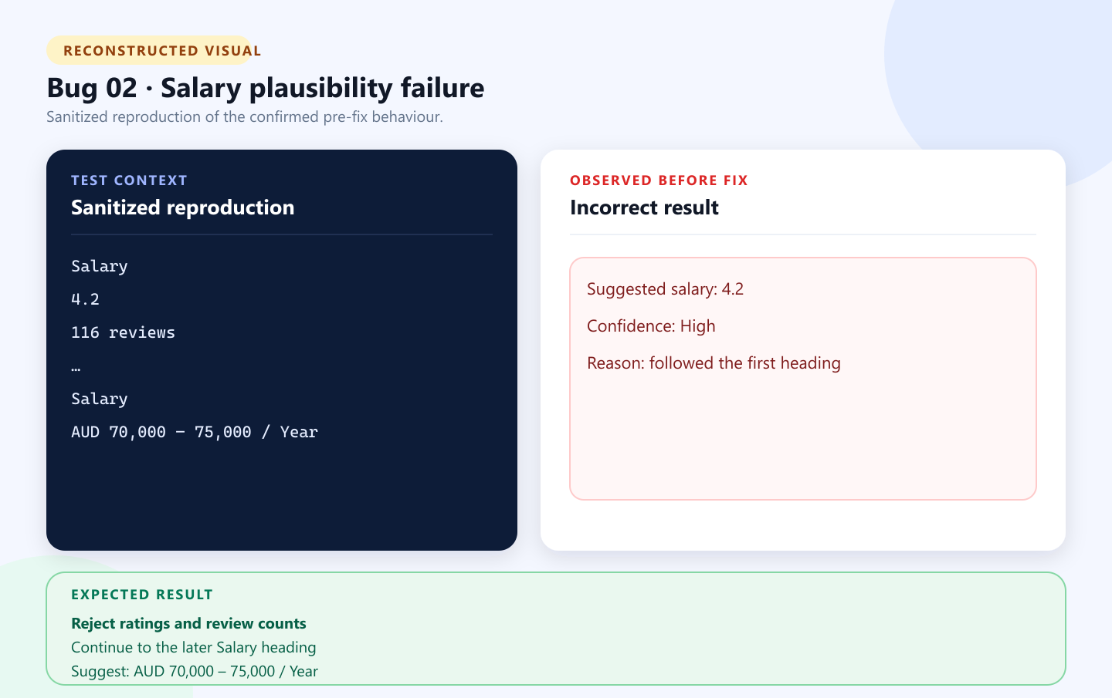
Incorrect salary extraction
Salary extraction | Severity: Medium | Priority: High | Fixed
WHAT HAPPENED — The first Salary heading contained 4.2 and 116 reviews. The extractor labelled 4.2 as salary with high confidence.
EXPECTED VERSUS ACTUAL — Expected: reject the rating and use AUD 70,000–75,000 / Year. Actual: 4.2 appeared as salary.
WHY IT MATTERED — Incorrect compensation could distort job comparisons. Editable review kept severity Medium; plausible financial data set priority High.
VERIFICATION AND REGRESSION — Plausibility checks now reject ratings, review counts, and vague text. A duplicate-heading fixture and manual retest confirmed the pay range while valid formats remained supported.
Reconstructed visual based on a sanitized deterministic scenario
GitHub issue #2
JobTracker QA Portfolio
02
Notes:
Sources: reported-bugs/bug-02/README.md and reported-bugs/bug-02/visual/reconstructed-salary-comparison.svg. The visual is a reconstruction, not a production screenshot.

Slide 3
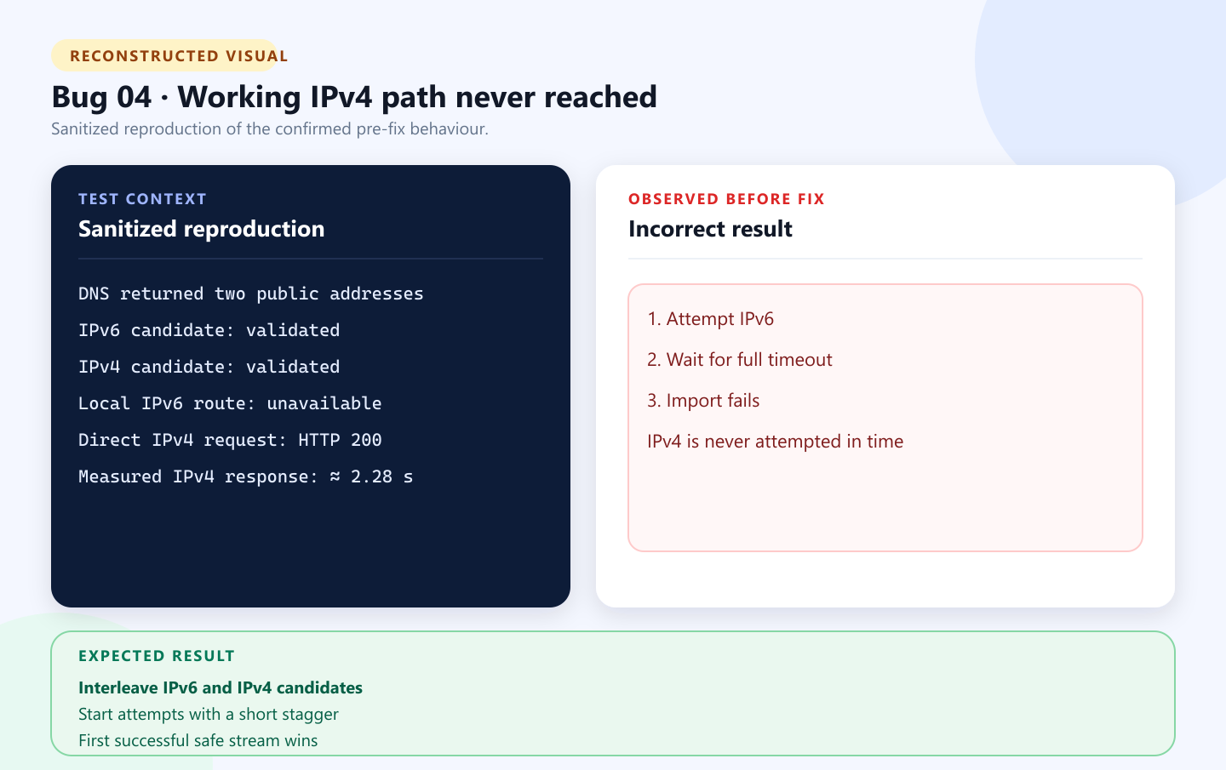
IPv6 delayed the IPv4 fallback
Networking / URL import | Severity: Medium | Priority: High | Fixed
TEST ENVIRONMENT — Windows, a public HTTPS job page, DNS resolving to IPv6 and IPv4, and an unavailable local IPv6 route.
EXPECTED VERSUS ACTUAL — Expected: reach the site through the working address. Actual: IPv6 consumed the timeout before IPv4 could run.
USER IMPACT — A valid URL-import workflow failed for reachable pages and forced users back to manual entry.
RESOLUTION AND EVIDENCE — Validated candidates are interleaved with a 250 ms stagger; the first success wins. IPv4 returned HTTP 200 in about 2.28 s. A deterministic fallback test and the 92-test release gate passed.
Reconstructed visual based on a sanitized deterministic scenario
GitHub issue #4
JobTracker QA Portfolio
03
Notes:
Sources: reported-bugs/bug-04/README.md and reported-bugs/bug-04/visual/reconstructed-ipv6-fallback-comparison.svg. The visual is a reconstruction, not a production screenshot.

Slide 4
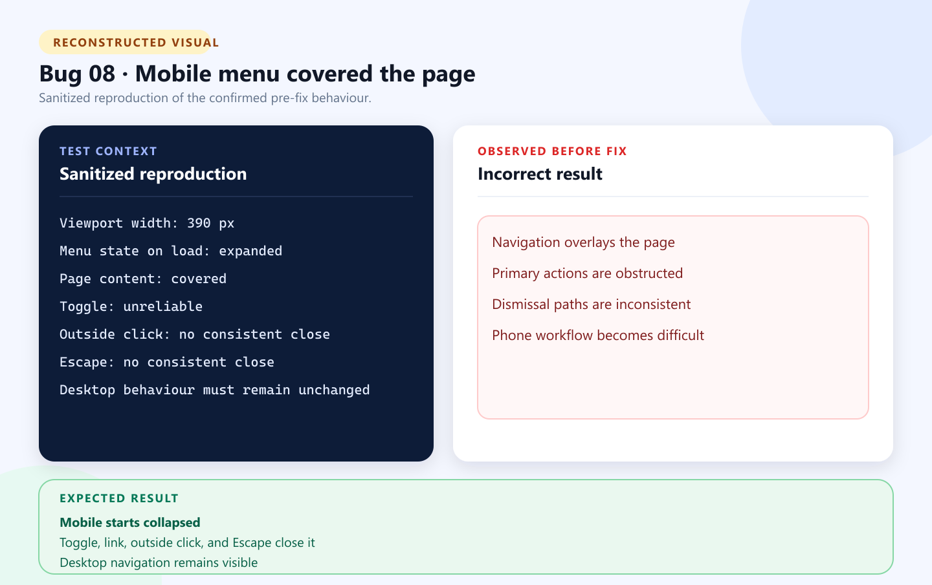
Mobile navigation obstructed the interface
Responsive navigation | Severity: High | Priority: High | Fixed
TEST ENVIRONMENT — Chrome responsive viewport at 390 px across the authenticated layout and public synthetic demo.
EXPECTED VERSUS ACTUAL — Expected: start collapsed and close by toggle, link, outside click, or Escape. Actual: expanded over content and dismissed inconsistently.
WHY IMPACT WAS HIGH — The menu obstructed the whole mobile interface and could make core pages unusable on a phone.
RETEST AND REGRESSION — Manual retesting covered both layouts at 390 px. Regression evidence: 104 unit tests, 96 integration tests, 3 browser journeys, formatting, audit, JavaScript checks, and publish verification.
Reconstructed visual based on a sanitized deterministic scenario
GitHub issue #8
JobTracker QA Portfolio
04
Notes:
Sources: reported-bugs/bug-08/README.md, reported-bugs/bug-08/visual/reconstructed-mobile-navigation-comparison.svg, and docs/QA-STRATEGY.md. The visual is a reconstruction, not a production screenshot.

Slide 5
Explore the complete QA record
These are selected examples. The repository contains the complete and continually updated QA record.
Repository contents
Complete source of truth
All reported defects
Resolution notes
Reproduction steps
Regression evidence
GitHub repository
Severity and priority assessments
Public issue status
Reported-bugs index
QA strategy
QA strategy
GitHub issue register
github.com/Chit-Thway/job-application-tracker-qa
JobTracker QA Portfolio
05
Notes:
Sources: repository README.md, reported-bugs/README.md, and docs/QA-STRATEGY.md. All displayed links are embedded as external hyperlinks.

