Slide 1
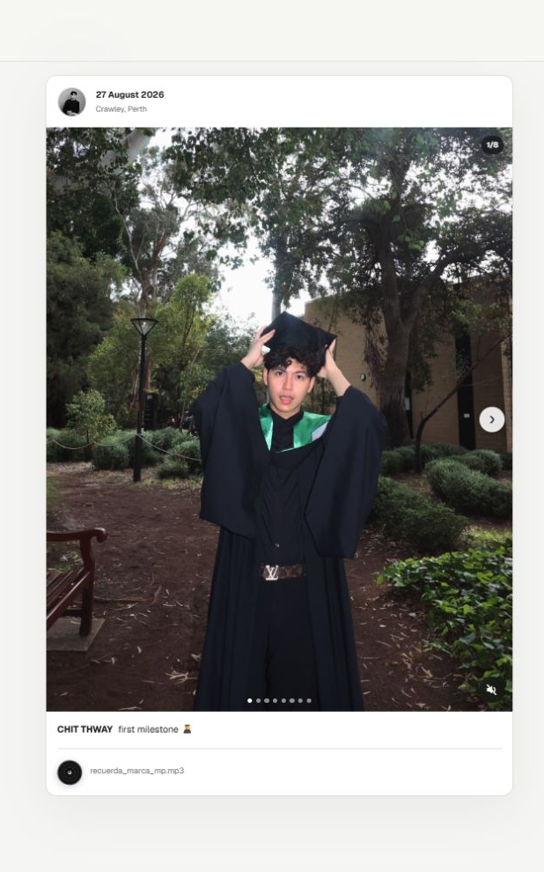
PORTFOLIO V2 · CASE STUDY
Portfolio
Diary
A private publishing workflow for a public, media-first archive.
Product design · Front-end · Cloudflare backend
CHIT THWAY · 2026
Notes:
[Sources]
- Live product screenshot: https://chitthway-portfolio.pages.dev/diary/ (captured 2026-08-28)
[/Sources]

Slide 2
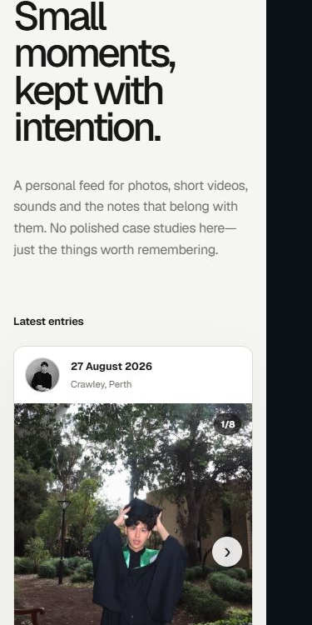
01 · PRODUCT INTENT
A portfolio needed room for the moments that are not case studies.
Personal, not performative
A chronological archive for photos, short videos, sound and the notes attached to them.
Familiar, not copied
The feed borrows recognizable social patterns without likes, comments or follower mechanics.
Curated, not open
Only the owner can publish; everyone else sees a calm, read-only experience.
Designed mobile-first
02
Notes:
[Sources]
- Live product screenshot and public copy: https://chitthway-portfolio.pages.dev/diary/ (captured 2026-08-28)
[/Sources]

Slide 3
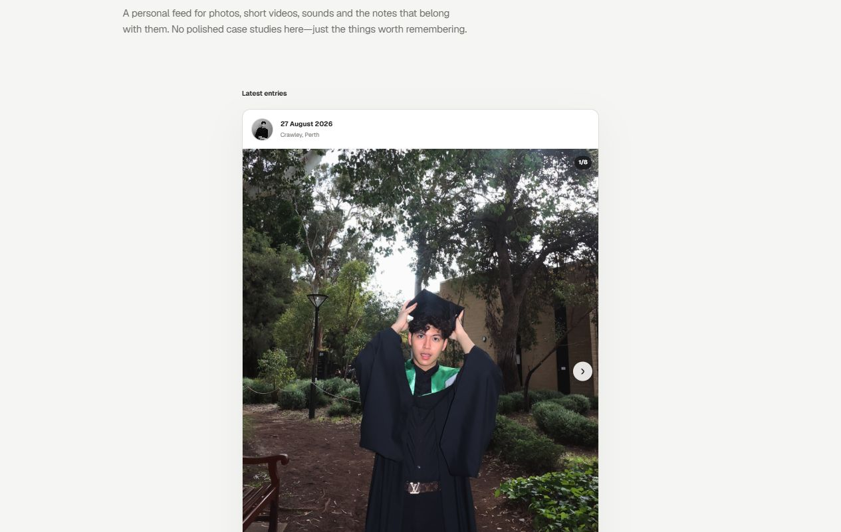
02 · PUBLIC EXPERIENCE
Familiar feed patterns make the archive immediately legible.
01
Date replaces username
Publication date leads; location appears only when it adds context.
02
Media behaves like a story
Up to ten photos or short videos can be browsed in one post.
03
Sound follows attention
Audio starts muted, fades with focus and keeps its position when a post leaves view.
04
Context stays lightweight
Caption, optional descriptions and service-aware links sit below the media.
03
Notes:
[Sources]
- Live product screenshot: https://chitthway-portfolio.pages.dev/diary/ (captured 2026-08-28)
- Interaction behavior: app/components/DiaryFeed.tsx and docs/diary-operations.md in the Portfolio V2 repository
[/Sources]

Slide 4
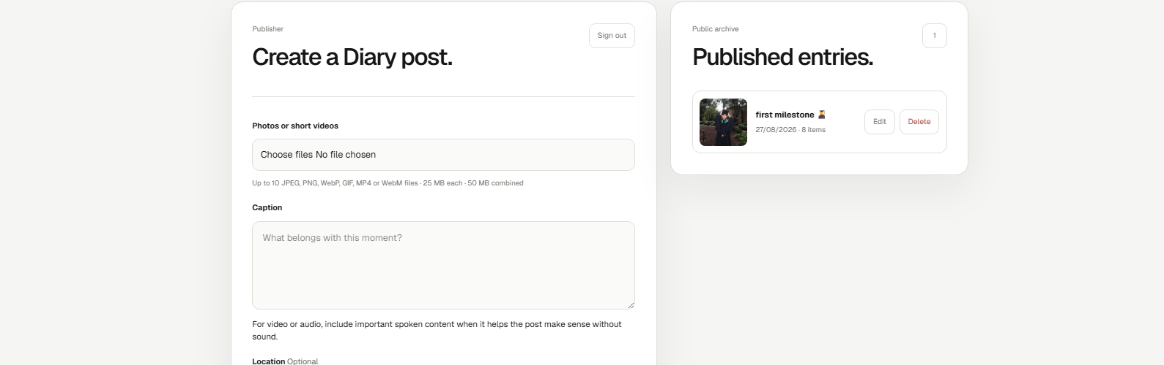
03 · ADMIN WORKFLOW
A private publisher keeps public posting controlled.
The interface exposes the creative choices while enforcing media, link and audio limits before anything reaches production.
01
Choose and order media
02
Add caption, location, links and audio
03
Publish, edit or remove
04
Notes:
[Sources]
- Admin interface screenshot supplied by the project owner in this task
- Publishing limits and edit behavior: app/components/DiaryManager.tsx, server/diary-store.js and docs/diary-operations.md
[/Sources]

Slide 5
04 · PRODUCTION ARCHITECTURE
Metadata and media are separated by design.
One checked request path serves both the private publishing workflow and the public feed.
D1
Post metadata, order, captions, links and publication state
CLOUDFLARE PAGES
→
PUBLIC + ADMIN
→
Pages Functions
Browser
Read the feed or publish after authentication.
Signed HTTP-only sessions, validation and same-origin request checks.
→
R2
Private photo, video and audio objects served through checked API routes
Guardrails
1–10 media items · 25 MB each · 50 MB combined · optional audio up to 12 MB · HTTPS links only
05
Notes:
[Sources]
- Architecture and guardrails: docs/diary-operations.md, wrangler.toml, functions/api/diary/posts.js, functions/api/diary/posts/[id].js and server/diary-store.js
- Data model: db/schema.ts
[/Sources]

Slide 6
05 · OUTCOME
Expressive on the surface. Controlled underneath.
Portfolio Diary is live as a focused extension of Portfolio V2—not a social network, but a durable place for personal moments.
01
02
03
Media-first
Sound-aware
Maintainable
Multi-item photo and video posts with optional descriptions.
Muted-by-default audio that follows the post in focus.
Admin editing can reorder media and update everything except the original date.
View the live Diary · chitthway-portfolio.pages.dev/diary/
CHIT THWAY · PORTFOLIO V2
06
Notes:
[Sources]
- Live product: https://chitthway-portfolio.pages.dev/diary/ (verified 2026-08-28)
- Implemented capabilities: app/components/DiaryFeed.tsx, app/components/DiaryManager.tsx and docs/diary-operations.md
[/Sources]

