Slide 1
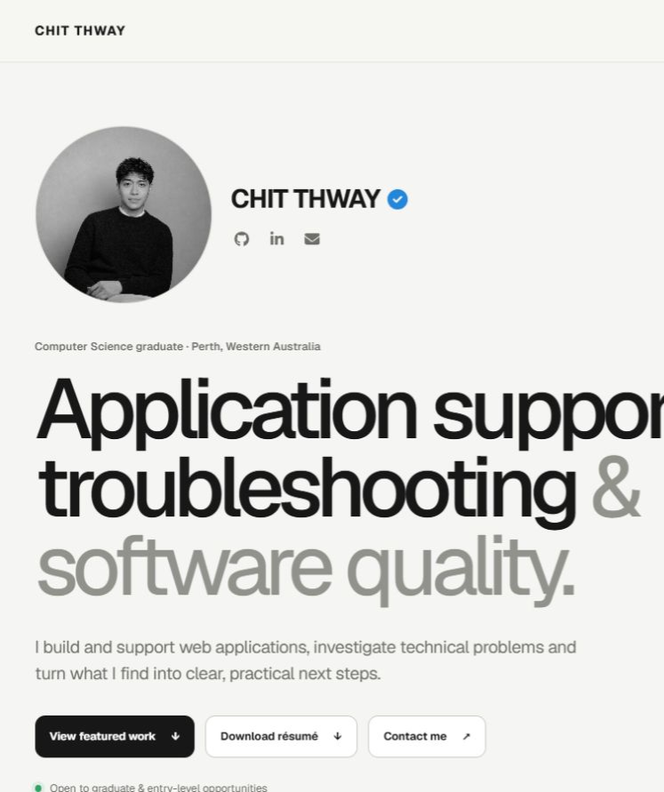
PORTFOLIO V2 · CASE STUDY
Portfolio V2
Evidence, not just claims.
A production portfolio designed to make capability easy to scan—and the underlying work easy to verify.
Product strategy · UX · Front-end · Cloudflare delivery
CHIT THWAY · 2026
Notes:
[Sources]
- Live homepage screenshot: https://chitthway-portfolio.pages.dev/ (captured 2026-08-28)
- Product purpose: docs/version-2-roadmap.md in the current Portfolio V2 repository
[/Sources]

Slide 2
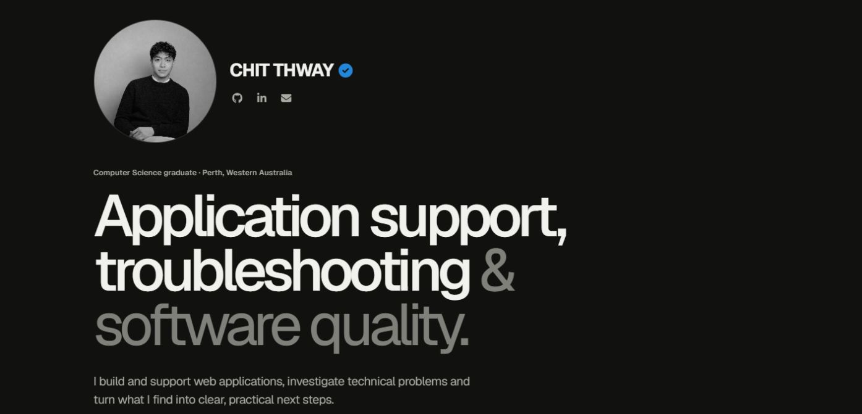
01 · FIRST-SCREEN STRATEGY
The first screen answers the questions employers ask first.
Role, evidence and next action are visible before the visitor has to explore.
01
Clear positioning
Application support, troubleshooting and software quality lead the page.
02
Immediate proof path
Featured work is the primary action; résumé and contact stay one click away.
03
Human context
Identity, location, availability and verified professional links establish trust.
02
Notes:
[Sources]
- Live dark-mode homepage screenshot: https://chitthway-portfolio.pages.dev/ (captured 2026-08-28)
- Homepage structure and actions: app/page.tsx and app/components/ThemeToggle.tsx
[/Sources]

Slide 3
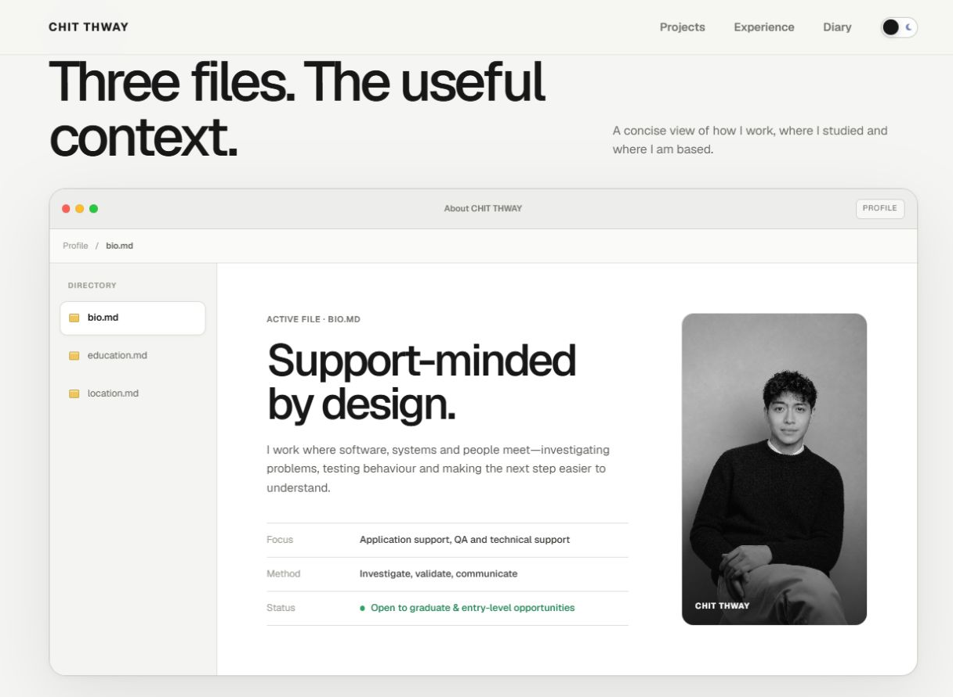
02 · INFORMATION ARCHITECTURE
The homepage turns browsing into a deliberate evidence journey.
01
Identity
Role, location and availability
02
Context
Bio, education and location
03
Proof
Selected projects and deeper case studies
04
Credibility
Experience, tools and public activity
05
Action
Résumé, email, LinkedIn and GitHub
03
Notes:
[Sources]
- Live profile-directory screenshot: https://chitthway-portfolio.pages.dev/ (captured 2026-08-28)
- Homepage section order and destinations: app/page.tsx and app/components/AboutDirectory.tsx
[/Sources]

Slide 4
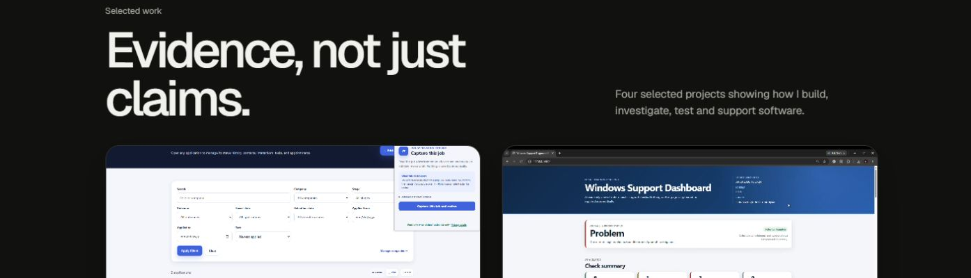
03 · SELECTED WORK
Projects are framed as proof—not a gallery of thumbnails.
Each card states the problem space, personal contribution, technology context and verified outcome before the visitor opens it.
01
Full-stack product
02
Support engineering
03
Commercial QA
04
Service workflow
04
Notes:
[Sources]
- Live selected-work screenshot: https://chitthway-portfolio.pages.dev/#projects (captured 2026-08-28)
- Featured-project framing and verified project types: app/page.tsx and app/data/projectCaseStudies.ts
[/Sources]

Slide 5
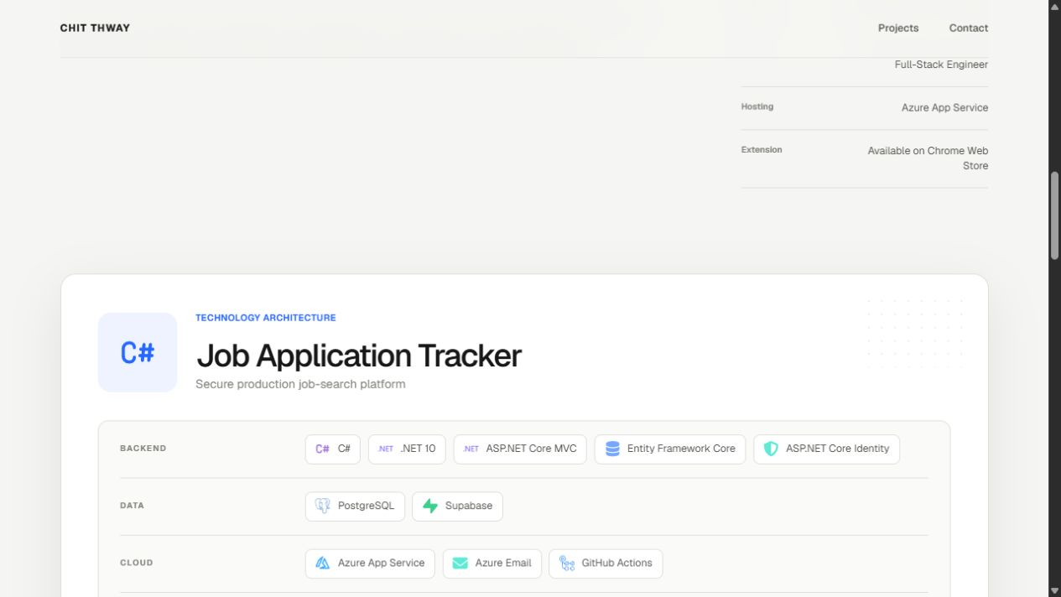
04 · DEEP EVIDENCE
Detailed case studies make the work inspectable.
CONTEXT
What was built, why it exists and the role owned.
DECISIONS
The product, workflow and safety choices behind the interface.
EVIDENCE
Architecture, media, public artifacts and explicit status.
The result: claims can be checked against implementation detail instead of taken on trust.
05
Notes:
[Sources]
- Live Job Application Tracker case-study screenshot: https://chitthway-portfolio.pages.dev/projects/job-application-tracker/ (captured 2026-08-28)
- Case-study content structure: app/data/projectCaseStudies.ts and project-page components in the current repository
[/Sources]

Slide 6
05 · OUTCOME
A focused portfolio that can grow without losing its point.
Portfolio V2 is live as a coherent product: fast to scan, deep enough to verify and direct about the next action.
01
02
03
Evidence-led
Accessible by design
Production-backed
Four selected projects connect concise homepage summaries to deeper implementation proof.
Semantic navigation, keyboard-aware interactions, reduced-motion behavior and clear public actions are built into the experience.
React and Vinext ship through Cloudflare Pages, with D1 supporting visitor data and automated route checks protecting the rendered experience.
View live · chitthway-portfolio.pages.dev
Diary is documented in a separate companion case study.
06
Notes:
[Sources]
- Live portfolio: https://chitthway-portfolio.pages.dev/ (verified 2026-08-28)
- Implementation stack: package.json and wrangler.toml
- Accessibility, routing and rendered-content checks: app/page.tsx, app/components/TechnologyMarquee.tsx and tests/rendered-html.test.mjs
- Diary is referenced only as an extension; see the separate Portfolio Diary case-study deck for detail
[/Sources]

