Slide 1
JIRA SERVICE MANAGEMENT CASE STUDY
Kestrel Ridge
IT Service Desk
11
fictional requests
9
configured request types
A fictional support environment built to demonstrate structured intake, investigation, approvals, automation, SLA monitoring, knowledge management, reporting, and validation.
11
configured queues
4
custom knowledge articles
FICTIONAL PORTFOLIO SIMULATION - NO REAL PROVISIONING
Final portfolio documentation | August 2026
Notes:
[Sources]
- Repository README.md and docs/implementation-reference.md for final project totals.
[/Sources]

Slide 2
BUSINESS SCENARIO
FICTIONAL PORTFOLIO SIMULATION
The objective: make broad IT needs traceable
Kestrel Ridge is a fictional organisation whose staff need one clear path for account, access, software, device, employee-lifecycle, and business-application support.
SERVICE-DESK OBJECTIVE
Collect the right context before an agent begins work.
Separate internal investigation from public customer communication.
Control governed work through approvals and least-privilege scope.
Expose active work, SLA risk, completed work, and report outcomes.
Validate workflow and data integrity through repeatable test scenarios.
Result: a compact, evidence-led simulation that connects portal design, operational workflow, automation, knowledge, and reporting.
Kestrel Ridge IT Service Desk | Jira Service Management case study
02
Notes:
[Sources]
- Repository README.md for the fictional business scenario and project objective.
[/Sources]

Slide 3
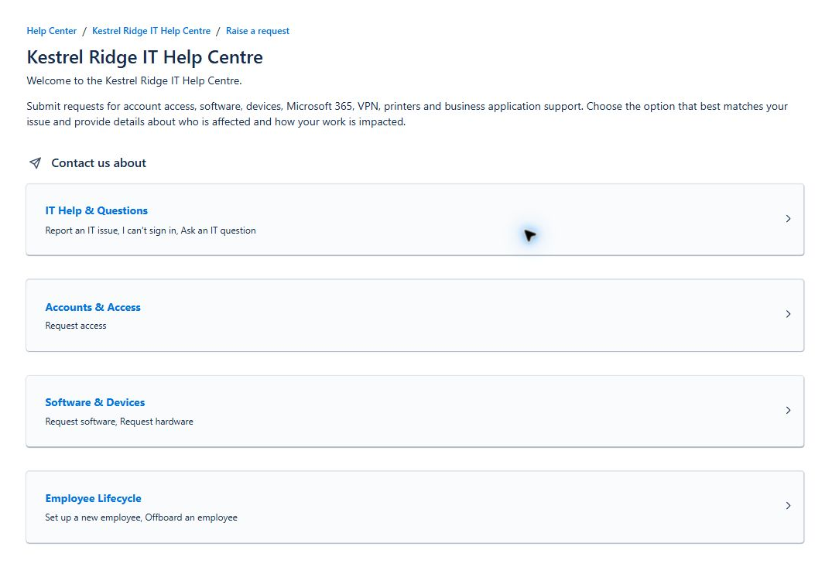
CUSTOMER PORTAL AND STRUCTURED INTAKE
FICTIONAL PORTFOLIO SIMULATION
Four portal groups make the right support path easier to find
Eight portal request types use plain-language labels. A separate Email request channel brings the configured total to nine.
IT Help & Questions
Accounts & Access
Software & Devices
Employee Lifecycle
Structured forms reduce follow-up by capturing impact, scope, approval, systems, and equipment details at intake.
Kestrel Ridge IT Service Desk | Jira Service Management case study
03
Notes:
[Sources]
- Repository screenshot: screenshots/final-capture/01_portal_overview.png.
[/Sources]

Slide 4
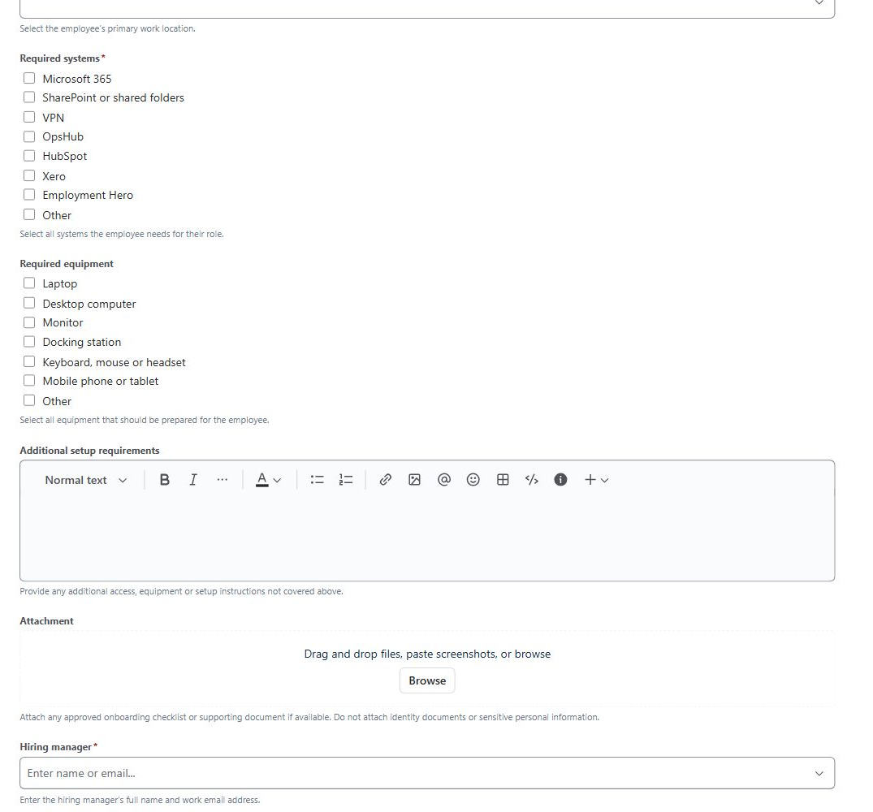
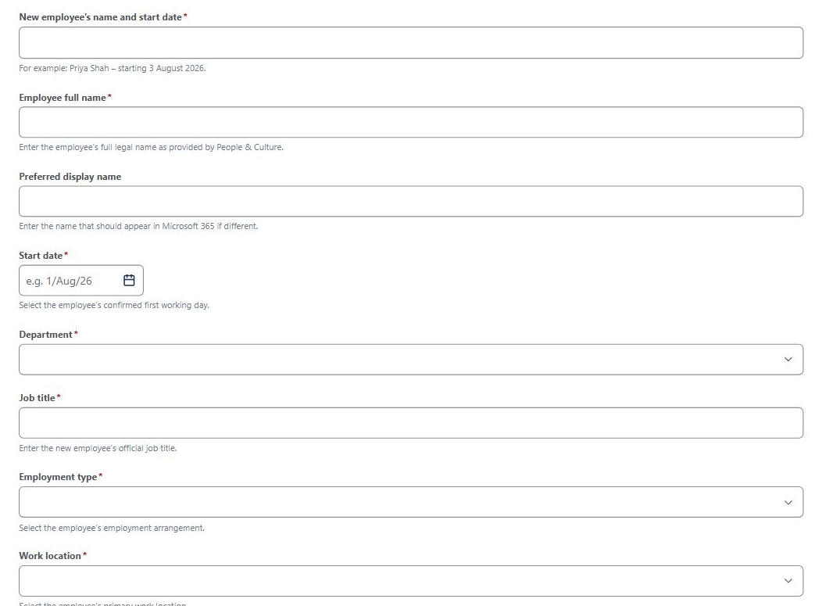
NEW EMPLOYEE ONBOARDING FORM
FICTIONAL PORTFOLIO SIMULATION
Onboarding structures identity, access, and equipment intake
Identity and employment context
Systems, equipment, setup detail, and hiring manager
Kestrel Ridge IT Service Desk | Jira Service Management case study
04
Notes:
[Sources]
- Repository screenshot: screenshots/final-capture/02_onboarding_form_identity.png (shown as two focused crops).
[/Sources]

Slide 5
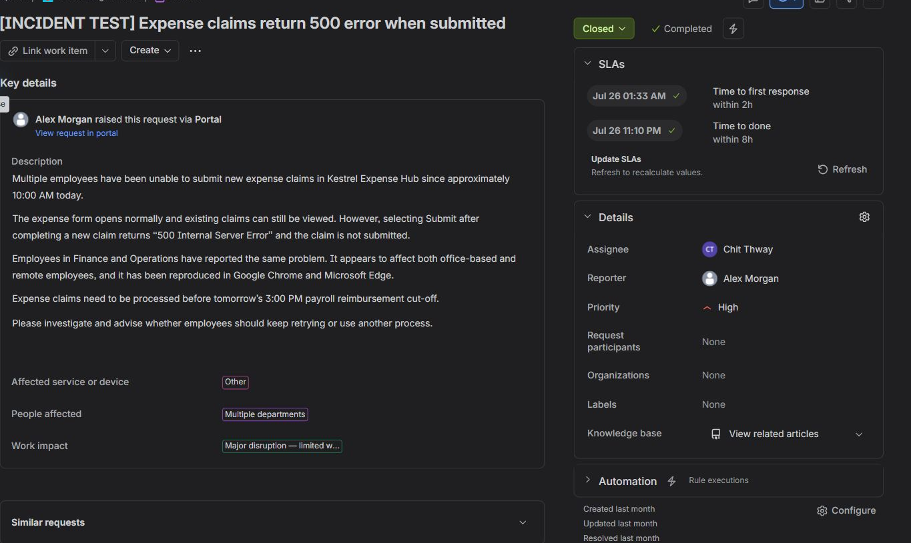
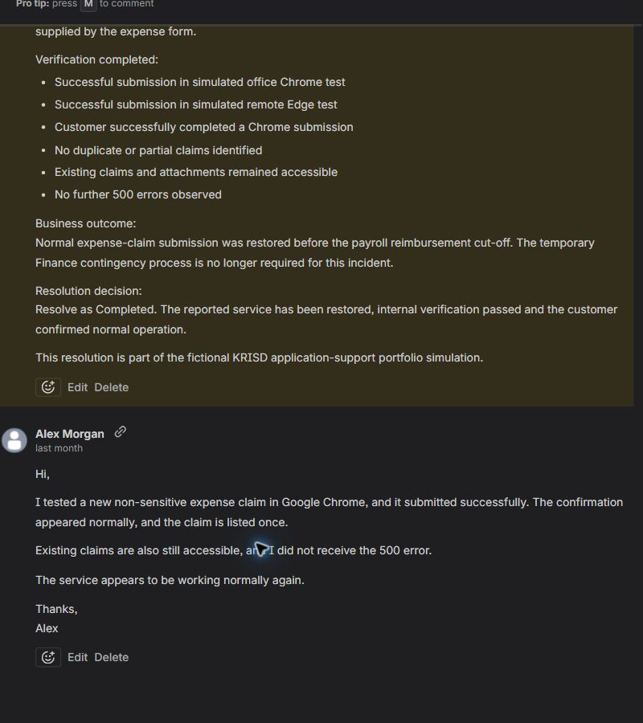
APPLICATION-SUPPORT INVESTIGATION
FICTIONAL PORTFOLIO SIMULATION
KRISD-9 links investigation, confirmation, and resolution
High priority | Multiple departments | Payroll deadline
Internal evidence + public reply
Kestrel Ridge IT Service Desk | Jira Service Management case study
05
Notes:
[Sources]
- Repository screenshot: screenshots/final-capture/04_krisd9_incident_overview.png.
- Repository screenshot: screenshots/final-capture/05_krisd9_investigation.png.
[/Sources]

Slide 6
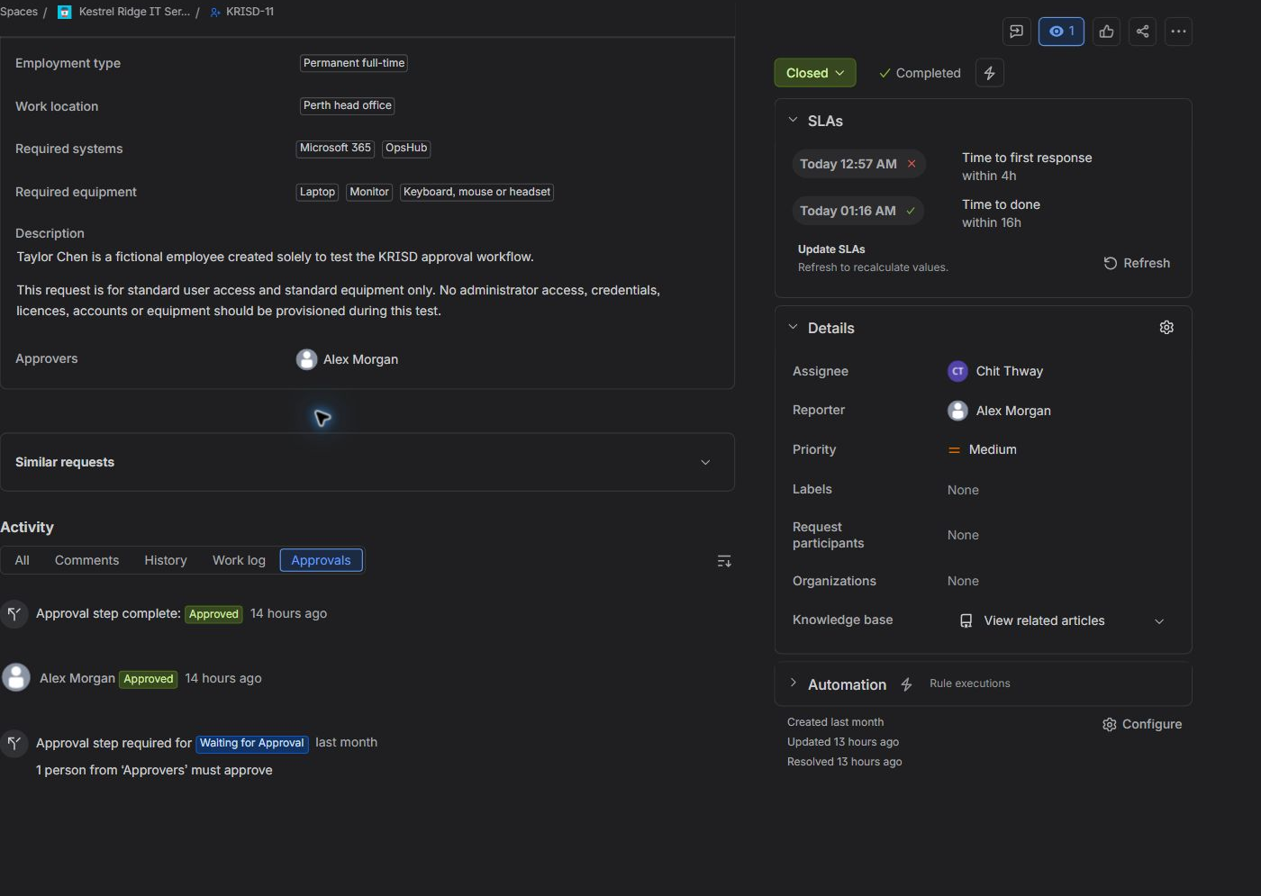
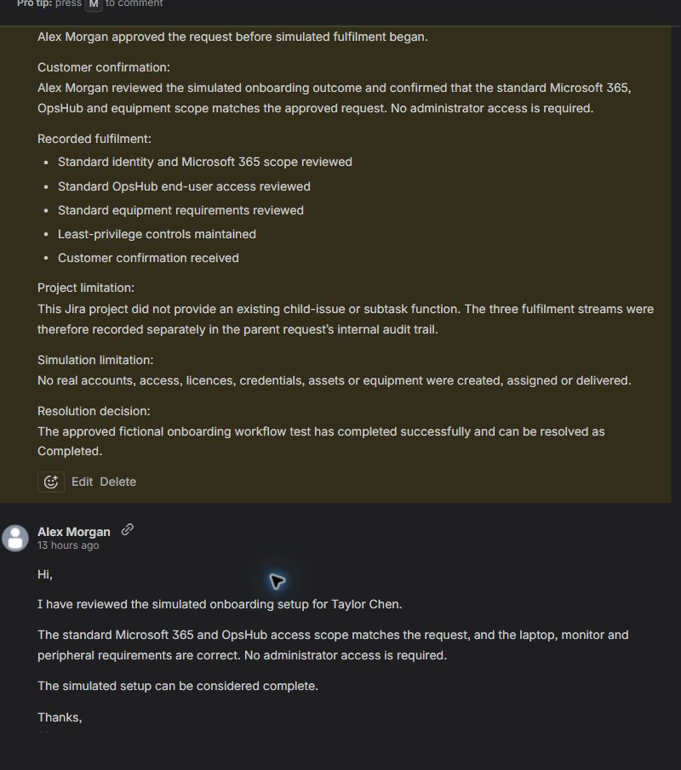
APPROVAL, LEAST PRIVILEGE, AND COMMUNICATION
FICTIONAL PORTFOLIO SIMULATION
KRISD-11 requires approval before fulfilment
Manager approval precedes work
No real accounts, access, licences, credentials, or equipment
Kestrel Ridge IT Service Desk | Jira Service Management case study
06
Notes:
[Sources]
- Repository screenshot: screenshots/final-capture/06_krisd11_approval.png.
- Repository screenshot: screenshots/final-capture/07_krisd11_fulfilment_communication.png.
[/Sources]

Slide 7
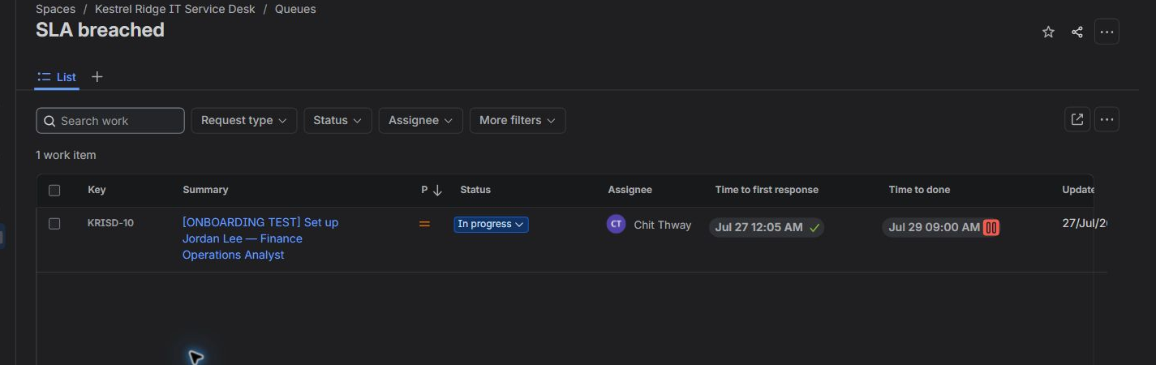
SLA-BREACH QUEUE MONITORING
FICTIONAL PORTFOLIO SIMULATION
KRISD-10 keeps breached work visible and prioritised
This is deliberate monitoring evidence - not a project error.
In Progress
None
Breached
Status
Resolution
SLA priority
Kestrel Ridge IT Service Desk | Jira Service Management case study
07
Notes:
[Sources]
- Repository screenshot: screenshots/final-capture/09_queue_sla_breached.png.
[/Sources]

Slide 8
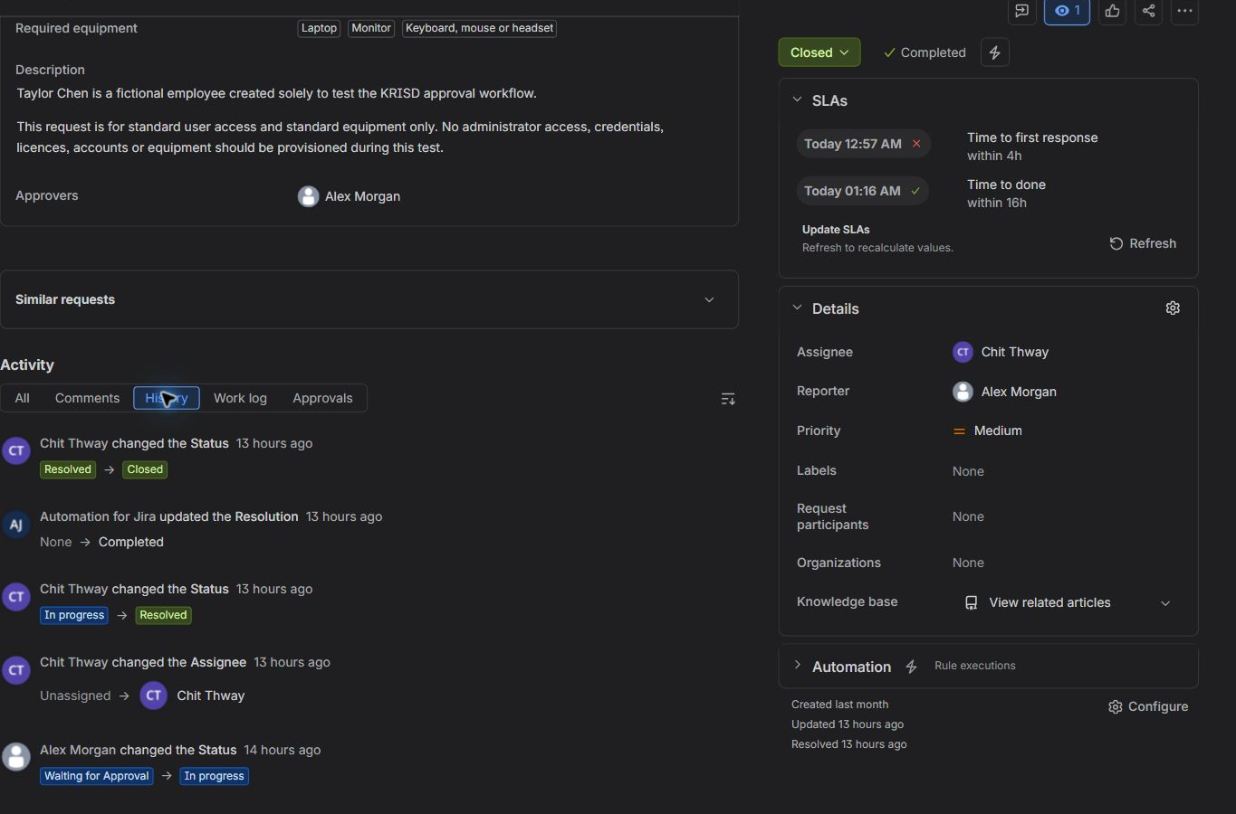
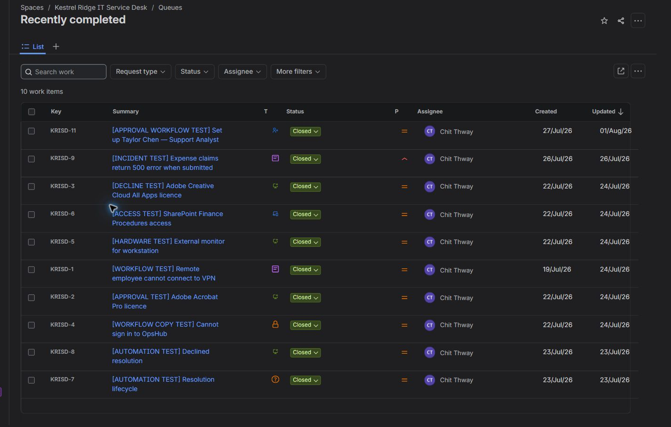
RESOLUTION AUTOMATION AND AUDIT HISTORY
FICTIONAL PORTFOLIO SIMULATION
Automation protects Resolution integrity and queue accuracy
None -> Completed is recorded by Automation for Jira
10 closed; KRISD-10 remains active
Kestrel Ridge IT Service Desk | Jira Service Management case study
08
Notes:
[Sources]
- Repository screenshot: screenshots/final-capture/08_krisd11_automated_resolution.png.
- Repository screenshot: screenshots/final-capture/10_queue_recently_completed.png.
[/Sources]

Slide 9
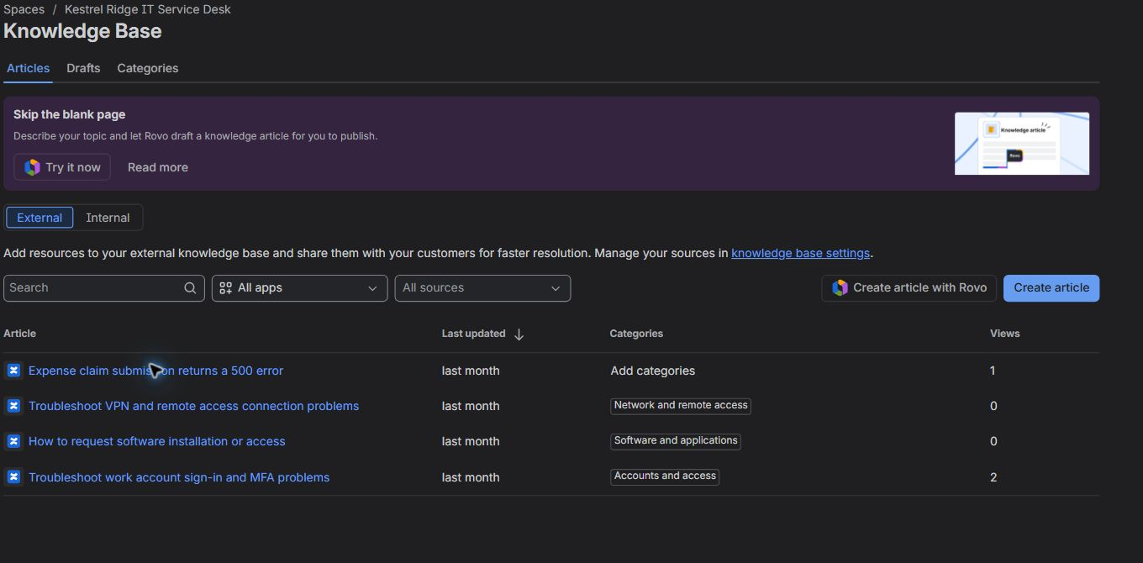
KNOWLEDGE MANAGEMENT
FICTIONAL PORTFOLIO SIMULATION
Four custom articles turn recurring issues into reusable guidance
The final set covers expense-claim errors, VPN access, software requests, and work account sign-in/MFA. Generic Jira sample templates are excluded.
Kestrel Ridge IT Service Desk | Jira Service Management case study
09
Notes:
[Sources]
- Repository screenshot: screenshots/final-capture/12_knowledge_base_overview.png.
[/Sources]

Slide 10
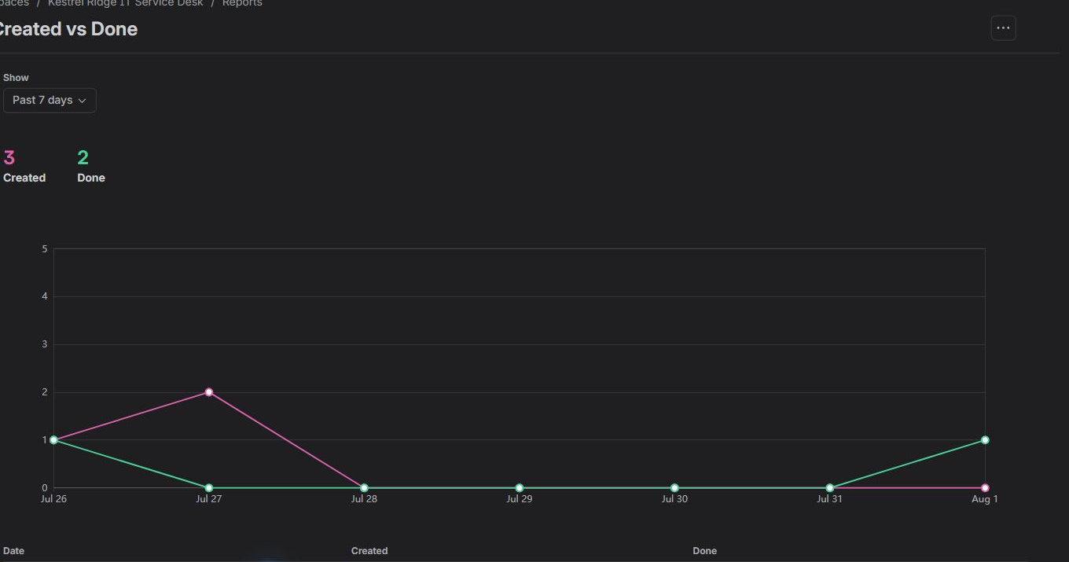
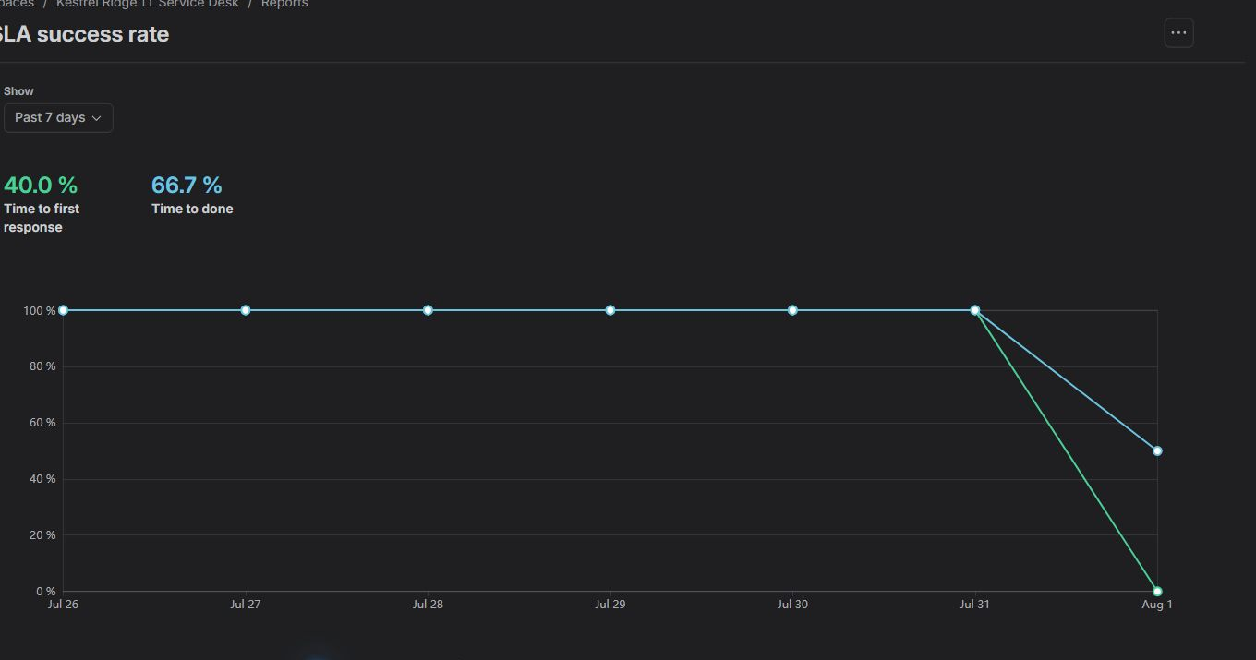
REPORTING AND ACCURATE INTERPRETATION
FICTIONAL PORTFOLIO SIMULATION
Past 7 days reports show Jira mechanics
3
2
40.0%
66.7%
2 / 1
created
done
first response success
time to done success
Time to done met / breached
Customer satisfaction: no submitted reviews. This is not a zero-star rating.
Kestrel Ridge IT Service Desk | Jira Service Management case study
10
Notes:
[Sources]
- Repository screenshot: screenshots/final-capture/15_report_created_vs_done.png.
- Repository screenshot: screenshots/final-capture/16_report_sla_success_rate.png.
- Repository brief for Time to done met-vs-breached and customer-satisfaction interpretation.
[/Sources]

Slide 11
SKILLS DEMONSTRATED AND LIMITATIONS
FICTIONAL PORTFOLIO SIMULATION
Capability demonstrated, limits explicit
SKILLS DEMONSTRATED
SIMULATION LIMITS
Structured intake and service-desk triage
Small fictional dataset and one administrator/agent
Application-incident investigation
No live identity provider, software catalogue, or asset database
Approval and least-privilege planning
No real Microsoft 365 or OpsHub provisioning
Internal notes and public communication
No real licences, credentials, accounts, devices, or equipment
Queue, SLA, automation, and audit review
No customer reviews in the reporting window
Knowledge writing, reporting, and test validation
Report values illustrate mechanics, not performance at scale
Kestrel Ridge IT Service Desk | Jira Service Management case study
11
Notes:
[Sources]
- Repository README.md and docs/test-register.md for skills and simulation boundaries.
[/Sources]

Slide 12
CLOSING SUMMARY
A complete support story,
backed by traceable evidence
The case study connects customer intake to investigation, approvals, communication, SLA monitoring, queue operations, Resolution automation, knowledge, reporting, and validation.
GITHUB REPOSITORY
github.com/Chit-Thway/kestrel-ridge-jira-service-desk
LinkedIn upload: PDF | Editable source: PowerPoint
FICTIONAL PORTFOLIO SIMULATION
Notes:
[Sources]
- Repository URL supplied in the project brief.
[/Sources]

