Slide 1
Task-Screenshots
By
Chitra Joshi

Slide 2
How To Run:
python manage.py makemigrations
python manage.py migrate
python manage.py createsuperuser
User:admin Password: admin
python manage.py runserver

Slide 3
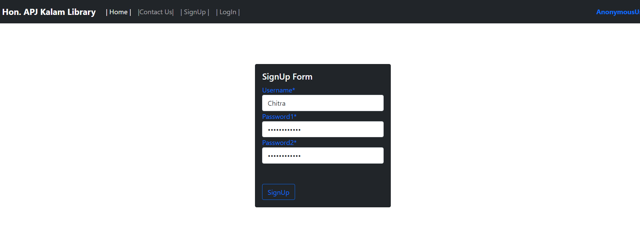
Signup

Slide 4
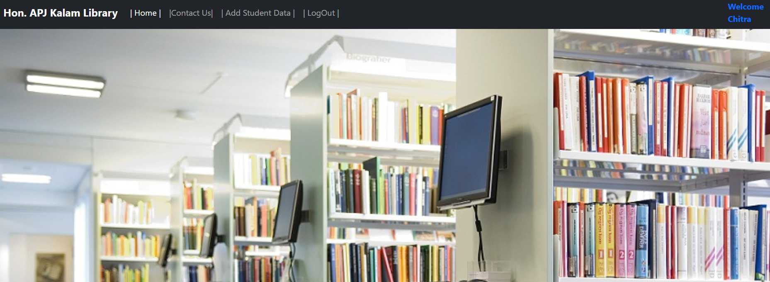
Manager Login - Homepage

Slide 5
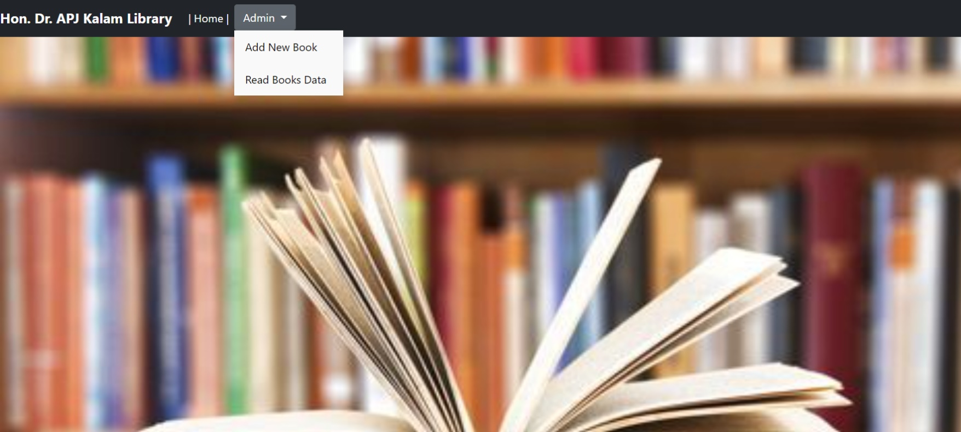
Admin Login - Homepage

Slide 6
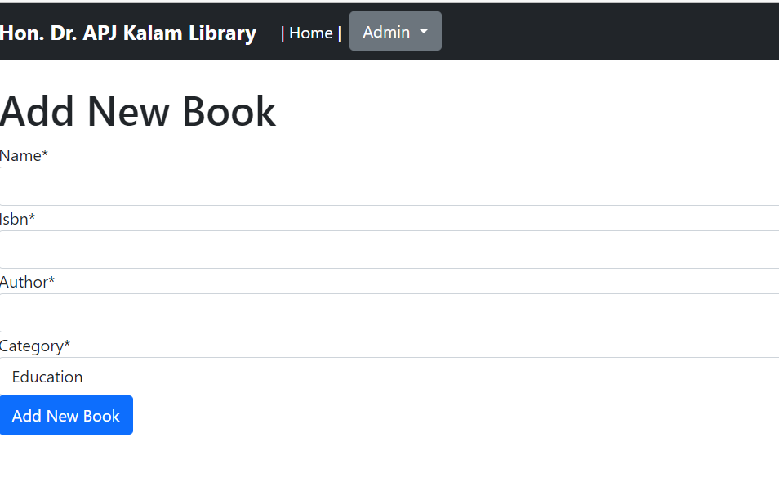
Add New Book Page

Slide 7
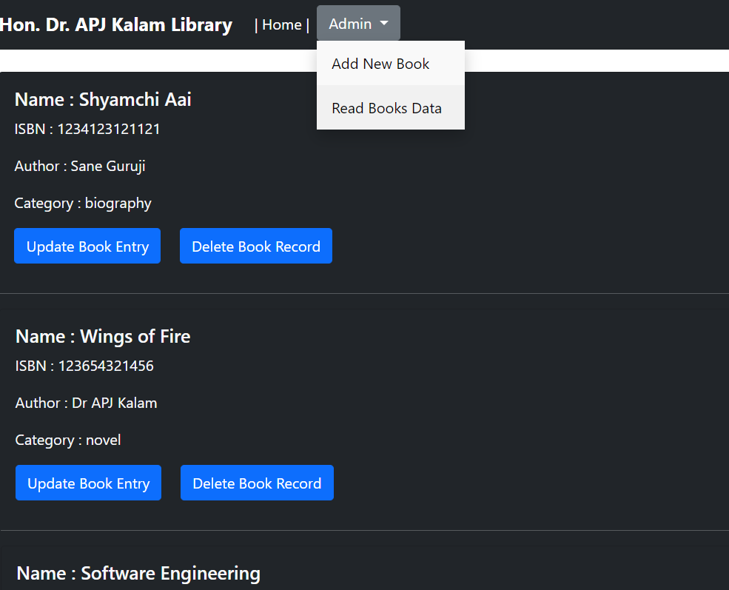
Read Book Data Page

Slide 8
Thank you!

