Slide 1

SMART INDIA HACKATHON 2026
TITLE PAGE
Problem Statement ID – SIH26092
Problem Statement Title- AI-Driven Scheme Matching for Marginalized Entrepreneurs
Theme- Smart Automation
PS Category- Software
Team ID - 253
Team Name – NextGen Coders

Slide 2
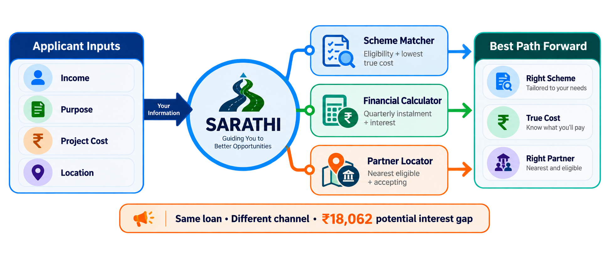
IDEA TITLE
NextGen Coders
Proposed Solution: Sarathi – Rule-Based Scheme Recommender, Calculator & Partner Locator for NSFDC Loans
SARATHI — AT A GLANCE
Rule-based scheme recommender + financial calculator + geo-spatial partner locator
Detailed explanation of the proposed solution
• Applicant enters income, purpose, project/course cost & location.
• Rule engine checks all 5 NSFDC schemes and ranks every eligible option by true cost.
• Calculator handles quarterly instalment, interest & moratorium; locator finds the nearest eligible partner.
How it addresses the problem
• Removes guesswork between overlapping schemes using the applicant’s own numbers.
• Filters partners by scheme support and acceptance status — not just distance.
• English + Hindi interface gives beneficiaries a simple, direct decision path.
Choose the right scheme → know the true cost → reach the right partner
Innovation and uniqueness of the solution
• Recommends the best scheme × channel combination, not just a scheme.
• Highlights the ₹18,062 potential interest gap for the same ₹1.08 lakh loan.
• Rules decide eligibility and money; AI only explains the finished decision.

Slide 3
TECHNICAL APPROACH
NextGen Coders
Technologies to be used
SYSTEM FLOW
Frontend
Backend
INPUT
RULE ENGINE
DECISION
React + CSS
HTML + OpenStreetMap
Python + FastAPI
REST API + rule engine
Income
Purpose
Cost
Location
All 5 schemes
Eligibility + ranking
True cost
+ best route
Data
AI layer
Structured JSON
No database required
Optional explanation,
Never decides the numbers
Financial Calculator
Partner Locator
Distance + scheme support
Accepting / limited / excluded
Quarterly instalment
Interest + moratorium
Methodology and process
1
2
3
4
5
Applicant
Profile
Eligibility
Engine
Ranking +
Calculator
Partner
Locator
Output
OUTPUT
Recommended scheme • true cost • eligible partner • checklist

Slide 4
FEASIBILITY AND VIABILITY
Your Team Name
NextGen Coders
A practical MVP built on verifiable rules and replaceable data
Analysis of feasibility
Potential challenges & risks
Strategies to overcome
✓ Public NSFDC scheme rules & eligibility
✓ Rule-based arithmetic — fast to verify and cheap to run
✓ No live bank data required for a working demo
✓ Partner dataset can be replaced without changing routing logic
⚠ Scheme rates and limits can change
⚠ Live partner acceptance / fund-utilisation data is not publicly available
⚠ Low-literacy or non-smartphone users may need simpler access
→ Store every scheme figure with source + last-verified date
→ Keep partner data swappable: SIMULATED now, live feed later
→ English + Hindi, lightweight mobile UI and future kiosk mode
DESIGNED FOR TRUST: SOURCE + DATE + EXPLICIT SIMULATED / VARIANT LABELS

Slide 5
IMPACT AND BENEFITS
Your Team Name
NextGen Coders
THE PROBLEM FOR BENEFICIARIES
SARATHI'S VALUE
THE RESULT
Before Sarathi
After Sarathi
SARATHI
100+
channel partners
Financial literacy
Rules decide
AI explains
Applicant understands the option, cost and route.
5
overlapping schemes
Lower borrowing cost
Cheapest eligible scheme × channel is surfaced.
1
wrong door can cost more
RIGHT
SCHEME
TRUE
COST
RIGHT
PARTNER
Faster, clearer routing
Eligible partner is found instead of guessing.

Slide 6
RESEARCH AND REFERENCES
Your Team Name
NextGen Coders
Primary sources used to build and verify Sarathi
01
NSFDC — Official Scheme Details
nsfdc.nic.in/scheme
Scheme limits, rates, tenure and channel mapping
02
NSFDC — Eligibility Requirements
nsfdc.nic.in/eligibility-requirements
SC status, income ceiling and applicant conditions
03
NSFDC — Channel Partners
nsfdc.nic.in/our-channel-partners
Partner categories and routing context
04
PM-SURAJ
pmsuraj.dosje.gov.in
Existing MoSJE application / tracking portal
05
SIH26092 Problem Statement
Ministry of Social Justice & Empowerment • SIH 2026
Official requirements for recommender, calculator and geo-spatial locator
SCHEME DATA VERIFIED AGAINST NSFDC • RETRIEVED 10 SEP 2026

