Slide 1

SMART INDIA HACKATHON 2026
TITLE PAGE
Problem Statement ID – SIH26092
Problem Statement Title- AI-Driven Scheme Matching for Marginalized Entrepreneurs
Theme- Smart Automation
PS Category- Software
Team ID - 253
Team Name – NextGen Coders

Slide 2
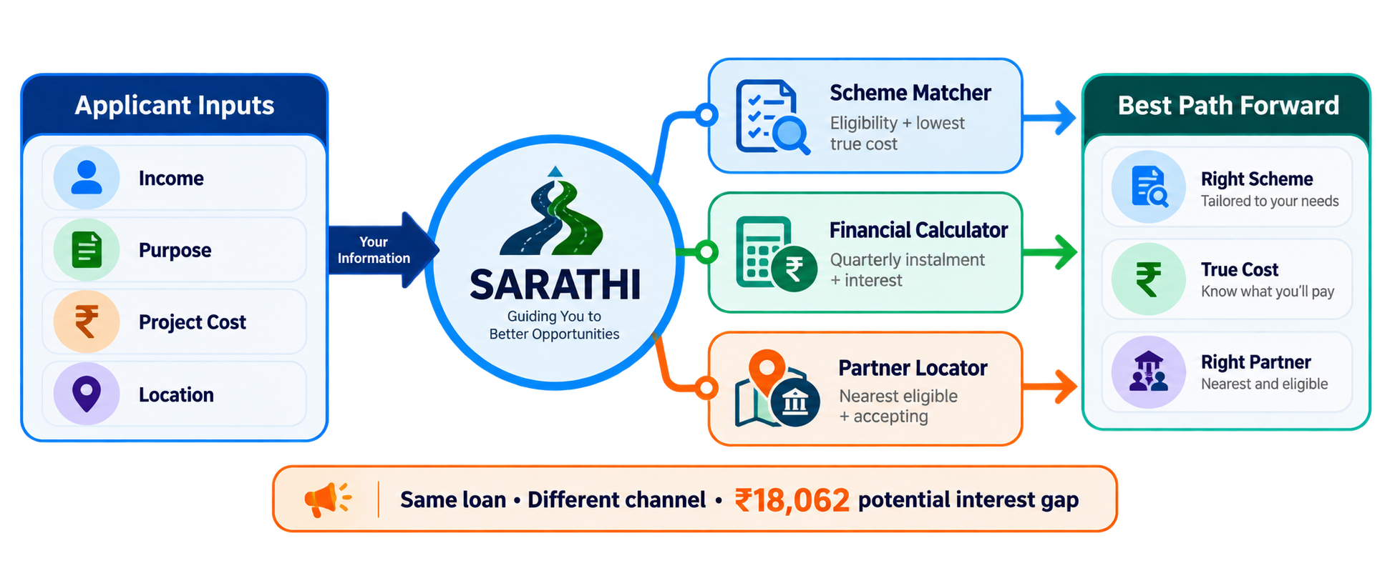
IDEA TITLE
NextGen Coders
Proposed Solution: Sarathi – Rule-Based Scheme Recommender, Calculator & Partner Locator for NSFDC Loans
SARATHI — AT A GLANCE
Rule-based scheme recommender + financial calculator + geo-spatial partner locator
Detailed explanation of the proposed solution
• Applicant enters income, purpose, project/course cost & location.
• Rule engine checks all 5 NSFDC schemes and ranks every eligible option by true cost.
• Calculator handles quarterly instalment, interest & moratorium; locator finds the nearest eligible partner.
How it addresses the problem
• Removes guesswork between overlapping schemes using the applicant’s own numbers.
• Filters partners by scheme support and acceptance status — not just distance.
• English + Hindi interface gives beneficiaries a simple, direct decision path.
Innovation and uniqueness of the solution
Choose the right scheme → know the true cost → reach the right partner
• Recommends the best scheme × channel combination, not just a scheme.
• Highlights the ₹18,062 potential interest gap for the same ₹1.08 lakh loan.
• Rules decide eligibility and money; AI only explains the finished decision.

Slide 3
NextGen Coders
TECHNICAL APPROACH
TECHNOLOGIES TO BE USED
SYSTEM FLOW
Frontend
React + CSS/HTML
OpenStreetMap · Leaflet
Backend
Python + FastAPI
Deterministic rule engine
INPUT
Income · purpose
project cost
location
RULE ENGINE
All 5 schemes
eligibility + ranking
DECISION
True cost +
best route
Data layer
SQLite / PostgreSQL
Schemes · partners · activities
AI layer
Optional LLM narration
Template fallback, 6s timeout
↓
FINANCIAL CALCULATOR
Quarterly instalment · interest
+ moratorium handling
PARTNER LOCATOR
Distance + scheme support
Accepting / limited / excluded
↓
Note: Relational schema for reference data (schemes, partners) — demo-ready on SQLite, deployment-ready on PostgreSQL with zero engine changes.
OUTPUT
Recommended scheme · true cost · eligible partner · document checklist
METHODOLOGY AND PROCESS
↓
1
2
3
4
5
Data honesty by design: every field tagged VERIFIED, VARIANT or SIMULATED in the API response itself — with source URL and date where applicable. Never mixed silently.
Applicant
Profile
Eligibility
Engine
Ranking +
Calculator
Partner
Locator
Output
@SIH Idea submission- Template
3
@SIH Idea submission- Template
3

Slide 4
FEASIBILITY AND VIABILITY
Your Team Name
NextGen Coders
A practical MVP built on verifiable rules and replaceable data
Feasibility & Viability
Technical
Financial
Operational
Trust & Adoption
• Rule engine is plain arithmetic — fast to build, trivial to verify by hand
• Zero third-party API costs — no paid maps, no paid LLM required to function
• Partner dataset is swappable — simulated now, live NSFDC feed later, zero change to routing logic
• Every figure is source-linked and dated — defensible to a judge or an auditor
• Relational schema (SQLite → PostgreSQL) needs no redesign to scale
• LLM layer is optional; core product runs at near-zero marginal cost
• Stateless API — no accounts, no migrations, easy to deploy anywhere
• English + Hindi from day one, for the audience that actually needs this
KNOWN RISKS — NAMED, NOT HIDDEN
⚠ Scheme rates/limits may change → mitigated by per-field source + as-of date, live at /schemes
⚠ Partner acceptance data isn't public → clearly labelled SIMULATED; algorithm is real
⚠ Low-literacy / non-smartphone users → Hindi UI now, lightweight, kiosk mode planned

Slide 5
IMPACT AND BENEFITS
Your Team Name
NextGen Coders
THE SAME APPLICANT, THE SAME ₹1.2 LAKH PROJECT — THREE DIFFERENT DOORS
Route
Scheme
Channel
Rate
Quarterly instalment
Interest
A
Micro Finance Scheme
SCA / PSB / RRB
6.5%
₹10,977 × 11
₹12,747
B
Udyam Nidhi Yojana
Co-op Bank / SFB
13–15%
—
—
C
Aajeevika Micro-Finance Yojana
NBFC-MFI
15%
₹12,619 × 11
₹30,809
Walking into the wrong office costs ₹18,062 — roughly a sixth of the loan. The same pattern repeats at every project size: a ₹4 lakh dairy loan can cost ₹45,121 more through the wrong channel.
THE PROBLEM FOR BENEFICIARIES
SARATHI'S ROLE
THE RESULT
Before Sarathi
SARATHI
Rules decide
AI explains
After Sarathi
18
channel-partner branches, unmapped to any single applicant journey
Financial literacy
Applicant understands the option, true cost and route before choosing.
Lower borrowing cost
The cheapest eligible scheme × channel combination is surfaced, not buried.
7
schemes & channel variants that can overlap for one applicant
Faster, fairer routing
An eligible, accepting partner is found — instead of guessed.
1
wrong door can cost a sixth of the entire loan
Right
Scheme
True
Cost
Right
Partner

Slide 6
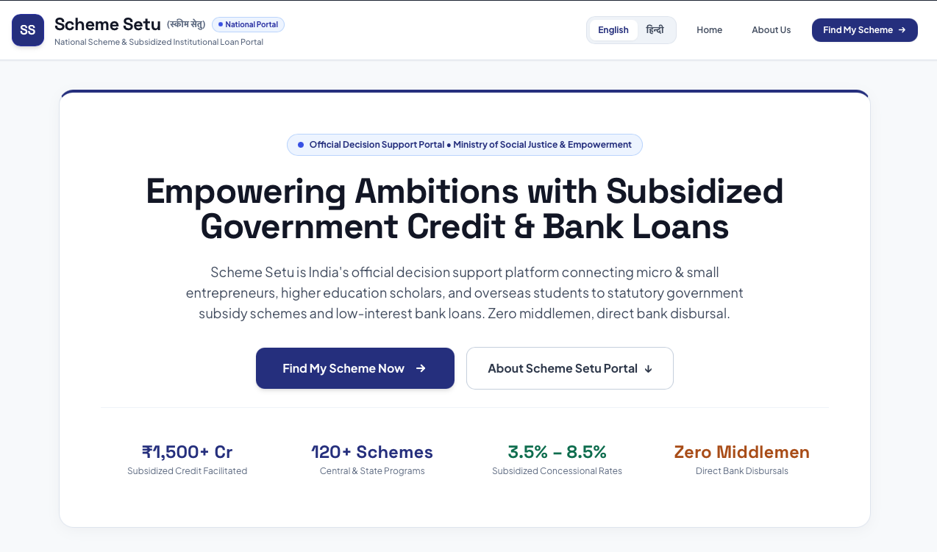
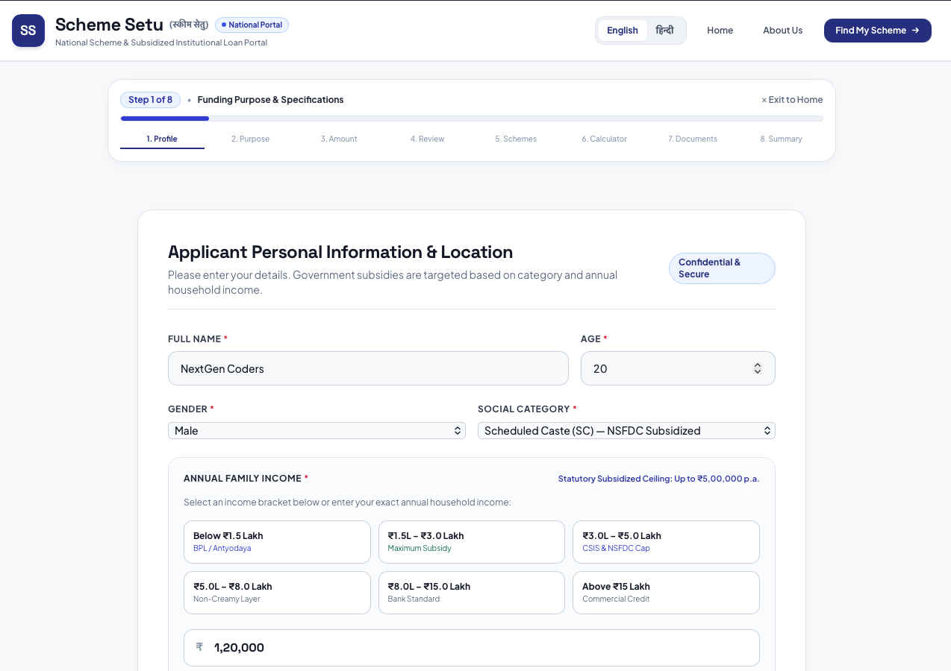
RESEARCH AND REFERENCES
Your Team Name
NextGen Coders
PRODUCT — BUILT BY THE TEAM
PRIMARY SOURCES USED TO BUILD AND VERIFY SARATHI
01
NSFDC — Official Scheme Details
nsfdc.nic.in/scheme
Scheme limits, rates, tenure and channel mapping
02
NSFDC — Eligibility Requirements
nsfdc.nic.in/eligibility-requirements
SC status, income ceiling and applicant conditions
03
NSFDC — Channel Partners
nsfdc.nic.in/our-channel-partners
Partner categories and routing context
04
PM-SURAJ
pmsuraj.dosje.gov.in
Existing MoSJE application / tracking portal
05
SIH26092 Problem Statement
Ministry of Social Justice & Empowerment · SIH 2026
Official requirements for recommender, calculator and geo-spatial locator
SCHEME DATA VERIFIED AGAINST NSFDC · RETRIEVED 10 SEP 2026

