Slide 1
Diagrams for Variational Quantum Optimization of Non-n-locality in Noisy Quantum Networks

Slide 2



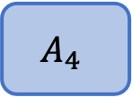
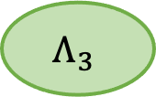


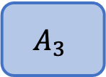
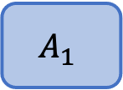

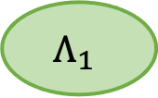
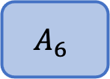

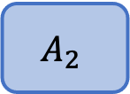

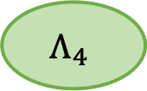


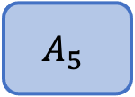


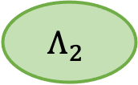
Example n-local network
$$x_{1}$$
$$x_{4}$$
$$x_{5}$$
$$Λ_{1}$$
$$Λ_{2}$$
$$A_{1}$$
$$A_{4}$$
$$A_{5}$$
$$x_{2}$$
$$x_{3}$$
$$Λ_{3}$$
$$x_{6}$$
$$a_{1}$$
$$a_{4}$$
$$a_{5}$$
$$A_{2}$$
$$A_{3}$$
$$A_{6}$$
$$Λ_{4}$$
$$a_{2}$$
$$a_{3}$$
$$a_{6}$$

Slide 3


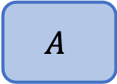


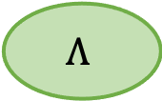

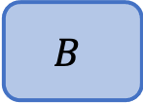

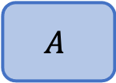
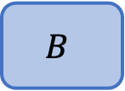
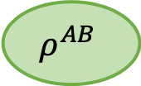

CHSH Scenario
$$x$$
$$Λ$$
$$y$$
$$x$$
$$ρ^{AB}$$
$$y$$
$$A$$
$$B$$
$$A$$
$$B$$
$$a$$
$$b$$
$$a$$
$$b$$

Slide 4

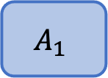


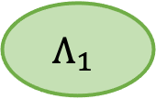



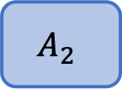
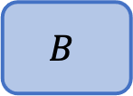
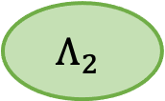
Bilocal Network
$$x_{1}$$
$$Λ_{1}$$
$$y$$
$$Λ_{2}$$
$$x_{2}$$
$$A_{1}$$
$$B$$
$$A_{2}$$
$$a_{1}$$
$$b$$
$$a_{2}$$

Slide 5
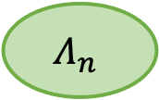
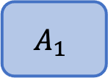

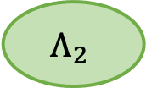
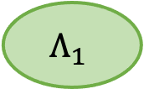





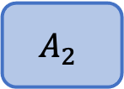
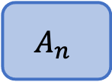
N-local star
$$x_{2}$$
$$A_{2}$$
$$x_{1}$$
$$Λ_{1}$$
$$y$$
$$Λ_{2}$$
$$A_{1}$$
$$B$$
…
$$a_{2}$$
$$x_{n}$$
$$a_{1}$$
$$b$$
$$Λ_{n}$$
$$A_{n}$$
$$a_{n}$$

Slide 6

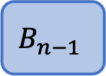
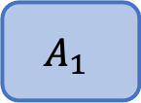

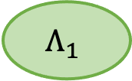
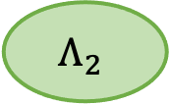




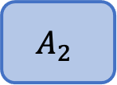
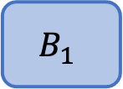
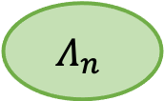

Chain n-local Network
$$x_{1}$$
$$Λ_{1}$$
$$y_{1}$$
$$Λ_{2}$$
$$y_{n−1 }$$
$$Λ_{n}$$
$$x_{1}$$
…
$$A_{1}$$
$$B_{1}$$
$$B_{n−1}$$
$$A_{2}$$
$$a_{1}$$
$$b_{1}$$
$$b_{n−1}$$
$$a_{2}$$

Slide 7
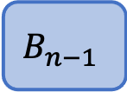
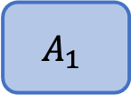

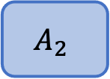
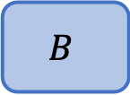
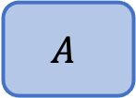

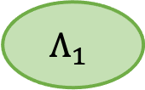
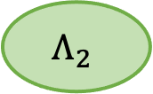
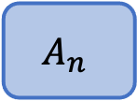


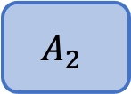
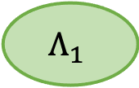




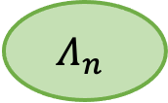
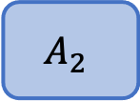
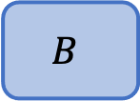


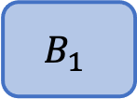
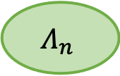


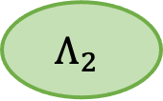












a) Local Network
c) n-Local Chain Network
$$x$$
$$Λ$$
$$y$$
$$x_{1}$$
$$Λ_{1}$$
$$y_{1}$$
$$Λ_{2}$$
$$y_{n−1 }$$
$$Λ_{n}$$
$$x_{2}$$
…
$$A$$
$$B$$
$$A_{1}$$
$$B_{1}$$
$$B_{n−1}$$
$$A_{2}$$
$$a$$
$$b$$
$$a_{1}$$
$$b_{1}$$
$$b_{n−1}$$
$$a_{2}$$
b) Bilocal Network
d) n-Local Star Network
$$x_{2}$$
$$A_{2}$$
$$x_{1}$$
$$Λ_{1}$$
$$y$$
$$Λ_{2}$$
$$x_{2}$$
$$x_{1}$$
$$Λ_{1}$$
$$y$$
$$Λ_{2}$$
$$A_{1}$$
$$B$$
$$A_{2}$$
$$A_{1}$$
$$B$$
…
$$a_{2}$$
$$x_{n}$$
$$a_{1}$$
$$b$$
$$a_{2}$$
$$a_{1}$$
$$b$$
$$Λ_{n}$$
$$A_{n}$$
$$a_{n}$$

Slide 8






















Noise Models
a) Source Noise
b) Communication Noise
c) Detector Noise
$$Λ$$
$$Λ$$
$$x$$
$$Λ$$
$$y$$
$$x$$
$$𝒩_{1}$$
$$y$$
$$x$$
$$𝒩_{1}$$
$$𝒩_{2}$$
$$y$$
$$A$$
$$B$$
$$A$$
$$B$$
$$A$$
$$B$$
$$E_{1}$$
$$E_{2}$$
$$a$$
$$b$$
$$a$$
$$b$$
$$a$$
$$b$$

Slide 9







































Bilocal ansatz example
$$x_{1}$$
$$\left|ψ^{Λ_{1}}\right\rangle$$
$$y$$
$$\left|ψ^{Λ_{2}}\right\rangle$$
$$x_{2}$$
$$Π_{a_{1}|x_{1}}^{A_{1}}$$
$${ 𝒩}^{q_{1}}$$
$${ 𝒩}^{q_{2}}$$
$${ 𝒩}^{q_{3}}$$
$${ 𝒩}^{q_{4}}$$
$$Π_{b|y}^{B}$$
$$Π_{a_{2}|x_{2}}^{A_{2}}$$
$$a_{1}$$
$$b$$
$$a_{2}$$
Sources
Noise
Nonsignaling Devices
$$|0⟩$$
$$U^{Λ_{1}}({\vec{φ}}_{1})$$
$${ 𝒩}^{q_{1}}$$
$$U^{A_{1}}({\vec{θ}}_{x_{1}})$$
$$z_{1}$$
$$a_{1}$$
$$|0⟩$$
$${ 𝒩}^{q_{2}}$$
$$U^{B}({\vec{θ}}_{y})$$
$$z_{2}$$
$$U^{Λ_{2}}({\vec{φ}}_{2})$$
$${ 𝒩}^{q_{3}}$$
$$⊕$$
$$b$$
$$|0⟩$$
$$z_{3}$$
$$|0⟩$$
$${ 𝒩}^{q_{4}}$$
$$U^{A_{2}}({\vec{θ}}_{x_{2}})$$
$$z_{4}$$
$$a_{2}$$
$${\left|0\right\rangle }^{N}$$
$${ U}_{ }^{Net}\left(Θ_{\vec{x}}^{ }\right)$$
$$\vec{z}$$

Slide 10












VQO framework
1) Input: $Θ_{init}$, Random Settings
2) Variational Quantum Optimization Loop
2.a) Classical: Calculate the collection of parameter-shift settings $\left\{Θ^{g}\right\}={\hat{Θ}}_{PS}$.
$${\hat{Θ}}_{PS}$$
2.b) Quantum: Simulate network for all inputs $\vec{x}∈𝒳$ and settings $Θ^{g}∈{\hat{Θ}}_{PS}$.
$P\left(\vec{z} | \vec{x}\right)={\left|{\left\langle \vec{z} | U_{Net}\left(Θ_{\vec{x}}^{g}\right) | 0\right\rangle }^{N}\right|}^{2}$
$${\left|0\right\rangle }^{N}$$
$$U_{Net}\left(Θ_{\vec{x}}^{g}\right)$$
$$\vec{z}$$
$$Θ^{′}$$
$${\left\{P_{QC}\left(Θ^{g}\right)\right\}}_{Θ^{g}∈{\hat{Θ}}_{PS}}$$
2.c) Classical: Update settings using gradient descent and parameter-shift rule.
3) Output: $Θ^{⋆}$, Optimal Settings

Slide 11




Unital noise plots

Slide 12






Amplitude and Phase Damping Channels
a) Dephasing
b) Amplitude Damping
$$ρ_{in}$$
$$ρ_{out}$$
$$ρ_{in}$$
$$ρ_{out}$$
$$|0⟩$$
$${ R}_{y}(θ)$$
$$|0⟩$$
$${ R}_{y}(θ)$$

Slide 13



Nonunital noise plots

Slide 14

















Hardware Ansatz Example
Sources
Nonsignaling Devices
$$Λ_{1}$$
$$A_{1}$$
$$|0⟩$$
$$H$$
$$R_{y}(θ_{x_{1}})$$
$$a_{1}$$
$$B_{1}$$
$$|0⟩$$
$$R_{y}(θ_{y}^{1})$$
$$Λ_{2}$$
$$⊕$$
$$b$$
$$|0⟩$$
$$H$$
$$R_{y}(θ_{y}^{2})$$
$$A_{2}$$
$$|0⟩$$
$$R_{y}(θ_{x_{2}})$$
$$a_{2}$$

Slide 15



