Slide 1
Diagrams for Variational Quantum Optimization of Non-n-locality in Noisy Quantum Networks

Slide 2
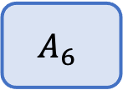


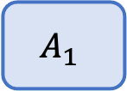
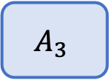
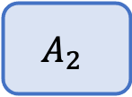


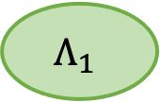

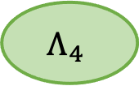
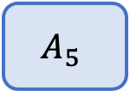

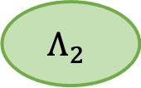




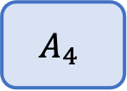
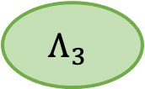


Example n-local network
$$x_{1}$$
$$x_{4}$$
$$x_{5}$$
$$Λ_{1}$$
$$Λ_{2}$$
$$A_{1}$$
$$A_{4}$$
$$A_{5}$$
$$x_{2}$$
$$x_{3}$$
$$Λ_{3}$$
$$x_{6}$$
$$a_{1}$$
$$a_{4}$$
$$a_{5}$$
$$A_{2}$$
$$A_{3}$$
$$A_{6}$$
$$Λ_{4}$$
$$a_{2}$$
$$a_{3}$$
$$a_{6}$$

Slide 3

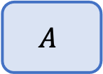

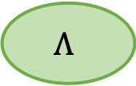


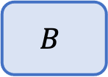
CHSH Scenario
$$x$$
$$y$$
$$Λ$$
$$A$$
$$B$$
$$a$$
$$b$$

Slide 4

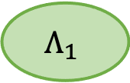

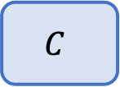
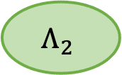
Bilocal Network
$$x$$
$$y$$
$$z$$
$$Λ_{1}$$
$$Λ_{2}$$
$$A$$
$$B$$
$$C$$
$$a$$
$$b$$
$$c$$

Slide 5
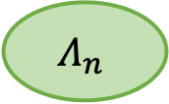
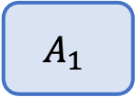

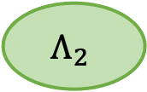
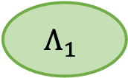





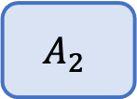
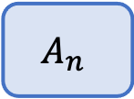
N-local star
$$x_{2}$$
$$A_{2}$$
$$x_{1}$$
$$Λ_{1}$$
$$y$$
$$Λ_{2}$$
…
$$a_{2}$$
$$A_{1}$$
$$B$$
$$x_{n}$$
$$a_{1}$$
$$Λ_{n}$$
$$b$$
$$A_{n}$$
$$a_{n}$$

Slide 6

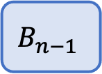
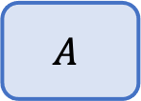


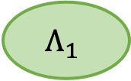
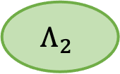




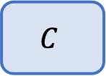
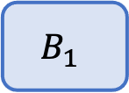
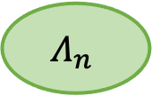

Chain n-local Network
$$x$$
$$y_{1}$$
$$y_{n−1 }$$
$$z$$
$$Λ_{1}$$
$$Λ_{2}$$
$$Λ_{n}$$
…
$$A$$
$$B_{1}$$
$$B_{n−1}$$
$$C$$
$$a$$
$$b_{1}$$
$$b_{n−1}$$
$$c$$

Slide 7










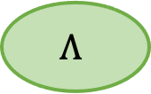



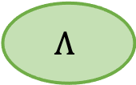





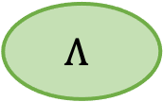




Noise Models
a) Source Noise
b) Communication Noise
c) Detector Noise
$$Λ$$
$$Λ$$
$$x$$
$$Λ$$
$$y$$
$$x$$
$$𝒩_{1}$$
$$y$$
$$x$$
$$𝒩_{1}$$
$$𝒩_{2}$$
$$y$$
$$A$$
$$B$$
$$A$$
$$B$$
$$A$$
$$B$$
$$E_{1}$$
$$E_{2}$$
$$a$$
$$b$$
$$a$$
$$b$$
$$a$$
$$b$$

Slide 8
































Bilocal ansatz example
$$x_{1}$$
$$\left|ψ^{Λ_{1}}\right\rangle$$
$$y$$
$$\left|ψ^{Λ_{2}}\right\rangle$$
$$x_{2}$$
$$𝒩_{1}$$
$$𝒩_{2}$$
$$𝒩_{3}$$
$$𝒩_{4}$$
$$⟨π_{a_{1}|x_{1}}^{A_{1}}|$$
$$⟨π_{b|y}^{B}|$$
$$⟨π_{a_{2}|x_{2}}^{A_{2}}|$$
$$a_{1}$$
$$b$$
$$a_{2}$$
Sources
Noise
Nonsignaling Devices
$$|0⟩$$
$$U^{Λ_{1}}({\vec{φ}}_{1})$$
$$𝒩_{1}$$
$$U^{A_{1}}({\vec{θ}}_{x_{1}})$$
$$a_{1}$$
$$|0⟩$$
$$𝒩_{2}$$
$$U^{B}({\vec{θ}}_{y})$$
$$⊕$$
$$b$$
$$|0⟩$$
$$U^{Λ_{2}}({\vec{φ}}_{2})$$
$$𝒩_{3}$$
$$|0⟩$$
$$𝒩_{4}$$
$$U^{A_{2}}({\vec{θ}}_{x_{2}})$$
$$a_{2}$$

