Slide 1
AIR QUALITY
Prepared By :-
Sudhir Panda (201510660)
Bikram Pradhan (201510088)
Chita Ranjan Pradhan (201540789)
Sahil Pradhan (201510746)

Slide 2
CONTENTS
Problem Type
Data Set Information
Abstract
Number Of Attribute
Missing value
Outlier’s
Normalization
Neuralnet
Testing Value
Rms Error

Slide 3
Why air quality data analysis?
A detailed study on the quantity of harmful pollutants present in the atmosphere and using the regression technique on the dataset, for keeping a check on the air quality.
Air quality
Affects public health
Can damage plants and ecosystems (e.g., acid rain)
Causes deterioration of buildings, monuments, etc.
Contributes to climate change

Slide 4
Data Set Information
The dataset contains 9358 instances of hourly averaged responses from an array of 5 metal oxide chemical sensors embedded in an Air Quality Chemical Multisensor Device. The device was located on the field in a significantly polluted area, at road level,within an Italian city. Data were recorded from March 2004 to February 2005 (one year)representing the longest freely available recordings of on field deployed air quality chemical sensor devices responses. Ground Truth hourly averaged concentrations for CO, Non Metanic Hydrocarbons, Benzene, Total Nitrogen Oxides (NOx) and Nitrogen Dioxide (NO2) and were provided by a co-located reference certified analyzer. Evidences of cross-sensitivities as well as both concept and sensor drifts are present as described in De Vito et al., Sens. And Act. B, Vol. 129,2,2008 (citation required) eventually affecting sensors concentration estimation capabilities. Missing values are tagged with -200 value. This dataset can be used exclusively for research purposes. Commercial purposes are fully excluded.

Slide 5
Abstract
The dataset contains the responses of a gas multi-sensor device deployed on the field in an Italian city. Hourly responses averages are recorded along with gas concentrations references from a certified analyzer.
DATASET CHARACTERISTICS :- | MULTIVARIATE TIME SERIES | NO OF INSTANCES :- | 9358
ATTRIBUTE CHARACTERISTICS :- | REAL | NO OF ATTRIBUTES :- | 15
ASSOCIATED TASKS :- | REGRESSION | MISSING VALUES? :- | YES

Slide 6
NUMBER OF ATTRIBUTES
Date (DD/MM/YYYY)
Time (HH.MM.SS)
True hourly averaged concentration CO in mg/m^3 (reference analyzer)
PT08.S1 (tin oxide) hourly averaged sensor response (nominally CO targeted)
True hourly averaged overall Non Metanic HydroCarbons concentration in microg/m^3 (reference analyzer)
True hourly averaged Benzene concentration in microg/m^3 (reference analyzer)
PT08.S2 (titania) hourly averaged sensor response (nominally NMHC targeted)
True hourly averaged NOx concentration in ppb (reference analyzer)
PT08.S3 (tungsten oxide) hourly averaged sensor response (nominally NOx targeted)
True hourly averaged NO2 concentration in microg/m^3 (reference analyzer)
PT08.S4 (tungsten oxide) hourly averaged sensor response (nominally NO2 targeted)
11 PT08.S5 (indium oxide) hourly averaged sensor response (nominally O3 targeted)

Slide 7
Contribution To The Society
Decreases the rate of corrosion of the monuments.
Keeps the major check in the climate change and global warming.
Decrease the risk of asthama and pneumonia and other air borne diseases.

Slide 8
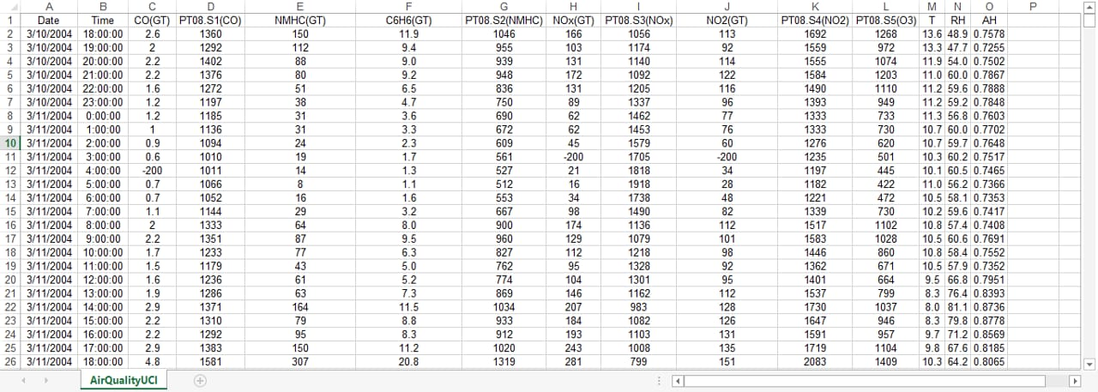
Sample Data SET

Slide 9
Variable Identification
TYPES OF VARIABLE | DATA TYPES | VARIABLE CATEGORIES
Prediction Variable:- CO(GT) NMMHC(GT) NO(GT) NOx(GT) C6H6 (GT) | Character:- DATE TIME | Categorical:-NIL
Target Value:- Temp RH(Relative Humidity) AH(Absolute Humidity) | Numeric:- REST OF THE ATTRIBUTES | Continuous:- ALL OF THE ATTRIBUTES

Slide 10
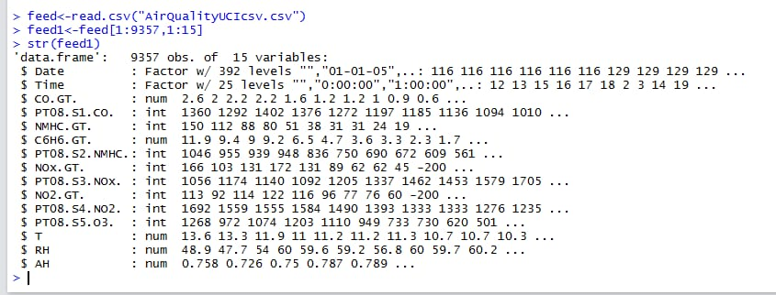
DATA TYPES AND VARIABLE CATEGORY

Slide 11
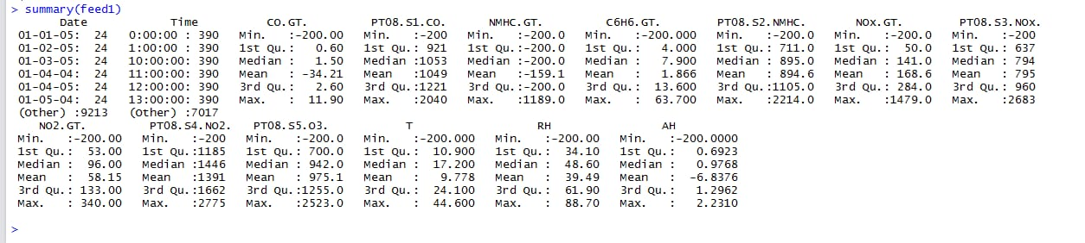
UNIVARIATE ANALYSIS

Slide 12
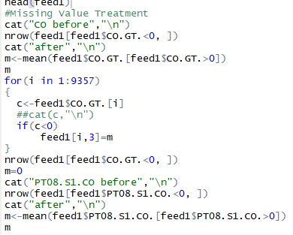
Missing Value

Slide 13
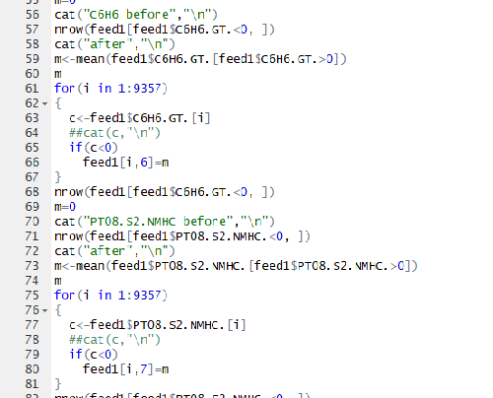

Slide 14
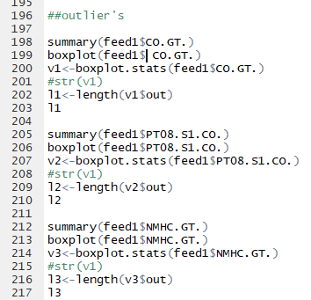
OUTLIER’S

Slide 15
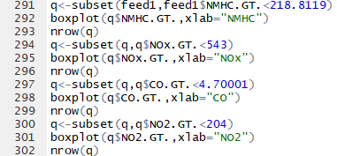

Slide 16
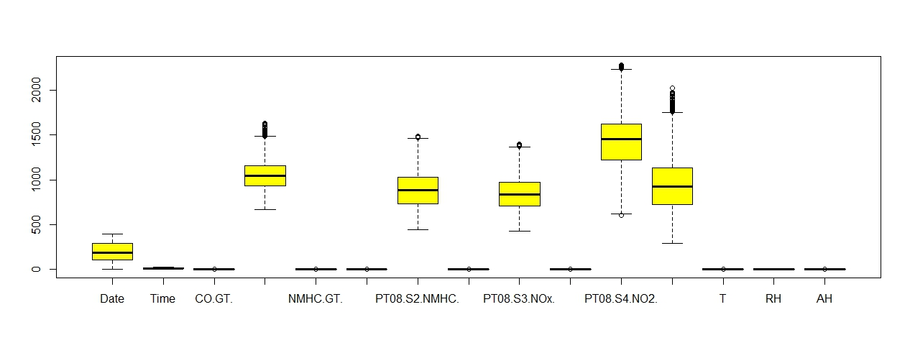

Slide 17
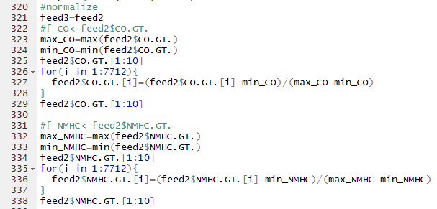
NORMALIZATION

Slide 18
Designing the Model
nt1 <- neuralnet(T~CO.GT.+C6H6.GT.+NMHC.GT.+NOx.GT.+NO2.GT., data = feed2[1:5398,1:15], hidden=2,rep=2,learningrate =0.1,algorithm = "rprop+",err.fct = "ce", linear.output=TRUE)
plot(nt1)
Here We have Taken only 70% of the data set for Training the Neuralnet Model and Rest 30% for testing

Slide 19
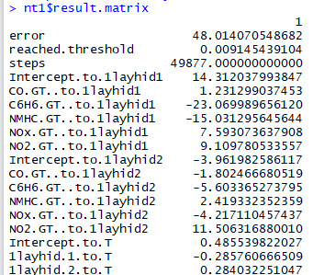

Slide 20
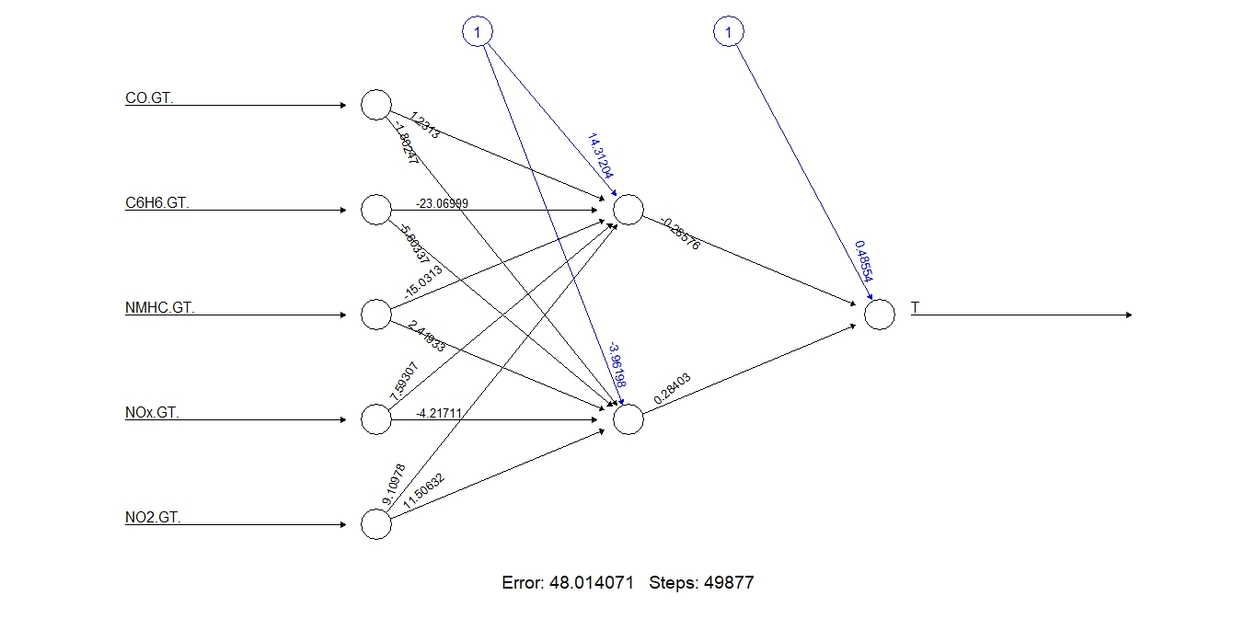

Slide 21
TESTING VALUE

Slide 22
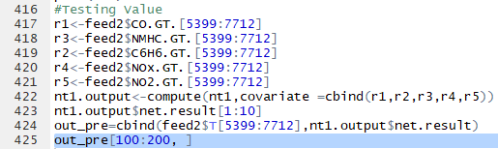
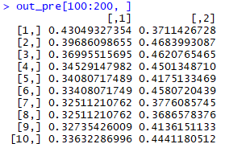

Slide 23
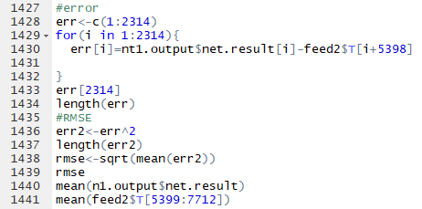

FINDING THE RMSE VALUE

Slide 24
ACTUAL VS PREDICTED
plot(nt1.output$net.result[1:500],feed2$T[5399:5898],col=3)
x=nt1.output$net.result[1:500]
y=feed2$T[5399:5898]
abline(lm(y~x))

Slide 25
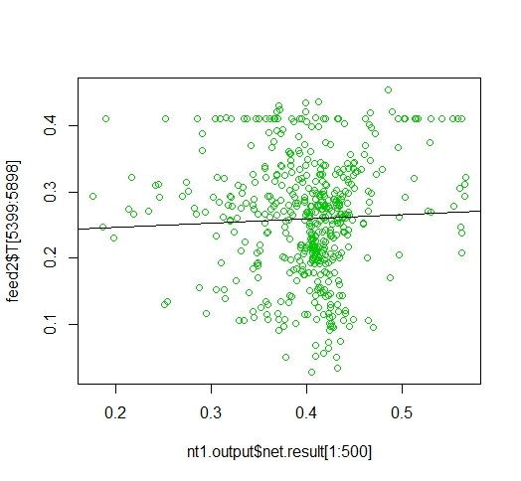

Slide 26
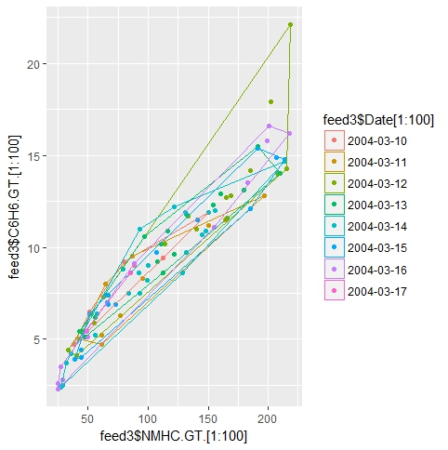

Slide 27
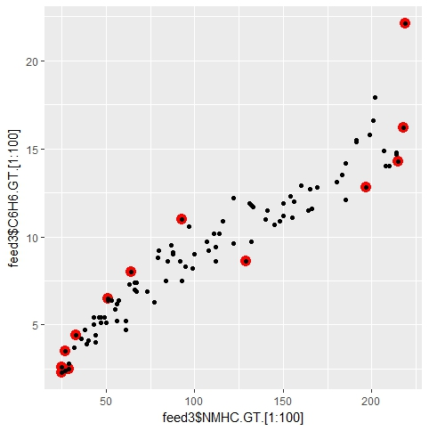

Slide 28
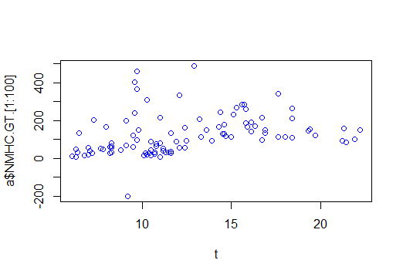
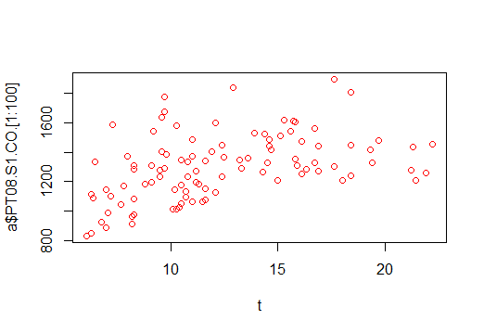
NON METANIC HYDRO CARBON vs TEMP
INDIUM OXIDE vs TEMP

Slide 29
CONCLUSION
From the above analysis we predicted the value of temperature by training the neuralnet model against 5 input parameters and found out the RMSE error i.e 0.222

Slide 30
THANK YOU…

