Slide 1
Employee Attrition
Team :- Roorkie

Slide 2
CONTENT
INTRODUCTION
AIM OF THEMES
OBJECTIVE
FLOW CHART
METHODOLOGY
TECHNOLOGY
POSSIBLE OUTCOMES
WHY THIS SOLUTION?

Slide 3
INTRODUCTION
People are the lifeblood of an organization. Employee attrition is an extremely important and relevant business problem all organizations face. The major problem with high attrition is the cost to the organization and the time and resource investment. We invite you to propose ideas that can help in predicting and finding proactive ways of reducing attrition using technologies of your choice For eg: use available data/ and create modeling tools to predict which employees are more likely to leave given some attributes like absenteeism, stagnation in a role, active disengagement, etc.

Slide 4
AIM OF THE THEMES
Predicting and finding proactive ways of reducing attrition using technologies of your choice For eg: use available data/ and create modeling tools to predict which employees are more likely to leave given some attributes

Slide 5
Objective
The objective of the present report to study factor like businesstravel, department, distance from home, policies and procedures, recognition, appreciation, suggestions of the employee’s by which it helps to know the attrition level in the organizations and factors relating to retain them. This study also helps to find out where the organizations are lagging in retaining.

Slide 6
FLOW CHART
BOXPLOT IS USED FOR ALL CATEGORICAL AND NUMERICAL VARIBALE FOR ATTRITION
PLOTTING DISTRIBUTION NUMERICAL VARIBLE WITH EFFECTS OF ATTRITION
CONFUSION MATRIX FOR MISCLASSIFICATION AND MATRIX CLASSIFICATION FOR ACCURACY FOR FINAL OUTPUT
SEPARATE CATEGORICAL DUMMY VARIABLE
NUMERICAL VARIABLE
CROSS VALIDATION FOR ACCURACY
DATA SET
SEPARTE THE TARGET AND THE PREDICTORS VARIABLE AND THEN TRAIN AND TEST SPLIT
BUILDING DECISION TREE
HANDLING CATEGORICAL/NUMERICAL VARIABLE
MERIGING NUMERICAL AND CATEGORICAL
VARIABLE
RANDOM FOREST CLASSIFIER FOR ACCURACY
CATEGORICAL VARIABLE
PLOTTING CATEGORICAL NUMERICAL VARIBLE WITH EFFECTS OF ATTRITION
SEPARATE NUMERICAL DUMMY VARIABLE
DECISION TREE USING GREEDY APPORACH

Slide 7
METHODLOGY
Data has been collected from the kaggle which consist of 35 columns and 1470 rows which consist of age ,attrition, business travel, dialyrate , department , distance from home, education , education field , environment satisfaction etc are the data columns.
Data types are consist of int and object
There are categorical as well as numerical data are in the data set .
Categorical data are Bussiness travel, department, educational field , jobrole, Martial status, over time etc.
Numerical data are age , dailyrate , distancefromhome, job level, monthly rate etc.

Slide 8
TECHNOLOGY
We will using python along with libraries like panda , numpy ,seaborn ,graphviz.
We have used decision tree modelling which is greedy algorithm, it search entire space for possible decision tree, so we had find optimum parameter For stopping decision tree at same point.
We had use hypothesis with all attribute in the data set and it will help us to find all the attrition by comparing with the attributes attrition at what range In the organisation employees faces issue. For example age vs attrition, salary vs attrition, working hour’s vs attrition, job involvement vs attrition.
We will be using OneHotEncoder to predict the accuracy of the data

Slide 9
TECHNOLOGY
We will be working on jupyter notebook anaconda.
We will be using OneHotEncoder to predict the accuracy of the data.
We will be using Logistic Regression and random forest algorithm to finding the accuracy of the attrition of the data.
We will be using the library of pivot and graphic for fetching the graph.
We had evaluated by help of k-fold validation for assessing how the result of a Model will generalize to an independent test data set.
We had used also confusion matrix for tabulating the number of misclassification.
We had also used Roc curve for depending true positive and tolerance for false positive rate.

Slide 10
POSSIBLE OF OUTCOMES
we are checking the distribution of employee age and its related to attrition or not.
Analyzing the daily wage rate vs employee left the company or not.
Percentage of worklife balance rating across the company data.
Analyzing the working years ,salary ,switch from another company having more expreince and lesser expreince employees attrition.
Analyzing the Distance from home to office .
Calculating the percentage of people having different job involvement rate.
Calculate the percentage of performance rating per category in the whole dataset.
Percentage of each relationship satisfaction category across the data.
Calculating Average accuracy of pipeline with Decision Tree Classifier.

Slide 11
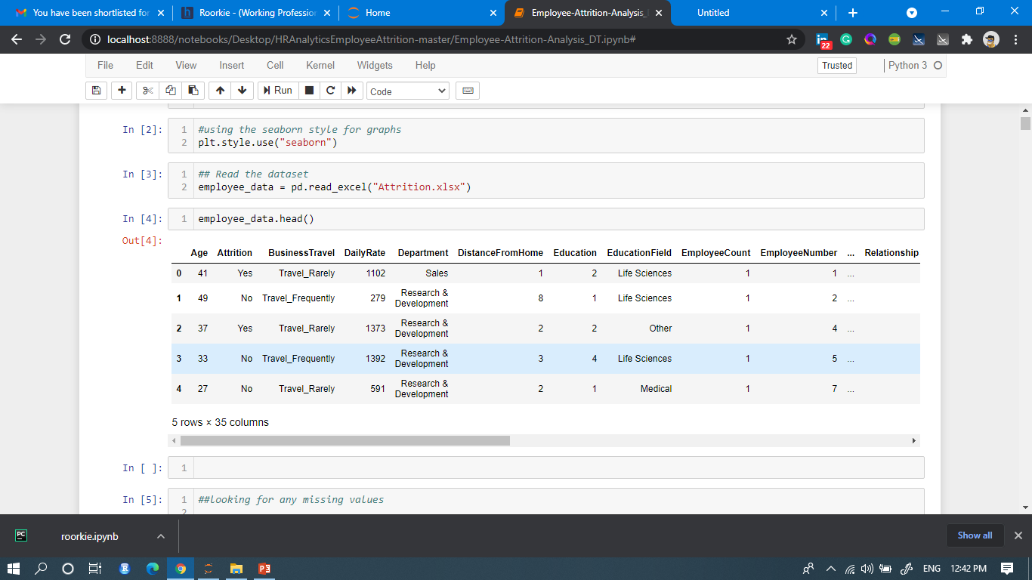
Solution:-
We are finding the first n rows for the object based on position. It is useful for quickly testing if your object has the right type of data in it.

Slide 12
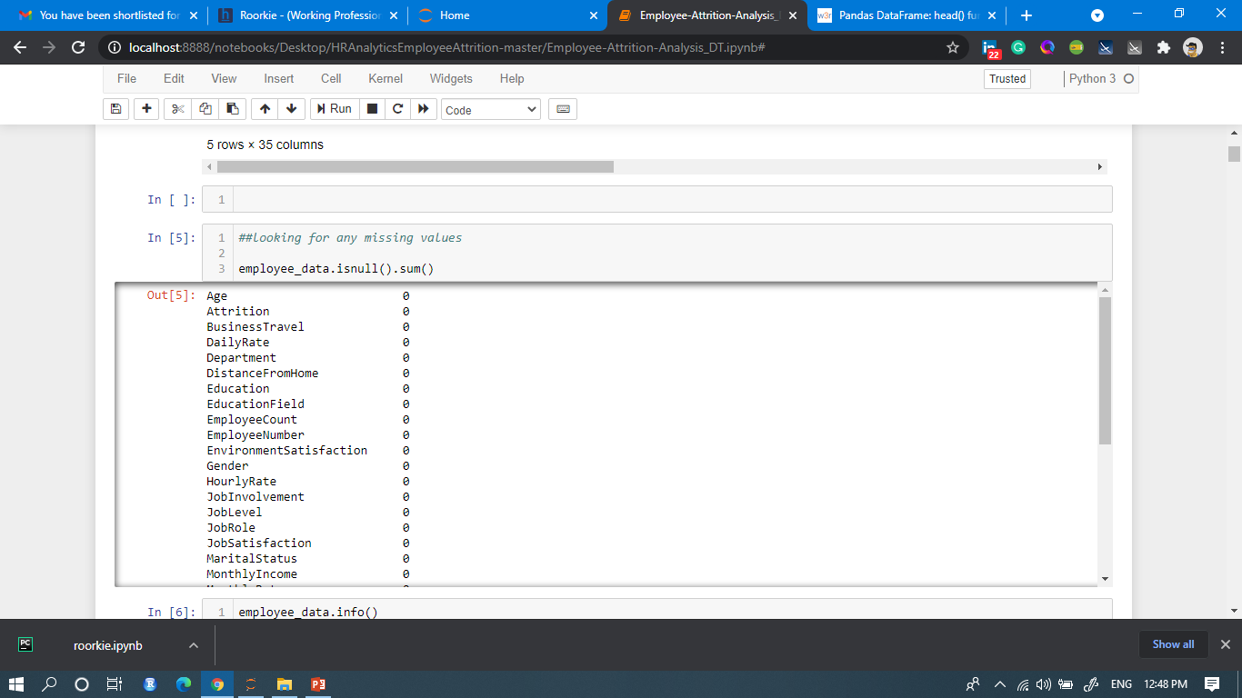
SOLUTION:-
it’s helps to find the missing value in data set

Slide 13
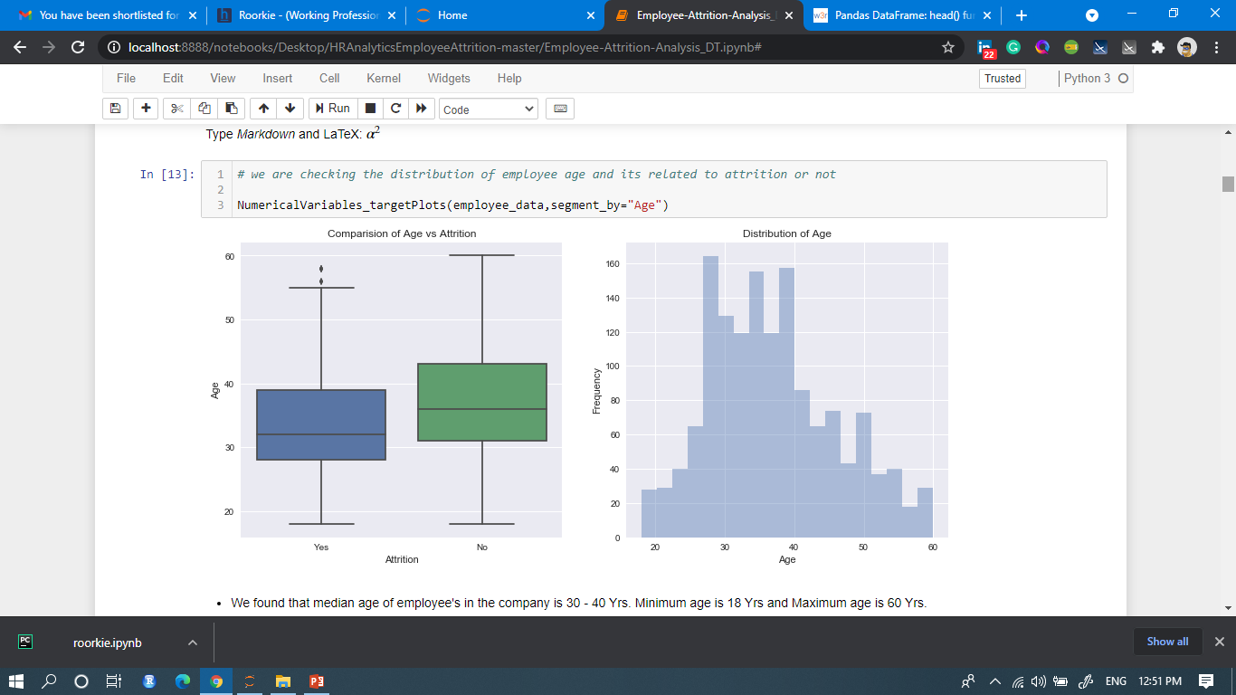
SOLUTION:-

Slide 14
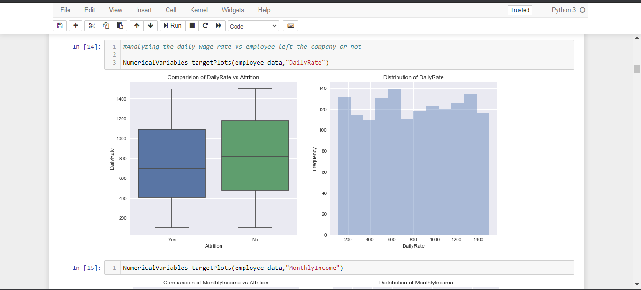
SOLUTION:-

Slide 15
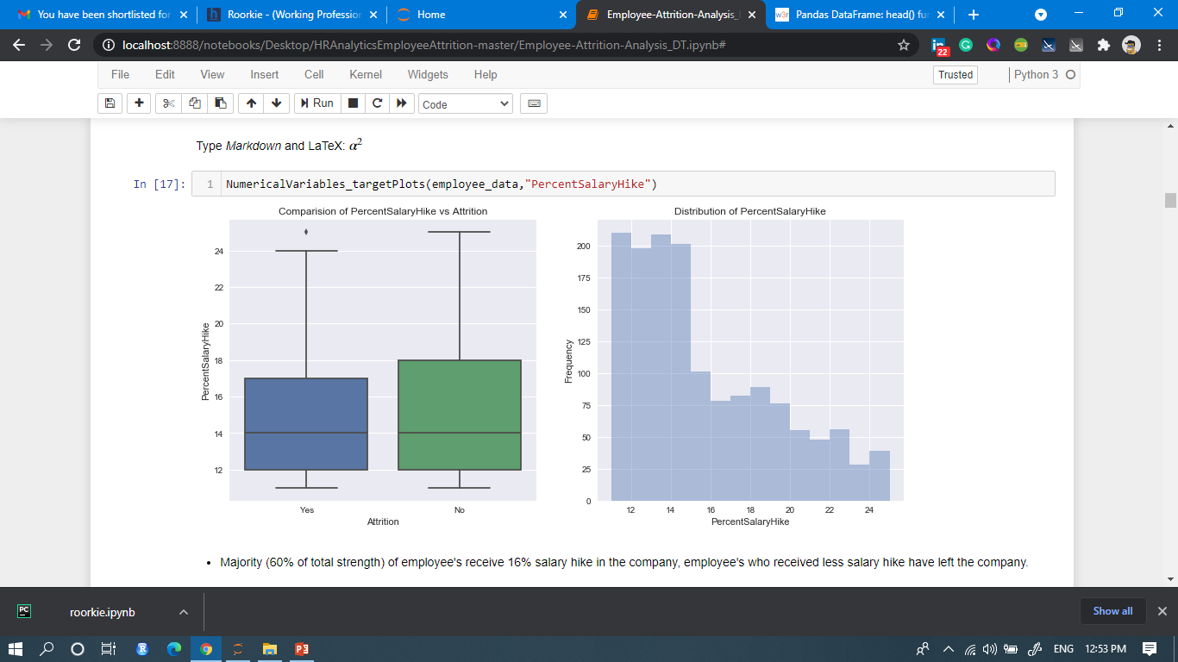
SOLUTION:-

Slide 16
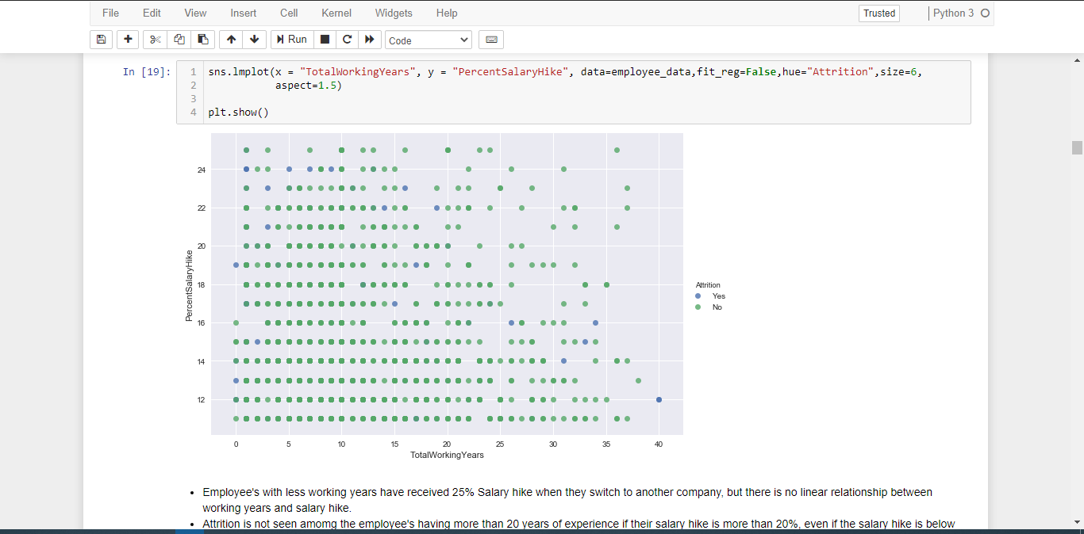
SOLUTION:-

Slide 17
WHY THIS SOLUTION?
It can refresh an organization and offer current employees new opportunities.
From above implementation we can able to conclude about what range these all attrition occurred.
We will able to know what type of problem are faced by the employee in working hour in the office as well as work from home.
What type talented employee in the office how we can use them in other platform and improve their skill which will be beneficial for the organisation.
It will help to know about Lack of Growth and Progression, Decision-Making, Being Overworked, Little Opportunity for Decision-Making.

Slide 18
Thank You

