Slide 1


Slide 2

GROUP MEMBERS
Chithmi Dilaksha GADSE231F-054
Pasindu Kodithuwakku GADSE231F-013

Slide 3

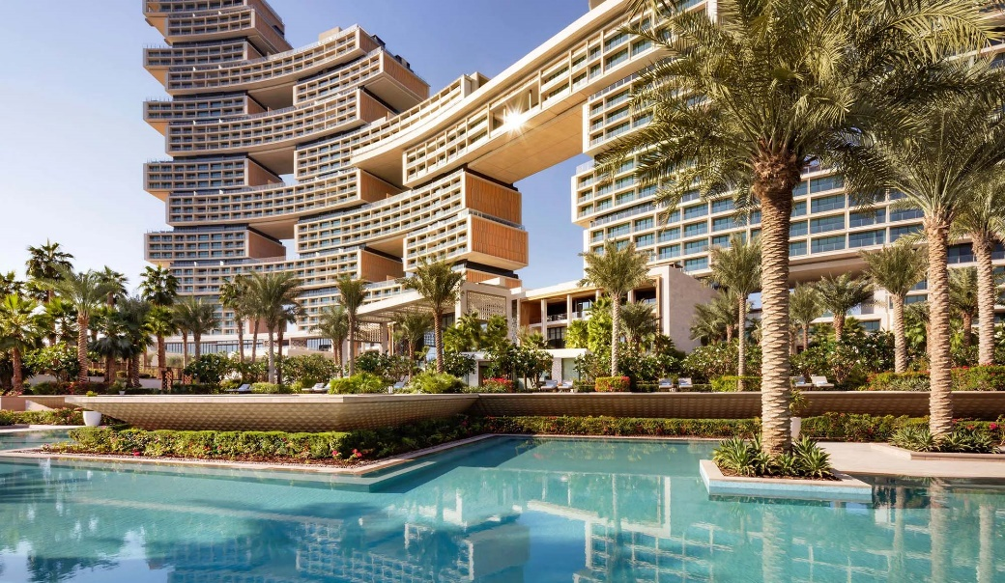

INTRODUCTION
This application is about an Travel Agency. Customers can Book vehicles , Book hotels and Order food.

Slide 4
THANK YOU!!!

