Slide 1
VISUALIZED
AudioBook

Slide 2
IDEA OF OUR AUDIOBOOK
‌We are making a player through which the user can select any pdf file they want and the player will convert that respective pdf file into mp3. We have added some important features which the user can access to adjust the volume and pause and play the mp3 file as per their needs .

Slide 3
Features of Visualized AudioBook
Convert Any Pdf Into AudioBook(mp3)
Play Button and Pause Button
Control Volume In AudioBook
Control the slider Anytime where you want to hear
Shows Total Time Elapsed and Volume Bar

Slide 4
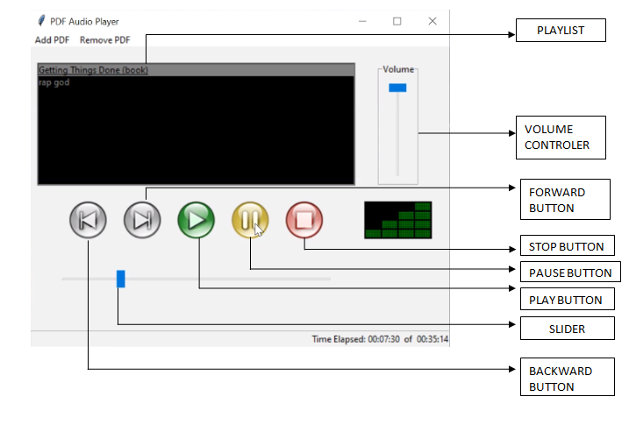
FUNCTION OF AUDIO BOOK

Slide 5


VISUAL AUDIOBOOK VS ZAMZAR
Faster Conversion from pdf to mp3
Providing Player to Play Mp3 Audio
Instant converting and hearing no need of extra space
Take More Time to Convert From Pdf to mp3
No Player to Play Mp3 Audio
Need to download mp3 file folder to hear

Slide 6
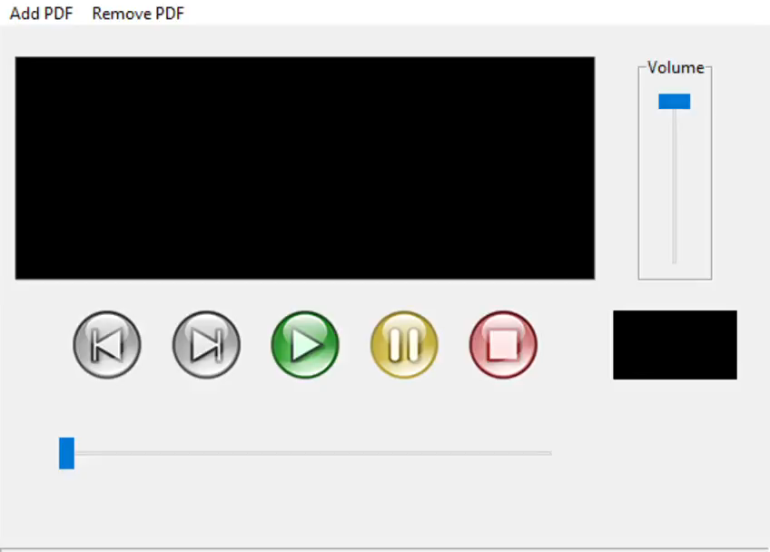
SAMPLE VIDEO OF AUDIOBOOK

Slide 7




TEAM CODE SQUAD
KAMAL CHAUHAN
MEEMANSA WALIA
KUSHGARA GUPTA
JAI ARORA

Slide 8
THANK YOU

