Slide 1

AMY CARE
The heart of your healthcare

Slide 2

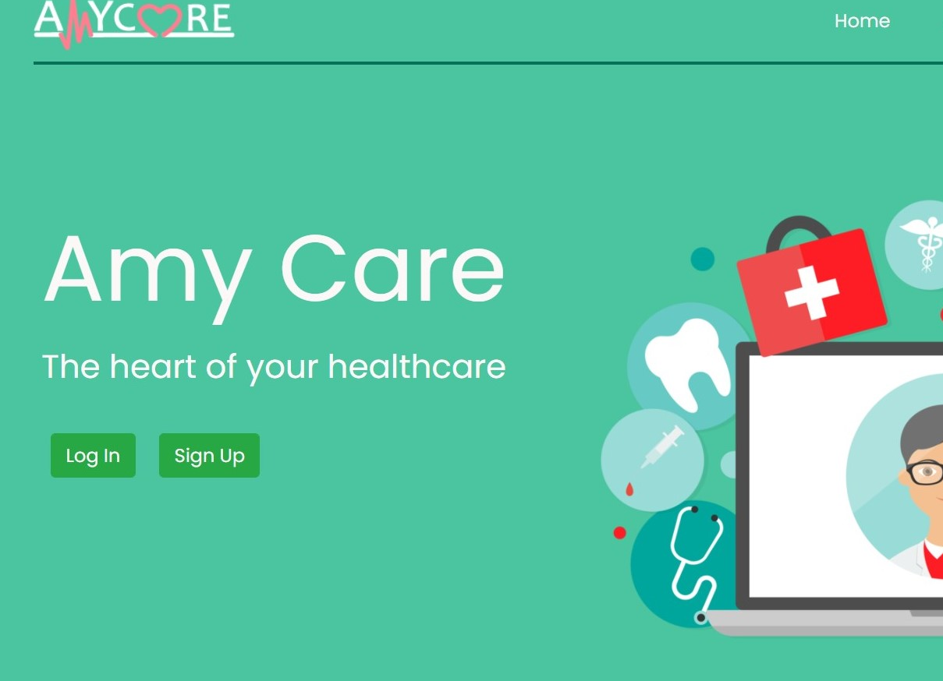
ABOUT US
Amy Care is a patient-centered information exchange system where the patients, doctors and the pharmacists are all connected under one roof.

Slide 3





THE PROBLEM
Platform
Trust
Time
Pharmacy
Patient Records
No platform which is connecting patients, doctors and pharmacists all together.
Lack of verified doctors and therapists.
Booking appointments are sometimes quite cumbersome.
Unauthorized pharmacists being growing in market.
Inadequate medical history can lead to wrong treatments and medications.
This Photo by Unknown Author is licensed under CC BY-SA

Slide 4
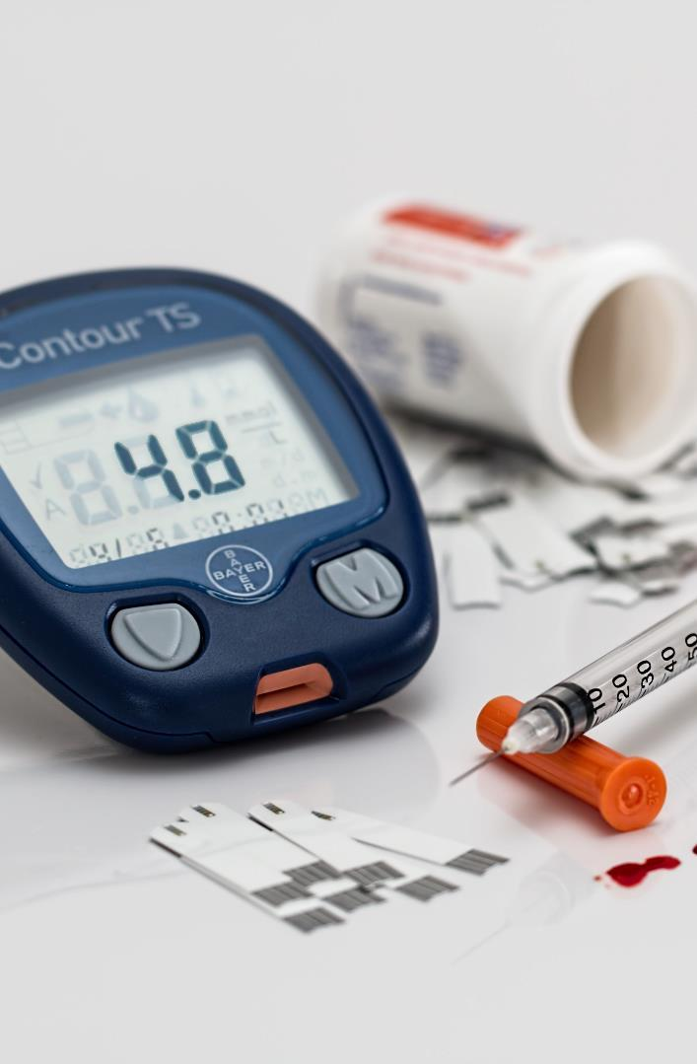



SOLUTION
Prioritize
Authorize
Affordable
Safe booking of appointments and access to nearby pharmacies
Verified doctors and pharmacies
Exclusive offers and discounts
Amy Care is all about coordinating benefits and services with the medical providers, managing internal database and processing medical records.

Slide 5




PRODUCT
Unique
First to Market
A patient oriented platform focused on overall interaction of patient with doctor and pharmacist
No other platform have all three end users connected under one roof
Amy Care is a user oriented platform with a commitment to ensure quality care for all the patients and all the end users.
Quick
Authentic
Easy exchange of information enabling quick measures to be taken regarding patient’s health.
All the doctors and pharmacists are verified and genuine.

Slide 6
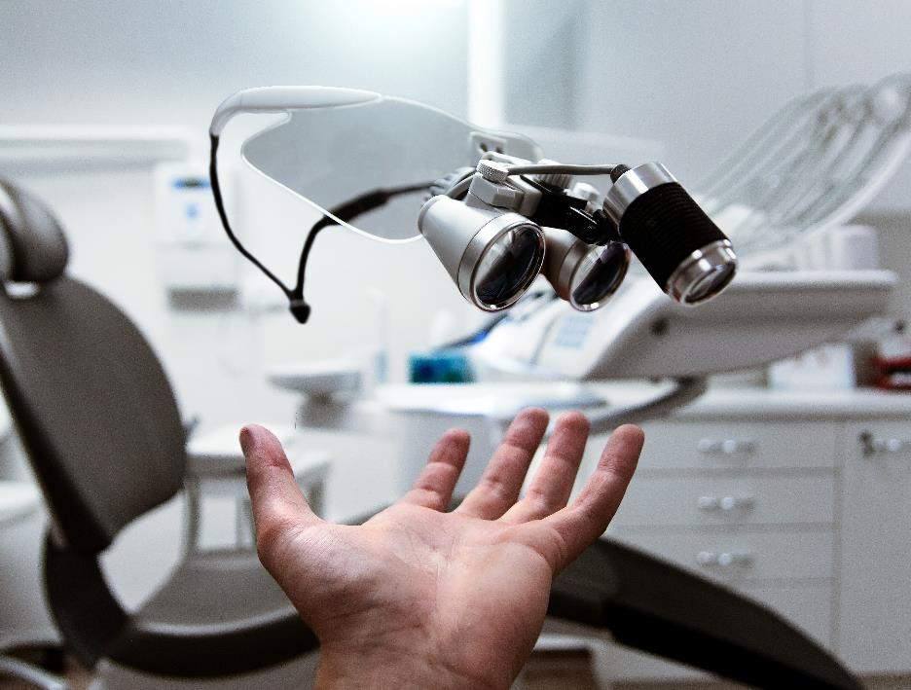

FUTURE IDEA
Authentication & Security
User authentication will be done to reduce spamming and maintaining the security of all end users.
Medical Laboratory
Medical laboratories and test labs will be integrated so as to ensure safe and complete user checkup from their place.
Wallet & Online Payment
With the growing digital world, an option for digital wallet and online payments for easy and secure transactions will be integrated.

Slide 7




OUR TEAM
Anirudh Sharma
Mayank Jindal
Yashita Khurana
Akshit Garg

Slide 8

SUMMARY
It is a patient-centered information exchange system where the patients, doctors and the pharmacists are all connected under one roof.
Provides easy exchange of information enabling quick measures to be taken regarding patient’s health.
Safe and easy booking appointments with verified doctors and providing exclusive discounts.
AMYCARE, where health meets digitalization.

Slide 9




THANK YOU
Amy Care
+91 9779729032
mayank712jindal@gmail.com

