Slide 1


Slide 2
Track – Education
Thought provoking facts about education :
An estimated 2/3 of students who are unable to read with proficiency by the end of 4th grade will end up on welfare or in jail.
More than 1/2 of the global low-literate population can be found in the regions of South and West Asia.
Uneducated girls are four times more likely to have child before their 19th birthday than those with a secondary education.
In most of the countries, public school is not free. Teacher salaries and the cost of books and uniforms are all paid for by the students’ families.
And the list goes on...

Slide 3
Problem Statement
Because of such reasons we started thinking how could we make education easy, interesting and rewarding at the same time for everyone at the lowest cost possible.
Solution
We often see that students share their notes and tricks with their friends and even to their classmates without any second thought. We appreciate the efforts of such students for their selfless work. So, we thought of creating a platform where thee students can share their work to a wider audience and can get rewarded for their hard work.
This will encourage students to work hard and their notes and ideas can reach a wider audience who can use it for their betterment.

Slide 4
Project Description
We propose an app with the vision to bring all learners on one platform. Users can share their work in our app in the form of image, video or pdf. Any user can share their work and bookmark those which they like. We have even provided a search bar to search for specific topics. For fast and secure handling of queries between the users and the app, we are using a cloud database. To keep the app simple yet secured, we have used google sign-in for registration. Other than this we have also implemented an open chat space where learners can ask or answer things.

Slide 5
Why will anyone use the app and what about the app revenue ?
Every time a user opens a post of another user, an advertisement will be shown to him/her. The revenue generated from showing the advertisement will be shared between the developers and the users. More the number of people open a particular user's work, more the money he/she will be making through the app.
The simple and easy to use app will attract students even from low developed regions, thus, making a bigger userbase for the app which will automatically result in more revenue for the developers and users.

Slide 6
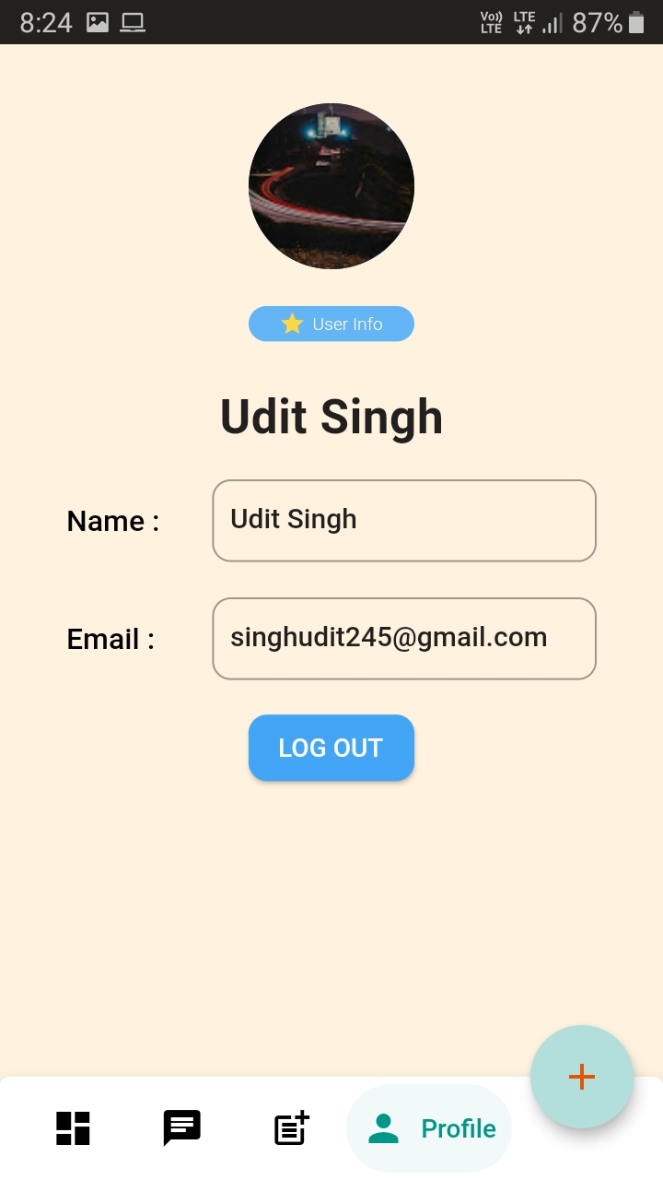
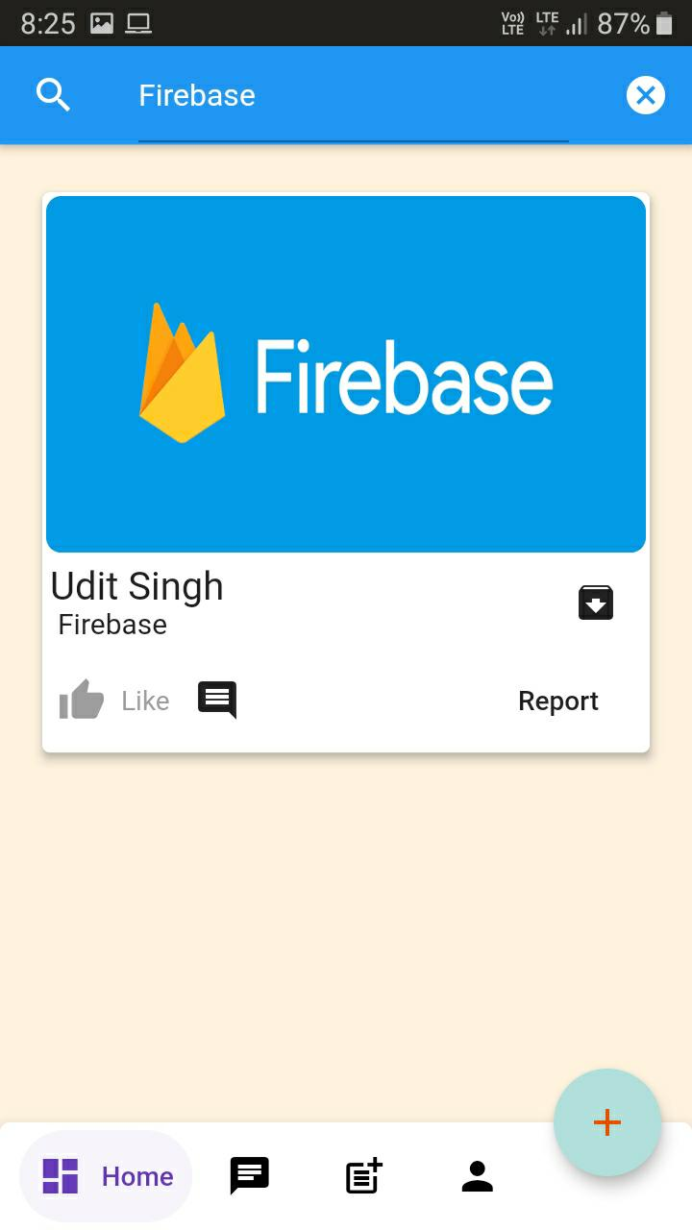

Screen Shots of the App
Ref – User file

Slide 7
