Slide 1

- Project under Code Innovation Series Hackathon
- Team – Py_Chasers

Slide 2
Problem Statement
Education
Create solutions to deal with these challenges faced by the users:
1. Transforming learning into Amazing e-learning Experiences.
2. Lack Of Learner Motivation And Engagement.
3. Staying Up-To-Date With Modern Tech.
4. Designing e-learning Courses For Different Generations.
5. Measurable learning outcomes.

Slide 3
Our Solution
We suggest a solution by making an desktop application for a wide range of people be it a Student, Job Professional, Educator, Recruiter.
The UI of the application is made to suit people of all ages which makes the E learning experience fun.
There are quizzes for the topics of a wide range of Tech Stacks to choose from which are up to date with the modern technologies and are also relevant to the questions asked in the interviews of the major MNC's. This helps the students to tackle lack of learner motivation and the progress of these quizzes is duly noted and helps the recruiters to filter the best of the best for the post. The daily quizzes are open for a person to attempt at any time at his/her speed, this learner model is such that it accommodates different learner needs and helps one to learn at their own speed. People can apply for jobs by searching in their relevant field. Recruiters can also post jobs for a particular post.
The application also has a smooth one time sign up and sign in feature with MD5 password hashing which ensures the security of the Password being entered. Moreover, the user also gets an automated email whenever he or she registers in the app for the first time.

Slide 4
Project Description
This is an desktop application for a wide range of people be it a Student, Job Professional, Educator, Recruiter.
The UI of the application is made to suit people of all ages which makes the E learning experience fun.
We know that in every other educational website or something, they promotes only their content. And if the user searches for free content on the Google there is a lot of variety available which confuses the user to what to do and from where to do.
Thus, one of the most admirable feature of the application is that it provides the suggestions to the content available over the internet, which is the best out of the best without any promotion of one website or channel. We provide the best and reliable content which is present on the internet and from where our user can directly learn what he wants to do, without any sort of confusion.

Slide 5


Tech Stacks

Slide 6
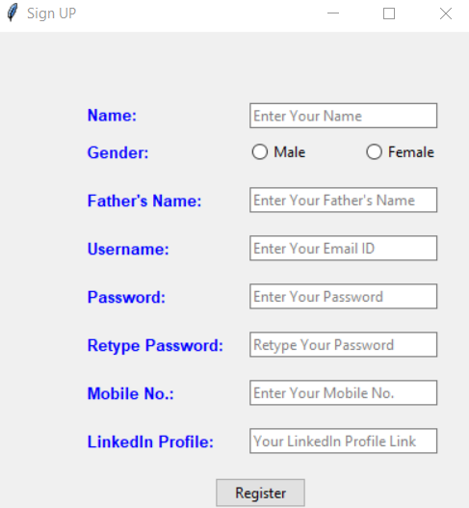
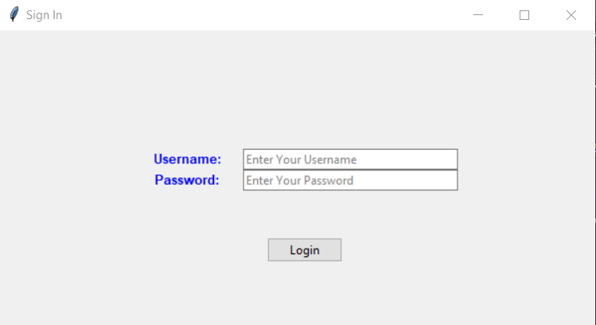
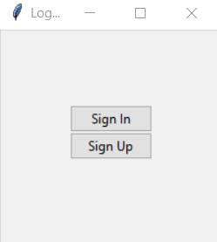
Screenshots of the Application

Slide 7
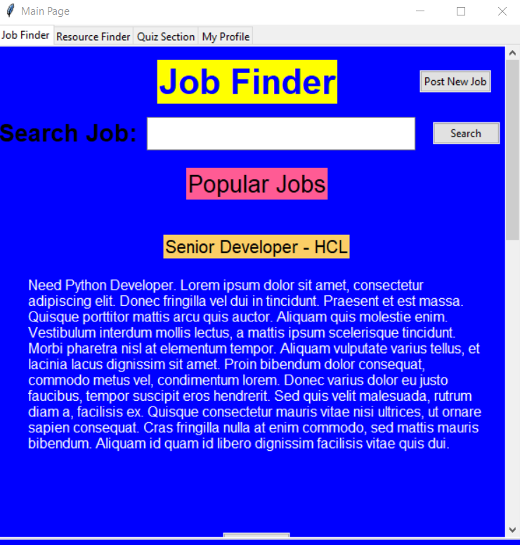
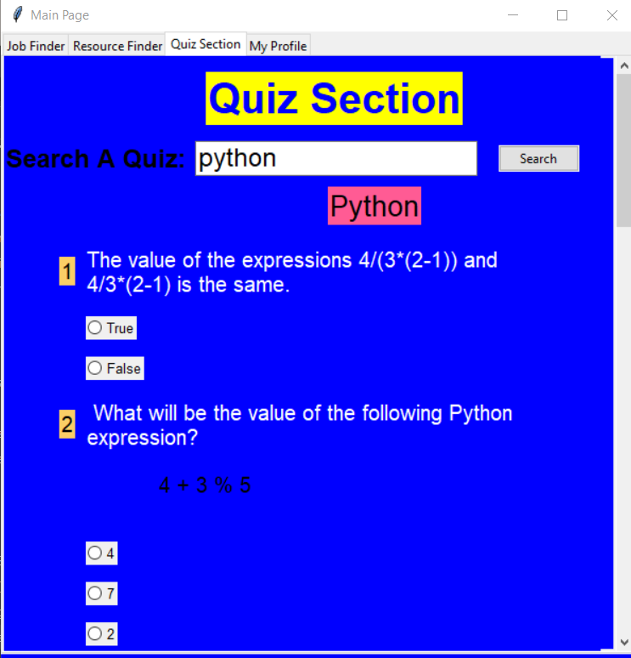

Slide 8
