Slide 1
Oasis
Your Virtual Health Assistant

Slide 2
Innovation
The unique feature that sets us apart from others is the fact that we provide our users with a one-stop solution platform. We provide all the health related solutions in one place.
A good example is the mood tracker feature, that tells helps you track your mood over a period of time.
You can also get information about your vaccines and also get update about the upcoming vaccines appointments (if any).

Slide 3
Problem Statement
Leverage Microsoft Azure Service in your project.
Build your hackathon project with a suite of secure storage, scalable compute, and integrated data analytics-dashboard products provided by Microsoft Azure.

Slide 4
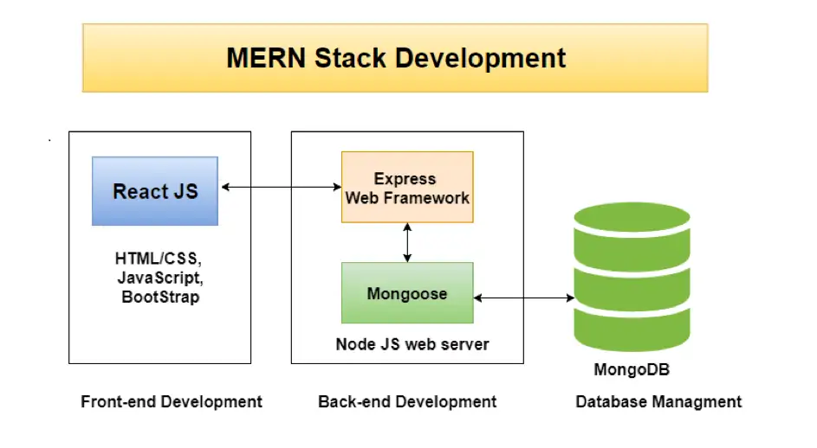
Tech Stack
MERN Stack
Microsoft Azure

Slide 5
User’s Pain Points
Scattered solutions exist for health care but, users find it a bit difficult to navigate between different apps/services for solutions.
Elderly people who aren’t well versed even with the basic technological developments like smartphones, find it difficult to navigate apps and websites.

Slide 6
Approach
To solve these problems, we came up with an easy to use, cloud based virtual health care platform, that helps users to keep track of their health and also gives information about nearby hospitals.
The user can easily track their health via the web app and also log their daily moods over a period of time.

Slide 7
Scalability
We used MERN stack since it is highly secure, provides better performance, reusable code, modularity and seamless integration with cloud platform and also can be easily integrated with secure devops environment and hosting providers.
The Azure services database (cosmos db) has more uptime, can handle large no of users easily and is an industry standard.

Slide 8
Uniqueness
Extremely user friendly interface for quick adaptation by the elderly population.
One stop solution for all your health needs which eases the process of tracking health, thus providing a evolved user experience.

Slide 9
Future Scope…..
This will be a highly scalable platform as it provides you with very unique health related features which are scattered over different apps on a single integrated platform, Oasis.
In near future this virtual assistant will be handy as the fast modern lifestyle that we follow, our attention towards our health is minimal.
But with our platform we bring your virtual doctor to your home, with minimal hassle.

