Slide 1
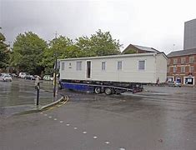
Making Mobile Homes
Making Mobile Homes

Slide 2
Problem Statement
Due to increasing human needs due to
overpopulation forests are being destroyed
For making space for humans to live.This is
destroying the natural haitat of animals and hence
destroying the animal life and biodiversity

Slide 3
Proposed solution
My solution to this problem is that to make houses
in such a way so that they are compact and
mobile. This will reduce the space requirement
for houses and thus will protect forests.

Slide 4

Tech stack used

Slide 5
Approach
In this project I have built a website which have 4 html pages
* Home page – In home page I have built the main page of the website
* About us - in this page I have explained what our company does
* Contact us - in this page, we have built a contact form using which
user can ask his queries
* Services page – in this page we allow users to select the type of house
he wants to construct on the basis of no. of rooms

Slide 6
Scalability
This idea is not much scalable as when our customers will
grow. Our costs will also grow according to that but this
idea can be profitable

Slide 7
Uniqueness
This idea is unique as it is not implemented much in the world.

