Slide 1
Smart audience marketplace
Team: SSAChampions

Slide 2
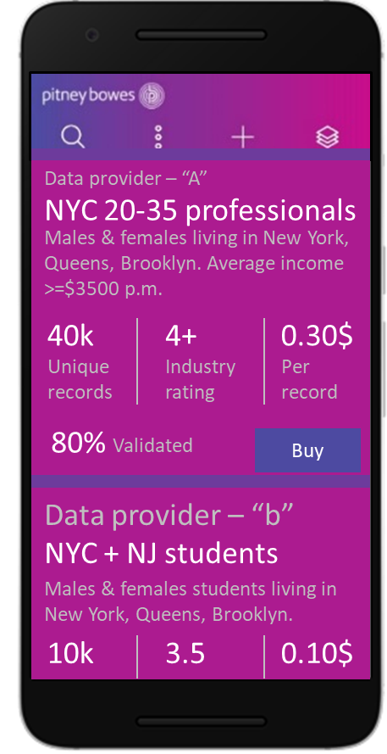

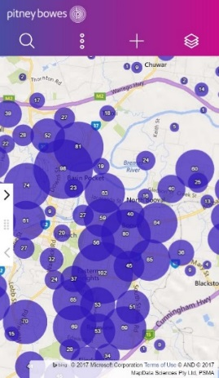


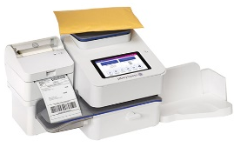





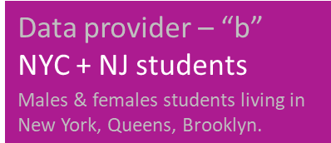
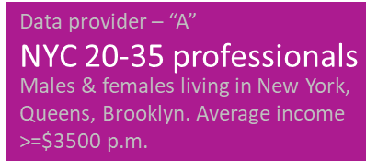
Problem / solution summary
Proposed app would allow businesses to discover and buy new prospective customers (audiences) and target them through SendPro ecosystem. Existing customer base may not be enough. Currently contracts for such data are negotiated in isolation, with no way to optimize. Proposed solution using ML based models, fed by PB LI tech, would directly improve businesses customer acquisition rate.
Rate
ML
Buy
Baker wants to run cookie promotion in a geo & is looking for audiences
ML: Rating, geo relevance, quality parameters etc.
Revenue is shared between Pitney & data agency
Agency “a” upload data
Agency “b” upload data
Pool

Slide 3
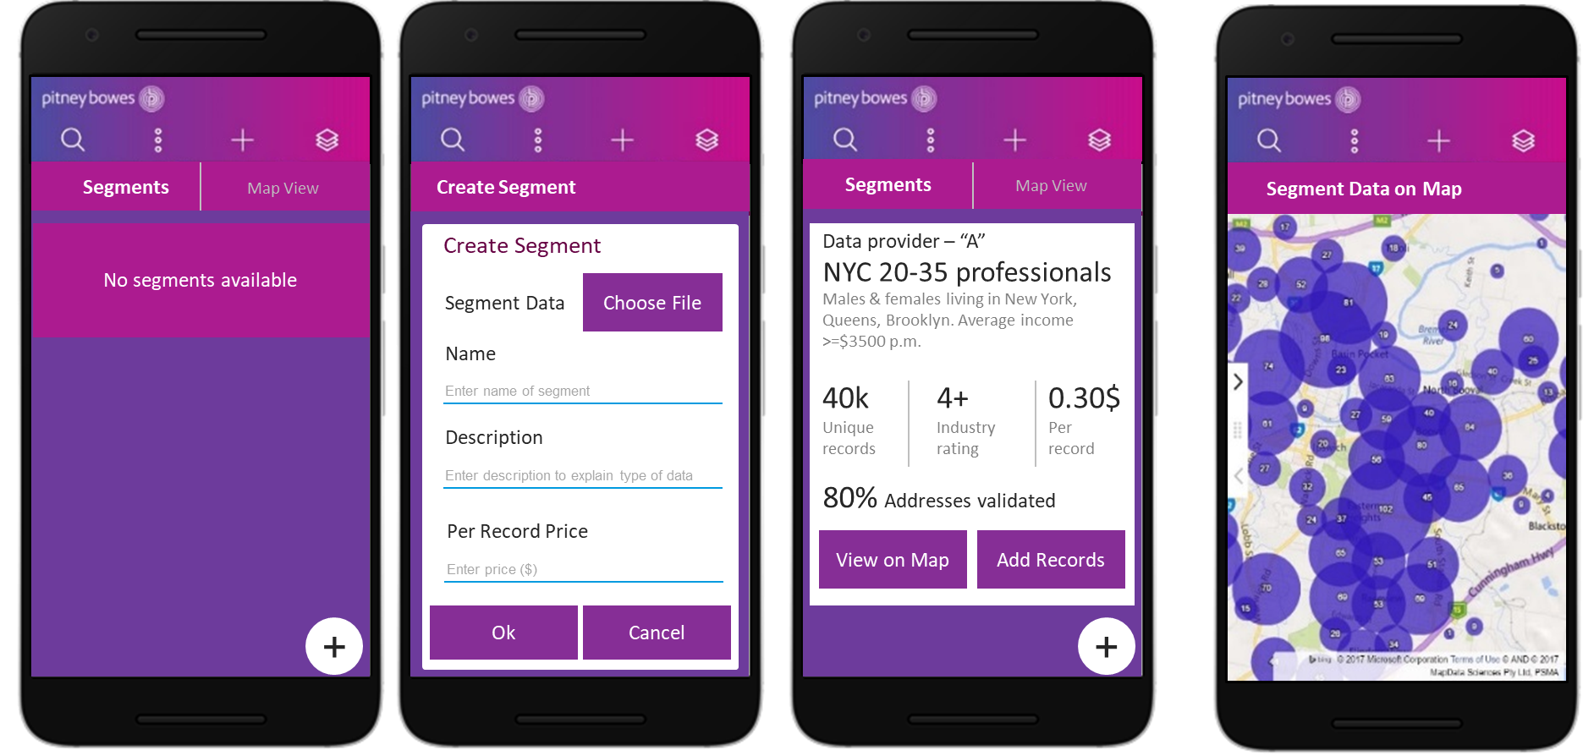
Day in life of data agency
Platform provides features like map visualization, adding records. Gamification ensures vendors to maintain & enrich data segments
Data providers(agency), using the marketplace, can upload their segments

Slide 4
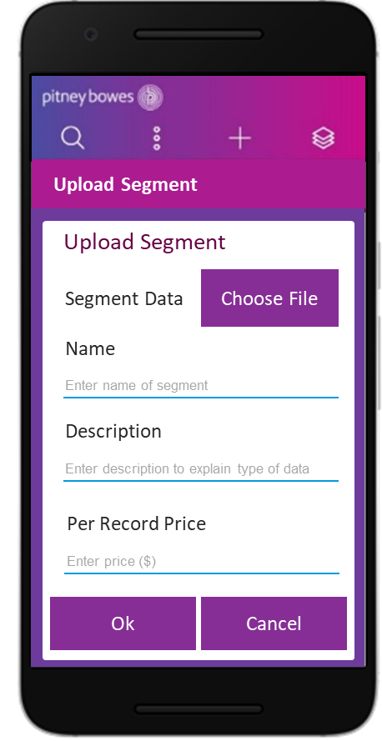
Architecture view
Small & medium business
PB cloud
Map rendering
Update contacts with segments
SMB services
Security
Buy
Cloud integration
Location APIs
Sync contacts
Location APIs
Access management
Segmentation
Geocoding adapter
Data agency
Recommendation
Location services
(nearby, drive-time etc.)
Address validation adapter
Upload segment
Audience segments
Locations
Metadata
Address cleansing adapter

Slide 5
Commercials
Opportunity
Direct mail marketing on an average in NA is close to 10-15% of marketing spend in most of B2C industries (Telco, Retail etc.). While cost optimization is among the top priorities, mass marketing is on decline & targeted marketing is the game forward.
Data providers in this industry are fragmented and quality metrics & collaborative rating on performance of different available audience data segments is missing. Proposed solution has capabilities to go beyond sendPro ecosystem and has potential to digitize the audience analytics in mail industry.
Monetization
Solution would enable open marketplace. SMB data buying revenue would split in desired way between data vendor & platform. Clear unit economics on every transaction can be easily overlayed over the proposed solution.

Slide 6
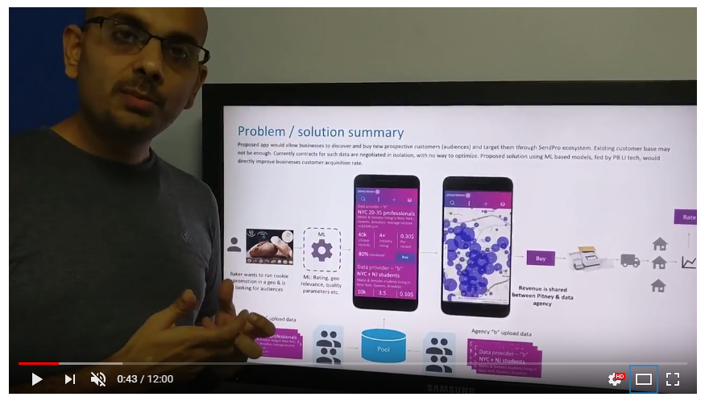
Demo video

Slide 7
THANK YOU

