Slide 1
Manufacturing Quality Improvement Through Defect Analysis and Process Improvement
By Chitra Shree
Lean Six Sigma Green Belt Project

Slide 2
DEFINE - Problem & Goal Statement
Problem Statement: Manufacturing unit is experiencing a high defect status, the production data reveals that 84.04% of units are classified under high-defect status, with an average defect rate of 2.75 defects per thousand units (range: 0.50–4.99). This indicates a significant and recurring quality issue across production operations, impacting cost, customer satisfaction and operational efficiency.
Goal Statement: Reduce the proportion of high-defect-status units from 84.04% to a target of 60% (or reduce average defect rate from 2.75 to 2.0 defects/thousand units) by identifying and addressing the key operational drivers contributing to defects, using a data-driven DMAIC approach.

Slide 3
DEFINE - Business Case
High defect rates increase rework, scrap, warranty claims and delivery delays raising the cost of poor quality and risking customer confidence
Reducing defects improves first-pass yield, lowers production cost and strengthens delivery reliability
This project targets a reduction in average defect rate from 2.75 to 2.0 defects per 1000 units

Slide 4
DEFINE - CTQ (Critical to Quality) Tree
Customer Need
Reliable, defect free products with consistent quality
Quality Driver
Low Defect Occurrence
Fewer high-defect Batches
CTQ Metric
DefectRate <= 2.0 per 1000 units
High-defect share <= 60%
Goal:
Reduce average defect rate from 2.75 to 2.0 per 1000 units
Reduce the proportion of high-defect-status units from 84% to a target of 60%

Slide 5
DEFINE - SIPOC
Suppliers | Input | Process | Output | Customers
Raw Material Suppliers | Materials (SupplierQuality) | Production Planning | Finished Units | End Customers
Maintenance Team | Machine Availability (MaintenanceHours) | Manufacturing /assembly | Defect-free Units | Downstream Assembly / OEMs
Logistics Partners | Delivery Schedules (DeliveryDelay) | Quality Inspection | Quality Reports (DefectRate) | Quality & Operations Management
Workforce | Labor (WorkerProductivity) | Packaging and Dispatch | Shipped Orders

Slide 6
MEASURE - Data Collection Plan
Source: Kaggle, synthetic manufacturing dataset
3240 production records, 17 variables, no missing values, no duplicates
Output (Y) | Input (X)
Primary: DefectRate Secondary: DefectStatus | SupplierQuality, DeliveryDelay, MaintenanceHours, DowntimePercentage, WorkerProductivity, etc

Slide 7
MEASURE - Baseline Performance
DefectRate
84.04% of records high-defect, 15.96% low-defect
33.83% of all records are at or below the target 2.0 this indicates approx. 1 in 3 records already meet target, goal is achievable through consistency
Baseline process capability is approx. 4.28sigma (2749 DPMO) indicating room for improvement toward the target of reduced defect variation
Mean | Median | Standard | Range
2.75 | 2.71 | 1.31 | 0.50 to 5.00
DefectStatus | Records | Avg DefectRate | Median
0 (low) | 517 | 2.01 | 1.98
1 (high) | 2723 | 2.89 | 3.03

Slide 8
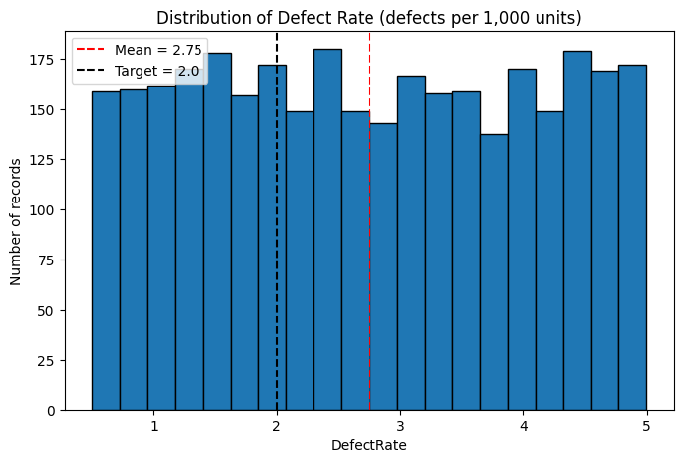
MEASURE - Distribution Chart
DefectRate varies widely across production records (0.5 to 5.0) with no stable central value,
indicating an unstable process with high variability.

Slide 9
ANALYZE - Correlation & Regression Findings
Correlation analysis and multiple linear regression were used to identify operational drivers of DefectRate
Combined regression of key operational factors yielded R² = 0.0014, indicating these factors explain less than 1% of the variation in DefectRate
Factor | Correlation with DefectRate
QualityScore | -0.0363
AdditiveProcessTime | -0.0284
DeliveryDelay | -0.0230
ProductionVolume | -0.0194
ProductionCost | 0.0144
*Ranked factors by absolute correlation strength

Slide 10
ANALYZE - Logistic Regression on DefectStatus
DefectRate showed no significant relationship with operational factors, DefectStatus was tested using logistic regression
MaintenanceHours (p<0.001) and QualityScore (p<0.001) both show statistically significant relationships with DefectStatus Pseudo R² = 0.156
MaintenanceHours: positive relationship (+0.139) likely reflects reverse causation (higher-risk lines receive more maintenance attention) rather than maintenance causing defects
QualityScore: negative relationship (-0.054) higher quality scores associate with lower likelihood of high-defect classification, as expected

Slide 11
ANALYZE - Interpretation
While DefectRate shows no significant driver, DefectStatus classification is meaningfully explained by MaintenanceHours and QualityScore (Pseudo R² = 0.156, p<0.001).
This suggests defect risk is better understood as a discrete quality outcome influenced by these factors, while defect intensity (rate) reflects broader process variability.

Slide 12
IMPROVE - Recommendations
Finding | Recommendation
QualityScore negatively predicts defect status | Strengthen in-process quality checks/inspection frequency to lift QualityScore directly reducing high-defect classification likelihood
MaintenanceHours positively predicts defect status (likely reactive) | Shift from reactive to preventive/scheduled maintenance i.e., maintain lines on a fixed schedule rather than only when problems appear breaking the "high-risk line gets more maintenance" cycle
DefectRate shows high variability, no single driver | Introduce Statistical Process Control (SPC) charts on DefectRate to catch abnormal spikes early and standardize operating procedures across lines/shifts
No defect-type/category data available | Recommend future data collection include defect type, machine ID and shift enabling deeper root-cause analysis going forward

Slide 13
IMPROVE - Prioritization
Recommendation | Impact | Effort
QualityScore inspection | High | Medium
Preventive maintenance scheduling | Medium | Medium
SPC monitoring | Medium | Low
Expanded data collection | Low immediate | foundational for future projects

Slide 14
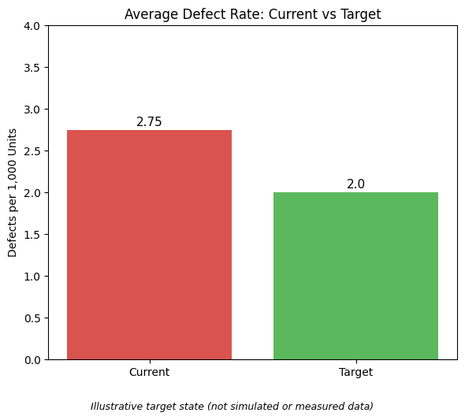
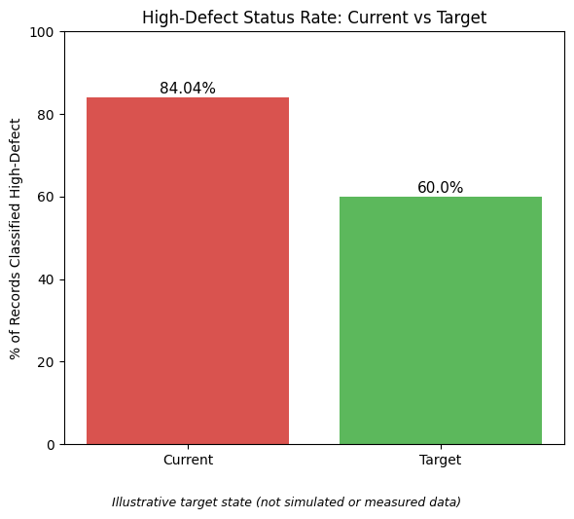
IMPROVE - Expected Impact
If implemented, these interventions are projected to reduce high-defect-status incidence and support progress toward the original goal of 84% → 60%. Actual impact to be validated through implementation and monitoring.

Slide 15
CONTROL - Control Plan
What to Monitor | Metric | Method
Overall Defect Intensity | Average DefectRate | SPC (control) chart track weekly average, flag if it exceeds upper control limit
Defect Classification | % High-defect Status | Trend line, monthly, with 60% target line marked
Quality Inspection Effectiveness | QualityScore | Monthly Average with alert threshold if it drops below current baseline
Maintenance Practice Shift | % Preventive vs Reactive Maintenance Hours | Track ratio monthly to confirm shift away from reactive only pattern

Slide 16
CONTROL - Sustaining the Gains
Standardize the quality inspection checklist/process across lines
Set a recurring review cadence for example monthly review of DefectRate/DefectStatus trend against targets
Clear ownership to be assigned to line/quality supervisor upon implementation
Future iterations should incorporate defect-type and machine-level data to enable deeper root-cause tracking

Slide 17
Conclusion & Scope
This project applied the DMAIC framework to diagnose high defect status in a manufacturing dataset (3,240 records)
Analysis found no significant driver for defect rate (intensity) but identified MaintenanceHours and QualityScore as statistically significant drivers of defect status (classification), Pseudo R² = 0.156, p<0.001
Improve phase proposed targeted interventions (quality inspection, preventive maintenance, SPC monitoring) with a Control plan for sustaining results
Scope note: as a self-initiated project on a static, synthetic dataset, this concludes at the recommendation and control-planning stage. Actual impact on defect rate/status would require live implementation and monitoring in a real production environment

