Slide 1
DataSpark: Illuminating Insights for Global Electronics
Retail Analytics in the Electronics Industry
Chitradevi.M

Slide 2
Skills Takeaway
Data Cleaning and Preprocessing: Ensured data accuracy and consistency.
Exploratory Data Analysis (EDA): Identified patterns and trends in data.
Python: Utilized for data manipulation and analysis.
SQL: Managed data in relational databases and performed complex queries.
Power BI: Visualized insights through interactive dashboards.

Slide 3
Key Findings
1.Top 10 Best-Selling Products
2.Country-Wise Sales
3.Annual Revenue
4.Gender Distribution
5.Average Exchange Rate Over Time
6.Currency Impact on Sales Revenue
7.Customer Distribution Across Cities
8.Top 5 Customers by Total Spending
9.Top 5 Stores by Total Sales
10.Total Sales by Category and Subcategory

Slide 4
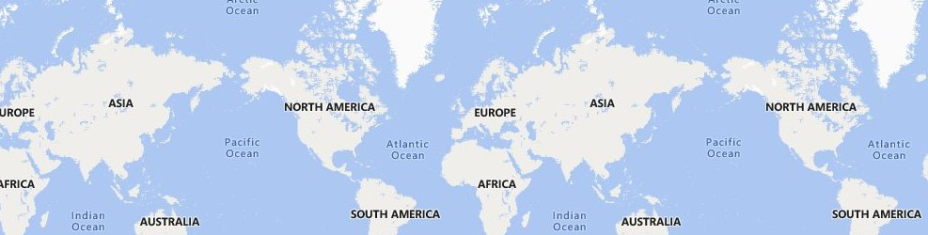
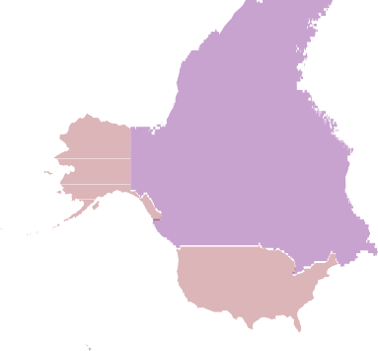


TOP 10 SELLING PRODUCTS
Power BI Desktop
505 (9.73%)
550 (10.6%)
ProductName
WWI Desktop PC2.33 X2330 B…
WWI Desktop PC1.80 E1800 … Adventure Works Desktop PC… Adventure Works Desktop PC… Adventure Works Desktop PC… Adventure Works Desktop PC… WWI Desktop PC1.60 E1600 B… WWI Desktop PC1.60 E1600 Si… Adventure Works Desktop PC… WWI Desktop PC1.80 E1801 Bl…
Top 10 products:show strong sales,indicating high customer demand
505 (9.73%)
538 (10.37%)
507 (9.77%)
521 (10.04%)
509 (9.81%)
521 (10.04%)
514 (9.9%)
520 (10.02%)
TOTALSALESAMOUNT ACROSS COUNTRIES
1515338.22 1962154.27 2475645.77 2708137.61 4724334.63 5414149.79 70840… 29871…
The total sales amount varies significantly across countries,with US leading in sales
© 2024 TomTom,, © 2024 Miiccrrossofftt Corrporrattiion,, © OpenSttrreettMap

Slide 5
Power BI Desktop
ANNUAL REVENUE
20M
18.3M
Annual revenue has shown notable growth, with Year 2019 experiencing the highest increase.
TOTALSALESAMOUNT
15M
12.8M
10M
9.3M
7.4M
5M
6.9M
0M
2016
1.0M
2021
2017
2018
2019
2020
YEAR
GENDER DISTRIBUTION AMOUNG CUSTOMERS
Gender Male
Female
The gender distribution reveals 50.75% of customers are male
Female 49.25%
Male 50.75%

Slide 6
Power BI Desktop
AVERAGE EXCHANGERATES OVER TIME
Currency AUD CAD
1.4
1.44
1.45
Sum of AverageExchangeRate
1.33
1.28
1.35
1.34
1.30
1.33
1.34
EUR GBP USD
1.31
1.30
1.27
1.2
1.0
1.00
1.00
1.00
1.00
1.00
1.00
1.00
0.90
0.90
0.89
0.89
0.88
0.8
0.85
0.82
0.74
0.78
0.75
0.78
0.78
0.73
0.6
0.65
YEAR
The average exchange rate has fluctuated over time, with Year 2019 showing the most significant change

Slide 7



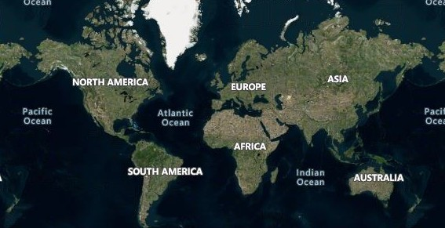




Analyzing the Currency Impact on Sales Revenue
Power BI Desktop
NumberOfOrders 2941 5415 8140 12621 33767
30M
Currency fluctuations significantly affect sales revenue, with USD showing the highest impact
Sum of TotalSales_Amount
20M
10M
0M
AUD
CAD
GBP
Currency_Code
EUR
USD
Customer Distribution Across Cities
Customer distribution varies widely, with Toronto having the highest number of customers
© 2024 TomTom,, Earrtthssttarr Geogrraphiiccss SIIO,, © 2024 Miiccrrossofftt Corrporrattiion,, © OpenSttrreettMap

Slide 8
Power BI Desktop
TOP 5 CUSTOMERS BY TOTALSPENDING AMOUNT
The top 5 customers, led by Matthew Flemming contribute the most to total revenue.
62K
60K
TOTAL SPENDING AMOUNT
44K
43K
42K
41K
40K
20K
TOP 5 STORESBY TOTAL SALES DISTRIBUTION
5K (7.88%)
5K (7.88%)
5K (7.97%)
5K (8.08%)
0K
State OF STORES
Online
Northwest Territories Nevada
Kansas
South Carolina
Matthew Karen Jones Zrina Topic Stefanie Stephan Flemming Hartmann Rothstein CUSTOMERS NAME
41K (68.2%)
The online store outperforms all other stores with the highest total sales.

Slide 9
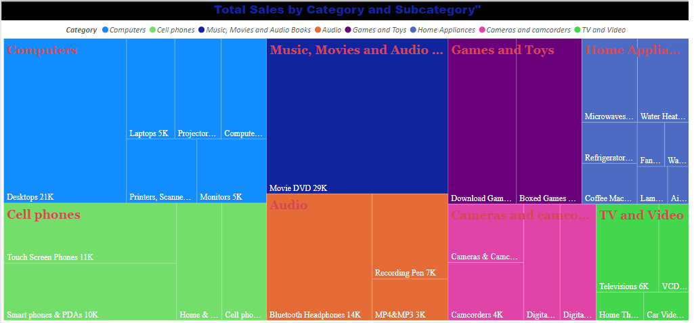
Sales are highest in the Music, Movies and Audio Books category, with Movie DVD leading the subcategories.

Slide 10
Conclusion
Key Points:
Top Products: Focus on best-sellers for better sales.
Revenue Growth: Maintain successful strategies to drive growthg.
Customer Insights: Target key demographics and locations.
Online Store: Invest more in digital sales.
Currency Impact: Adjust plans for currency changes.
Thank you

